Slide 1
Intro to Ethical Hacking
MIS 5211.001
Week 12
Site: http://community.mis.temple.edu/mis5211sec001f14/

Slide 2
Tonight's Plan
In the news
Answers to Questions
Web Services
Next Week

Slide 3
In The News
Submitted
http://thehackernews.com/2014/11/nogotofail-Network-Security-Testing-Tool.html
http://www.washingtonpost.com/blogs/federal-eye/wp/2014/11/10/china-suspected-of-breaching-u-s-postal-service-computer-networks/
http://threatpost.com/powerful-masque-ios-vulnerability-disclosed/109272
http://www.darkreading.com/application-security/the-staggering-complexity-of-application-security/a/d-id/1317345
http://www.washingtontimes.com/news/2014/nov/7/indiana-doe-website-back-up-after-2nd-hacking/

Slide 4
In The News
More
http://www.bbc.com/news/technology-29928751 (WireLurker)
http://www.wired.com/2014/11/darkhotel-malware/
http://www.foxnews.com/politics/2014/11/10/postal-service-confirms-security-breach-chinese-govt-hackers-reportedly/

Slide 5
In The News
What I noted
http://www.goldenfrog.com/blog/fcc-must-prevent-isps-blocking-encryption
https://www.techdirt.com/blog/netneutrality/articles/20141012/06344928801/revealed-isps-already-violating-net-neutrality-to-block-encryption-make-everyone-less-safe-online.shtml
http://www.net-security.org/malware_news.php?id=2913 (Stuxnet)
http://www.pcworld.com/article/2845352/tor-project-mulls-how-feds-took-down-hidden-websites.html

Slide 6
Saved Burp Suite Files
Saving and Restoring State are functions that are only available in the Pro version
The save function shown previously was for saving history
From the tool forum:
The option to save as XML is designed just for consumption by other tools / scripts. There are no plans to implement an importer for this format.
Could likely import to Excel with some effort.

Slide 7
Example Pen Test Reports
http://www.offensive-security.com/penetration-testing-sample-report.pdf
http://blog.hackaserver.com/howto-complete-a-penetration-test-report/
http://resources.infosecinstitute.com/writing-penetration-testing-reports/
http://www.niiconsulting.com/services/security-assessment/NII_Sample_PT_Report.pdf

Slide 8
Vocabulary
XML – Structured data that can be exchanged between applications and platforms
SOAP – messaging protocol for transporting information and instructions between applications (uses XML)
WSDL – a standard method of describing web services and their specific capabilities (XML)
UDDI – defines XML-based rules for building directories in which companies advertise themselves and their web services

Slide 9
More Vocabulary
REST - Representational State Transfer – Describes a architectural framework for web applications that includes:
Client–server
Stateless
Cacheable
Layered system
Code on demand (optional)
Uniform interface
WADL – Web Application Description Language (Replaces WSDL in REST Applications)

Slide 10
Still More Vocabulary
JSON - JavaScript Object Notation
WS-Security – An extension to SOAP to apply security to Web services. It is a member of the Web service specifications and was published by OASIS.
SAML – Security Assertion Markup Language

Slide 11
Web Services
From OWASP
At the simplest level, web services can be seen as a specialized web application that differs mainly at the presentation tier level. While web applications typically are HTML-based, web services are XML-based.
Web services are employed as building blocks used by other web applications using the so-called SOA model.
Web services typically present a public functional interface, callable in a programmatic fashion.

Slide 12
Web Services
Web services, like other distributed applications, require protection at multiple levels:
SOAP messages that are sent on the wire should be delivered confidentially and without tampering
The server needs to be confident who it is talking to and what the clients are entitled to
The clients need to know that they are talking to the right server, and not a phishing site.
System message logs should contain sufficient information to reliably reconstruct the chain of events and track those back to the authenticated callers

Slide 13
Advantages
Open, text-based standards
Modular approach
Inexpensive to implement (relatively)
Reduce the cost of enterprise application integration
Incremental implementation

Slide 14
XML
Developed from Standard Generalized Markup Method (SGML)
XML widely supported by W3C
Essential characteristic is the separation of content from presentation
XML describes only data
Any application that understands XML can exchange data

Slide 15
XML
XML parser checks syntax
If syntax is good the document is well-formed
XML document can optionally reference a Document Type Definition (DTD), also called a Schema
If an XML document adheres to the structure of the schema it is valid

Slide 16
SOAP
SOAP enables between distributed systems
SOAP message has three parts
envelope – wraps entire message and contains header and body
header – optional element with additional info such as security or routing
body – application-specific data being communicated

Slide 17
WSDL
Web services are self-describing
Description is written in WSDL, an XML-based language through which a web service conveys to applications the methods that the service provides and how those methods are accessed
WSDL is meant to be read by applications (not humans)

Slide 18
UDDI
UDDI defines an XML-based format that describes electronic capabilities and business processes
Entries are stored in a UDDI registry
UDDI Business Registry (UBR)
"white pages" – contact info, description
"yellow pages" – classification info, details
"green pages" – technical data
uddi.microsoft.com

Slide 19
REST
SOAP is a heavy weight protocol
REST uses simple HTML operations GET, PUT, POST, DELETE for carrying out web operations/activity
It is an architectural style not a protocol
REST has become the favored style for web services to communicate
REST-based APIs provided by many applications

Slide 20
WADL
WADL models the resources provided by a service and the relationships between them.
WADL is intended to simplify the reuse of web services that are based on the existing HTTP architecture of the Web.
WADL is platform and language independent and aims to promote reuse of applications beyond the basic use in a web browser.

Slide 21
JSON
JSON - An open standard format that uses human-readable text to transmit data objects consisting of attribute–value pairs. Used primarily to transmit data between a server and web application, as an alternative to XML.

Slide 22
WS-Security
WS-Security describes three main mechanisms:
How to sign SOAP messages to assure integrity. Signed messages also provide non-repudiation.
How to encrypt SOAP messages to assure confidentiality.
How to attach security tokens to ascertain the sender's identity.
The specification allows a variety of signature formats, encryption algorithms and multiple trust domains, and is open to various security token models, such as:
X.509 certificates
Kerberos tickets
UserID/Password credentials
SAML Assertions
Custom-defined tokens.

Slide 23
SAML
XML-based open standard data format for exchanging authentication and authorization data between parties, in particular, between an identity provider and a service provider.
SAML is a product of the OASIS Security Services Technical Committee.
Even with this, best practice is to only transmit inside of an SSL protected channel

Slide 24
Why is this Important
Web services are built to be reusable
As a result, they typically make a lot of data available, more then the specific application they support needs
Often, but not always, this means an attacker can gather data that was not intended to be made available
Also, developers creating later applications may include similar data in their applications believing it’s OK because why else would it have been provided

Slide 25
Where Do We Start
WSDigger - WSDigger is a free open source tool designed by McAfee Foundstone to automate black-box web services security testing.
Version one of this framework contains sample attack plug-ins for SQL injection, cross site scripting and XPATH injection attacks.
A web service vulnerable to XPATH injection is provided as an example with the tool.
http://www.mcafee.com/us/downloads/free-tools/wsdigger.aspx

Slide 26
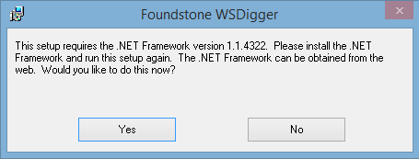
Where to get WSDigger
Available at:
http://www.mcafee.com/us/downloads/free-tools/wsdigger.aspx
After launching you will likely get this

Slide 27
More on Installing
You will need to do a search. This is an old package.
Use for testing, but delete afterwards

Slide 28
Eventually

Slide 29
Uses for WSDigger
Tool covers the following
Service Discovery
Attack Vector Discovery
Exploit Testing
Analysis

Slide 30
Examples from Foundstone
Target public UDDI from drop down
Target private UDDI by typing over public
Then search

Slide 31
Examples from Foundstone

Slide 32
Examples from Foundstone
Previous capture shows list of WSDLs
Pick one and explore

Slide 33
Examples from Foundstone

Slide 34
Examples from Foundstone
Then, similar to Intercepting Proxies, we can enter or own values
In the following example “KLAX”

Slide 35
Examples from Foundstone

Slide 36
Final Notes on WSDigger
Obviously, only target systems you own or have permission
These examples came out of the Foundstone documentation
Documentation is included with the download

Slide 37
Alternatives
Can be done manually in Burp Suite
See: https://www.fishnetsecurity.com/6labs/blog/using-burp-suite-test-web-services-ws-security
Burp Suite also has it’s own plug in for Web Services via Burp Extender in the Pro version
See: http://portswigger.net/burp/extender/
And
https://pro.portswigger.net/bappstore/ShowBappDetails.aspx?uuid=ef2f3f1a593d417987bb2ddded760aee

Slide 38
Alternatives
WebScarab also has Web Services Functionality
WebScarab replaced by ZED Attack Proxy
Please note: Download only from owasp.org if you want to play with either. Lots of “Free” software sites offering copies that are likely malware.

Slide 39
More Alternatives
Microsoft has a “Web Performance Test Editor” in Visual Studio
Directions for use are here: http://msdn.microsoft.com/en-us/library/ms182557.aspx
Visual Studio is available from the software repository

Slide 40
More Alternatives
SOAPUI
Supports SOAP and REST

Slide 41
Using SOAPUI

Slide 42
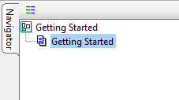
Using SOAPUI

Slide 43
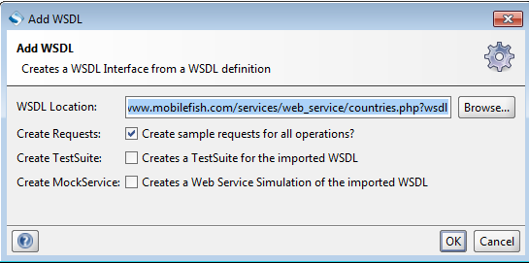
Adding a WSDL

Slide 44
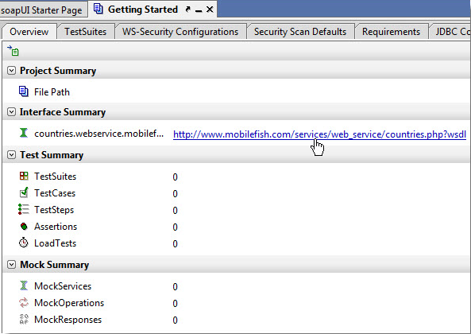
Navigating

Slide 45
Eventually You Get Here

Slide 46
Final Option
Samurai WTF (Web Testing Framework)
Available Here: http://samurai.inguardians.com/
Similar to KALI, but focused entirely on Web Applications
If you do want to play with it, remember the password for Samurai is “samurai”.
Asking this question in a help forum will garner a lot of abuse

Slide 47
Samurai Features

Slide 48
Samurai Features

Slide 49
Samurai Features

Slide 50
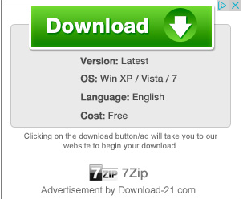
Warning On Sourceforge
DO NOT click on anything that looks like this!
These are advertisers that are trying to trick you in to installing adware at best, or worse!

Slide 51
Interesting Item
Kali is available via Amazon Web Services
https://aws.amazon.com/marketplace/pp/B00HW50E0M
Free for up to 750 hrs/month for first year after signup
As low as $.02/hr with a paid account

Slide 52
Next Week
In the news
Evasion
Odds and Ends

Slide 53
Questions
?

