Slide 1
Intro to Ethical Hacking
MIS 5211.001
Week 13
Site: http://community.mis.temple.edu/mis5211sec001f14/

Slide 2
Tonight's Plan
In the news
Answers to Questions
Evasion
Next Week

Slide 3
In The News
Submitted
http://www.darkreading.com/attacks-breaches/deconstructing-the-cyber-kill-chain/a/d-id/1317542
https://www.yahoo.com/tech/win-doh-microsoft-finally-fixes-19-year-old-windows-102543050624.html
http://www.wired.com/2014/08/will-much-data-blind-data-breach-network/
http://threatpost.com/microsoft-considering-public-key-pinning-for-internet-explorer/109365

Slide 4
In The News
More
http://www.darkreading.com/attacks-breaches/bashlite-malware-leverages-shellshock-in-busybox-attack/d/d-id/1317508
http://www.cnet.com/news/tech-boost-promises-more-secure-credit-cards-but-signature-still-required/
http://thehackernews.com/2014/11/windows-phone-81-hacked.html
http://www.infosecurity-magazine.com/news/coca-cola-in-the-dock-laptop-theft/

Slide 5
In The News
What I noted
https://technet.microsoft.com/en-us/library/security/ms14-nov.aspx (MS14-068 - Critical Kerberos Vulnerability)
http://arstechnica.com/tech-policy/2014/11/court-agrees-that-googles-search-results-qualify-as-free-speech/
http://www.infosecurity-magazine.com/news/amex-to-implement-digital-tokens/
http://robert.penz.name/964/a-practical-example-how-broken-md5-really-is/
http://blogs.technet.com/b/mmpc/archive/2014/11/05/cracking-the-cve-2014-0569-nutshell.aspx

Slide 6
WiFi Cards for Testing
A question was raised around which WiFi card to use for testing wireless systems
The card that I use, and the one recommended by the testers I know is from the Alfa line
I have these two:
AWUS051NH-802-11b-802-11a-802-11g-Wireless
AWUS036H-802-11g
Both are high power (1000mw) and work with wireless pen testing tools

Slide 7
TOR Onion Routing
What is Tor Onion Routing?
Tor is a distributed overlay network which anonymizes TCP-based applications (e.g. web browsing, secure shell, instant messaging applications.)
Clients choose the circuit paths
Message are put in cells and unwrapped at each node or onion router with a symmetric key.
The ORs only know the successor or predecessor but not any other Onion Router.

Slide 8
TOR Design
Tor is an overlay network
Each router has a user-level process w/o special privileges.
Each onion router maintains a TLS connection to every other onion router.
Each user runs local software called onion proxy (OP) to fetch directories, establish circuits across the network, and handle connections from users.
Each router maintains a long-term & short term onion identity key. These are used to sign TLS certificates which sign the OR’s router descriptor(summary of keys, address, bandwidth ,etc.)

Slide 9
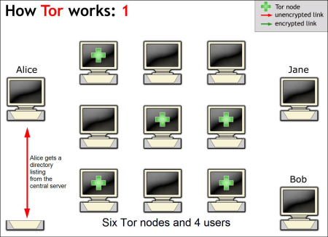
How TOR Works
http://www.iusmentis.com/society/privacy/remailers/onionrouting/

Slide 10
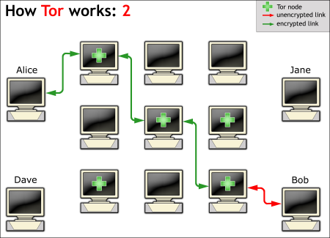
How TOR Works (2)
http://www.iusmentis.com/society/privacy/remailers/onionrouting/

Slide 11
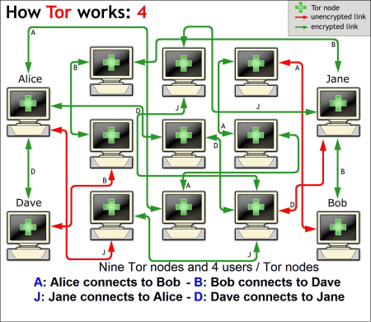
How TOR Works (3)
http://www.iusmentis.com/society/privacy/remailers/onionrouting/

Slide 12
References for TOR
https://www.torproject.org/
http://www.iusmentis.com/society/privacy/remailers/onionrouting/
http://www.onion-router.net/

Slide 13
Ping Sweep
This was covered when we talked about nmap
There are tools that just do a ping of a list of addresses
However:
Be careful if you look for one of these tools
Lots of “free” download sites
Can be done straight from command line:
Try: C:\> FOR /L %i in (1,1,255) do @ping -n 1 10.10.10.%i | find "Reply“
Pings all addresses in range 10.10.10.1-255

Slide 14
Ping War
Yet another “Free” POS (piece of software)
See remarks from previous page

Slide 15
War Dialing
Old school technique of calling successive phone numbers to see if a modem answers
If modem does answer, some tools will attempt to try basic attacks to see if they work
Tools are still used, but generally don’t find much as they are ineffective in modern VOIP phone networks

Slide 16
Netscantools 2.0
Short answer, never heard of em, till I looked em up!
As best I can tell, they repackaged open source tools and scripts and are asking $348 for it.
If I really needed a tool in this space, it would probably be from Fluke:
http://www.flukenetworks.com/enterprise-network/network-testing/OneTouch-AT-Network-Assistant

Slide 17
Cheops Network User Interface
Little better: I do recall hearing about this
There web site says all you need to know
Also, all links for download are dead and they are not in the repositories for Linux

Slide 18
FreePorts Scanner
Basically, same comment as two slides back. Never heard of em!
And probably wouldn’t risk downloading are installing

Slide 19
Maltego Kali Linux
Maltego is a whole different story
Definitely heard of them. Automates portions of the Recon process
Used by some companies to “research” prospective hires
Here’s a pretty interesting example:
http://www.geekyshows.com/2013/07/how-to-use-maltego-in-kali-linux.html

Slide 20
JMeter
An application testing tool used for load testing
I have not seen this used in pen testing
However, I have seen application developers use this and similar tools to stress test their applications
Lots of info here:
http://jmeter.apache.org/

Slide 21
Evasion
You are the attacker, you made it in. Now what?
We’ll cover some basics of what an attacker might do once inside

Slide 22
Secure a Way In
The first thing an attacker wants to do after getting in is to ensure they can get back in
Can you create a new privileged account for yourself?
Can you fix the vulnerability you used to get in
Don’t want another attacker stepping on top of you

Slide 23
Basic Track Covering
Is logging even turned on?
No, you are in luck
Yes, more work to do
Is logging kept on the box?
Yes, great. Delete it.
No. Check for syslog services sending data out
This tells you there is a logging server somewhere
Also gives you the starting address for the logging server
Maybe you can get in and delete records there

Slide 24
More on Logging Servers
Even if you can’t delete records it’s still a gold mine. Every machine worth protecting is sending logs to the service
If you can read the stored data or listen to the data coming in you can grab UserIDs and maybe even passwords

Slide 25
Pivoting
The box you break in on should not be the box you launch attacks from
Just like outside, pivot through boxes to use another machine for your attack
If detected, likely only the attacking machine is taken down, not you gateway in to the network

Slide 26
More on Pivoting
Don’t keep the data you steal on your attack machine or your gateway machine
Look for an open file share or a desktop to store what you steal
Don’t use box for anything else, don’t want to call attention to your loot!

Slide 27
Boxing up on Moving Day
Break your data up in to blocks
Consider RAR or PAR with error correction
If you lose part of your traffic, you might be able to reconstruct
Don’t be in a hurry
Volume traffic attracts attention
Don’t go to slow
The driver doing exactly the speed limit looks very suspicious
You want your activity to blend in

Slide 28
How do I get out of here?
Small volume of data?
Email it
Post to a website
Drop box
Need to worry about Data Loss Protection systems
They look for data matching patterns
SSNs
Account numbers
PII

Slide 29
How do I get out of here? (2)
Sensitive data?
Obfuscation
Encryption
Larger volumes?
Fragmentation
Redundancy

Slide 30
Obfuscation
Can I do some simple data manipulation
Substitute letters for numbers and vice versa
Might confuse DLP
Can I use code words?
Answers depend on what data I’m trying to get out

Slide 31
Fragmentation
Large volumes of data need to be packaged and broken in to manageable chunks
Compression is your friend as well
In short
Package
Zip
Break in to pieces (RAR)
Here’s a link for RAR if you want to play with it: http://www.rarlab.com/download.htm
Also available in Linux
If you do look a RAR, also look at CRC options

Slide 32
Encryption
Do I need to go to full blown encryption?
Might need to if a robust DLP solution is in place
Can also do encryption as part of fragmentation process

Slide 33
Tunneling
Recall from beginning of course when we talked about TCP/IP, ping, etc…
Ping can carry data
Replies can carry data
DNS can carry data

Slide 34
Physical Access
If you can get physical access consider:
Cellular data connection
Point to Point WiFi
Printing
Your own SAN Storage

Slide 35
DOS Batch Scripting
First off, almost everything I present here started at:
http://blog.commandlinekungfu.com/

Slide 36
Reading Files w/o Editor
Similar to Linux, try these:
“type test.txt”
Or “type *.txt”

Slide 37
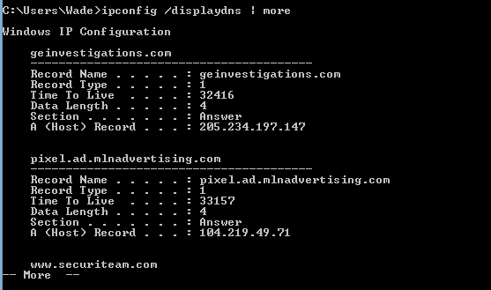
Finding Other Machines
Try: “ipconfig /displaydns
I added “| more” to avoid overflow

Slide 38
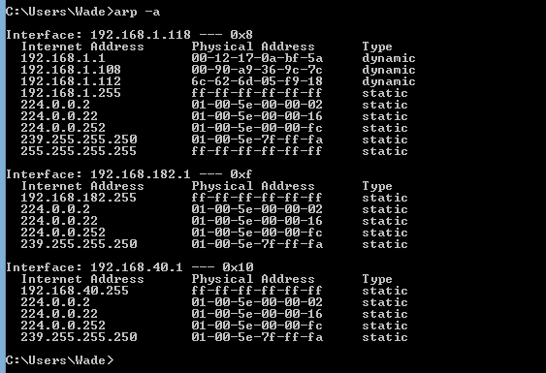
Finding Other Machines
Try “arp –a”

Slide 39
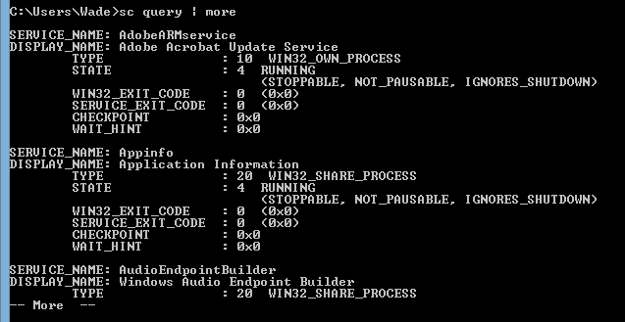
Find “Running” Services
Try “sc query”

Slide 40
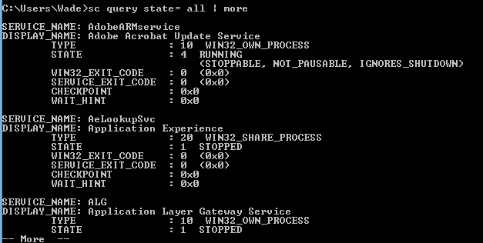
Find “All” Service
Try “sc query state=all”

Slide 41
Details on a Service
Try “sc qc [service_name]

Slide 42
Start/Stop Services
Try “sc start [service_name]” or “sc stop [service_name]
Remember, you can use “sc query state= all” to find the service names
If you have access to a similar machine, you could also look at the GUI

Slide 43
Basic Coding
For Loops
FOR /L -> Counter
FOR /F - > Iterates through a file

Slide 44
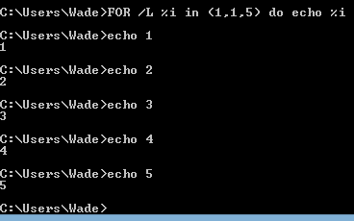
FOR /L -> Counter
Example
FOR /L %i in ([Start],[Step],[Stop]) do [command]
Translates to
FOR /L %i in (1,1,5) do echo %i

Slide 45
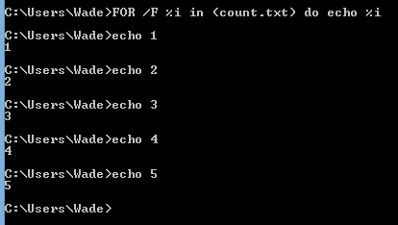
FOR /F - > Iterates through a file
FOR /F (“options”) %i in ([text_file]) do [command]
Translates to:
FOR /F %i in count.txt do echo %i

Slide 46
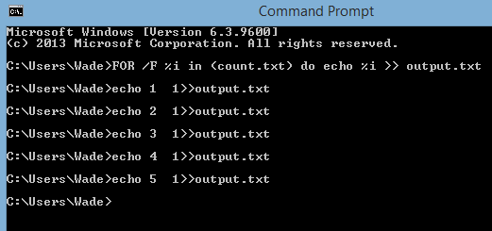
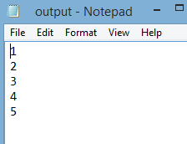
Sending to Outfile
Can add “ >> output.txt” to redirect to an output file
Try “FOR /F %i in (count.txt) do echo %i >> output.txt”

Slide 47
Reference
Lots more at:
http://blog.commandlinekungfu.com/

Slide 48
Next Week
No class next week
Test 2 in two weeks
Only material from Evasion will be testable
If there are “Any” questions between now and then write, text, or call.

Slide 49
Questions
?

