Slide 1
Intro to Ethical Hacking
MIS 5211.001
Week 5
Site: http://community.mis.temple.edu/mis5211sec001f15/

Slide 2
Tonight's Plan
Questions from last week
In the news
Nmap
  Fundmentals
  Scan and Scan Options
  ZenMap

Slide 3
In The News
Submitted
  https://www.govtechworks.com/military-battles-to-man-its-growing-cyber-force/#gs.BUzyl30
  http://www.ehackingnews.com/2015/09/security-bug-allows-hackers-to-take.html
  http://krebsonsecurity.com/2013/06/the-value-of-a-hacked-email-account/
  http://www.scmagazineuk.com/apples-chinese-app-store-gets-infected-with-malware/article/439793/
  http://www.darkreading.com/analytics/healthcare-biggest-offender-in-10-years-of-data-breaches/d/d-id/1322292
  http://www.zdnet.com/article/hp-bulks-up-security-features-on-enterprise-laserjet-printers/
  http://www.cnn.com/2015/09/17/politics/opm-hack-director-national-intelligence-response-wyden/index.html
  http://arstechnica.com/security/2014/03/malware-designed-to-take-over-cameras-and-record-audio-enters-google-play/

Slide 4
In The News
Submitted
  http://thehackernews.com/2015/09/hack-router.html
  http://www.databreachtoday.com/apple-battles-app-store-malware-outbreak-a-8538#
  http://betanews.com/2015/09/22/apple-sweeps-aside-app-store-malware-mess/
  http://www.cnbc.com/2015/09/20/apples-ios-app-store-suffers-first-major-attack.html
  http://www.wired.com/2015/09/hack-brief-popular-mobile-phone-manager-open-lock-wipe-hacks/http://www.wired.com/2015/09/hack-brief-popular-mobile-phone-manager-open-lock-wipe-hacks/
  http://www.cultofmac.com/389904/apple-takes-steps-to-avoid-a-repeat-of-xcodeghost-debacle/
  http://www.bbc.com/news/technology-34324252 (China Hacking)
  http://www.securitymagazine.com/articles/86653-study-says-75-of-us-organizations-are-not-prepared-to-respond-to-cyber-attacks

Slide 5
In The News
What I noted
  http://www.networkworld.com/article/2985246/security/cia-details-agency-s-new-digital-and-cyber-espionage-focus.html
  http://www.hindustantimes.com/india-news/bowing-to-public-pressure-govt-withdraws-draft-encryption-policy/article1-1392348.aspx
  http://www.nytimes.com/2015/09/19/business/volkswagen-is-ordered-to-recall-nearly-500000-vehicles-over-emissions-software.html?_r=0

Slide 7

Quick Info On Kali 2.0

Slide 8


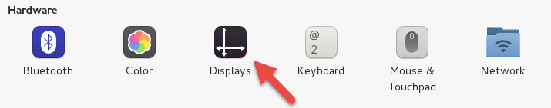
Setting Screen Size

Slide 9
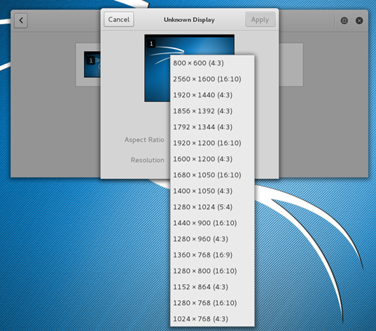
Setting Screen Size

Slide 10
Scanning
Goals
  Find live network hosts, Firewalls, Routers, Printers, etc…
  Work out network topology
  Operating systems used
  Open ports
  Available network services
  Potential vulnerabilities
  While minimizing the chance of disrupting operations

Slide 11
Type of Scans
Sweep – Send a series of probes (ICMP ping) to find live hosts
Trace – Use tools like traceroute and/or tracert to map network
Port Scanning – Checking for open TCP or UDP ports
Fingerprinting – Determine operating system
Version Scanning – Finding versions of services and protocols
Vulnerability Scanning

Slide 12
More on Types
Order works from less to more intrusive
  Sweeps are unlikely to disrupt anything, probably will not even alert security systems
  Vulnerability scans may cause system disruptions, and will definitely light up even a marginally effective security system

Slide 13
Targeting
Always target by IP address
Round Robbin DNS (Think basic load balancing) may spread packets to different machines and corrupt your results

Slide 14
Big Scans
Targeting a large number of addresses and/or ports will create a very long scan
Need to focus on smaller scope of addresses and a limited number of ports
If you have to scan large addresses space or all ports consider:
  Multiple scanners
  Distributed scanners (Closer to Targets)

Slide 15
Sniffers for Scanning
Some Pen Testers suggest running a sniffer to watch activity
  Detect errors
  Visualize what is happening

Slide 16
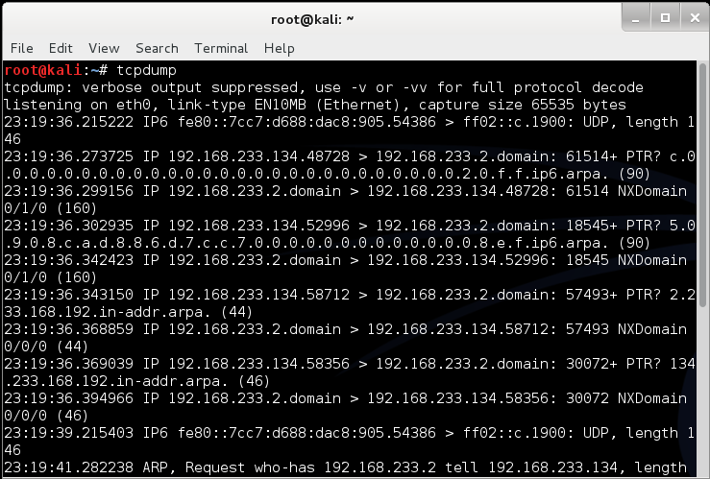
tcpdump
Linux sniffer tool is tcpdump

Slide 17
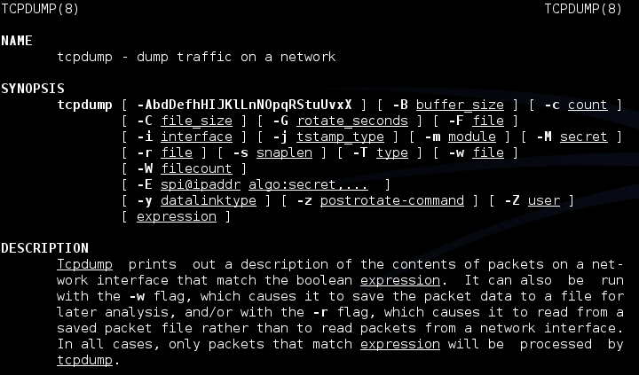
tcpdump
Remember Man page for tcpdump is already installed

Slide 18
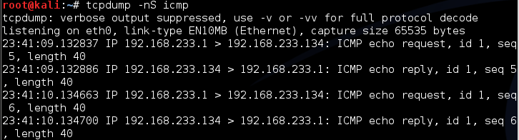
tcpdump
Basic Communications
  Try tcpdump -nS
Looking for pings

Slide 19
tcpdump
If you are not root:
  Remember: sudo tcpdump
Can filter for specific IP
  Try: tcpdump –nn tcp and dst 10.10.10.10
  Try: tcpdump –nn udp and src 10.10.10.10
  Try: tcpdump –nn tcp and port 443 and host 10.10.10.10
  FYI
    -n : Don’t resolve hostnames.
    -nn : Don’t resolve hostnames or port names.
More detailed How To:
  http://danielmiessler.com/study/tcpdump/

Slide 20
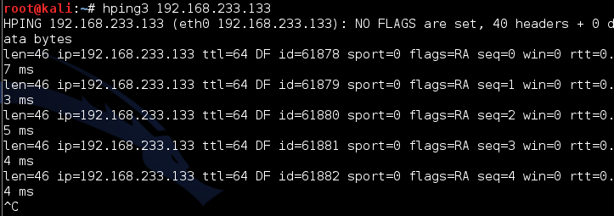
Network Sweeps
Hping3
  One target at a time
Caution: Windows firewalls may block functionality

Slide 21
Hping3
Can spoof source
  --spoof
  Example
    Hping3 –spoof 10.10.10.10 10.10.10.20
    Sets source to 10.10.10.10
    Sets destination to 10.10.10.20

Slide 22
Hping3
Targets ports
  -- destport [port]
  Example
    Hping3 10.10.10.10 –p 53
    Targets port 53 on 10.10.10.10
Target multiple port

Slide 23
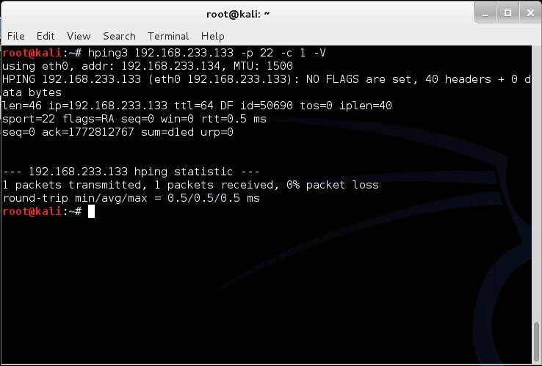
Example targeting port 22 with count “-c” and verbose “-V”

Slide 24
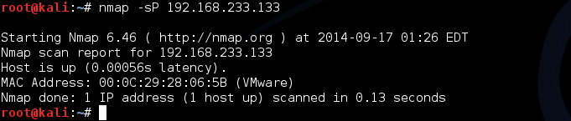
Nmap
Nmap is a network mapper
Very basic example
Just pings a machine and confirms it exists

Slide 25
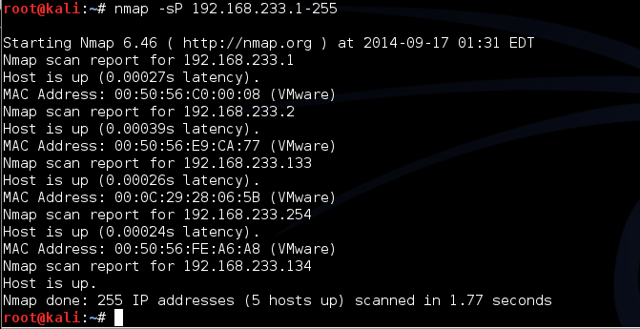
Nmap
Now we take it up a notch
Lets check an entire class “C” address
Example:
  Try: nmap –sP 192.168.1-255

Slide 26
A Little Refresher
Recall, two principle packet types
  TCP (Transmission Control Protocol)
    Connection oriented
    Reliable
    Sequenced
  UDP (User Datagram Protocol)
    Connectionless
    Best effort (Left to higher level application to detect loss and request retransmission if needed)
    Independent (un-sequenced)

Slide 27
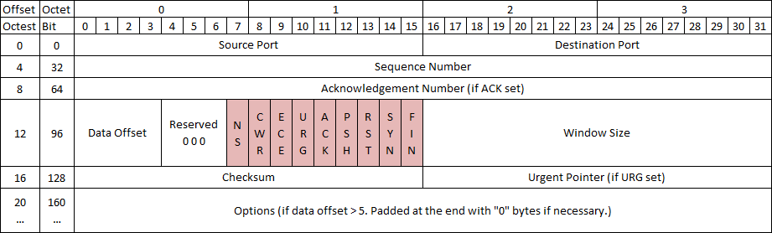
TCP Protocol
Number of flags have grown over the years, adding flags to the left as new ones are approved
With nine flags, there are 512 unique combinations of 1s and 0s
Add the three reserved flags and the number grows to 4096

Slide 28
TCP Control Bits
Control bits also called “Control Flags”
Defined by RFCs 793, 3168, and 3540
Currently defines 9 bits or flags
  See: http://en.wikipedia.org/wiki/Transmission_Control_Protocol

Slide 29
Three Way Handshake
Every “Legal” TCP connection begins with a three way handshake.
Sequence numbers are exchanged with the Syn, Syn-Ack, and Ack packets

Slide 30
How This Applies to Scanning
Per the RFC (793)
A TCP listener on a port will respond with Ack, regardless of the payload
Listener responds with a Syn-Ack
Therefore, if you get a Syn-Ack, something that speaks TCP was listening on that port

Slide 31
Behaviors
Port Open
Port Closed or Blocked by Firewall

Slide 32
Behaviors 2
Port Inaccessible (Likely Blocked by Firewall)
Port Inaccessible (Likely Blocked by Firewall)
Note: Nmap will mark both as “filtered”

Slide 33
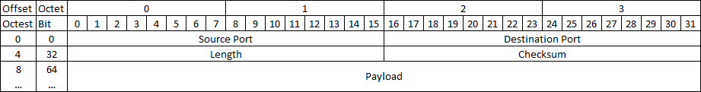
UDP Protocol
As you can see, UDP is a lot simpler.
  No Sequence Numbers
  No flags or control bits
  No “Connection”
As a result
  Slower to scan
  Less reliable scanning

Slide 34
Behaviors
Port Open
Port Closed or Blocked by Firewall

Slide 35
Behaviors 2
Port Inaccessible
Could be:
  Closed
  Blocked going in
  Blocked coming out
  Service not responding (Looking for a particular payload)
  Packet simply dropped due to collision

Slide 36
On to Nmap the Tool
Written and maintained by Fyodor
http://nmap.org/
Note: Lots of good info on the site, but the tutorial is a bit out of date. Latest info was put in a book and is sold on Amazon
  http://www.amazon.com/Nmap-Network-Scanning-Official-Discovery/dp/0979958717/ref=sr_1_1?ie=UTF8&qid=1411443925&sr=8-1&keywords=nmap

Slide 37
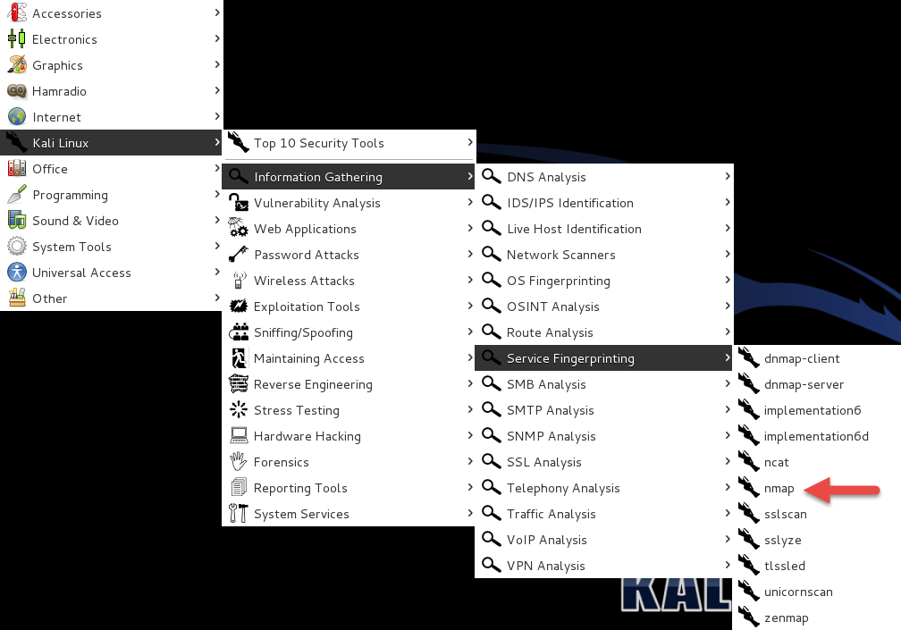
Nmap Location On Kali (old)

Slide 38
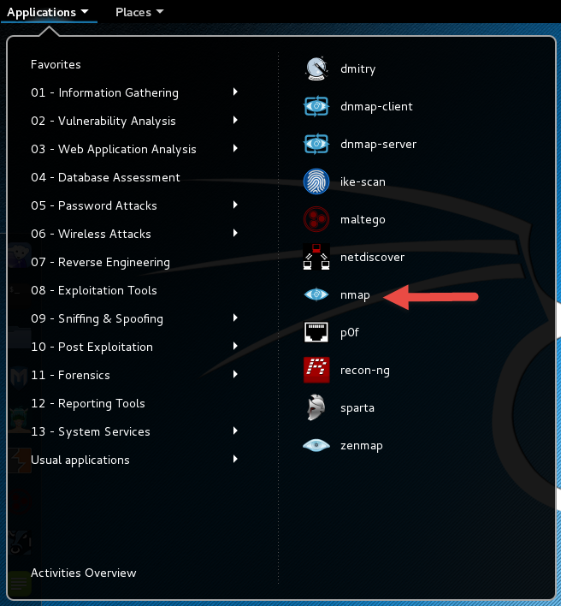
NMAP New

Slide 39
A Suitable Target
Metasploitable
  Deliberately vulnerable version of Linux developed for training on Metasploit
  We’ll use it here since there will be worthwhile things to find with nmap.
http://sourceforge.net/projects/virtualhacking/files/os/metasploitable/metasploitable-linux-2.0.0/download
UserID: msfadmin Password: msfadmin

Slide 40
Heads Up
After downloading the zip file, extract to a convenient location. VMWare should have created a folder in “My Documents” called “Virtual Machines”
Let Kali get started first
Then, select “Open a Virtual Machine” and navigate to the folder for metasploitable. Then launch.
You get a prompt asking if you moved or copied the VM, select “Moved”
Once started, login and issue command ifconfig to get you IP address and your done.

Slide 41
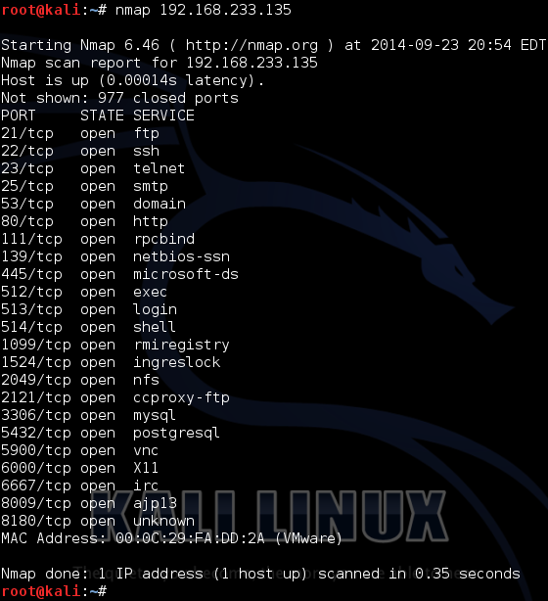
Back to Nmap
Lets try something simple
Nmap 192.168.233.135

Slide 42
What This Tells Us
There are a number of interesting ports here
  ftp
  Ssh
  telnet
  Smtp (Mail)
  domain (DNS)
  http (Web Server)
Keep in mind, ports are “commonly associated” with these services, but not guaranteed
http://www.iana.org/assignments/service-names-port-numbers/service-names-port-numbers.xhtml

Slide 43
Points to Remember
-n – Don’t resolve host names
-nn – Don’t resolve host names OR port names
-v – Verbose, tell me more
-vv – Really Verbose, tell me lots more
-iL – Input from list, get host list from a text file
--exclude – Don’t scan a particular host
--excludefile – Don’t scan hosts from a text file
Remember – “man nmap”

Slide 44
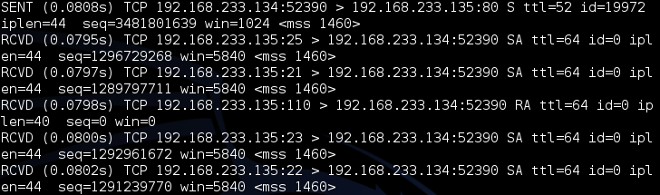
--packet-trace
Nmap prints a summary of every packet sent or received
May want to limit ports “-p1-1024” or less
There are also
  --version-trace
  --script-trace

Slide 45
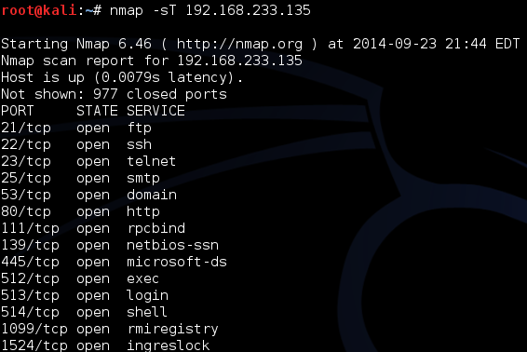
Basic Scan Types
-sT – TCP connect() scanning
  If connect succeeds, port is open

Slide 46
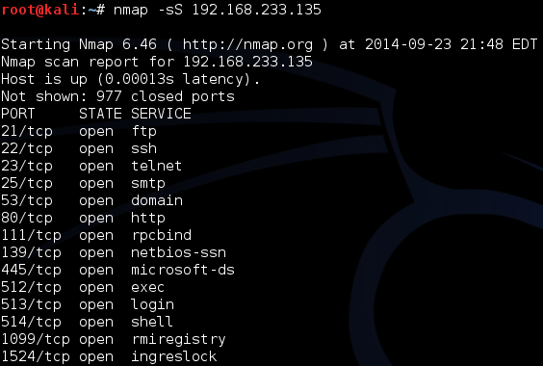
Basic Scan Types
-sS – SYN stealth Scan
  If SYN-ACK is received, port is open

Slide 47
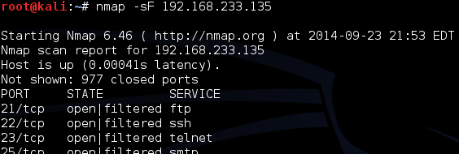
FIN Scan
-sF – Like SYN Scan, less likely to be flagged
  Closed port responds w/ RST, Open port drops
  Works on RFC 793 compliant systems
    Windows not compliant, could differentiate a Windows system

Slide 48
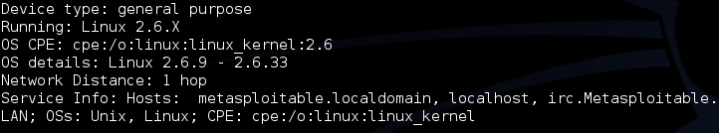
Other Options
-sN – Null scan
  Similar to FIN
-sX – Xmas tree scan
  Sets FIN, PSH, and URG
-sM – Maiman scan
  sets FIN and ACK
All work by looking for the absence of a RST

Slide 49
Roll Your Own
--scanflags
  Example:
    Nmap –scanflags SYNPSHACK –p 80 19

Slide 50
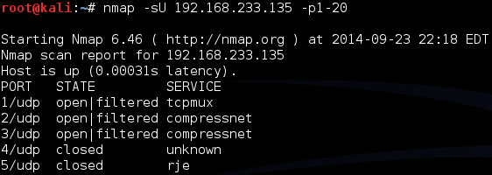
UDP Scans
-sU – 0 Byte UDP Packet
  Port unreachable – Port is closed
  No response – Port assumed open
  Very time consuming
  20 ports took 5.46 seconds, -sT scan only took 0.15

Slide 51
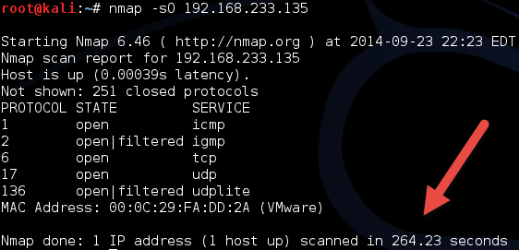
Protocol Scan
-sO – Looks for IP Protocols supported
  Sends raw IP packets without additional header information
  Takes time

Slide 52
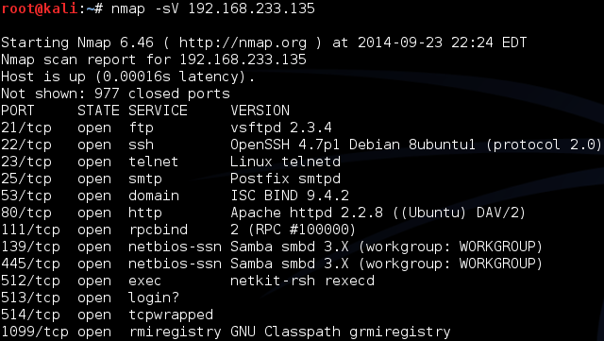
Version Detection
-sV – Attempts to determine version of services running

Slide 53
More on Version
-A – Looks for version of OS as well

Slide 54
Still More on Version Scan
-O – Fingerprint the operating system
-A = -sV + -O

Slide 55
Nmap Scripting Engine
Also known as NSE
  Written in “Lua”
  Activated with “-sC” or “- - script”
Categories
  Safe
  Intrusive
  Malware
  Version
  Discovery
  Vulnerability

Slide 56
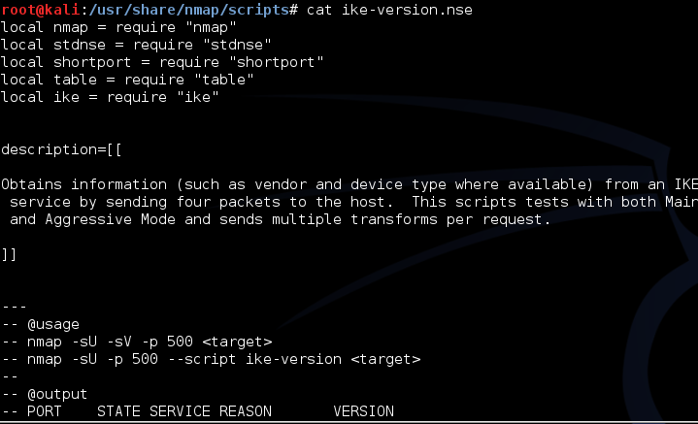
Script Location
In Kali, nmap scripts are located in:
  /usr/share/nmap/scripts
Can view using either “cat” OR gedits

Slide 57
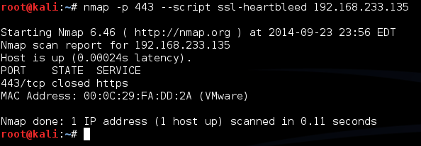
Script Example
SSL-Heartbleed
Try: nmap –p 443 --script ssl-heartbleed {target}
In this case, 443 is not even open

Slide 58
Zenmap
Graphical User Interface for nmap
Why did we just spend that time on the command line?
  Better control
  Better understanding

Slide 59
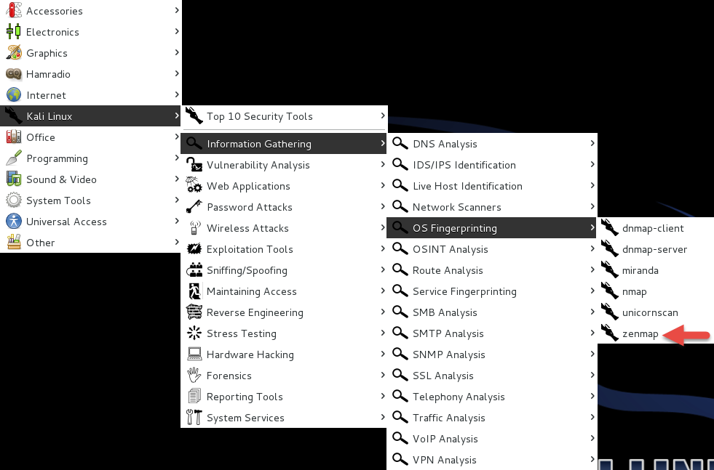
Zenmap Location

Slide 60
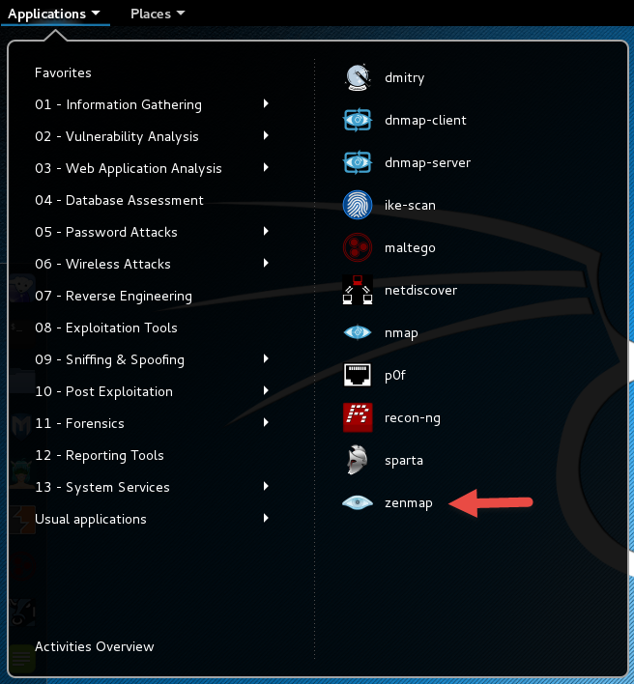
Zenmap New

Slide 61
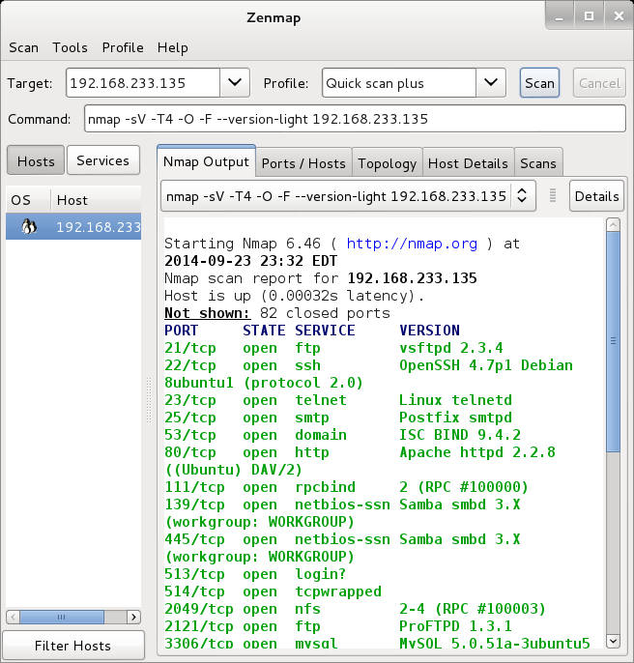
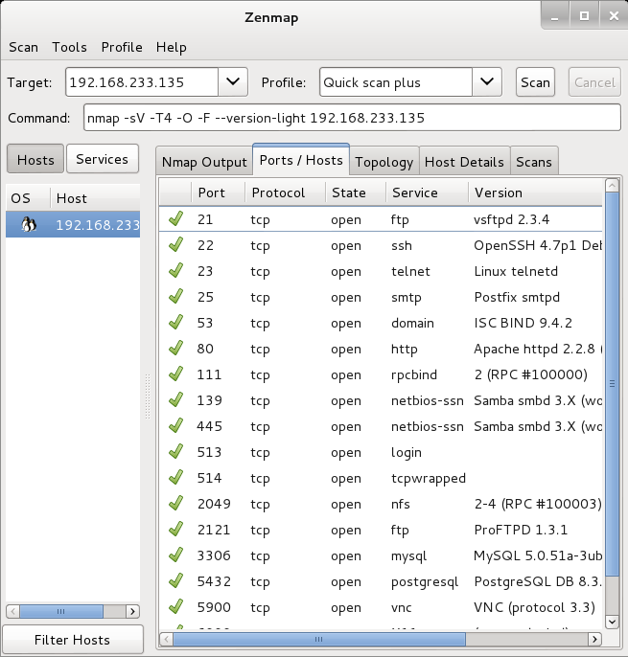
Zenmap Scan

Slide 62
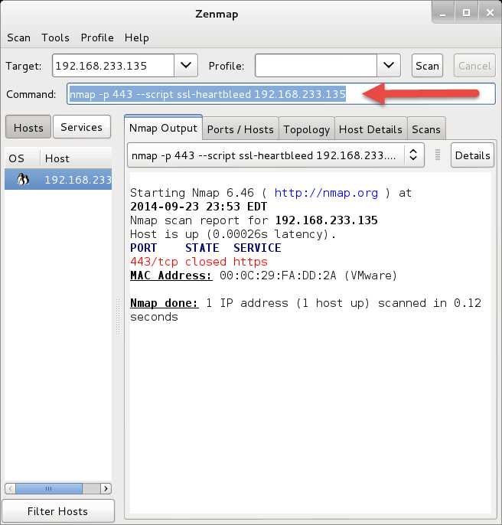
Still Really a Command Line
Look at the arrow
You can add to command line
Remember that SSL-hearbleed script

Slide 63
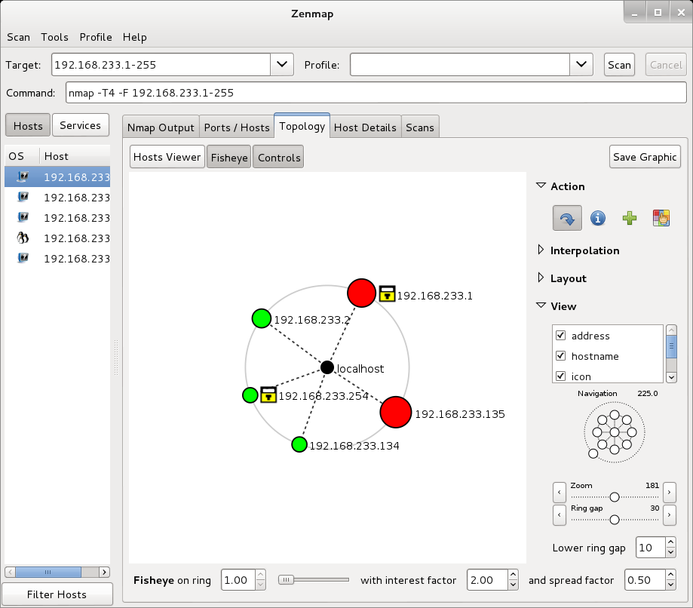
With a few Extras

Slide 64
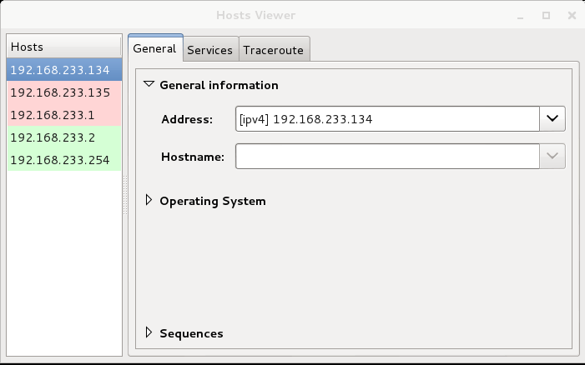
And More

Slide 65
Zenmap Reference
https://www.linux.com/learn/tutorials/381794-audit-your-network-with-zenmap?format=pdf

Slide 66
Next Week
Readings and Articles as usual
Nessus

Slide 67
Questions
?

