Slide 1
Intro to Ethical Hacking
MIS 5211.001
Week 6
Site: http://community.mis.temple.edu/mis5211sec001f15/

Slide 2
Tonight's Plan
In the news
Nessus
Next Week

Slide 3
Nessus
Started in 1998 as an open source security scanning tool
Changed to a close sourced tool in 2005, but has remained “free” for personal use.
Surveys by sectools.org indicate Nessus remains the most popular vulnerability scanners
Not installed with Kali

Slide 4
The Nessus Server
Four basic parts to the Nessus server:
Nessus-core
Nessus-libraries
Libnasl
Nessus-plugins

Slide 5
Plugins
Plugins are the scripts that perform the vulnerability tests.
NASL – This is the Nessus Attack Scripting Language which can be used to write your own plugins.

Slide 6
Defining Targets
Hosts
Server.domain.edu
172.21.1.2
Subnet
192.168.100.0
Address range
192.168.1.1-192.168.1.10

Slide 7
Vulnerability Scanning
Scanning methods:
Safe
Destructive
Service recognition – Will determine what service is actually running on a particular port.
Handle multiple services – Will test a service if it appears on more then one port.
Will test multiple systems at the same time.

Slide 8
Viewing Reports
Nessus will indicate the threat level for services or vulnerabilities it detects:
Critical
High
Medium
Low
Informational
Description of vulnerability
Risk factor
CVE number

Slide 9
Common Vulnerabilities and Exposures
CVE created by http://www.cve.mitre.org/
Attempting to standardize the names for vulnerabilities.
CVE search engine at http://icat.nist.gov/
Notes:
SANS Institute Weekly Critical Vulnerability Analysis Report http://www.sans.org, also Reading Room and Internet Storm Center

Slide 10
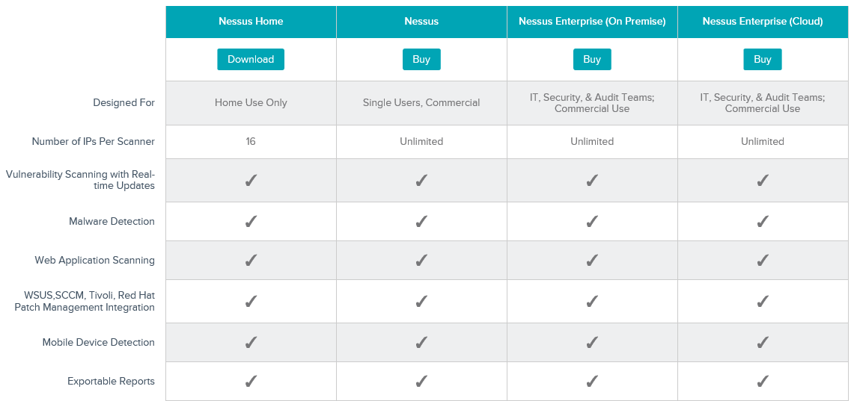
Options

Slide 11
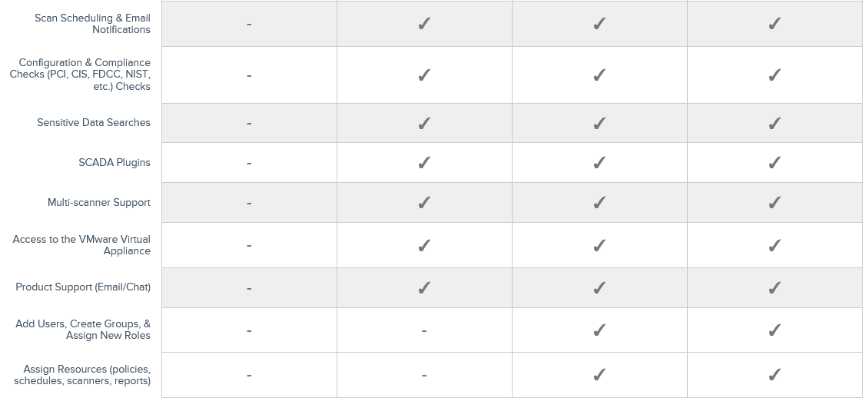
Options
http://www.tenable.com/products/nessus/select-your-operating-system

Slide 12
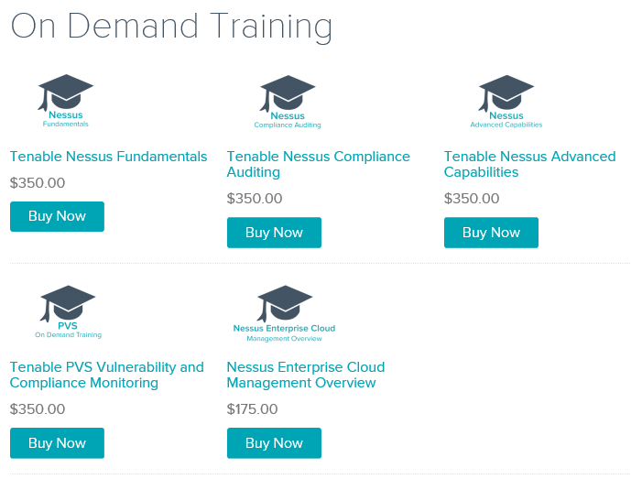
Nessus Sponsored Training

Slide 13
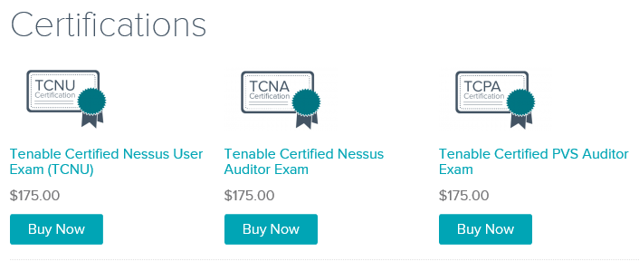
Certification Options
https://store.tenable.com/index.php?main_page=index&cPath=2

Slide 14
Architecture
Nessus is built on a classic client/server model.
The server portion may reside on a separate machine, or on the same machine as the client
The client is the interface that you will interact with to execute scans

Slide 15
Getting Nessus
Download from Tenable Security
http://www.tenable.com/products/nessus/select-your-operating-system
Before installing, go to registration page and get the activation code
http://www.tenable.com/products/nessus-home
Run the MSI package and follow the prompts
Install will also install PCAP and then take you to the registration page.
Enter activation code and follow the prompts to get updates and plugins

Slide 16
Documentation
Documentation for Nessus is available here:
http://static.tenable.com/documentation/nessus_4.2_user_guide.pdf
You will also get a link to this location during the install.

Slide 17
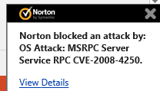
AV and Firewalls
You will need to turn off Anti-Virus and Firewall in order to get an effective scan or you will see this:
Before you do this, disconnect from any and all networks.
You will likely still get some blocking as AV doesn’t like to give up.

Slide 18
Location
Nessus is installed here:

Slide 19
Getting Started
You should end up looking at web page hosted from your machine.
Book mark the page to save time getting back
URL will look like this:
https://localhost:8834/html5.html

Slide 20
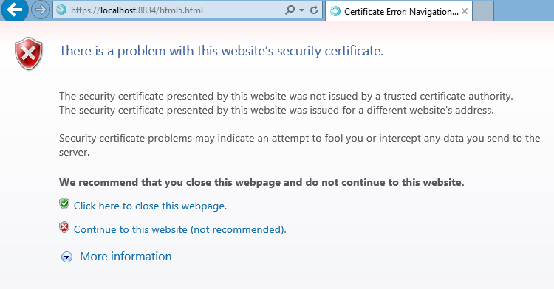
SSL Warning
When you first go to site, you will need to click on continue to the website.:

Slide 21
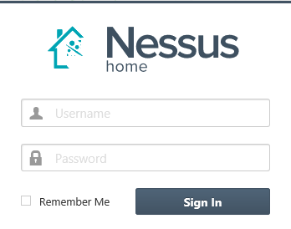
Logging In
Start

Slide 22
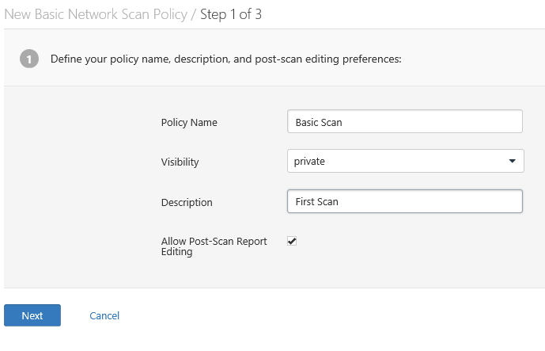
Policies
Scans are based on policies, you will need to create that first.

Slide 23
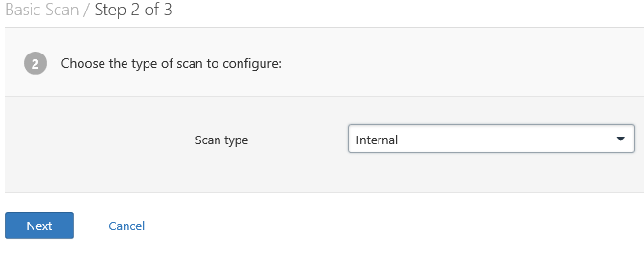
Policies 2
Next

Slide 24
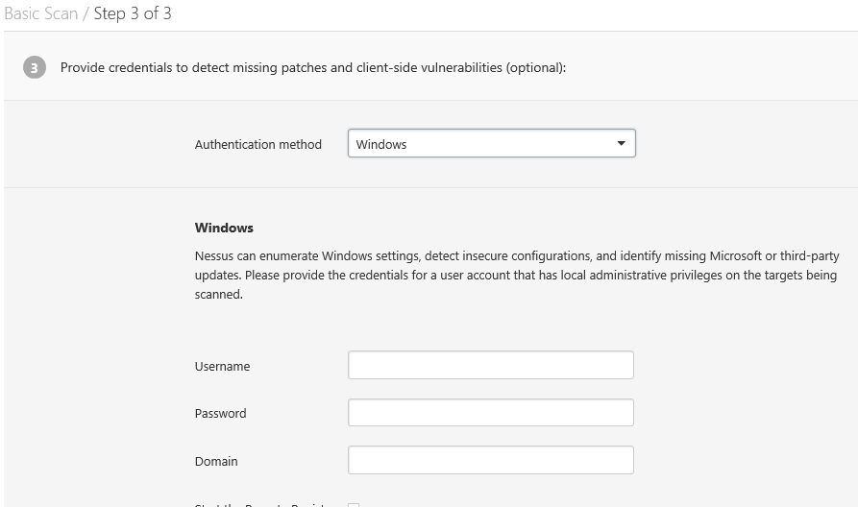
Policies 3

Slide 25
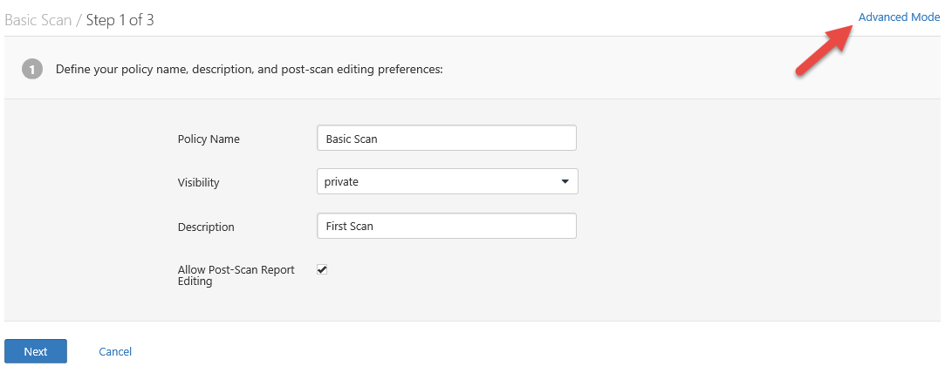
There are many more options

Slide 26
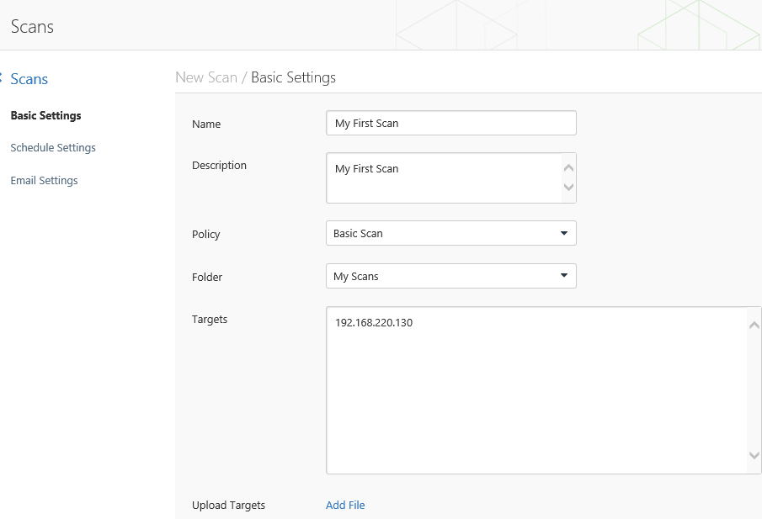
Creating A Scan

Slide 27
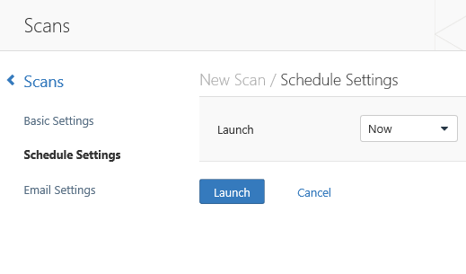
Scheduling A Scan

Slide 28
Scan Status
Once your scan has started you will see a status field like this:

Slide 29
Scan Status
Once completed you will get the following notification:

Slide 30
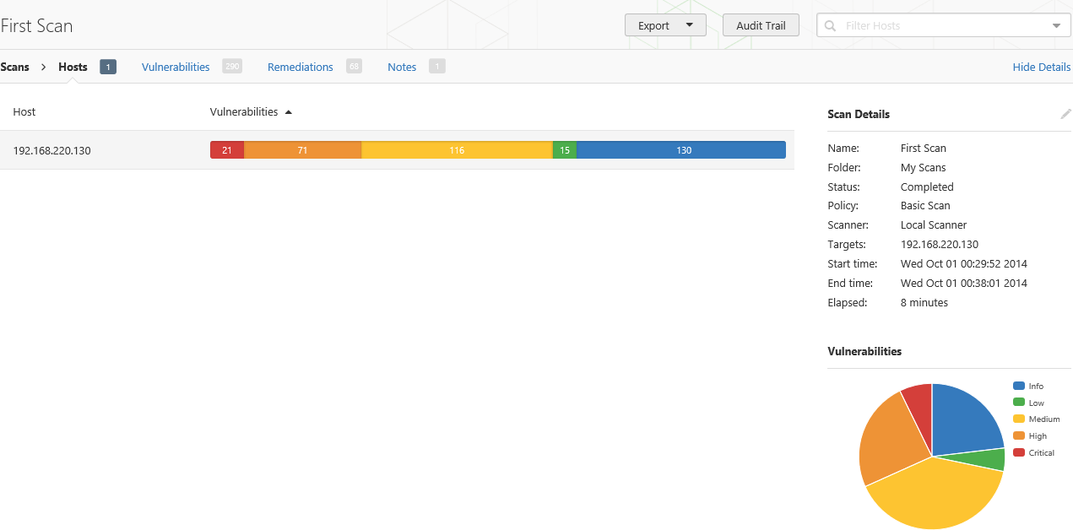
Output From First Scan

Slide 31
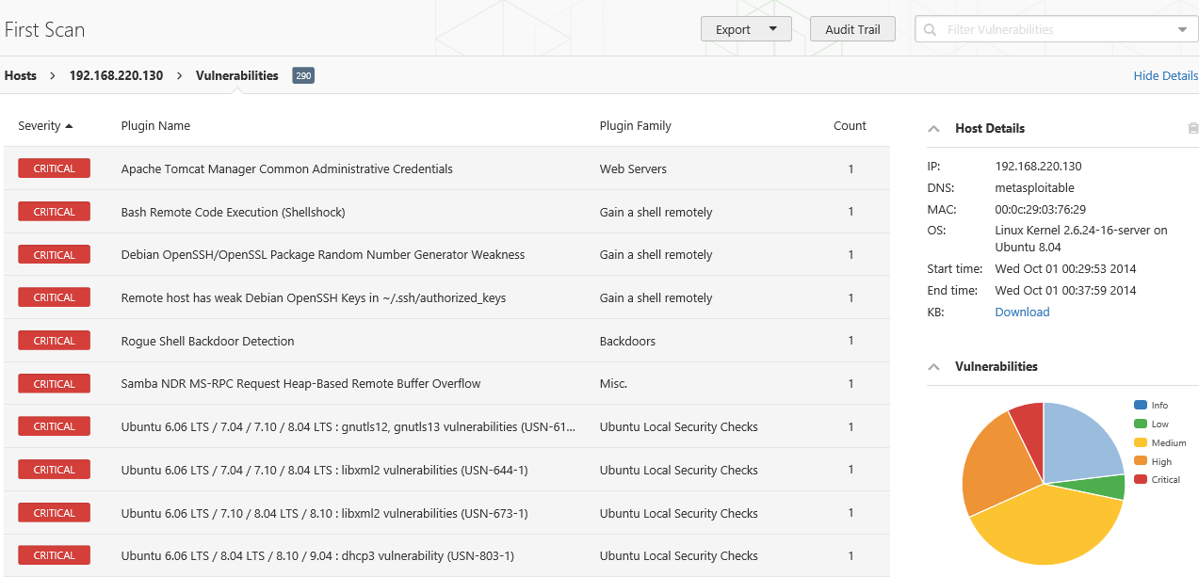
Clicking on scan gives details

Slide 32
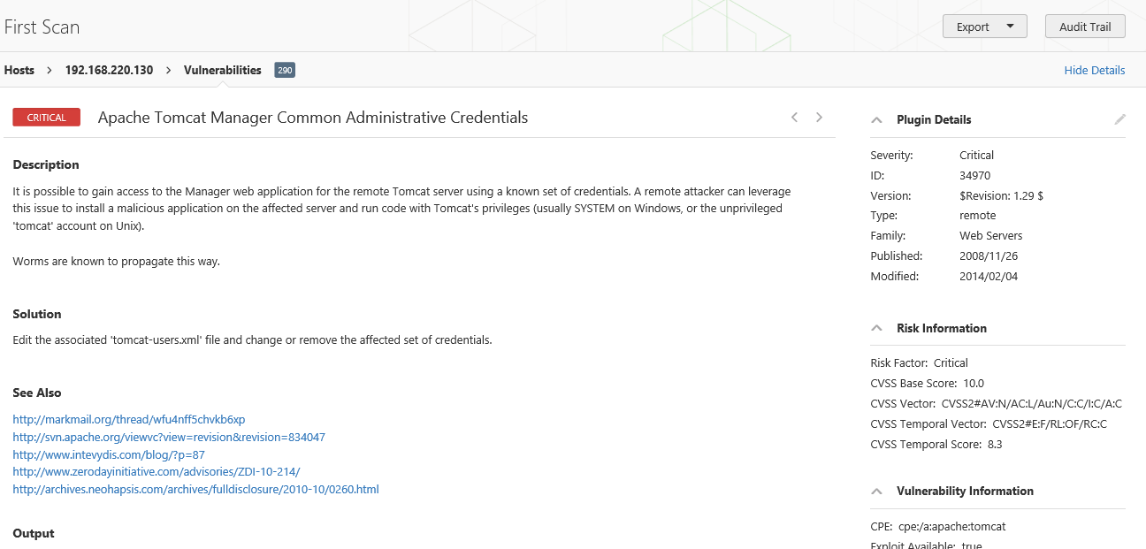
Continuing to drill down

Slide 33
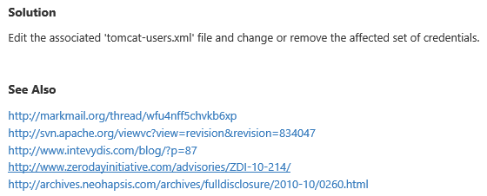
Good Information
Important to note:
Also

Slide 34
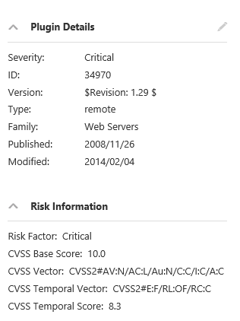
Criticality
Note on criticality
The “Critical” risk factor is without any mitigating controls being taken in to account
Vulnerabilities need to be evaluated in context

Slide 35
More on Results
These results were obtained, even though Anti-Virus continued blocking multiple techniques.
Consider setting up a scanning machine without any AV or Host Firewall.

Slide 36
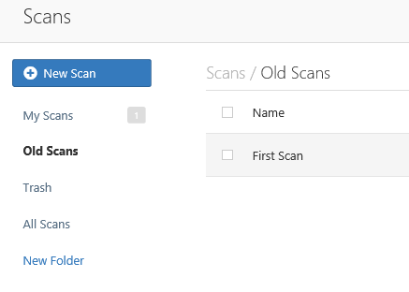
Organizing Scans
In short order you will gather a large collection of scans
Use the built in folder system to move scans off of the main page

Slide 37
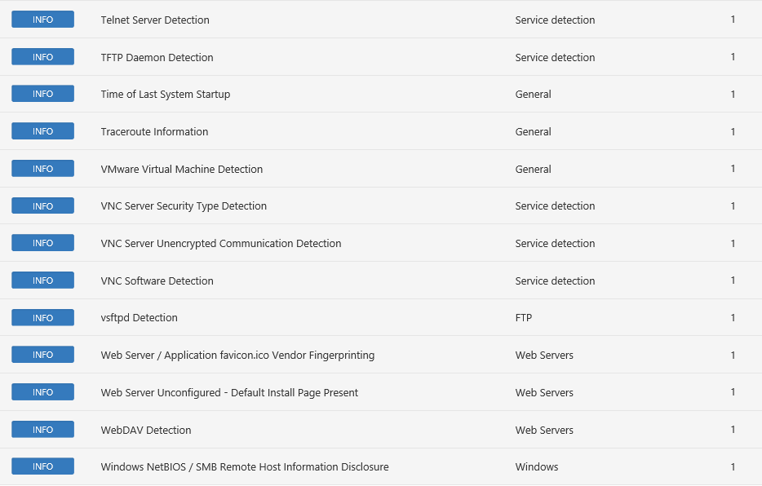
Don’t Forget the Info

Slide 38
Info Vulnerabilities
The least significant vulnerabilities are classified as “Info” or informational.
These are often very useful in understanding details of the asset being scanned.

Slide 39
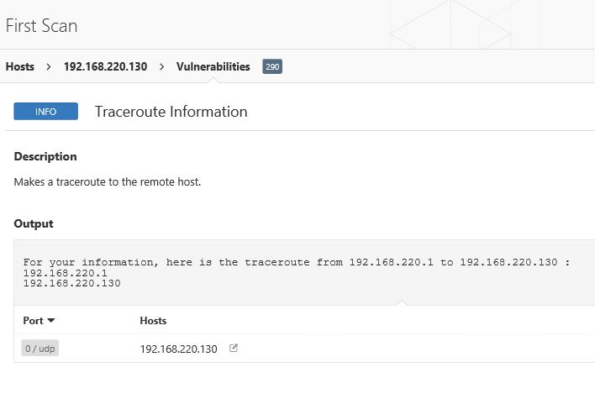
For Instance

Slide 40
Next Week
Test 1
Will cover weeks 1-5. Will not include information from tonight
Questions will come from the presentation material
Exam will be multiple choice
NetCat
Potentially
Batch Scripting

Slide 41
Questions
?

