Slide 1
Intro to Ethical Hacking
MIS 5211.001
Week 10
Site: http://community.mis.temple.edu/mis5211sec001f15/

Slide 2
Tonight's Plan
In the news
Follow Up On Malware
Web Application Security (will not finish tonight)

Slide 3
In The News
Submitted
  http://uk.reuters.com/article/2015/10/12/uk-cybersecurity-insurance-insight-idUKKCN0S609S20151012
  http://www.govconwire.com/2015/09/id-experts-wins-330m-federal-data-breach-recovery-services-bpa/
  http://www.ehackingnews.com/2015/09/starbucks-fixes-critical-flaws-that.html
  http://www.informationweek.com/government/mobile-and-wireless/smartphones-on-drones-can-hack-your-wireless-printer/d/d-id/1322547
  http://www.computerworld.com/article/2998397/security/iranian-hackers-show-interest-in-android-spying-tools.html

Slide 4
In The News
Submitted
  http://www.bbc.com/news/technology-34646146 (Drop Box)
  https://www.eff.org/document/eff-jailbreaking-exemption-request
  http://www.dailymail.co.uk/news/article-3273519/US-Naval-Academy-returns-celestial-navigation-amid-fears-computer-hacking.html
  http://www.inc.com/joseph-steinberg/millennials-women-and-cybersecurity-new-survey-reveals-an-alarming-trend.html
  http://www.zdnet.com/article/find-a-flash-drive-pick-it-up-study-highlights-poor-city-security-habits/
  http://qz.com/534554/estonia-is-making-it-easier-to-cross-borders-digitally/
  http://www.securityweek.com/what-happens-stolen-data-after-breach

Slide 5
In The News
Submitted
  http://www.databreachtoday.com/talktalk-breach-fuels-call-for-tougher-uk-laws-a-8618
  http://arstechnica.com/security/2015/10/13-million-plaintext-passwords-belonging-to-webhost-users-leaked-online/

Slide 6
In The News
What I noted
  https://threatpost.com/car-hacking-mobile-jailbreaking-among-dcma-exemptions-granted/115185/?utm_source=twitterfeed&utm_medium=twitter&utm_campaign=information_security
  http://www.dailydot.com/politics/cisa-senate-passage-cybersecurity-information-sharing-act-congress/

Slide 7
Malware Continued

Slide 8
Technical Types
User Mode Root Kits
Kernel Mode Root Kits
Keyloggers
Sniffers
Downloaders
HTTP C2 Channels

Slide 9
User Mode Root Kits
Purpose
  Attain access
  Maintain access
  Hide access
Operates in user mode
  That is, gets injected into one or more individual processes

Slide 10
What it Looks Like

Slide 11
What is Happening
Rootkit intercepts data to:
  Netstat
  Process Explorer
  Task Manager
Therefore, when a user or admin looks at these tools everything looks normal

Slide 12
Two Key Infection Steps
DLL Injection (Dynamic Link Library)
  Running code within the address space of another process
  Malware “Injects” itself into a DLL using
    SetWindowsHookEx
    CreateRemoteThread/LoadLibrary
  Note: These are legitimate commands that are used by software for things like patching
API Hooking (Application Programming Interface)
  Intercepting function calls, messages, or events passed between software components

Slide 13
Notes on Rootkits
These methods were developed in Windows XP and earlier machines
Still possible with Vista, 7, and 8 – Just need to work a little harder

Slide 14
Kernel Mode Rootkits
Injected into the Kernel, below the level of process and DLL
Runs at the highest privilege level for software
Removal likely requires reinstallation of operating system

Slide 15
Keyloggers
Monitor user key strokes
Lots of bots, worms, and assorted other malware does this
  Sends logs to attacker
Common methods
  Hook for keyboard events
  Poll keyboard state with GetAsyncKey()

Slide 16
Sniffers
Similar to tcpdump or windump covered earlier, but now its malicious
Common method
  Put interface into promiscuous mode
  Controller passes all traffic it receives to the CPU
Other ways
  Intercept network related calls
  Intercept higher level functions
    We’ll see this late with Browser proxies
  Installing BHOs (Browser Helper Objects)

Slide 17
Downloaders
Used by attackers to deliver malware in stages
Initial malware can be very small, only needs to fetch the next piece of software
  Easier to obfuscate
  May escape detection
  Action is not malicious in and by itself
Droppers are similar, but embedded the downloaded functionality in their own code

Slide 18
Example Commands
URLDownloadToFile()
  Download and save file to disk
ShellExecute()
  Execute file
WinExec()
  Execute file

Slide 19
Command and Control Channels
AKA HTTP C2 Channels
  Ubiquitous
  Port 80 almost always open
  Use port 443 and your coms are encrypted
Alternatives
  IRC (Internet Relay Chat)
  P2P (File Sharing)
  DNS (Tunnel data over DNS)

Slide 20
Approaches
Reverse shell over HTTP (Port 80)
Embedded in regular HTTP traffic
  Disguised like normal user traffic

Slide 21
Infection Channels
MS Office Files
PDF Files
Flash
JavaScript
Lots more, but these are the ones we will talk about

Slide 22

MS Office Files
Why Office
  Everybody is using it
  File freely passed around and not unexpected
  Parsing binary office format is difficult
  Robust embedded scripting language (VBA)
  You can even hook Apple products
Source for Graphic: http://www.motionvfx.com/mblog/microsoft_office_coming_for_ipad_as_well_as_a_new_desktop_version_for_lion!,p960.html

Slide 23
Techniques
Embedded Shellcode
  Exploits vulnerability in office software
  No user interaction required
Embedded VBA Script
  Executes on document open
  May require user to click OK or “Enable Content”
Note about VBA – Term Macro is misleading. Implies it is for basic scripting. Today, VBA is a full fledged language.

Slide 24
Adobe PDF
Why PDF
  Everybody is using it
  Files freely passed around and not unexpected
  PDF Format
    Proprietary(ish)
      Used to be proprietary, published by ISO as ISO/IEC 32000-1:2008
    Feature rich
    Can include active content
      JavaScript
      ActionScript via Flash Objects
  And finally
    New vulnerabilities found regularly

Slide 25
More Adobe PDF
High profile attack target
  http://www.darkreading.com/vulnerabilities---threats/report-sixty-percent-of-users-are-running-unpatched-versions-of-adobe/d/d-id/1136022
  6 in 10 installs of Adobe Reader are out of date
Complex structure
  Easily obfuscated
  Need software tools to open and understand
  Even AV vendors have problems keeping an eye on this

Slide 26
Where are the Vulnerabilities
Parser components
JavaScript and ActionScript
Embedded Shellcode executes by exploiting these vulnerabilities

Slide 27
Flash
Ubiquitous on websites
New vulnerabilities weekly (at least that’s how it feels)
So bad Apple and now Kindle will not allow flash to be installed without jail breaking the devices

Slide 28
More Flash
Uses the SWF file format
See: http://wwwimages.adobe.com/www.adobe.com/content/dam/Adobe/en/devnet/swf/pdf/swf-file-format-spec.pdf
Supports ActionScript language for scripting, including legacy support for older versions of ActionScript

Slide 29
Flash Vulnerabilities
Client Side
  Flash Parameter Injection
    Inject parameters when Flash object is embedded in an HTML page
  Cross Domain Privilege Escalation
    Access and modify DOM
  Cross Site Scripting
    Access and modify DOM
  Cross Site Flashing
    Call another flash object from flash

Slide 30
JavaScript
Just a teaser at this point
JavaScript is a primary infection path with web site based attacks
  Used for:
    Cross Site Scripting (XSS)
    Cross Site Request Forgery (CSRF)
    Direct Delivery
      Downloaders
      Droppers
      Keyloggers
      And anything else you want

Slide 31
More JavaScript
JavaScript based attacks are frequently heavily obfuscated with multiple layers of encryption, obfuscation, encoding, and false flags
Attackers will “buy” ad space and put up legitimate looking ads on legitimate sites
  Since adds are rotated, infection is inconsistent and difficult to pin down

Slide 32
Testing AV
During Penetration Tests a tester may be asked to verify that the AV suite is working
You don’t want to actually send malware
What do you do?
Answer
  EICAR
  http://www.eicar.org/86-0-Intended-use.html

Slide 33
EICAR
EICAR is a Anti-Malware Test File
Originally developed by Paul Ducklin
All major AV vendors will flag this file if properly installed and configure
Tester can simply send the file in via normal channel being tested and then confirm that AV suites correctly identified and blocked file.

Slide 34
Odds and Ends
I’m malware, where do I hide
  Inside other executables
  Inside data files
  In Alternate Data Streams (ADS)
  On the hard drive, but outside of the file system
  In BIOS

Slide 35
Detection
Malware in executables and data files can be detected of you know what good is supposed to look like
Malware also leaves markers in the file system that can be detected
Commercial tools like Mandiant, FireEye, and others can pick these up
  Worth noting: FireEye bought Mandiant

Slide 36
Alternate Data Stream (ADS)
Compatibility feature of NTFS
  Part of file system, but not part of file system
  Originally created to allow NTFS to handle Apple file attributes that were stored outside of the file structure
  Creates an “Off Book” location to store data and/or executables that will not be seen via file commands or through GUI folder tools
  http://www.windowsecurity.com/articles-tutorials/windows_os_security/Alternate_Data_Streams.html

Slide 37
Hard Drive
Not all space on the drive is consumed by the file system
Vendors sometime use this space to keep configuration information or recovery files
Attackers can use the space as well
Caution: While tools exist to read and write to raw space, writing is extremely dangerous as you can render the file system useless.

Slide 38
BIOS
Firmware installed on motherboard that instructs CPU how to turn on
  What drive to boot from
  Is there a password to just turn on
Other hardware has similar Firmware
  Graphics Cards
  Network Cards
  Other specialty boards

Slide 39
What is Firmware
Firmware is rewritable code in a chip or other piece of hardware that retains it’s coding even without power
It only changes when specific external commands are given to update or overwrite

Slide 40
Impact of BIOS Malware
Malware can withstand a complete re-image of the file system
Replacing the hard drive will not mitigate
Since it is in place a boot time, before the kernel ever starts, it can re-infect

Slide 41
Web Application Security
First (and nearly only) Rule
Never Trust User Input

Slide 42

Where Do We Start
For web application security and web application penetration testing
Owasp.org

Slide 43
OWASP
OWASP stands for the Open Web Application Security Project
Founded in 2001 as a charitable organization dedicated to improving Web Application Security
Creators and publishers of the OWASP top 10
Hosts numerous Web App tools and projects

Slide 44
The OWASP Top 10
OWASP Top 10 – 2013 (New)
2013-A1 – Injection
2013-A2 – Broken Authentication and Session Management
2013-A3 – Cross Site Scripting (XSS)
2013-A4 – Insecure Direct Object References
2013-A5 – Security Misconfiguration
2013-A6 – Sensitive Data Exposure
2013-A7 – Missing Function Level Access Control
2013-A8 – Cross-Site Request Forgery (CSRF)
2013-A9 – Using Known Vulnerable Components (NEW)
2013-A10 – Unvalidated Redirects and Forwards
Source: http://owasptop10.googlecode.com/files/OWASP_Top-10_2013%20-%20Presentation.pptx

Slide 45
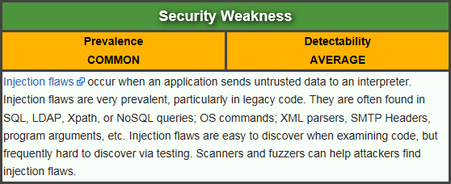
Injection
Attacker sends simple text-based attacks that exploit the syntax of the targeted interpreter. Almost any source of data can be an injection vector, including internal sources.
https://www.owasp.org/index.php/Top_10_2013-A1-Injection

Slide 46
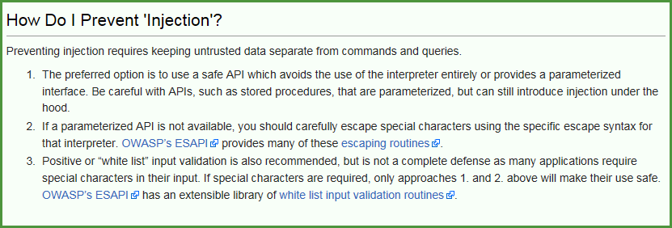
Injection
Finding a way to send text to a web application or browser that is interpreted as a command or code
Tricks systems or browsers in to taking action

Slide 47
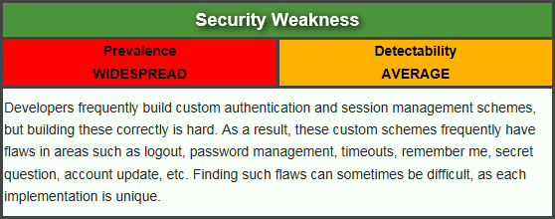
Broken Authentication and Session Management
Attacker uses leaks or flaws in the authentication or session management functions (e.g., exposed accounts, passwords, session IDs) to impersonate users.
https://www.owasp.org/index.php/Top_10_2013-A2-Broken_Authentication_and_Session_Management

Slide 48
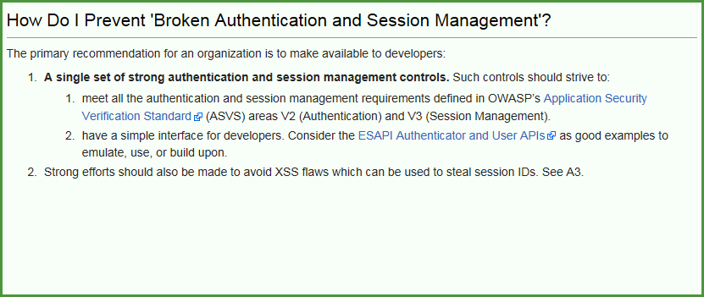
Broken Authentication and Session Management
Steal an identity, and use it.

Slide 49
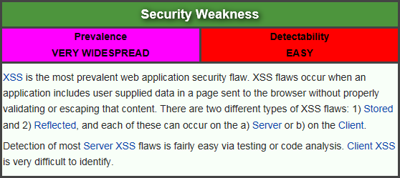
Cross Site Scripting (XSS)
Attacker sends text-based attack scripts that exploit the interpreter in the browser. Almost any source of data can be an attack vector, including internal sources such as data from the database.
https://www.owasp.org/index.php/Top_10_2013-A3-Cross-Site_Scripting_(XSS)

Slide 50
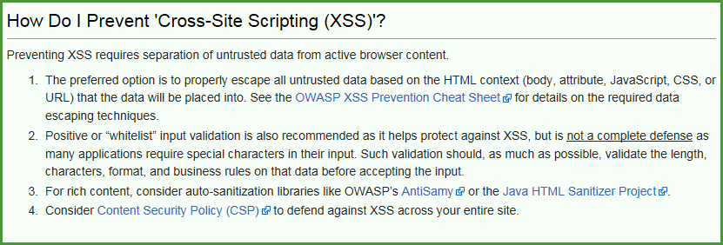
Cross Site Scripting (XSS)
Can be as simple as <script>alert(“XSS”)</script>

Slide 51
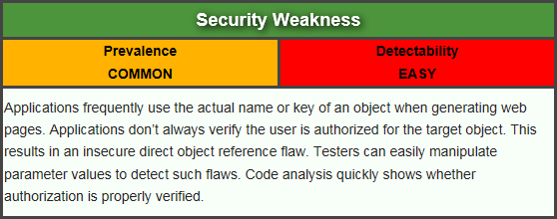
Insecure Direct Object References
Attacker, who is an authorized system user, simply changes a parameter value that directly refers to a system object to another object the user isn’t authorized for. Is access granted?
https://www.owasp.org/index.php/Top_10_2013-A4-Insecure_Direct_Object_References

Slide 52
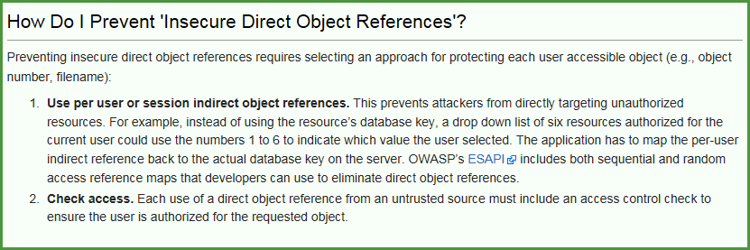
Insecure Direct Object References
Keep in mind, “Authorized User” does not necessarily mean “Admin”. Just a user that is allowed on the web site. If public, that means everyone.

Slide 53
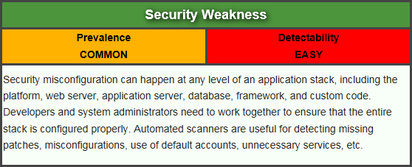
Security Misconfiguration
Attacker accesses default accounts, unused pages, unpatched flaws, unprotected files and directories, etc. to gain unauthorized access to or knowledge of the system.
https://www.owasp.org/index.php/Top_10_2013-A5-Security_Misconfiguration

Slide 54
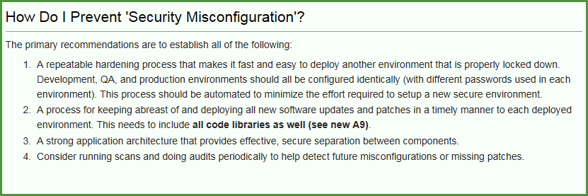
Security Misconfiguration
  Remember those Google searches from Reconnaissance? For instance: intitle:"Test Page for Apache"

Slide 55
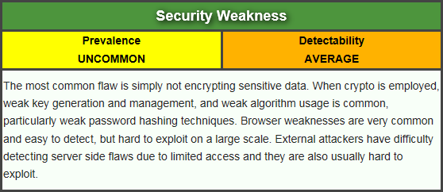
Sensitive Data Exposure
Attackers typically don’t break crypto directly. They break something else, such as steal keys, do man-in-the-middle attacks, or steal clear text data off the server, while in transit, or from the user’s browser.
https://www.owasp.org/index.php/Top_10_2013-A6-Sensitive_Data_Exposure

Slide 56
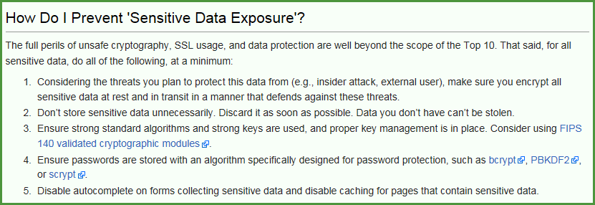
Sensitive Data Exposure
Example: A site simply doesn’t use SSL for all authenticated pages. Attacker simply monitors network traffic (like an open wireless network), and steals the user’s session cookie.

Slide 57
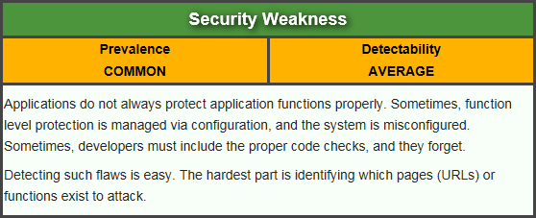
Missing Function Level Access Control
Attacker, who is an authorized system user, simply changes the URL or a parameter to a privileged function. Is access granted? Anonymous users could access private functions that aren’t protected.
https://www.owasp.org/index.php/Top_10_2013-A7-Missing_Function_Level_Access_Control

Slide 58
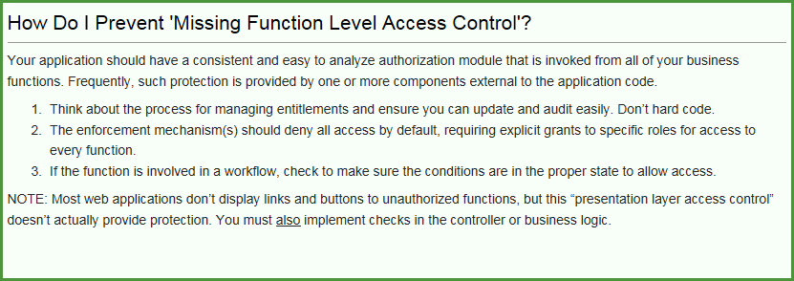
Missing Function Level Access Control
Example from OWASP:
  http://example.com/app/getappInfo
  http://example.com/app/admin_getappInfo

Slide 59
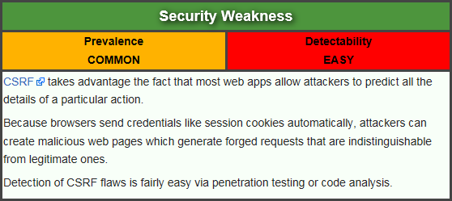
Cross-Site Request Forgery (CSRF)
Attacker creates forged HTTP requests and tricks a victim into submitting them via image tags, XSS, or numerous other techniques. If the user is authenticated, the attack succeeds.
https://www.owasp.org/index.php/Top_10_2013-A8-Cross-Site_Request_Forgery_(CSRF)

Slide 60
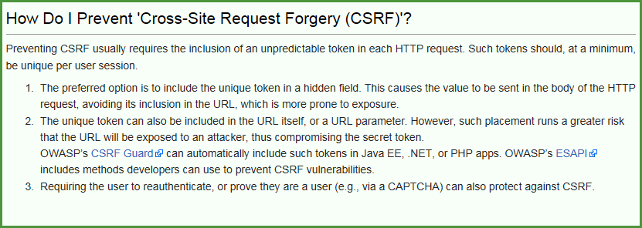
Cross-Site Request Forgery (CSRF)
Example from OWASP
  http://example.com/app/transferFunds?amount=1500&destinationAccount=4673243243
  <img src="http://example.com/app/transferFunds?amount=1500&destinationAccount=attackersAcct#" width="0" height="0" />

Slide 61
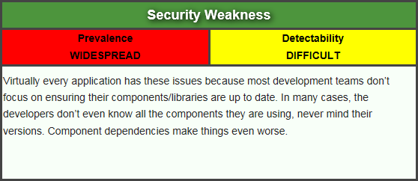
Using Components with Known Vulnerabilities
Attacker identifies a weak component through scanning or manual analysis. He customizes the exploit as needed and executes the attack. It gets more difficult if the used component is deep in the application.
https://www.owasp.org/index.php/Top_10_2013-A9-Using_Components_with_Known_Vulnerabilities

Slide 62
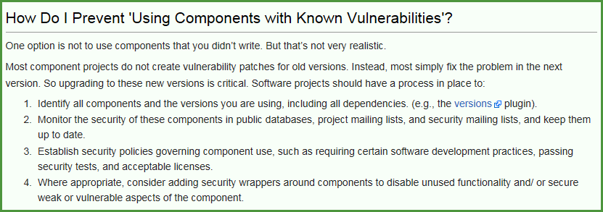
Using Components with Known Vulnerabilities
Example from OWASP
  Spring Remote Code Execution – Abuse of the Expression Language implementation in Spring allowed attackers to execute arbitrary code, effectively taking over the server.

Slide 63
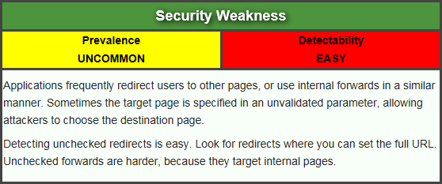
Unvalidated Redirects and Forwards
Attacker links to unvalidated redirect and tricks victims into clicking it. Victims are more likely to click on it, since the link is to a valid site. Attacker targets unsafe forward to bypass security checks.
https://www.owasp.org/index.php/Top_10_2013-A10-Unvalidated_Redirects_and_Forwards

Slide 64
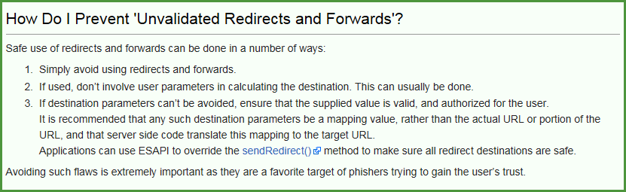
Unvalidated Redirects and Forwards
Example from OWASP
  http://www.example.com/redirect.jsp?url=evil.com

Slide 65
Now What
So, all of this is interesting, but does that have to do with penetration testing
Or, to put it another way. How de we exploit these issues?
First step:
Intercepting Proxies

Slide 66
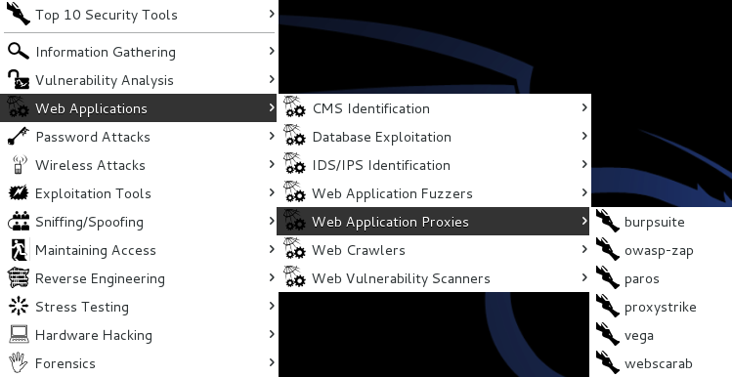
What’s an Intercepting Proxy
In this instance, an intercepting proxy is software that acts as a server and sits between the web browser and your internet connection
Examples
  Burp Suite
  Webscarab
  Paros

Slide 67
Some Rules for Our Use of Intercepting Proxies
For this course
Monitor and record ONLY
Do not inject or alter any traffic unless you personally own the web site.
We’ll save changing traffic in the next course
For this course

Slide 68
Burp Suite
Start Burp Suite by logging in to Kali and selecting Burp Suite from:
Kali Linux>Web Applications>Web Application Proxies>burpsuite

Slide 69
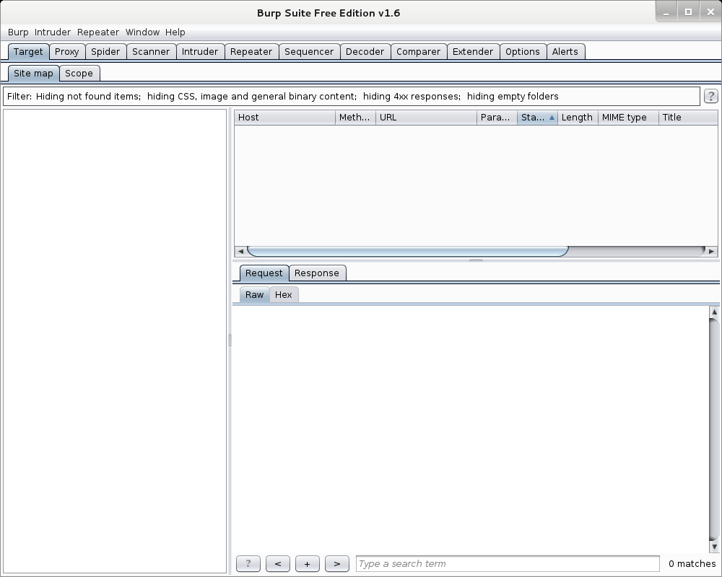
Burp Suite

Slide 70
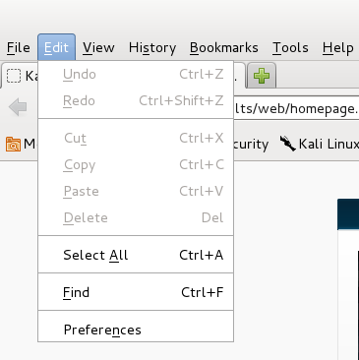
Getting Started
Once burpsuite is running, you will need to start and configure a browser
Kali’s web browser is “Iceweasel”, an adaptation of Firefox
After starting Iceweasel, navigate to preferences
And select it

Slide 71
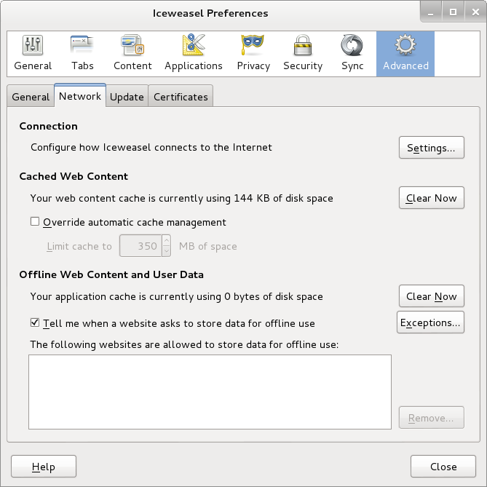
Configuring the Network Proxy
Navigate to the Network Tab and select settings… for Connection

Slide 72
Configuring the Network Proxy
Change selection from “Use system proxy settings” to “Manual proxy configuration and enter “127.0.0.1” for “HTTP Proxy” and “8080” for “Port”
Also, select check box for “Use this proxy server for all protocols”
Select “OK” when done
Browser is now setup to use burpsuite
See next slide for example

Slide 73
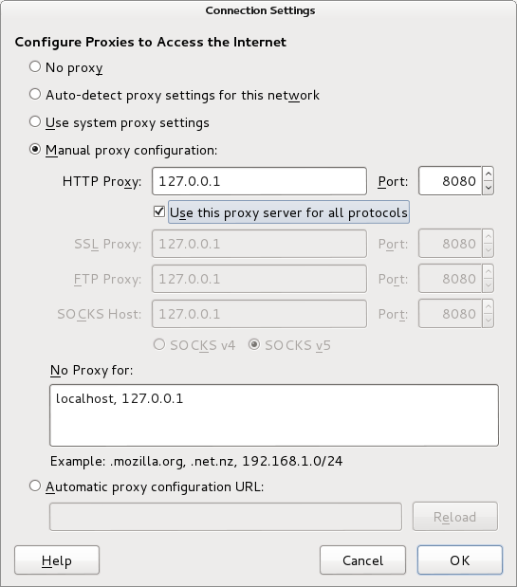
Configuring the Network Proxy

Slide 74
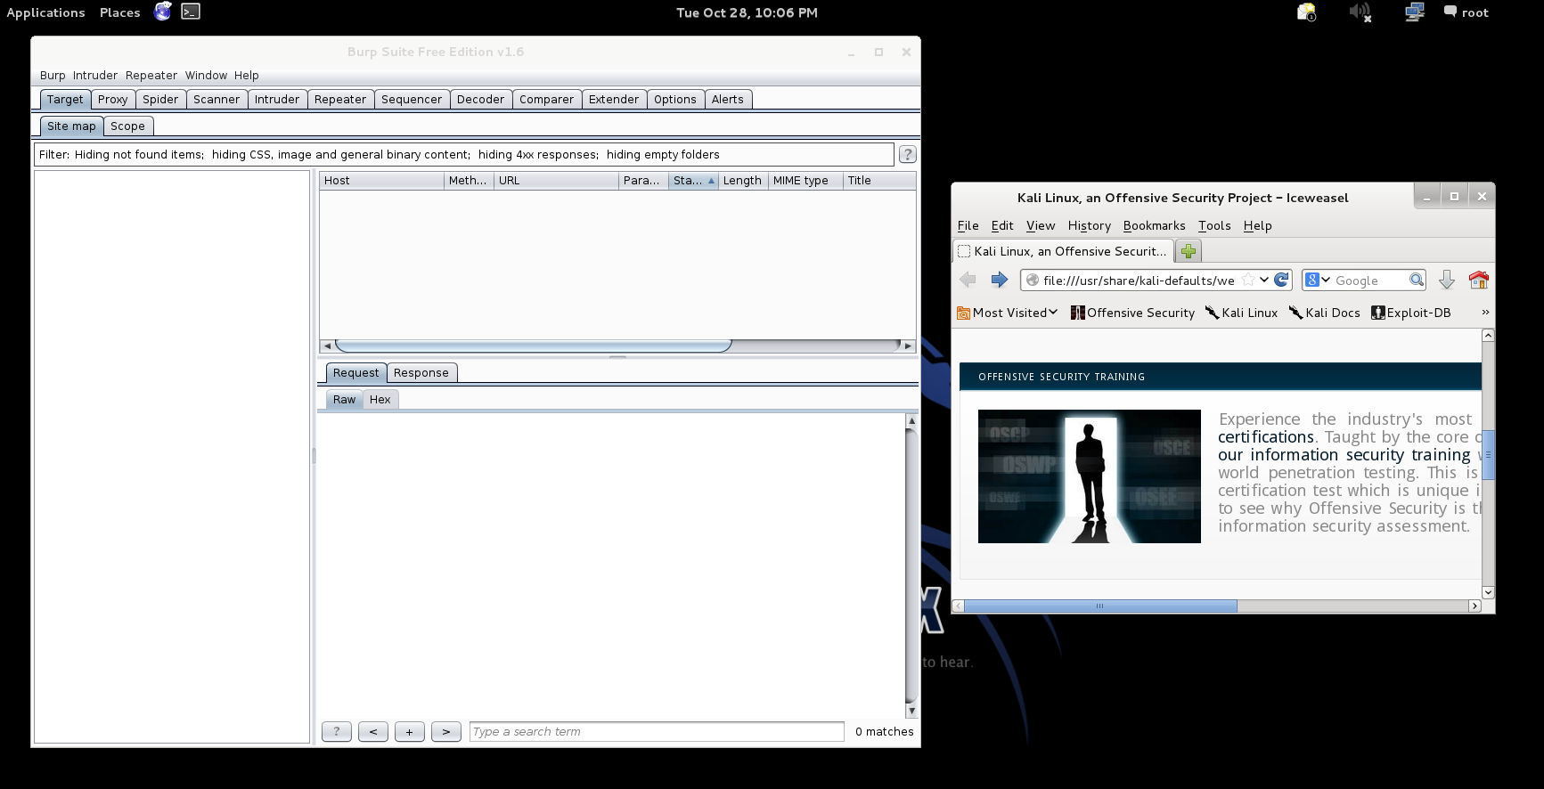
Should Look Like This

Slide 75
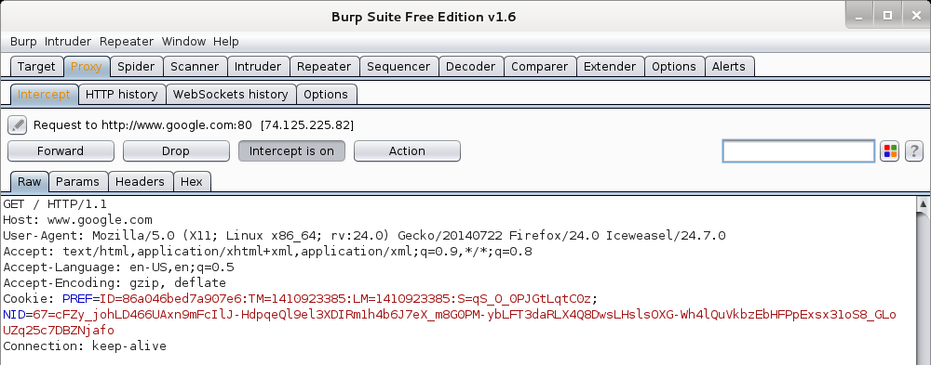
Now We Can Test
In browser, navigate to google.com
Browser will hang and look busy
Select the “Proxy” tab in burpsuite
Burpsuite is waiting for you, select forward

Slide 76
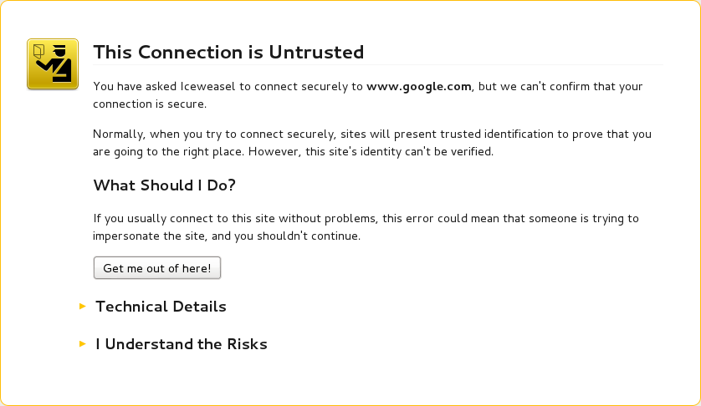
Browser Knows Something is Up
Select “I understand the Risks” and follow prompts to add an exception

Slide 77
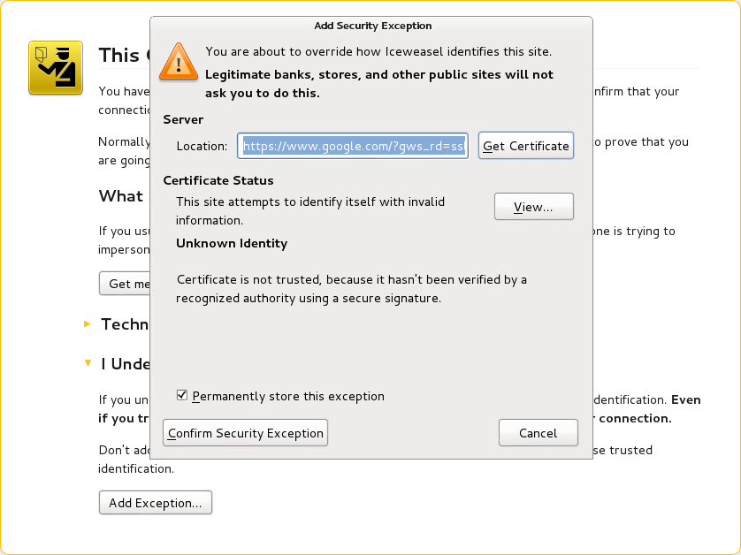
Browser Knows Something is Up

Slide 78
Continuing
You may have to hit forward a number of times
You may want to click “Intercept is on” to turn it off and save hitting the forward button
Eventually, all traffic is forwarded.
Now, select “HTTP history” and see what you have

Slide 79
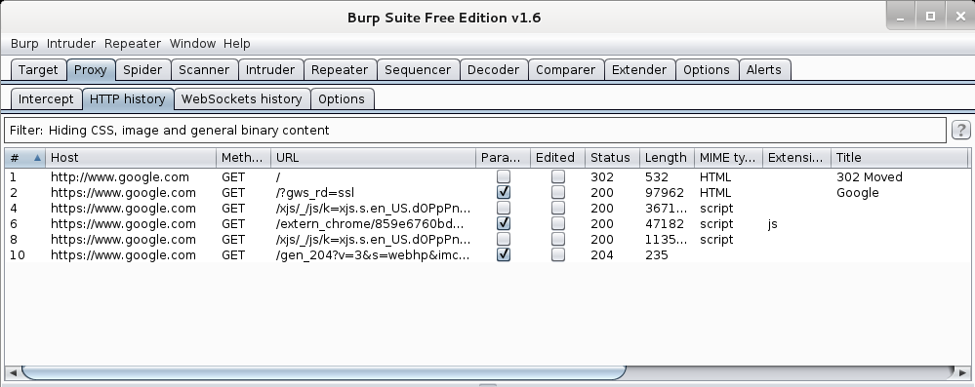
Results
Your traffic

Slide 80
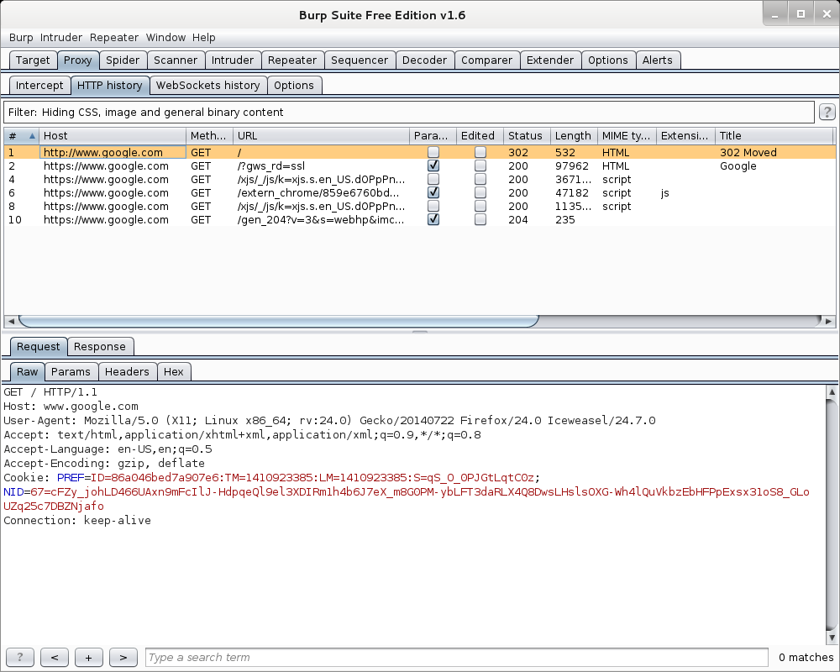
More Results

Slide 81
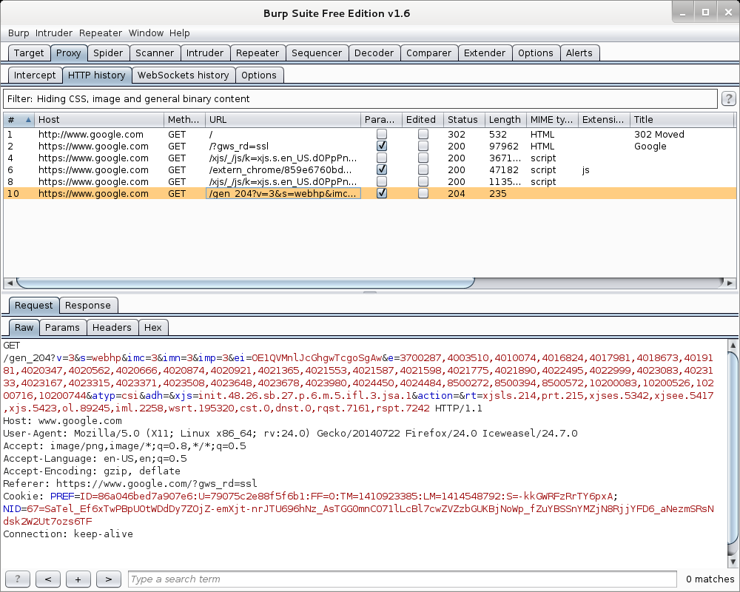
More Results

Slide 82
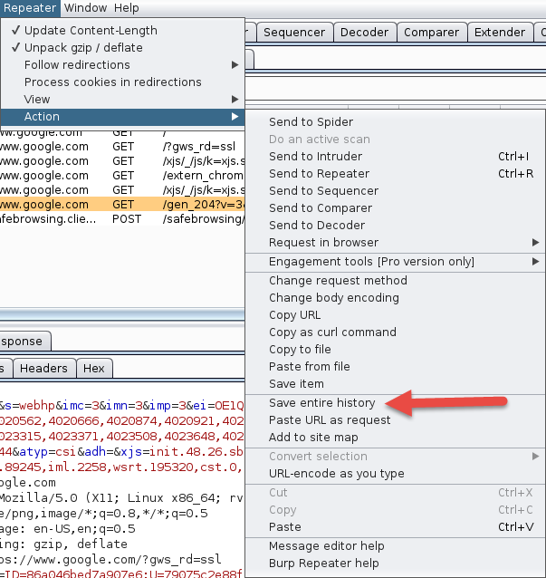
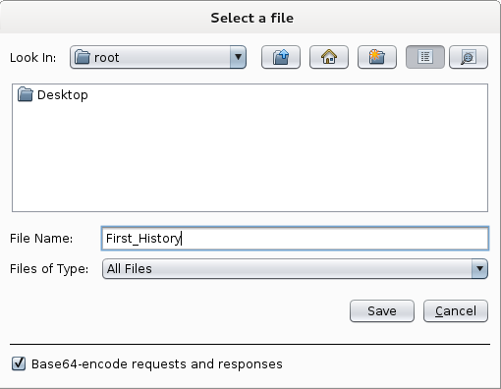
Saving Our Results
Under “Repeater”, select “Action”, then select “Save Entire History”

Slide 83
Now, Lets Go Somewhere More Interesting
Restart burpsuite and turn intercept off
Now navigate to temple.edu and look around the sitetemple.edu
Look over the results

Slide 84
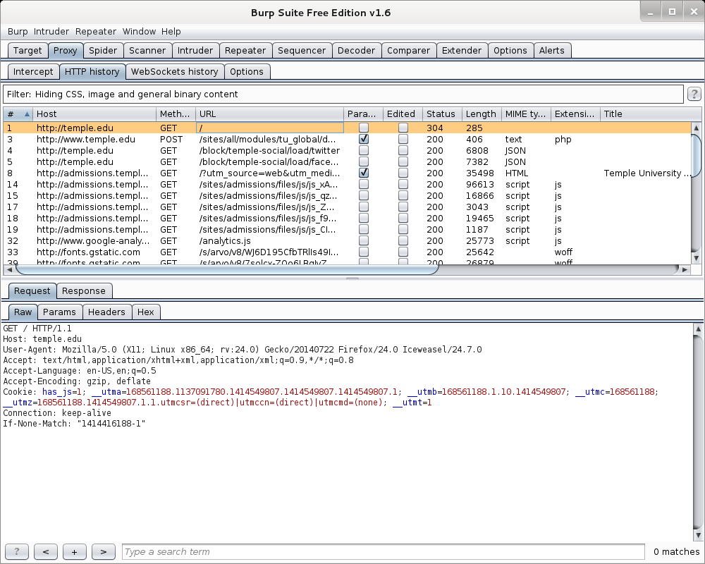
Temple.edu

Slide 85
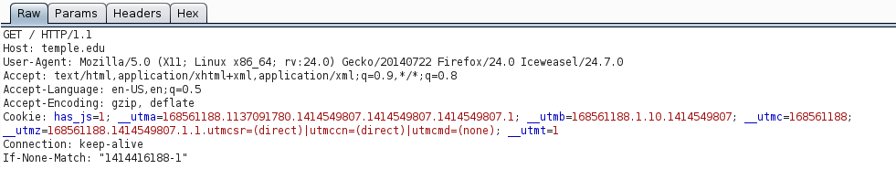
Some Basics
What can we tell from this?
First we can see what we are telling temple about us
  Web Browser is Iceweasel, a derivative of Firefox
  What versions we are running
  Cookies
  What exactly is If-None-Match: “1414416188-1”

Slide 86
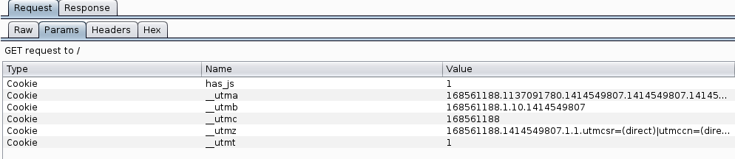
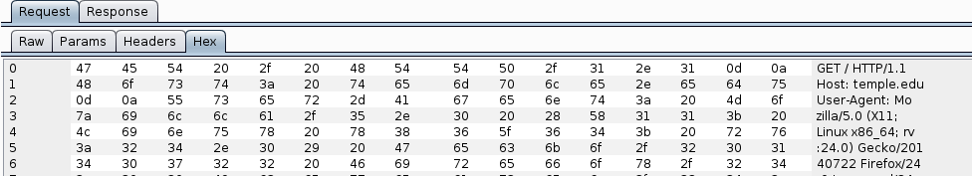
But Wait, There’s More
As Darth Vader says “Come to the Dark Side, We’ve got Cookies”
Or worse “Hex”

Slide 87
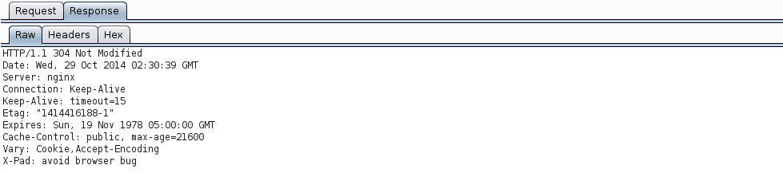
We’ve Got Both Sides
Note: There’s both a request and a response tab.

Slide 88
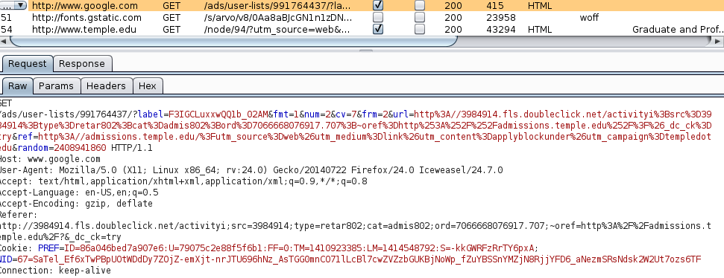
A Few Interesting Things
Google Adds
Other outside references

Slide 89
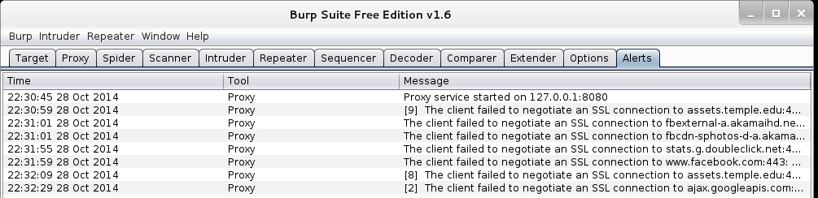
Check The Alerts
A few things to look at

Slide 90
What Now
If this was a real Web App Test
  Navigate the web site recording everything
  Review looking for interesting leads to follow
  Set Proxy to crawl site (DO NOT DO THIS)

Slide 91
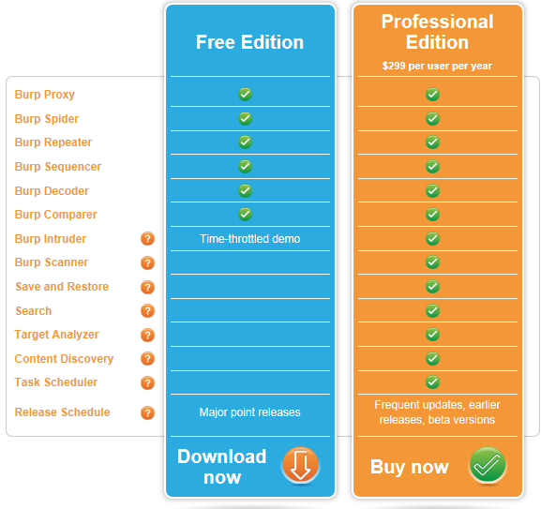
If Few More Things
This is the “Free” version of burpsuite
Some of the more interesting features are turned off or limited
  Scanner
  Intruder
http://portswigger.net/burp/download.html

Slide 92
If Few More Things
We covered just one proxy
Different proxies have different strengths and weaknesses
For instance, Webscarab will flag potential XSS automatically

Slide 93
Poor Man's Substitute
In Internet Explorer
  F12 Developer Tools
  Allows user to at least see the code loaded in browser
  Often worth looking at as developers sometimes leave comments

Slide 94
Next Week
Introduction to SQL Injection

Slide 95
Questions
?

