Slide 1
Intro to Ethical Hacking
MIS 5211.001
Week 11
Site: http://community.mis.temple.edu/mis5211sec001f15/

Slide 2
Tonight's Plan
In the news
Student Presentations
SQL Injection

Slide 3
In The News
Submitted
  http://www.scmagazine.com/hacker-group-claims-to-have-looted-100k-via-sql-injection-attack/article/317412/
  http://www.ehackingnews.com/2015/11/attackers-used-sql-injection-flaw-to.html
  http://www.zdnet.com/article/dark-mail-debut-to-open-door-for-lavabit-return-ladar-levison/
  http://www.securityweek.com/russian-hackers-target-industrial-control-systems-us-intel-chief
  http://www.bbc.com/news/technology-34677323 (TOR Anti-Censorship)
  https://www.washingtonpost.com/news/the-intersect/wp/2015/11/02/how-anonymouss-big-kkk-dump-got-muddled-before-it-even-began/
  http://www.scmagazineuk.com/ransomwares-new-threat-if-you-dont-pay-well-publish-your-photos-online/article/451304/

Slide 4
In The News
Submitted
  http://thehackernews.com/2015/11/german-atm-hack.html

Slide 5
In The News
What I noted
  http://www.theregister.co.uk/2015/10/29/google_symantec_dodgy_certs/

Slide 6
Web Applications Continued

Slide 7
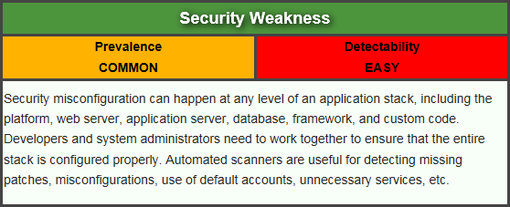
Security Misconfiguration
Attacker accesses default accounts, unused pages, unpatched flaws, unprotected files and directories, etc. to gain unauthorized access to or knowledge of the system.
https://www.owasp.org/index.php/Top_10_2013-A5-Security_Misconfiguration

Slide 8
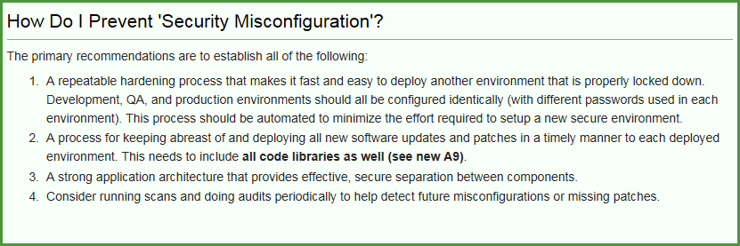
Security Misconfiguration
  Remember those Google searches from Reconnaissance? For instance: intitle:"Test Page for Apache"

Slide 9
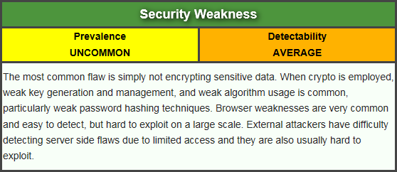
Sensitive Data Exposure
Attackers typically don’t break crypto directly. They break something else, such as steal keys, do man-in-the-middle attacks, or steal clear text data off the server, while in transit, or from the user’s browser.
https://www.owasp.org/index.php/Top_10_2013-A6-Sensitive_Data_Exposure

Slide 10
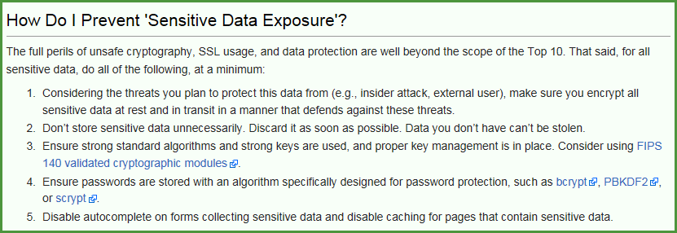
Sensitive Data Exposure
Example: A site simply doesn’t use SSL for all authenticated pages. Attacker simply monitors network traffic (like an open wireless network), and steals the user’s session cookie.

Slide 11
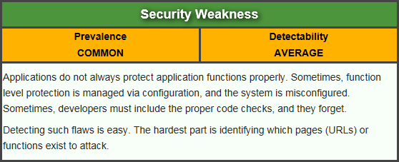
Missing Function Level Access Control
Attacker, who is an authorized system user, simply changes the URL or a parameter to a privileged function. Is access granted? Anonymous users could access private functions that aren’t protected.
https://www.owasp.org/index.php/Top_10_2013-A7-Missing_Function_Level_Access_Control

Slide 12
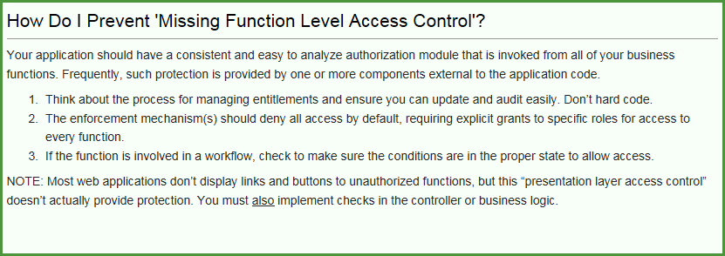
Missing Function Level Access Control
Example from OWASP:
  http://example.com/app/getappInfo
  http://example.com/app/admin_getappInfo

Slide 13
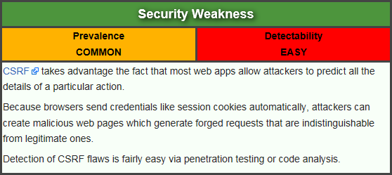
Cross-Site Request Forgery (CSRF)
Attacker creates forged HTTP requests and tricks a victim into submitting them via image tags, XSS, or numerous other techniques. If the user is authenticated, the attack succeeds.
https://www.owasp.org/index.php/Top_10_2013-A8-Cross-Site_Request_Forgery_(CSRF)

Slide 14
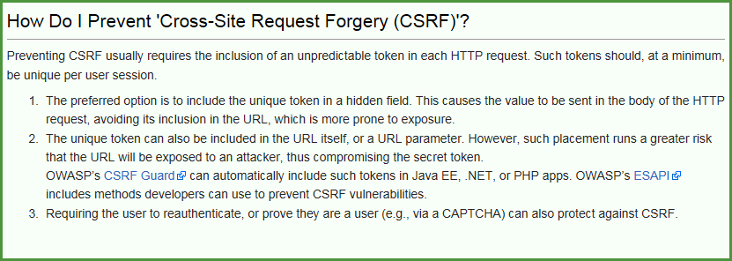
Cross-Site Request Forgery (CSRF)
Example from OWASP
  http://example.com/app/transferFunds?amount=1500&destinationAccount=4673243243
  <img src="http://example.com/app/transferFunds?amount=1500&destinationAccount=attackersAcct#" width="0" height="0" />

Slide 15
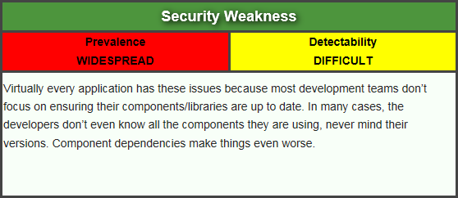
Using Components with Known Vulnerabilities
Attacker identifies a weak component through scanning or manual analysis. He customizes the exploit as needed and executes the attack. It gets more difficult if the used component is deep in the application.
https://www.owasp.org/index.php/Top_10_2013-A9-Using_Components_with_Known_Vulnerabilities

Slide 16
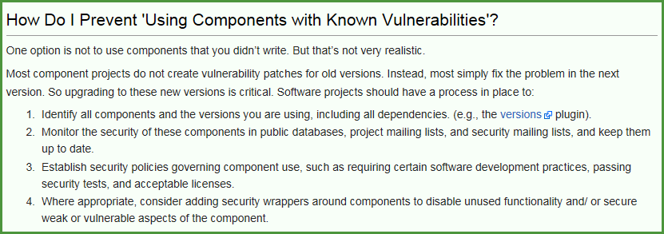
Using Components with Known Vulnerabilities
Example from OWASP
  Spring Remote Code Execution – Abuse of the Expression Language implementation in Spring allowed attackers to execute arbitrary code, effectively taking over the server.

Slide 17
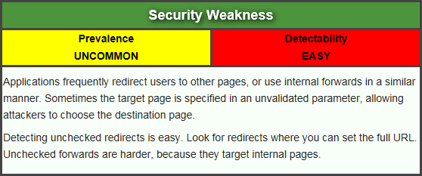
Unvalidated Redirects and Forwards
Attacker links to unvalidated redirect and tricks victims into clicking it. Victims are more likely to click on it, since the link is to a valid site. Attacker targets unsafe forward to bypass security checks.
https://www.owasp.org/index.php/Top_10_2013-A10-Unvalidated_Redirects_and_Forwards

Slide 18
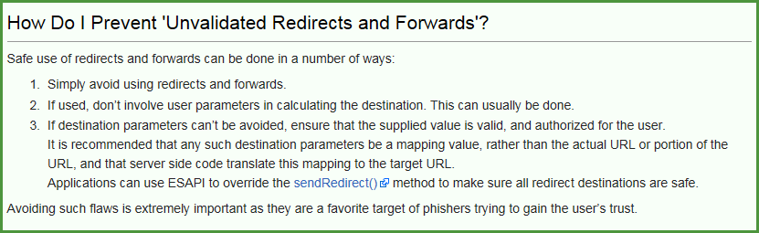
Unvalidated Redirects and Forwards
Example from OWASP
  http://www.example.com/redirect.jsp?url=evil.com

Slide 19
Now What
So, all of this is interesting, but what does that have to do with penetration testing
Or, to put it another way. How de we exploit these issues?
First step:
Intercepting Proxies

Slide 20
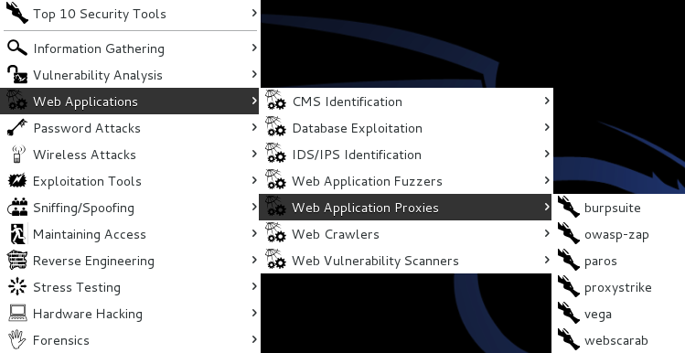
What’s an Intercepting Proxy
In this instance, an intercepting proxy is software that acts as a server and sits between the web browser and your internet connection
Examples
  Burp Suite
  Webscarab
  Paros

Slide 21
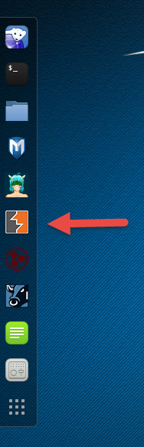
Kali 2.0 Version

Slide 22
Some Rules for Our Use of Intercepting Proxies
For this course
Monitor and record ONLY
Do not inject or alter any traffic unless you personally own the web site.
We’ll save changing traffic in the next course
For this course

Slide 23
Burp Suite
Start Burp Suite by logging in to Kali and selecting Burp Suite from:
Kali Linux>Web Applications>Web Application Proxies>burpsuite

Slide 24
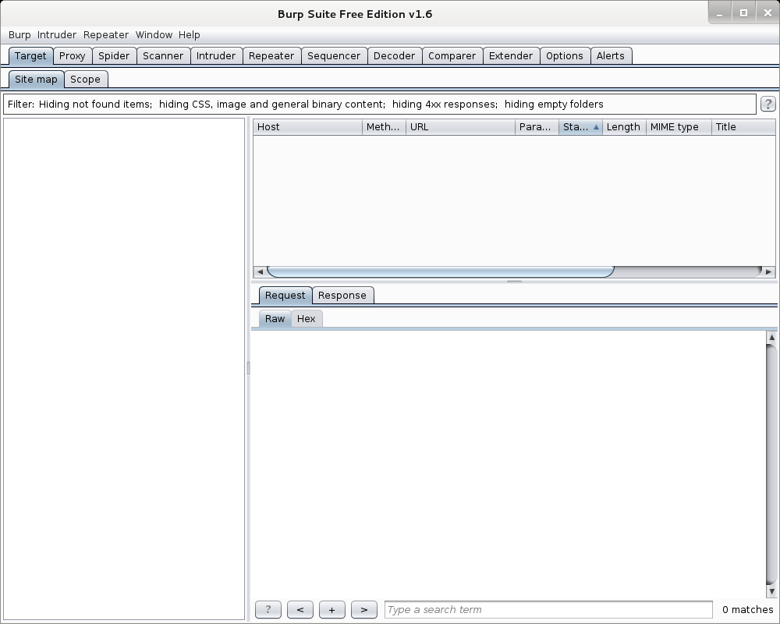
Burp Suite

Slide 25
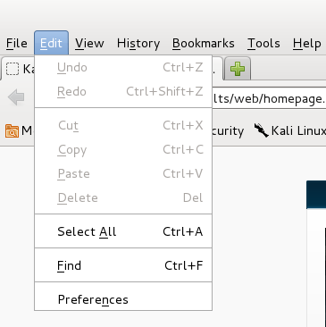
Getting Started
Once burpsuite is running, you will need to start and configure a browser
Kali’s web browser is “Iceweasel”, an adaptation of Firefox
After starting Iceweasel, navigate to preferences
And select it

Slide 26
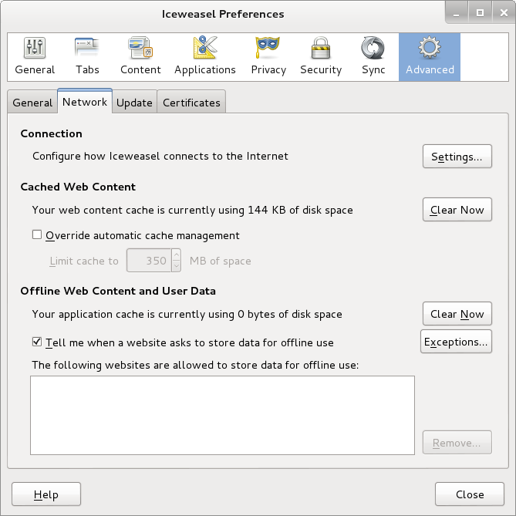
Configuring the Network Proxy
Navigate to the Network Tab and select settings… for Connection

Slide 27
Configuring the Network Proxy
Change selection from “Use system proxy settings” to “Manual proxy configuration and enter “127.0.0.1” for “HTTP Proxy” and “8080” for “Port”
Also, select check box for “Use this proxy server for all protocols”
Select “OK” when done
Browser is now setup to use burpsuite
See next slide for example

Slide 28
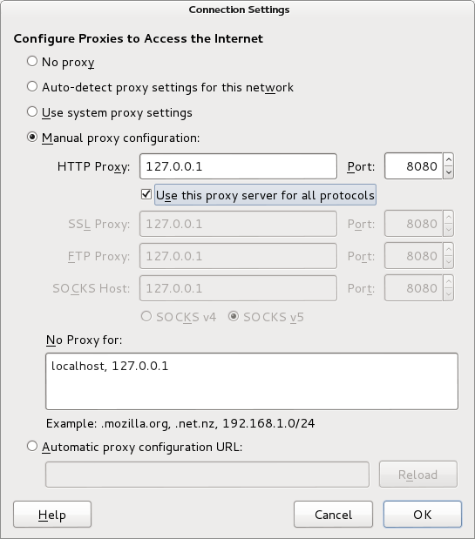
Configuring the Network Proxy

Slide 29
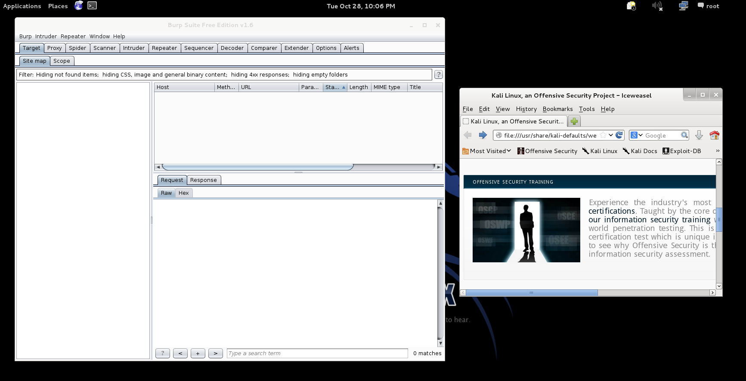
Should Look Like This

Slide 30
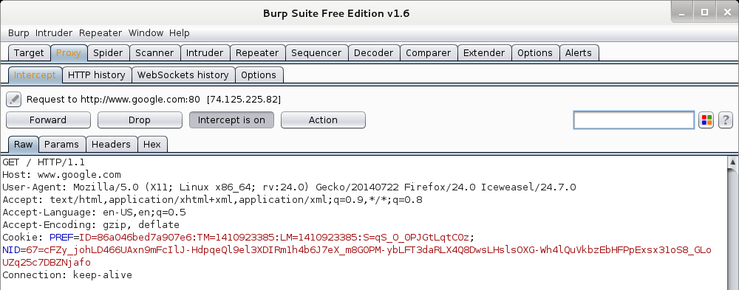
Now We Can Test
In browser, navigate to google.com
Browser will hang and look busy
Select the “Proxy” tab in burpsuite
Burpsuite is waiting for you, select forward

Slide 31
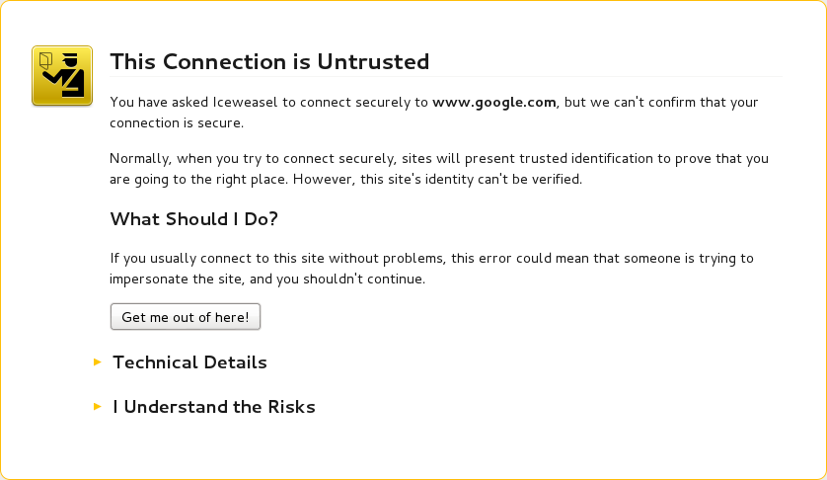
Browser Knows Something is Up
Select “I understand the Risks” and follow prompts to add an exception

Slide 32
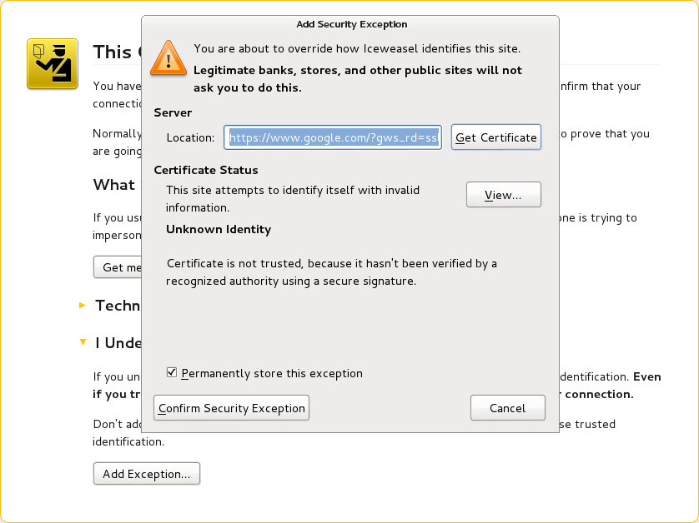
Browser Knows Something is Up

Slide 33
Continuing
You may have to hit forward a number of times
You may want to click “Intercept is on” to turn it off and save hitting the forward button
Eventually, all traffic is forwarded.
Now, select “HTTP history” and see what you have

Slide 34
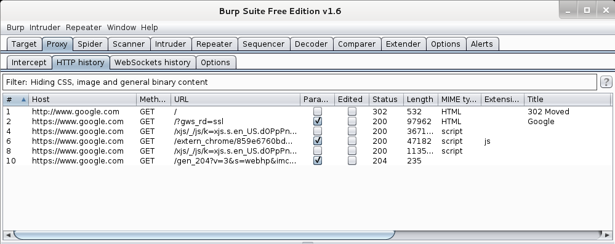
Results
Your traffic

Slide 35
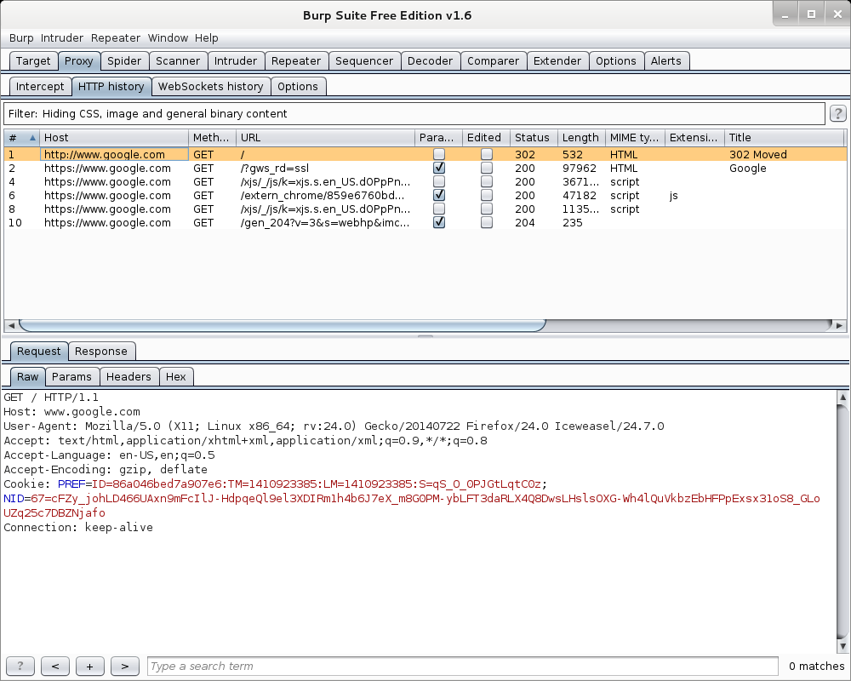
More Results

Slide 36
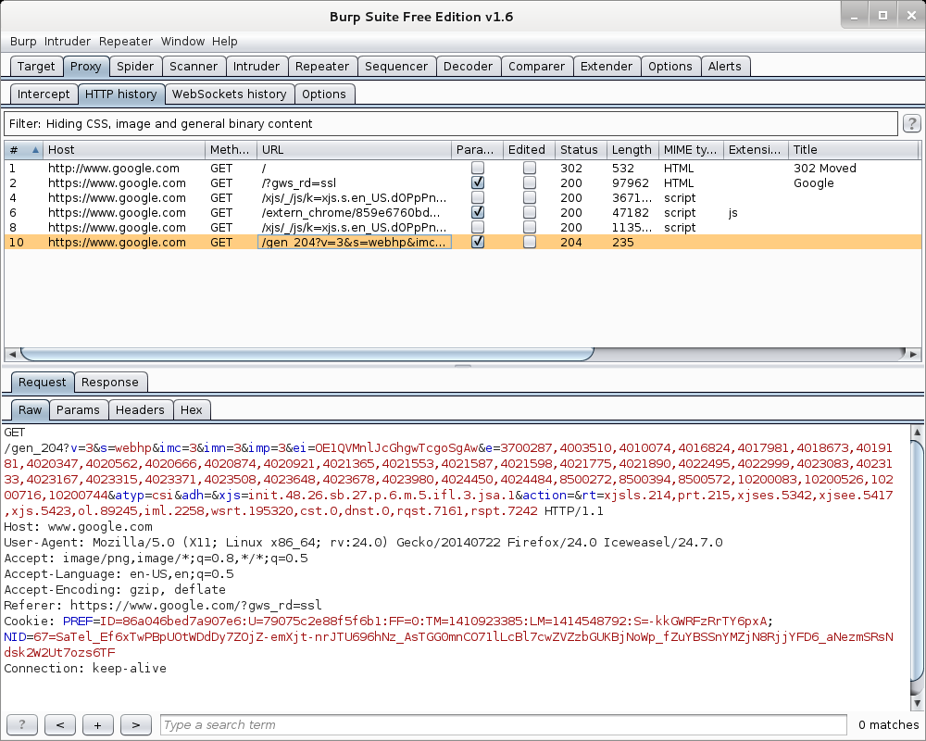
More Results

Slide 37
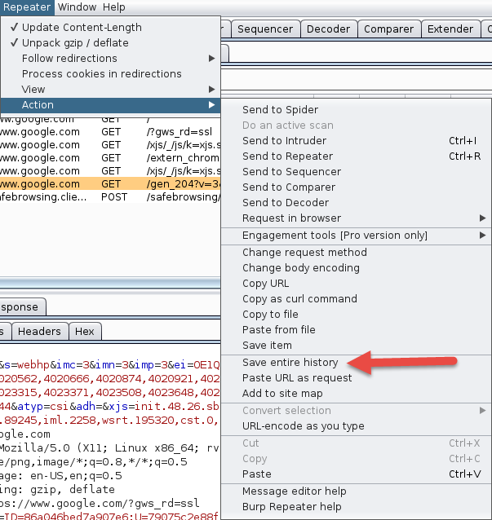
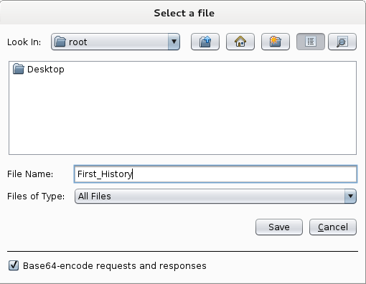
Saving Our Results
Under “Repeater”, select “Action”, then select “Save Entire History”

Slide 38
Now, Lets Go Somewhere More Interesting
Restart burpsuite and turn intercept off
Now navigate to temple.edu and look around the sitetemple.edu
Look over the results

Slide 39
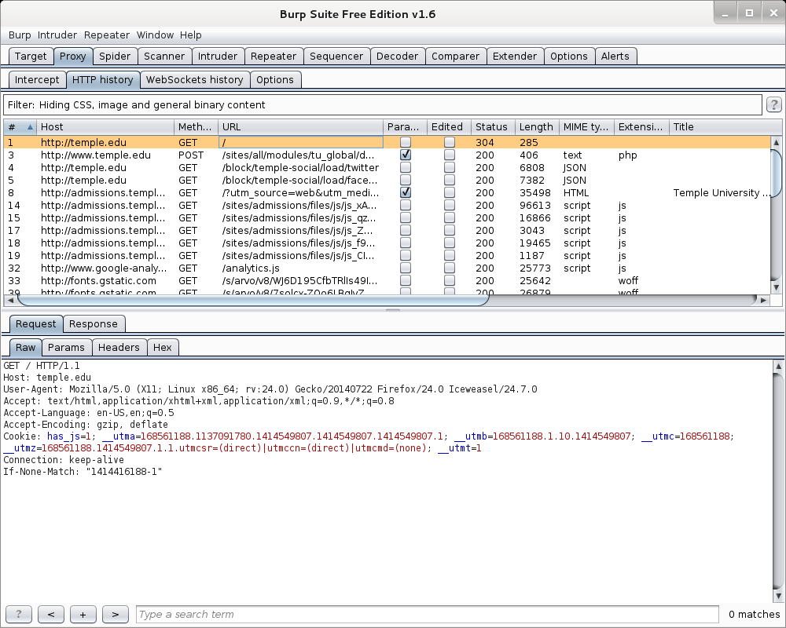
Temple.edu

Slide 40
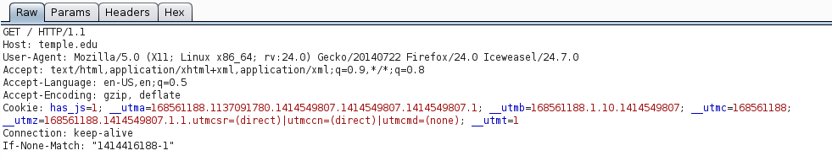
Some Basics
What can we tell from this?
First we can see what we are telling temple about us
  Web Browser is Iceweasel, a derivative of Firefox
  What versions we are running
  Cookies
  What exactly is If-None-Match: “1414416188-1”

Slide 41
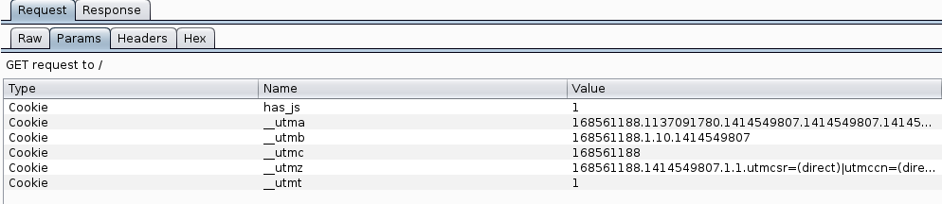
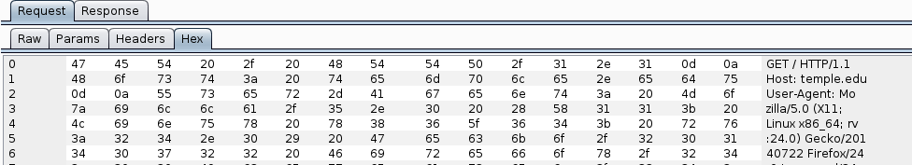
But Wait, There’s More
As Darth Vader says “Come to the Dark Side, We’ve got Cookies”
Or worse “Hex”

Slide 42
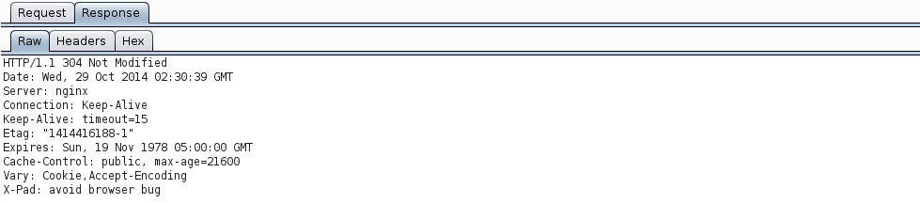
We’ve Got Both Sides
Note: There’s both a request and a response tab.

Slide 43
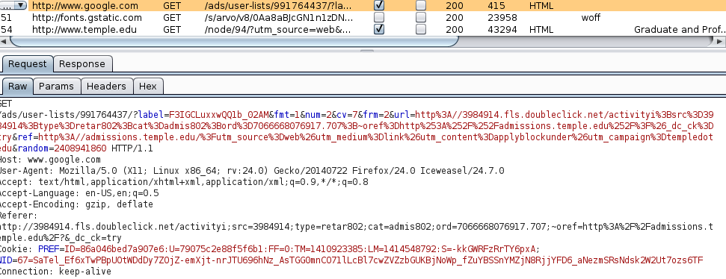
A Few Interesting Things
Google Adds
Other outside references

Slide 44
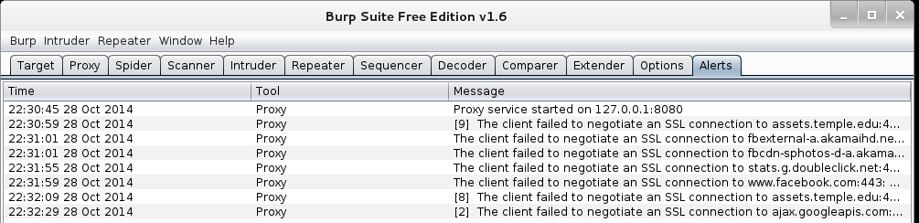
Check The Alerts
A few things to look at

Slide 45
What Now
If this was a real Web App Test
  Navigate the web site recording everything
  Review looking for interesting leads to follow
  Set Proxy to crawl site (DO NOT DO THIS)

Slide 46
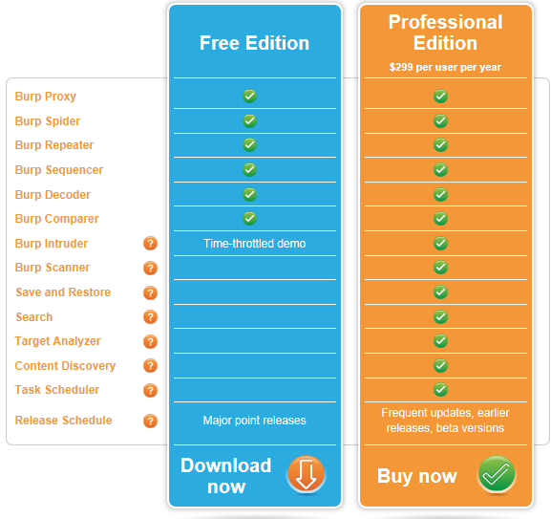
If Few More Things
This is the “Free” version of burpsuite
Some of the more interesting features are turned off or limited
  Scanner
  Intruder
http://portswigger.net/burp/download.html

Slide 47
If Few More Things
We covered just one proxy
Different proxies have different strengths and weaknesses
For instance, Webscarab will flag potential XSS automatically

Slide 48
Poor Man's Substitute
In Internet Explorer
  F12 Developer Tools
  Allows user to at least see the code loaded in browser
  Often worth looking at as developers sometimes leave comments

Slide 49
On to SQL Injection

Slide 50
SQL Injection
We are going to cover some “Basics”
SQL Injection is a subset of the general flaw “Injection” covered last week
Client supplied data passed to an application without appropriate data validation
Processed as commands by the database
Remember in all of this that we can also use the intercepting proxy to “add” text the browser doesn’t want to accept

Slide 51
Frequently Used To:
Perform operations on the database
Bypass authentication mechanisms
Read otherwise unavailable information from the database
Write information such as new user accounts to the database

Slide 52

Caution
Do not use your powers for evil.
Ultimately, the reason for covering these attacks is to teach you how to prevent them.
Well established sites are generally hardened to this type of attack.
You might cause irreparable harm to a small “mom-and-pop” business.
Even if you don’t, breaking into someone else’s database is illegal and unethical.

Slide 53
Brief SQL Review
Querying tables:
select column1, column2 from table_name;
or
select * from table_name;
Conditions:
select columns from table_name where condition;

Slide 54
Brief SQL Review
Inserting new rows:
  insert into table_name values (value1, value2);
  or
  insert into table_name set column1=value1, column2=value2, ...;
Updating rows:
  update table_name set column1=value1 where condition;

Slide 55
Brief SQL Review
Deleting rows:
  delete from table_name where condition;
Set values in conditions:
  select * from table_name
  where column in (select_statement);
or
  select * from table_name
  where column in (value1, value2, ...);

Slide 56
Brief SQL Review
Joining tables:
  select * from table1, table2 where table1.attribute1 = table2.attribute2;
Built-in Functions
  select count(*) from test;

Slide 57
Brief SQL Review
Pattern Matching
select * from test where a like '%c_t%';
Other Keywords
select * from test where a is null;
Metadata Tables
  Highly vendor-specific
  Available tables, table structures are usually stored in some reserved table name(s).

Slide 58
Form Specific to Version
Different Vendor’s Databases use different forms
May want to use reconn techniques to determine which database is in use
What follows are some general techniques

Slide 59
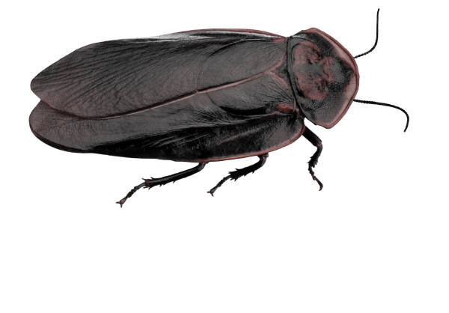
Finding SQL Injection Bugs
Submit a single quote (‘), this is used in SQL as a string terminator and, if not filtered by the application, would lead to an incorrect query
Submit a semicolon (;) this is used to end a SQL statement and, if it is not filtered, it is also likely to generate an error
In either case:
  If an error results, app is vulnerable.
  If no error, check for any output changes.

Slide 60
Finding SQL Injection Bugs
Can also try
  Submit two single quotes (‘’).
    Databases use ’’ to represent literal ’
    If error disappears, app is vulnerable
  Comment deliminators (-- or /* */, etc)
  SQL keywords like ‘AND’ and ‘OR’
  String where a number is expected
    Might also slip by SQL Injection detection system

Slide 61
Simple Example
Assume actual SQL is
  SELECT * FROM Users WHERE Username='$username' AND Password='$password‘
Now consider
  $username = 1' or '1' = '1
  $password = 1' or '1' = '1
Becomes
  SELECT * FROM Users WHERE Username='1' OR '1' = '1' AND Password='1' OR '1' = '1'
https://www.owasp.org/index.php/Testing_for_SQL_Injection_(OTG-INPVAL-005)

Slide 62
Simple Example (2)
Assume actual SQL is
  SELECT * FROM products WHERE id_product=$id_product
  Or
  http://www.example.com/product.php?id=10
Now consider:
  http://www.example.com/product.php?id=10 AND 1=2
If you get a response that there are no matches try:
  http://www.example.com/product.php?id=10 AND 1=1

Slide 63
Fingerprinting Databases
Look at your error messages
MySQL
  You have an error in your SQL syntax; check the manual that corresponds to your MySQL server version for the right syntax to use near '\'' at line 1
SQL Server
  ORA-00933: SQL command not properly ended
PostgresSQL
  Query failed: ERROR: syntax error at or near "’" at character 56 in /www/site/test.php on line 121.

Slide 64
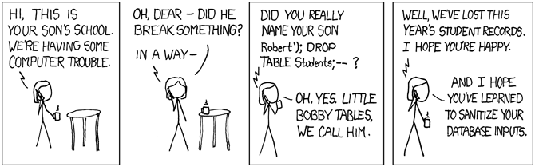
Famous SQL Humor
http://xkcd.com/327/

Slide 65
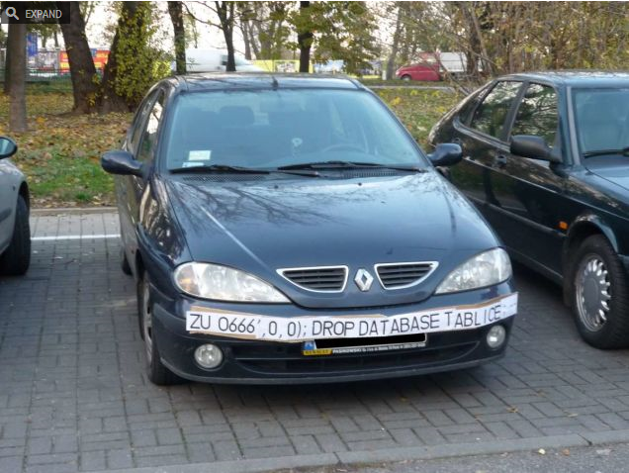
Famous SQL Humor
http://gizmodo.com/5498412/sql-injection-license-plate-hopes-to-foil-euro-traffic-cameras

Slide 66
Next Week
Web Services

Slide 67
Questions
?

