Slide 1
Intro to Ethical Hacking
MIS 5211.001
Week 5
Site: http://community.mis.temple.edu/mis5211sec001fall17/

Slide 2
Tonight's Plan
Questions from last week
Nessus
Next Week

Slide 3
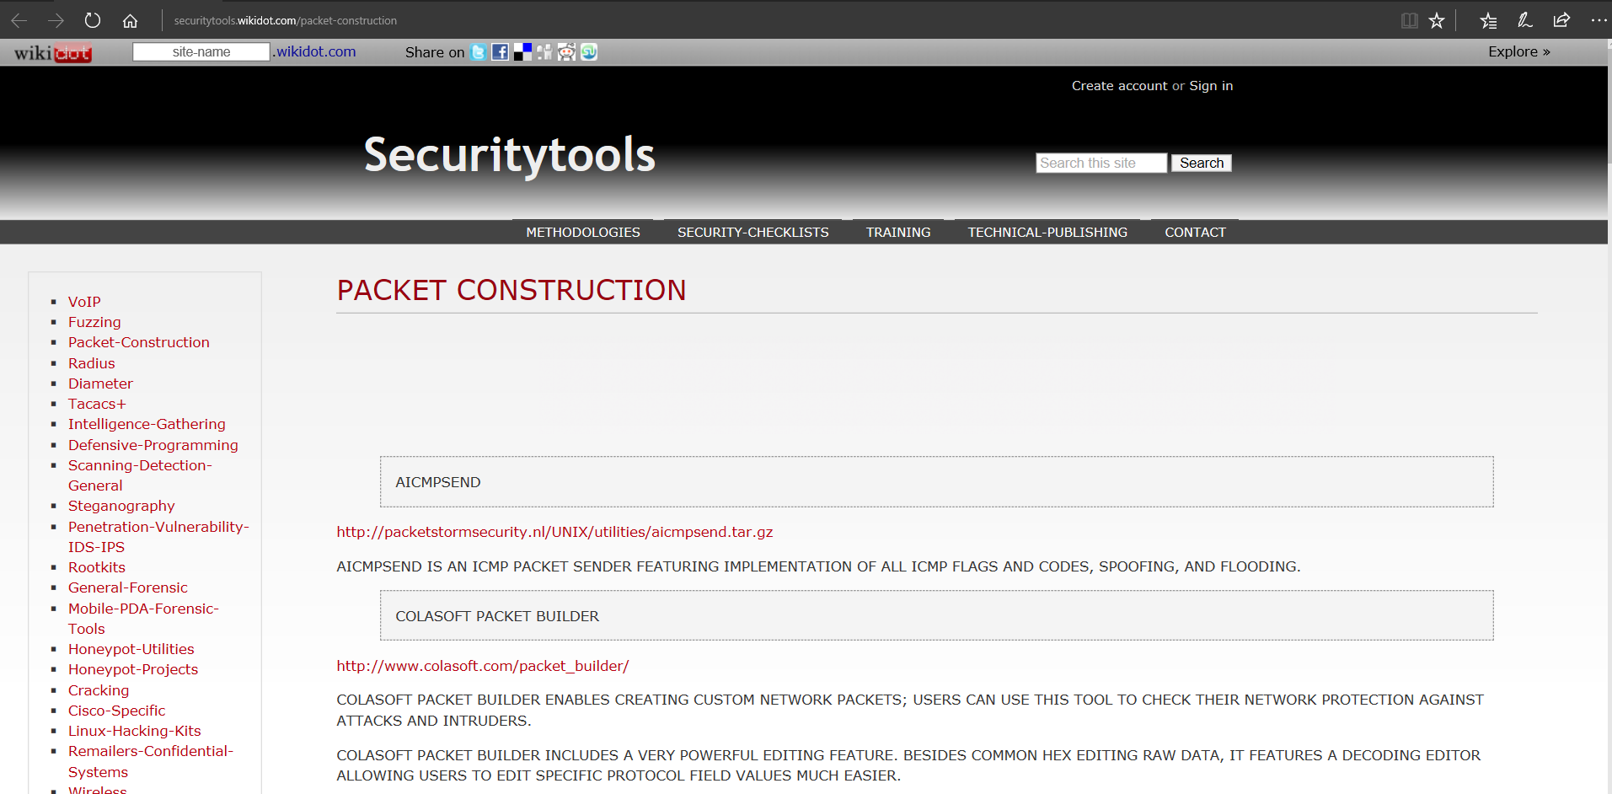
Packet Construction Tools
The tool I spoke of last week is SCAPY
http://securitytools.wikidot.com/packet-construction

Slide 4
IPv6 Scanning
IPv6 fingerprinting
Nmap has a similar but separate OS detection engine specialized for IPv6
  Use the -6 and –O options

Slide 5
IPv6 Scanning
Nping – Comes with Nmap
https://nmap.org/book/nping-man-ip6-options.html
From the site
  Nping is an open-source tool for network packet generation, response analysis and response time measurement. Nping allows users to generate network packets of a wide range of protocols, letting them tune virtually any field of the protocol headers. While Nping can be used as a simple ping utility to detect active hosts, it can also be used as a raw packet generator for network stack stress tests, ARP poisoning, Denial of Service attacks, route tracing, and other purposes.

Slide 6
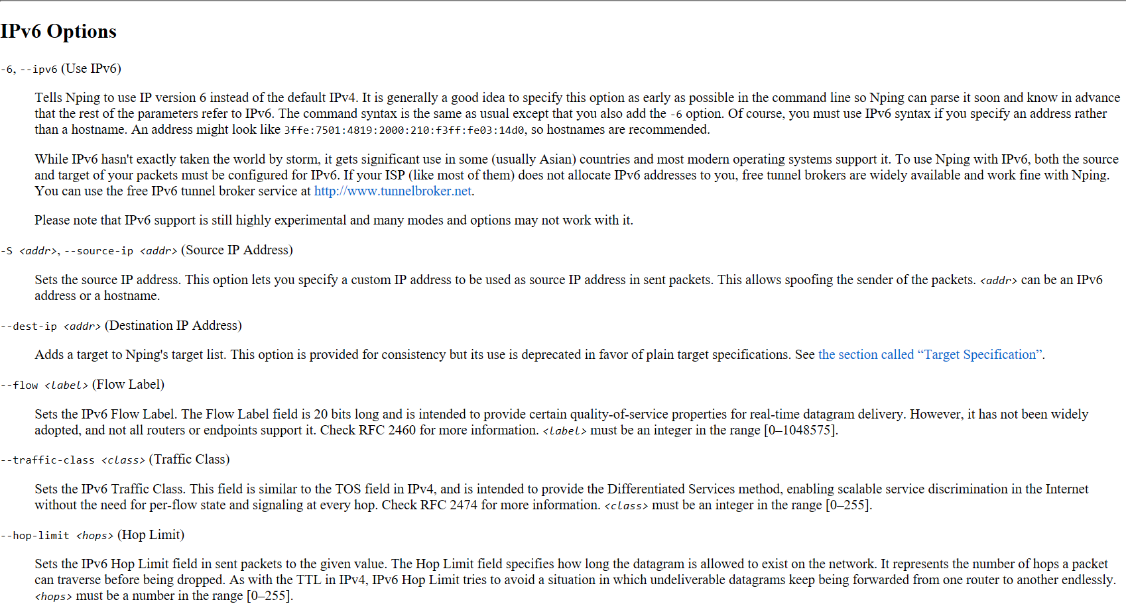

Slide 7
Nessus
Started in 1998 as an open source security scanning tool
Changed to a close sourced tool in 2005, but has remained “free” for personal use.
Surveys by sectools.org indicate Nessus remains the most popular vulnerability scanners
Not installed with Kali

Slide 8
The Nessus Server
Four basic parts to the Nessus server:
  Nessus-core
  Nessus-libraries
  Libnasl
  Nessus-plugins

Slide 9
Plugins
Plugins are the scripts that perform the vulnerability tests.
NASL – This is the Nessus Attack Scripting Language which can be used to write your own plugins.

Slide 10
Defining Targets
Hosts
  Server.domain.edu
  172.21.1.2
Subnet
  192.168.100.0
Address range
  192.168.1.1-192.168.1.10

Slide 11
Vulnerability Scanning
Scanning methods:
  Safe
  Destructive
Service recognition – Will determine what service is actually running on a particular port.
Handle multiple services – Will test a service if it appears on more then one port.
Will test multiple systems at the same time.

Slide 12
Viewing Reports
Nessus will indicate the threat level for services or vulnerabilities it detects:
  Critical
  High
  Medium
  Low
  Informational
Description of vulnerability
Risk factor
CVE number

Slide 13
Common Vulnerabilities and Exposures
CVE created by http://www.cve.mitre.org/
  Attempting to standardize the names for vulnerabilities.
CVE search engine at http://icat.nist.gov/
Notes:
SANS Institute Weekly Critical Vulnerability Analysis Report http://www.sans.org, also Reading Room and Internet Storm Center

Slide 14
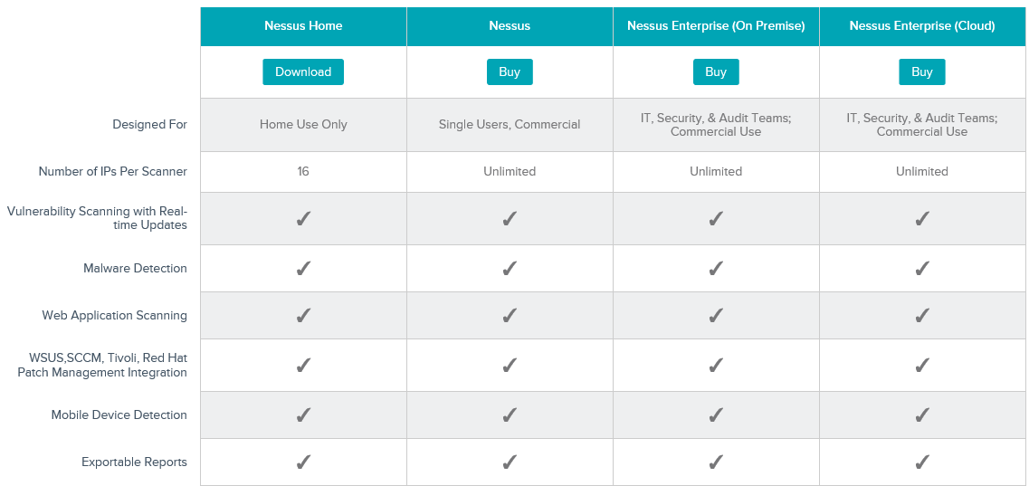
Options

Slide 15
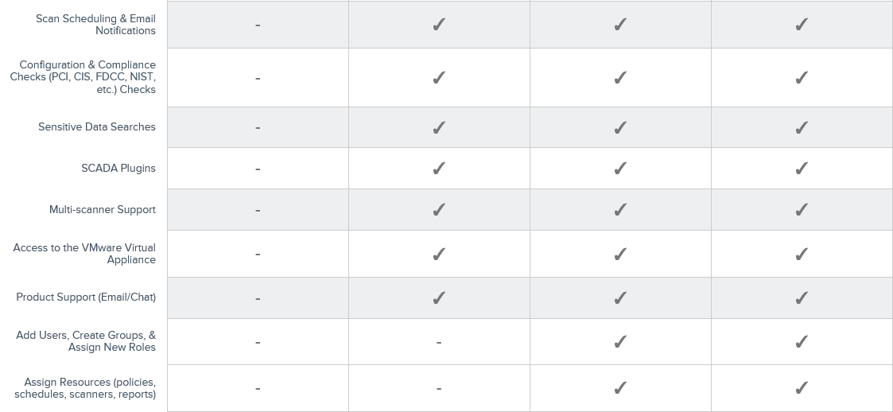
Options
http://www.tenable.com/products/nessus/select-your-operating-system

Slide 16
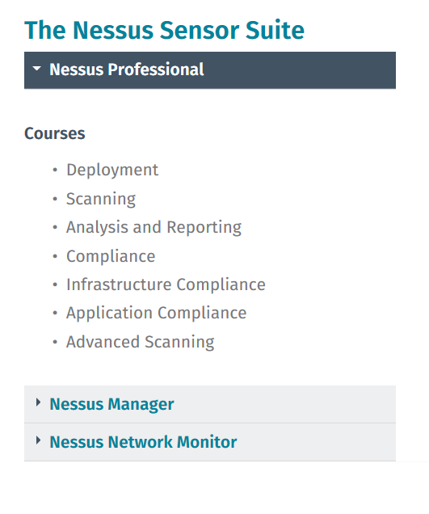
Free Training
http://www.tenable.com/education/on-demand-courses

Slide 17
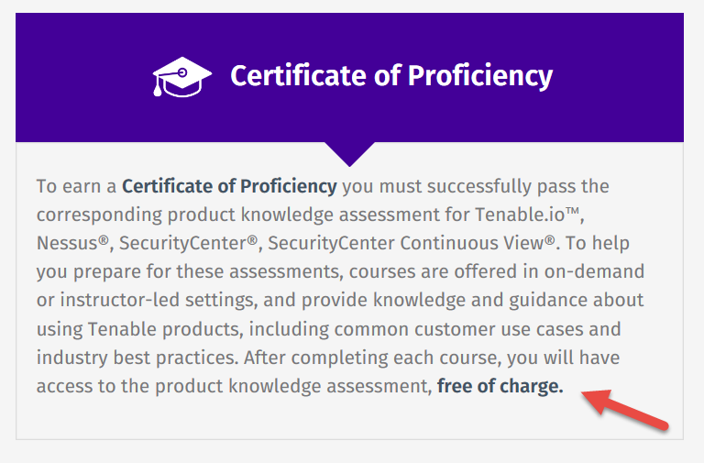
Certification Options
http://www.tenable.com/education/certification

Slide 18
Architecture
Nessus is built on a classic client/server model.
The server portion may reside on a separate machine, or on the same machine as the client
The client is the interface that you will interact with to execute scans

Slide 19
Getting Nessus
Download from Tenable Security
  http://www.tenable.com/products/nessus/select-your-operating-system
  Before installing, go to registration page and get the activation code
  http://www.tenable.com/products/nessus-home
Run the MSI package and follow the prompts
Install will also install PCAP and then take you to the registration page.
Enter activation code and follow the prompts to get updates and plugins

Slide 20
Documentation
Documentation for Nessus is available here:
  http://static.tenable.com/documentation/nessus_4.2_user_guide.pdf
You will also get a link to this location during the install.

Slide 21
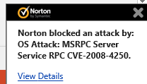
AV and Firewalls
You will need to turn off Anti-Virus and Firewall in order to get an effective scan or you will see this:
Before you do this, disconnect from any and all networks.
You will likely still get some blocking as AV doesn’t like to give up.

Slide 22
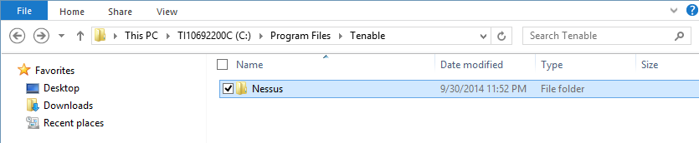
Location
Nessus is installed here:

Slide 23
Getting Started
You should end up looking at web page hosted from your machine.
Book mark the page to save time getting back
URL will look like this:
  https://localhost:8834/html5.html

Slide 24
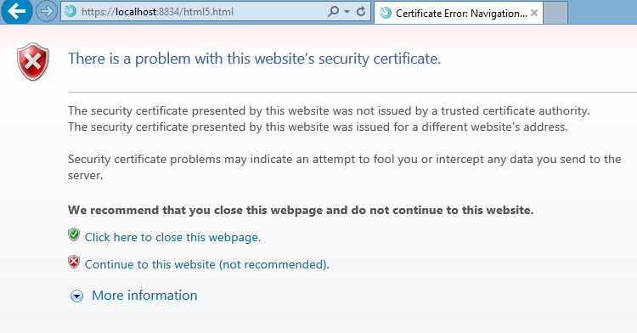
SSL Warning
When you first go to site, you will need to click on continue to the website.:

Slide 25
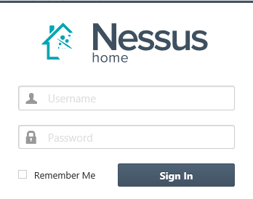
Logging In
Start

Slide 26
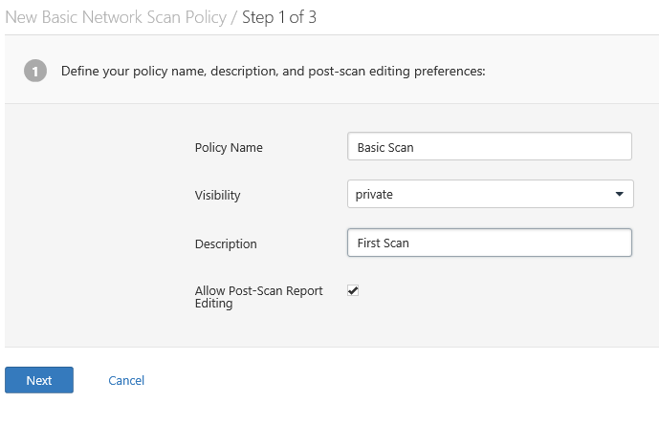
Policies
Scans are based on policies, you will need to create that first.

Slide 27
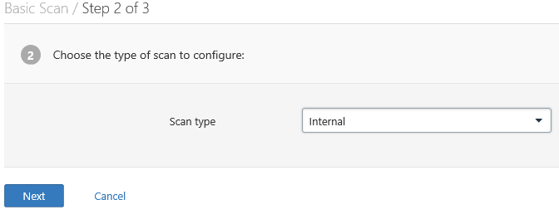
Policies 2
Next

Slide 28
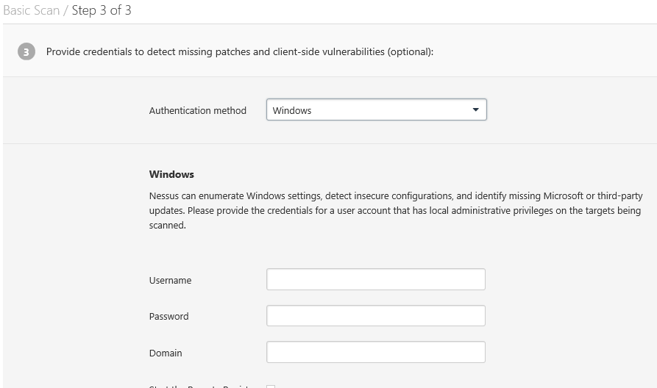
Policies 3

Slide 29
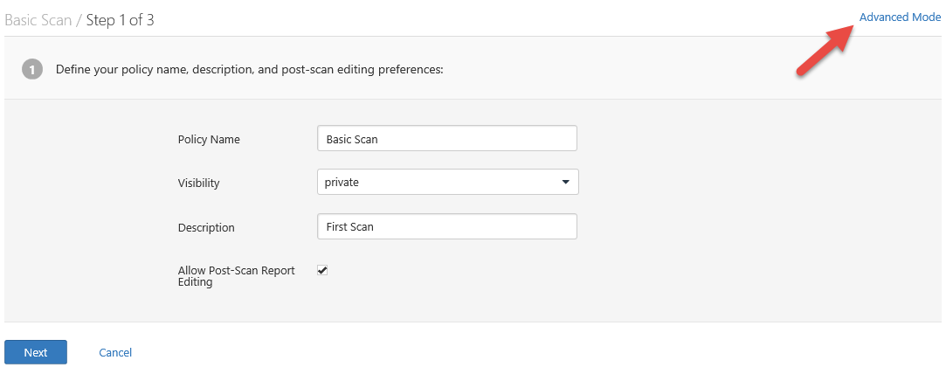
There are many more options

Slide 30
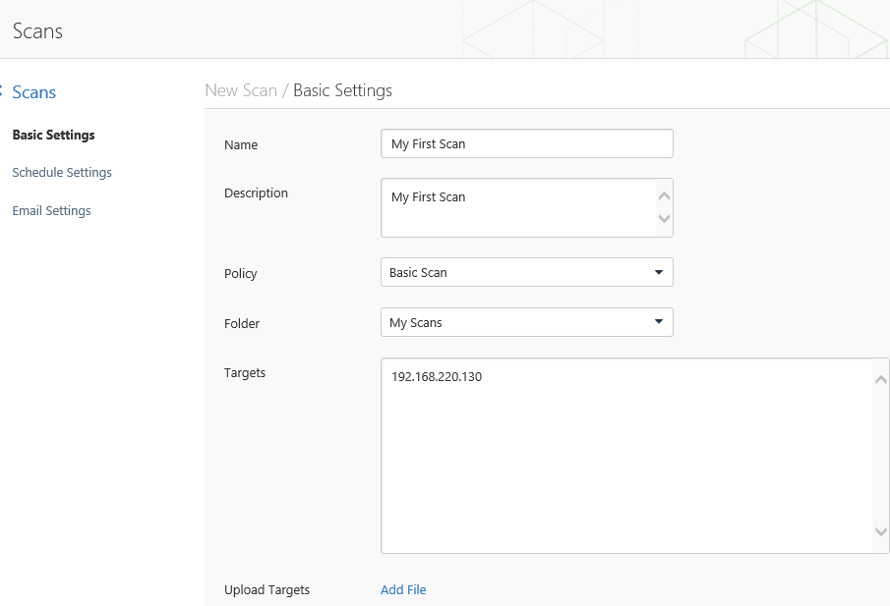
Creating A Scan

Slide 31
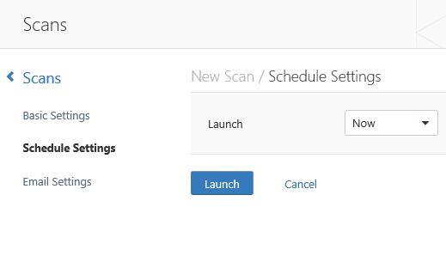
Scheduling A Scan

Slide 32
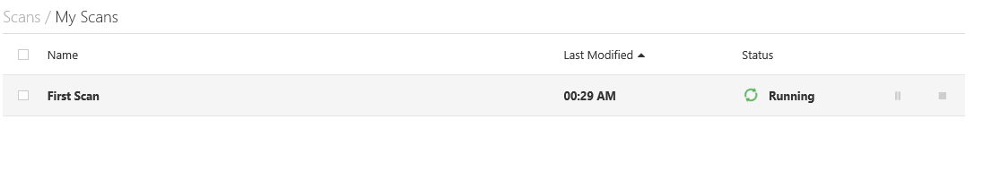
Scan Status
Once your scan has started you will see a status field like this:

Slide 33
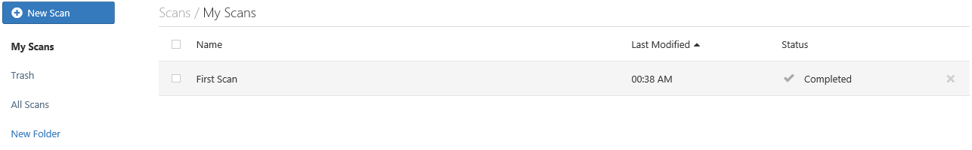
Scan Status
Once completed you will get the following notification:

Slide 34
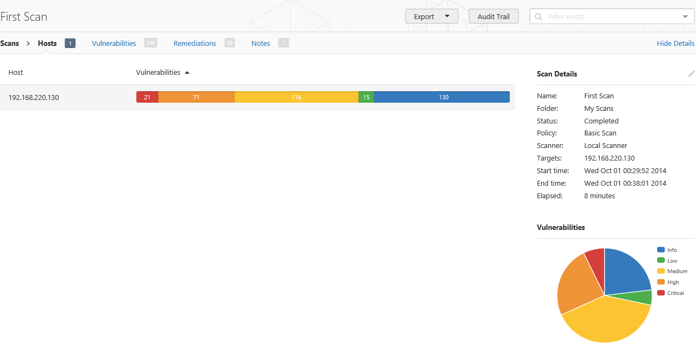
Output From First Scan

Slide 35
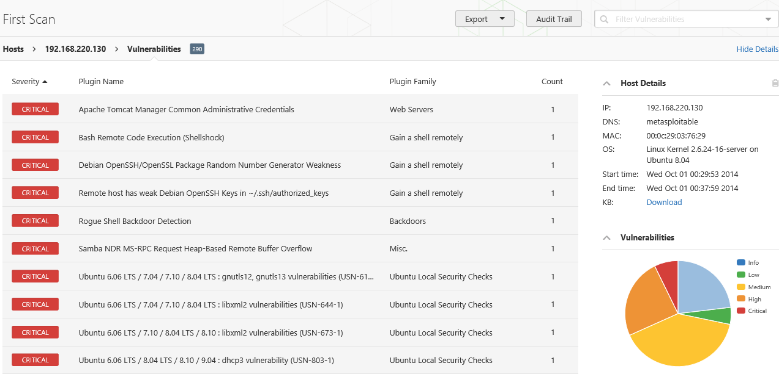
Clicking on scan gives details

Slide 36
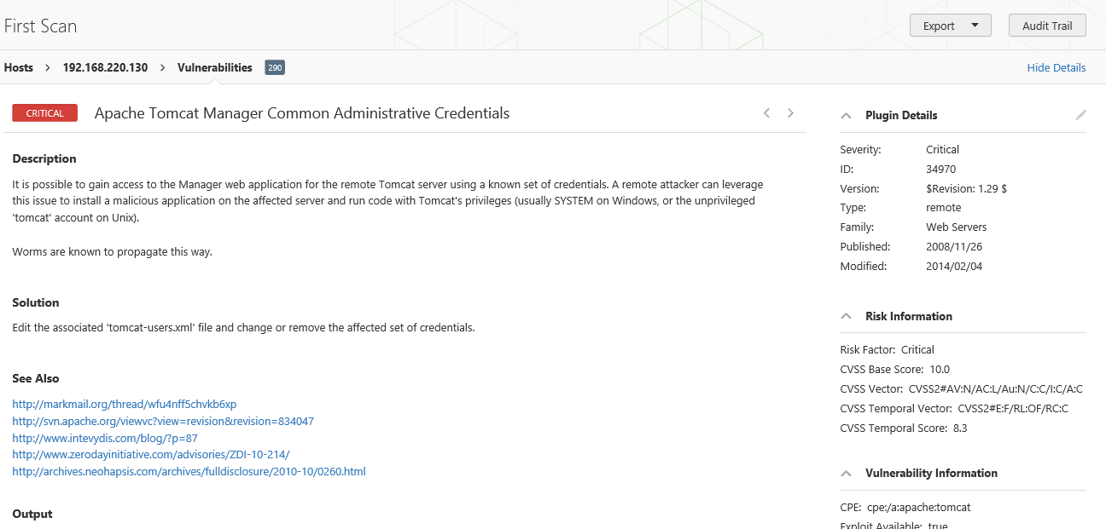
Continuing to drill down

Slide 37
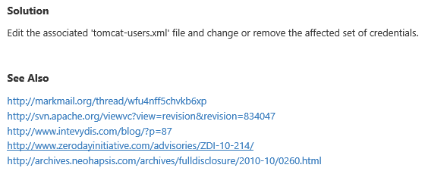
Good Information
Important to note:
Also

Slide 38
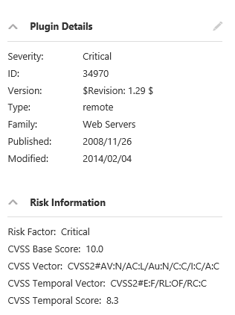
Criticality
Note on criticality
The “Critical” risk factor is without any mitigating controls being taken in to account
Vulnerabilities need to be evaluated in context

Slide 39
More on Results
These results were obtained, even though Anti-Virus continued blocking multiple techniques.
Consider setting up a scanning machine without any AV or Host Firewall.

Slide 40
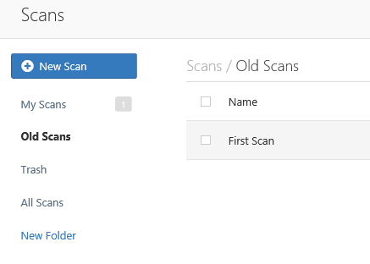
Organizing Scans
In short order you will gather a large collection of scans
Use the built in folder system to move scans off of the main page

Slide 41
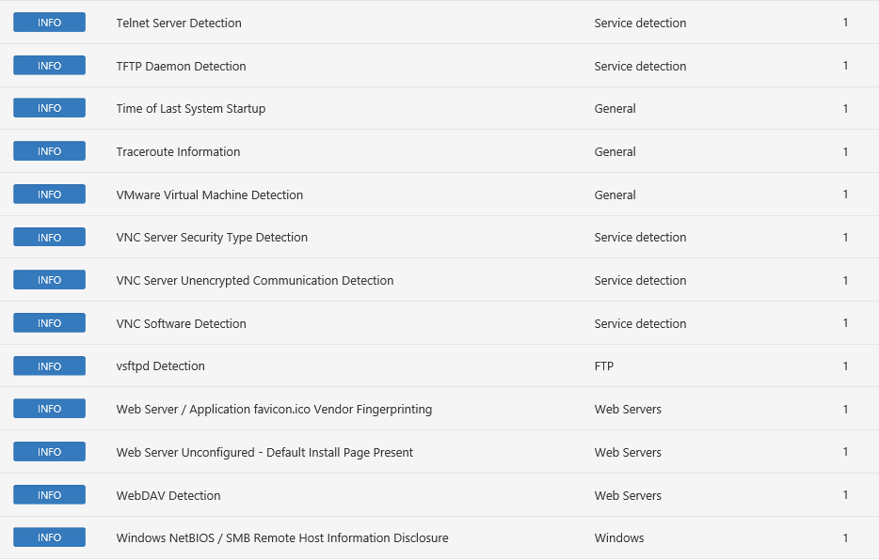
Don’t Forget the Info

Slide 42
Info Vulnerabilities
The least significant vulnerabilities are classified as “Info” or informational.
These are often very useful in understanding details of the asset being scanned.

Slide 43
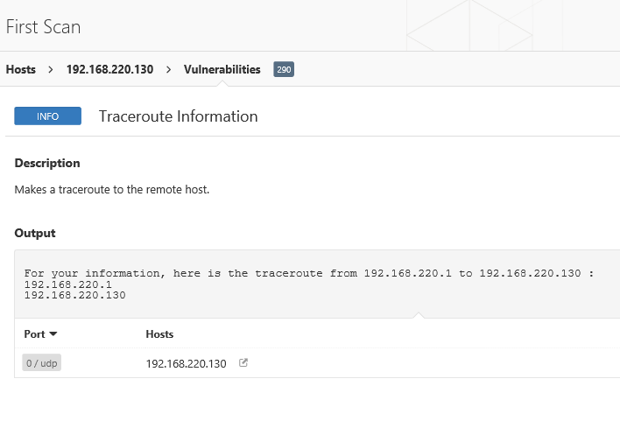
For Instance

Slide 44
Next Week
NetCat
DOS Batch

Slide 45
Questions
?

