Slide 1
Intro to Ethical Hacking
MIS 5211.001
Week 7
http://community.mis.temple.edu/mis5211sec001fall17/

Slide 2
Tonight's Plan
Tcpdump
Windump
Just a little bit of Wireshark
Network Taps

Slide 3
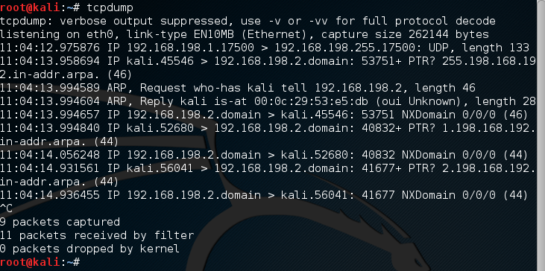
tcpdump
Tcpdump is a network analysis tool
Requires root or sudo priveleges
Displays network traffic in a raw state

Slide 4
Windows and Mac
On Windows there is an equivalent called windump
  Available at: https://www.winpcap.org/windump/
  WinDump captures using the WinPcap library and drivers, which are freely downloadable from the WinPcap.org website.
Note: Installing windows version of Wireshark will add the WinPcap files needed by WinDump
For Mac tcpdump is built in
  Apple provides some direction on use at: https://support.apple.com/en-us/HT202013

Slide 5
Basic Use
Some basic flags (See man page for more)
  -c Count function, how many packets to you want. If you don’t say it will just keep running until you hit CTRL-C
  -n Don’t resolve addresses to names
  -nn Don’t resolve address or port names
  -s Snap Length, how much of the packet do you want
  -S Absolute sequence number
  -v, -vv, and –vvv Varying degrees of verbose. How much do you want tcpdump to tell you
  -X Data from each packet

Slide 6
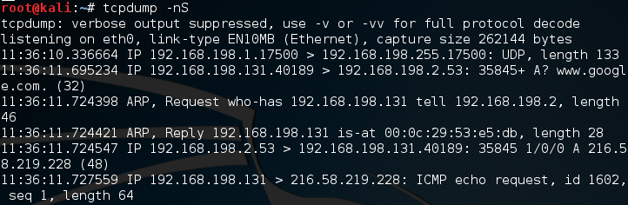
First example
Tried tcpdump –nS
  -n (Don’t convert addresses)
  -S (Absolute sequence numbers)

Slide 7
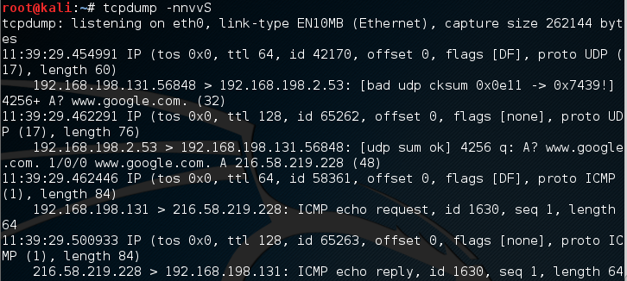
Next Example
Tried tscpdump –nnvvS
  -nn (Don’t resolve address or port to names)
  -vv (Tell me more)
  -S (Absolute sequence numbers)

Slide 8
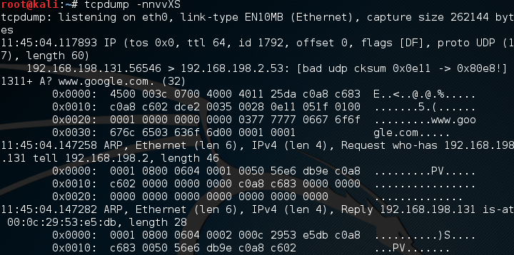
Next Example
Try tcpdump –nnvvXS
  Add -X (Captures data)

Slide 9
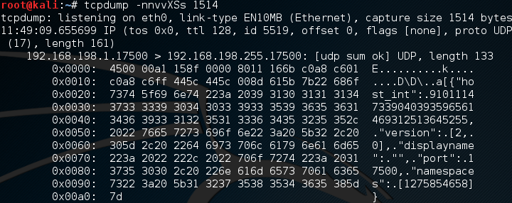
Try tcpdump –nnvvXSs 1514
  Final –s extends defaults snap length to capture full packet

Slide 10
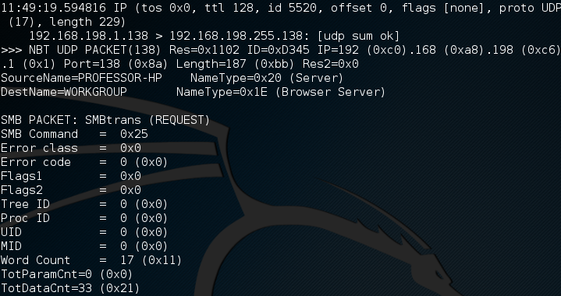
More Capture

Slide 11
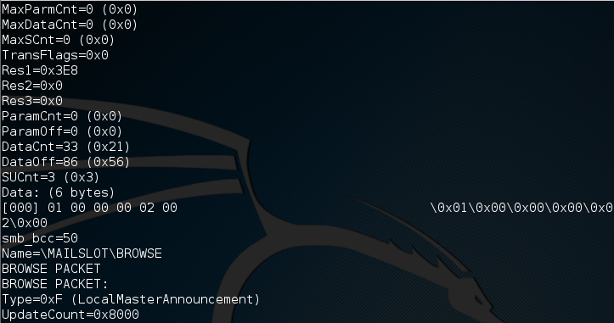
Yet More Capture
There is more after this, but I’ll stop here.

Slide 12
Adding More
Try tcpdump –nnvvXSs 0 -c2 icmp
  0 sets snaplenngth to default
  -c2 Restricts capture to two packets
  Using icmp filters so only icmp packet headers are captured
  See Next slide for example

Slide 13
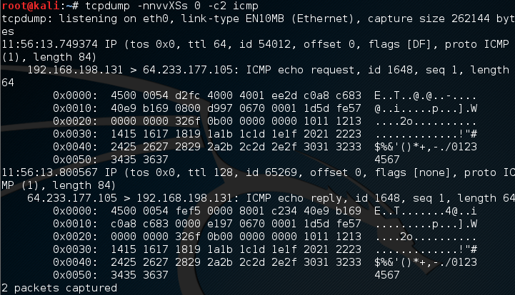

Slide 14
Other Options
Try adding host to look for traffic based on IP address (also works with hostname if you’re not using -n)
Try adding SRC or DST to find traffic from only a source or destination (eliminates one side of a host conversation)
Try adding port to see only traffic to or from a certain port
Lots more: portrange, less/more, or >/<

Slide 15
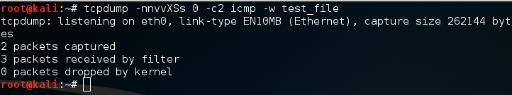
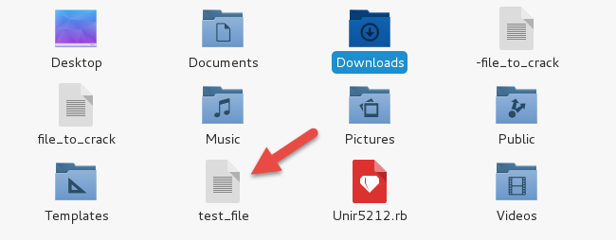
Writing to a File
Try –w to write to a file
Resultant file

Slide 16
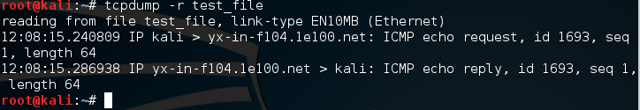
Reading Files
Try –r to read a file in

Slide 17
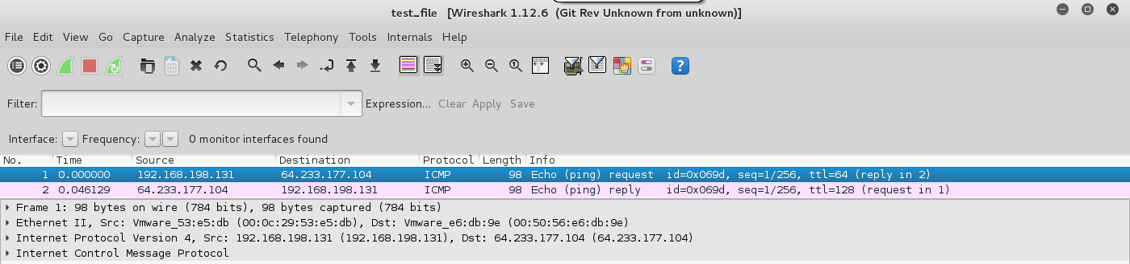
File Contents
Opens by default in Wireshark

Slide 18
Reference for tcpdump
Lots more at:
http://www.tcpdump.org/

Slide 19
Network Protocol Analyzer
  Computer s/w or h/w, intercepts & logs traffic passing over the network
  Captures packets, decodes & analyzes contents
  A network Analyzer is used for
    Troubleshooting problems on the network
    Analyzing the performance of a network to discover bottlenecks
    Network intrusion detection
    Analyzing the operations of applications

Slide 20
About Wireshark
It is a packet sniffer
Functionality is very similar to tcpdump
Has a GUI front-end and many more information sorting and filtering options

Slide 21
Background
Initiated by Gerald Combs under the name Ethereal
First version was released in 1998
The name Wireshark was adopted in June 2006

Slide 22
Features
“Understands" the structure of different network protocols.
Displays encapsulation and single fields and interprets their meaning.
It can only capture on networks supported by pcap.
It is cross-platform running on various OS (Linux, Mac OS X, Microsoft windows)

Slide 23
WinP Cap
Industry standard tool for link layer network access in windows environment
Allows application to capture and transmit network packets by passing the protocol stack
Consists of a driver-extends OS to provide low level network access
Consists of library for easy access to low level network layers
Also contains windows version of libPCap Unix API

Slide 24
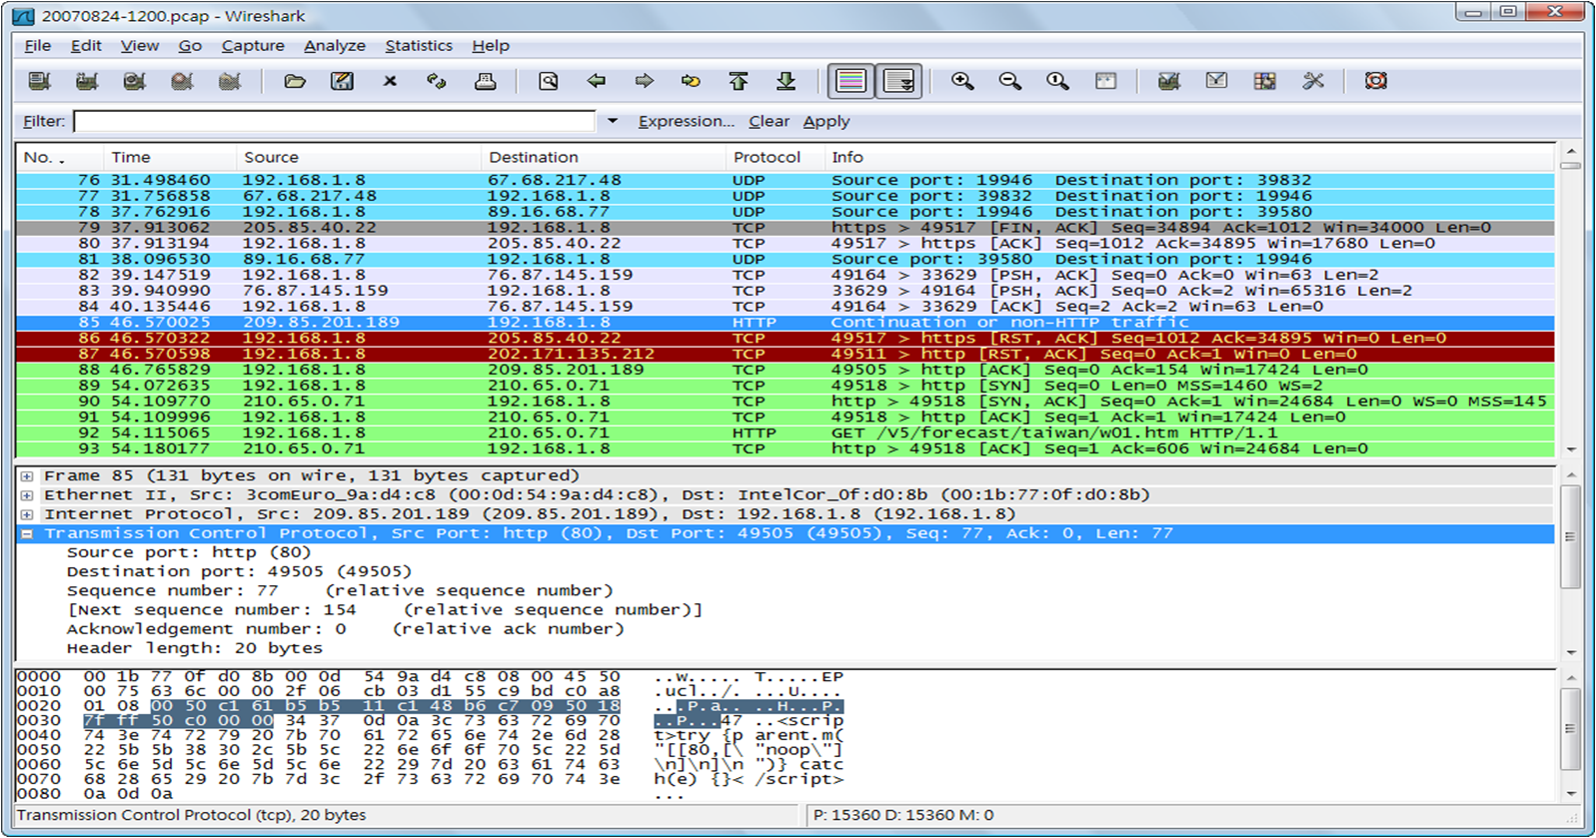
Example

Slide 25
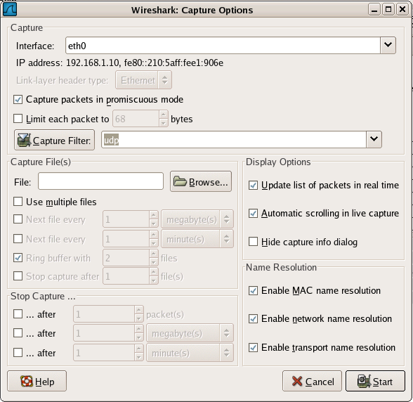
Capture Options

Slide 26
Wireshark
Reference
  http://www.wireshark.org/docs/wsug_html_chunked/
Books
  https://www.amazon.com/dp/1593271492/?tag=stackoverfl08-20
  https://www.amazon.com/dp/1597490733/?tag=stackoverfl08-20
Tutorials
  https://cs.gmu.edu/~astavrou/courses/ISA_564_F15/Wireshark-Tutorial.pdf
Blog
  https://blog.wireshark.org/

Slide 27
Packet Sniffing or Taps
Packet Sniffer Definition:
A packet sniffer is a wire-tap device that plugs into computer networks and eavesdrops on the network traffic.

Slide 28
Options
Using the SPAN port on a switch
inline (dedicated) tap
Aggregating tap

Slide 29
Using the SPAN Port
Commercial switches (Not home and small office gear) have a function called SPAN that mirror all data passing through the switch to a single port where it can be monitored
Both Network Engineering and Security groups will try to use this as it is inexpensive (free) and relatively simple to set up

Slide 30
Inline Tap
As the name implies, the tap is inserted in to the network, typically at a choke point near the central router where it can “see” the most traffic.
  Advantage – Seamless and undetectable
  Disadvantage
    creates a network outage when it is inserted, can create a network outage if it fails
    Switch packet scheduler grants the Switch Port Mirroring function lowest possible priority
    Switch Port Mirroring will be disabled in case of congestion with packet loss on the monitoring port as a result.
    Switch Port Mirroring might require switch resources that can load the switch and lead to reduced switching performance.

Slide 31
Aggregating Tap
Basically, multiple inline taps that aggregate their output to a single port for monitoring
Advantage
  Simplifies monitoring (data collection)
Disadvantage
  Expensive (Last time a looked $50,000 per tap)

Slide 32
Packet Sniffer Mitigation
Host A
Host B
Router A
Router B
The following techniques and tools can be used to mitigate sniffers:
  Authentication—Using strong authentication, such as one-time passwords, is a first option for defense against packet sniffers.
  Switched infrastructure—Deploy a switched infrastructure to counter the use of packet sniffers in your environment.
  Cryptography—The most effective method for countering packet sniffers does not prevent or detect packet sniffers, but rather renders them irrelevant.

Slide 33
Questions
?

