Slide 1
Intro to Ethical Hacking
MIS 5211.001
Week 9
Site: http://community.mis.temple.edu/mis5211sec001fall17/

Slide 2
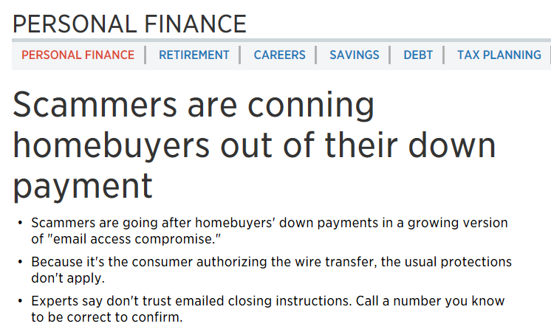
News
https://www.cnbc.com/2017/10/19/scammers-are-conning-home-buyers-out-of-their-down-payment.html

Slide 3
News
Classic “Reconnasaince”
  Scammers monitor Realtors or Mortgage companies waiting for “Closing”
  Shortly before closing the spoof a message to buyer indicating changes to wire transfer instructions
  Since transfer is initiated by buyer, there is a very limited time period to recover the money

Slide 4
Tonight's Plan
Malware

Slide 5
Malware
Code used to perform malicious action
Or
Malware is a set of instructions that run on your computer and make your system do something that an attacker wants it to do.

Slide 6
What it is used for
Steal personal information
  Credentials
  Credit Card Numbers
  Whole Identities
Ransom files
Delete files
Click fraud
Use your computer as relay
Logic bombs

Slide 7
Forms
Static (My words)
Polymorphic : uses a polymorphic engine to mutate while keeping the original algorithm intact (packer)
Metamorphic : Change after each infection

Slide 8
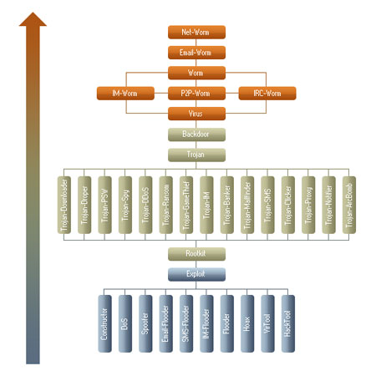
Kaspersky Malware Classification Tree
Source: http://usa.kaspersky.com/internet-security-center/threats/malware-classifications#.VEcRrXl0yUk

Slide 9
Some Definitions
Payload - harmful things the malicious program does, after it has had time to spread.
Worm - a program that replicates itself across the network (usually riding on email messages or attached documents (e.g., macro viruses).
Trojan Horse - instructions in an otherwise good program that cause bad things to happen (sending your data or password to an attacker over the net).
Logic Bomb - malicious code that activates on an event (e.g., date).
Trap Door (or Back Door) - undocumented entry point written into code for debugging that can allow unwanted users.

Slide 10
Shellcode
You will see the term Shellcode used intermittently throughout the presentation
Shellcode is defined as a set of instructions injected and then executed by an exploit program – The Shellcoder’s Handbook 2nd Edition
Derived from the original purpose of the software to create a “Shell” at the root level

Slide 11
What is a Shell
First, a shell is not a terminal
  For the mathematically inclined
  Shell != Terminal
What this means
  Not all terminal commands will work in a shell
  For instance:
    Clear for clear screen
    Turn Echo On or Off
    CTRL-C
    CTRL-D
    Etc…

Slide 12
More on Shell
Terminals include code and protection to interpret user input, and ensure everything works
A shell is a raw command line to send characters to, and receive characters from a system. That is, raw stdin and stdout. That’s it. It cannot interpret or catch control codes or screen commands

Slide 13
Technical Types
User Mode Root Kits
Kernel Mode Root Kits
Keyloggers
Sniffers
Downloaders
HTTP C2 Channels

Slide 14
User Mode Root Kits
Purpose
  Attain access
  Maintain access
  Hide access
Operates in user mode
  That is, gets injected into one or more individual processes

Slide 15
What it Looks Like

Slide 16
What is Happening
Rootkit intercepts data to:
  Netstat
  Process Explorer
  Task Manager
Therefore, when a user or admin looks at these tools everything looks normal

Slide 17
Two Key Infection Steps
DLL Injection (Dynamic Link Library)
  Running code within the address space of another process
  Malware “Injects” itself into a DLL using
    SetWindowsHookEx
    CreateRemoteThread/LoadLibrary
  Note: These are legitimate commands that are used by software for things like patching
API Hooking (Application Programming Interface)
  Intercepting function calls, messages, or events passed between software components

Slide 18
Notes on Rootkits
These methods were developed in Windows XP and earlier machines
Still possible with Vista, 7, and 8 – Just need to work a little harder

Slide 19
Kernel Mode Rootkits
Injected into the Kernel, below the level of process and DLL
Runs at the highest privilege level for software
Removal likely requires reinstallation of operating system

Slide 20
Keyloggers
Monitor user key strokes
Lots of bots, worms, and assorted other malware does this
  Sends logs to attacker
Common methods
  Hook for keyboard events
  Poll keyboard state with GetAsyncKey()

Slide 21
Sniffers
Similar to tcpdump or windump covered earlier, but now its malicious
Common method
  Put interface into promiscuous mode
  Controller passes all traffic it receives to the CPU
Other ways
  Intercept network related calls
  Intercept higher level functions
    We’ll see this late with Browser proxies
  Installing BHOs (Browser Helper Objects)

Slide 22
Downloaders
Used by attackers to deliver malware in stages
Initial malware can be very small, only needs to fetch the next piece of software
  Easier to obfuscate
  May escape detection
  Action is not malicious in and by itself
Droppers are similar, but embedded the downloaded functionality in their own code

Slide 23
Example Commands
URLDownloadToFile()
  Download and save file to disk
ShellExecute()
  Execute file
WinExec()
  Execute file

Slide 24
Command and Control Channels
AKA HTTP C2 Channels
  Ubiquitous
  Port 80 almost always open
  Use port 443 and your coms are encrypted
Alternatives
  IRC (Internet Relay Chat)
  P2P (File Sharing)
  DNS (Tunnel data over DNS)

Slide 25
Approaches
Reverse shell over HTTP (Port 80)
Embedded in regular HTTP traffic
  Disguised like normal user traffic

Slide 26
Infection Channels
MS Office Files
PDF Files
Flash
JavaScript
Lots more, but these are the ones we will talk about

Slide 27

MS Office Files
Why Office
  Everybody is using it
  File freely passed around and not unexpected
  Parsing binary office format is difficult
  Robust embedded scripting language (VBA)
  You can even hook Apple products
Source for Graphic: http://www.motionvfx.com/mblog/microsoft_office_coming_for_ipad_as_well_as_a_new_desktop_version_for_lion!,p960.html

Slide 28
Techniques
Embedded Shellcode
  Exploits vulnerability in office software
  No user interaction required
Embedded VBA Script
  Executes on document open
  May require user to click OK or “Enable Content”
Note about VBA – Term Macro is misleading. Implies it is for basic scripting. Today, VBA is a full fledged language.

Slide 29
Adobe PDF
Why PDF
  Everybody is using it
  Files freely passed around and not unexpected
  PDF Format
    Proprietary(ish)
      Used to be proprietary, published by ISO as ISO/IEC 32000-1:2008
    Feature rich
    Can include active content
      JavaScript
      ActionScript via Flash Objects
  And finally
    New vulnerabilities found regularly

Slide 30
More Adobe PDF
High profile attack target
  http://www.darkreading.com/vulnerabilities---threats/report-sixty-percent-of-users-are-running-unpatched-versions-of-adobe/d/d-id/1136022
  6 in 10 installs of Adobe Reader are out of date
Complex structure
  Easily obfuscated
  Need software tools to open and understand
  Even AV vendors have problems keeping an eye on this

Slide 31
Where are the Vulnerabilities
Parser components
JavaScript and ActionScript
Embedded Shellcode executes by exploiting these vulnerabilities

Slide 32
Flash
Ubiquitous on websites
New vulnerabilities weekly (at least that’s how it feels)
So bad Apple and now Kindle will not allow flash to be installed without jail breaking the devices

Slide 33
More Flash
Uses the SWF file format
See: http://wwwimages.adobe.com/www.adobe.com/content/dam/Adobe/en/devnet/swf/pdf/swf-file-format-spec.pdf
Supports ActionScript language for scripting, including legacy support for older versions of ActionScript

Slide 34
Flash Vulnerabilities
Client Side
  Flash Parameter Injection
    Inject parameters when Flash object is embedded in an HTML page
  Cross Domain Privilege Escalation
    Access and modify DOM
  Cross Site Scripting
    Access and modify DOM
  Cross Site Flashing
    Call another flash object from flash

Slide 35
JavaScript
Just a teaser at this point
JavaScript is a primary infection path with web site based attacks
  Used for:
    Cross Site Scripting (XSS)
    Cross Site Request Forgery (CSRF)
    Direct Delivery
      Downloaders
      Droppers
      Keyloggers
      And anything else you want

Slide 36
More JavaScript
JavaScript based attacks are frequently heavily obfuscated with multiple layers of encryption, obfuscation, encoding, and false flags
Attackers will “buy” ad space and put up legitimate looking ads on legitimate sites
  Since adds are rotated, infection is inconsistent and difficult to pin down

Slide 37
Testing AV
During Penetration Tests a tester may be asked to verify that the AV suite is working
You don’t want to actually send malware
What do you do?
Answer
  EICAR
  http://www.eicar.org/86-0-Intended-use.html

Slide 38
EICAR
EICAR is a Anti-Malware Test File
Originally developed by Paul Ducklin
All major AV vendors will flag this file if properly installed and configure
Tester can simply send the file in via normal channel being tested and then confirm that AV suites correctly identified and blocked file.

Slide 39
Odds and Ends
I’m malware, where do I hide
  Inside other executables
  Inside data files
  In Alternate Data Streams (ADS)
  On the hard drive, but outside of the file system
  In BIOS

Slide 40
Detection
Malware in executables and data files can be detected of you know what good is supposed to look like
Malware also leaves markers in the file system that can be detected
Commercial tools like Mandiant, FireEye, and others can pick these up
  Worth noting: FireEye bought Mandiant

Slide 41
Alternate Data Stream (ADS)
Compatibility feature of NTFS
  Part of file system, but not part of file system
  Originally created to allow NTFS to handle Apple file attributes that were stored outside of the file structure
  Creates an “Off Book” location to store data and/or executables that will not be seen via file commands or through GUI folder tools
  http://www.windowsecurity.com/articles-tutorials/windows_os_security/Alternate_Data_Streams.html

Slide 42
Hard Drive
Not all space on the drive is consumed by the file system
Vendors sometime use this space to keep configuration information or recovery files
Attackers can use the space as well
Caution: While tools exist to read and write to raw space, writing is extremely dangerous as you can render the file system useless.

Slide 43
BIOS
Firmware installed on motherboard that instructs CPU how to turn on
  What drive to boot from
  Is there a password to just turn on
Other hardware has similar Firmware
  Graphics Cards
  Network Cards
  Other specialty boards

Slide 44
What is Firmware
Firmware is rewritable code in a chip or other piece of hardware that retains it’s coding even without power
It only changes when specific external commands are given to update or overwrite

Slide 45
Impact of BIOS Malware
Malware can withstand a complete re-image of the file system
Replacing the hard drive will not mitigate
Since it is in place a boot time, before the kernel ever starts, it can re-infect

Slide 46
Next Week
We will be covering
  Web Application Hacking
  Intercepting Proxies
  URL Editing

Slide 47
Questions
?

