Slide 1
Intro to Ethical Hacking
MIS 5211.001
Week 10
Site: http://community.mis.temple.edu/mis5211sec001fall17/

Slide 2
Tonight's Plan
Web Application Security

Slide 3
Web Application Security
First (and nearly only) Rule
Never Trust User Input

Slide 4
Where Do We Start
For web application security and web application penetration testing
Owasp.org

Slide 5
OWASP
OWASP stands for the Open Web Application Security Project
Founded in 2001 as a charitable organization dedicated to improving Web Application Security
Creators and publishers of the OWASP top 10
Hosts numerous Web App tools and projects

Slide 6
The OWASP Top 10
OWASP Top 10 – 2013
2013-A1 – Injection
2013-A2 – Broken Authentication and Session Management
2013-A3 – Cross Site Scripting (XSS)
2013-A4 – Insecure Direct Object References
2013-A5 – Security Misconfiguration
2013-A6 – Sensitive Data Exposure
2013-A7 – Missing Function Level Access Control
2013-A8 – Cross-Site Request Forgery (CSRF)
2013-A9 – Using Known Vulnerable Components (NEW)
2013-A10 – Unvalidated Redirects and Forwards
Source: http://owasptop10.googlecode.com/files/OWASP_Top-10_2013%20-%20Presentation.pptx

Slide 7
New Top Ten Coming Soon
OWASP is working on an update
https://www.owasp.org/index.php/Category:OWASP_Top_Ten_Project

Slide 8
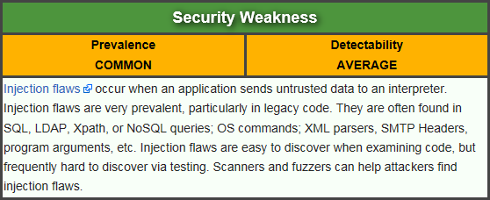
Injection
Attacker sends simple text-based attacks that exploit the syntax of the targeted interpreter. Almost any source of data can be an injection vector, including internal sources.
https://www.owasp.org/index.php/Top_10_2013-A1-Injection

Slide 9
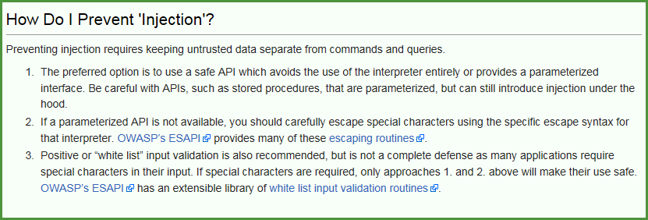
Injection
Finding a way to send text to a web application or browser that is interpreted as a command or code
Tricks systems or browsers in to taking action

Slide 10
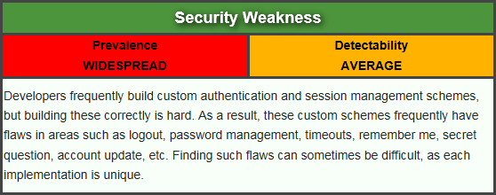
Broken Authentication and Session Management
Attacker uses leaks or flaws in the authentication or session management functions (e.g., exposed accounts, passwords, session IDs) to impersonate users.
https://www.owasp.org/index.php/Top_10_2013-A2-Broken_Authentication_and_Session_Management

Slide 11
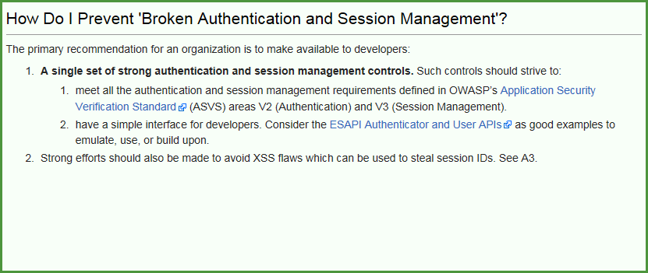
Broken Authentication and Session Management
Steal an identity, and use it.

Slide 12
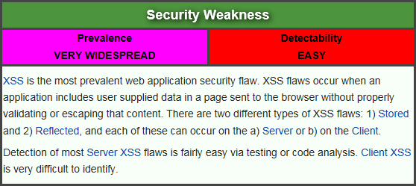
Cross Site Scripting (XSS)
Attacker sends text-based attack scripts that exploit the interpreter in the browser. Almost any source of data can be an attack vector, including internal sources such as data from the database.
https://www.owasp.org/index.php/Top_10_2013-A3-Cross-Site_Scripting_(XSS)

Slide 13
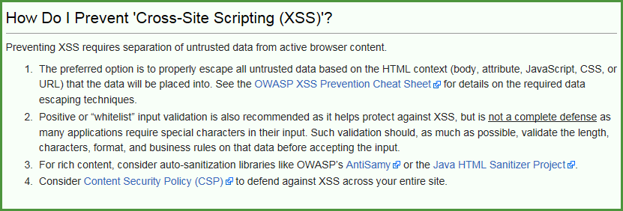
Cross Site Scripting (XSS)
Can be as simple as <script>alert(“XSS”)</script>

Slide 14
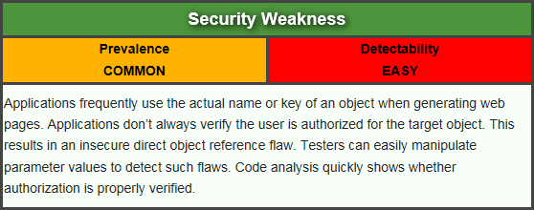
Insecure Direct Object References
Attacker, who is an authorized system user, simply changes a parameter value that directly refers to a system object to another object the user isn’t authorized for. Is access granted?
https://www.owasp.org/index.php/Top_10_2013-A4-Insecure_Direct_Object_References

Slide 15
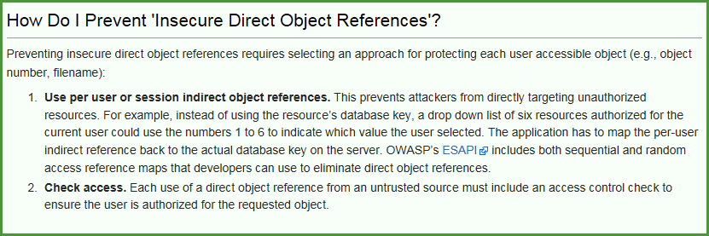
Insecure Direct Object References
Keep in mind, “Authorized User” does not necessarily mean “Admin”. Just a user that is allowed on the web site. If public, that means everyone.

Slide 16
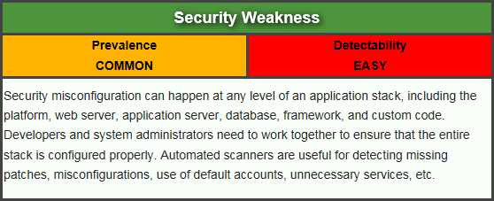
Security Misconfiguration
Attacker accesses default accounts, unused pages, unpatched flaws, unprotected files and directories, etc. to gain unauthorized access to or knowledge of the system.
https://www.owasp.org/index.php/Top_10_2013-A5-Security_Misconfiguration

Slide 17
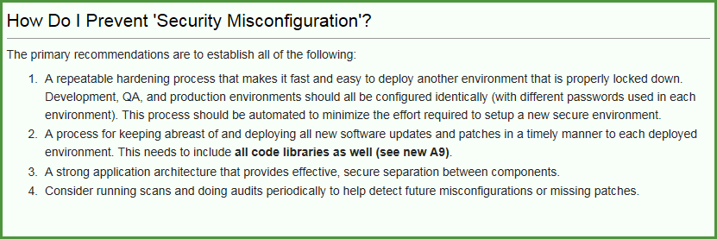
Security Misconfiguration
Remember those Google searches from Reconnaissance? For instance: intitle:"Test Page for Apache"

Slide 18
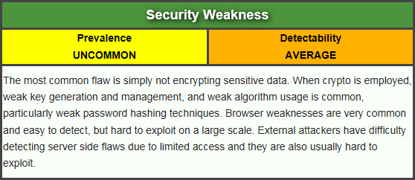
Sensitive Data Exposure
Attackers typically don’t break crypto directly. They break something else, such as steal keys, do man-in-the-middle attacks, or steal clear text data off the server, while in transit, or from the user’s browser.
https://www.owasp.org/index.php/Top_10_2013-A6-Sensitive_Data_Exposure

Slide 19
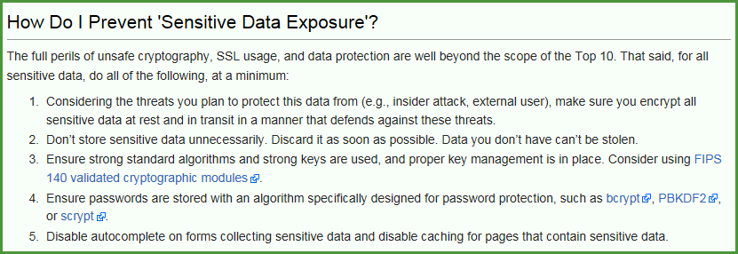
Sensitive Data Exposure
Example: A site simply doesn’t use SSL for all authenticated pages. Attacker simply monitors network traffic (like an open wireless network), and steals the user’s session cookie.

Slide 20
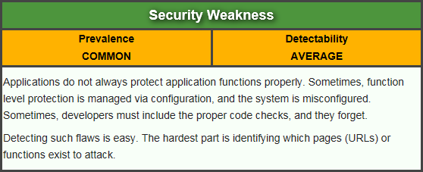
Missing Function Level Access Control
Attacker, who is an authorized system user, simply changes the URL or a parameter to a privileged function. Is access granted? Anonymous users could access private functions that aren’t protected.
https://www.owasp.org/index.php/Top_10_2013-A7-Missing_Function_Level_Access_Control

Slide 21
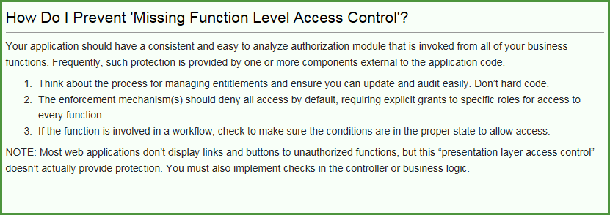
Missing Function Level Access Control
Example from OWASP:
http://example.com/app/getappInfo
http://example.com/app/admin_getappInfo

Slide 22
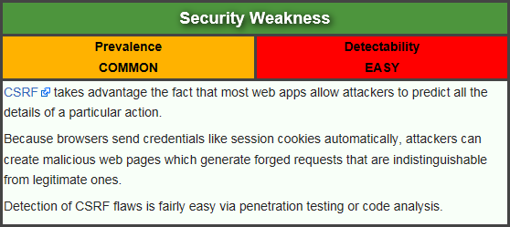
Cross-Site Request Forgery (CSRF)
Attacker creates forged HTTP requests and tricks a victim into submitting them via image tags, XSS, or numerous other techniques. If the user is authenticated, the attack succeeds.
https://www.owasp.org/index.php/Top_10_2013-A8-Cross-Site_Request_Forgery_(CSRF)

Slide 23
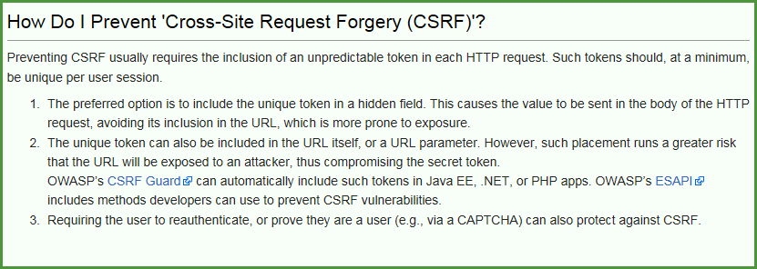
Cross-Site Request Forgery (CSRF)
Example from OWASP
http://example.com/app/transferFunds?amount=1500&destinationAccount=4673243243
<img src="http://example.com/app/transferFunds?amount=1500&destinationAccount=attackersAcct#" width="0" height="0" />

Slide 24
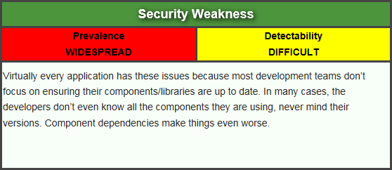
Using Components with Known Vulnerabilities
Attacker identifies a weak component through scanning or manual analysis. He customizes the exploit as needed and executes the attack. It gets more difficult if the used component is deep in the application.
https://www.owasp.org/index.php/Top_10_2013-A9-Using_Components_with_Known_Vulnerabilities

Slide 25
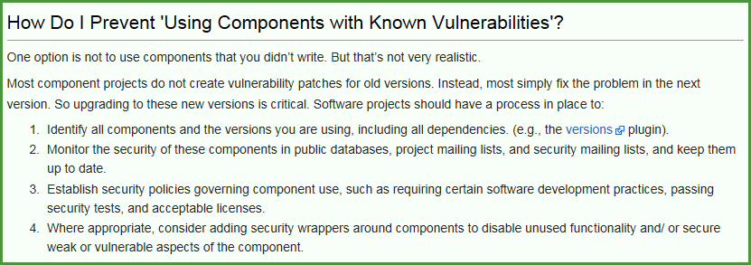
Using Components with Known Vulnerabilities
Example from OWASP
Spring Remote Code Execution – Abuse of the Expression Language implementation in Spring allowed attackers to execute arbitrary code, effectively taking over the server.

Slide 26
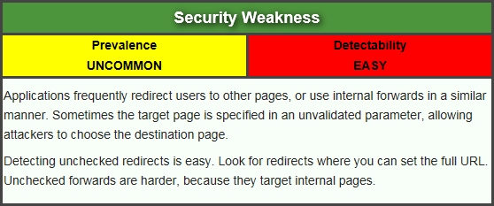
Unvalidated Redirects and Forwards
Attacker links to unvalidated redirect and tricks victims into clicking it. Victims are more likely to click on it, since the link is to a valid site. Attacker targets unsafe forward to bypass security checks.
https://www.owasp.org/index.php/Top_10_2013-A10-Unvalidated_Redirects_and_Forwards

Slide 27
Unvalidated Redirects and Forwards
Example from OWASP
http://www.example.com/redirect.jsp?url=evil.com

Slide 28
Now What
So, all of this is interesting, but does that have to do with penetration testing
Or, to put it another way. How de we exploit these issues?
First step:
Intercepting Proxies

Slide 29
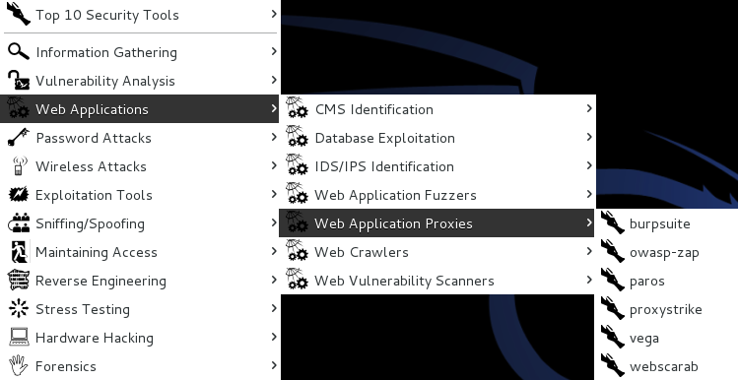
What’s an Intercepting Proxy
In this instance, an intercepting proxy is software that acts as a server and sits between the web browser and your internet connection
Examples
Burp Suite
Webscarab
Paros

Slide 30
Some Rules for Our Use of Intercepting Proxies
For this course
Monitor and record ONLY
Do not inject or alter any traffic unless you personally own the web site.
We’ll save changing traffic in the next course

Slide 31
Burp Suite
Start Burp Suite by logging in to Kali and selecting Burp Suite from:
Kali Linux>Web Applications>Web Application Proxies>burpsuite

Slide 32
Burp Suite

Slide 33
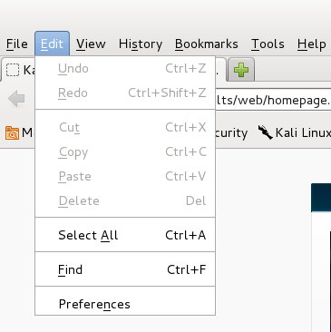
Getting Started
Once burpsuite is running, you will need to start and configure a browser
Kali’s web browser is “Iceweasel”, an adaptation of Firefox
After starting Iceweasel, navigate to preferences
And select it

Slide 34
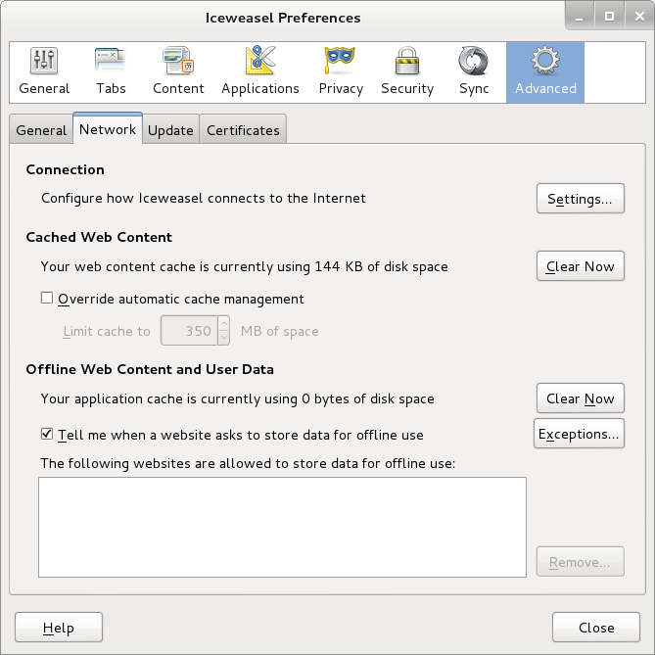
Configuring the Network Proxy
Navigate to the Network Tab and select settings… for Connection

Slide 35
Configuring the Network Proxy
Change selection from “Use system proxy settings” to “Manual proxy configuration and enter “127.0.0.1” for “HTTP Proxy” and “8080” for “Port”
Also, select check box for “Use this proxy server for all protocols”
Delete reference to localhost and 127.0.0.1 from the no proxy list
Select “OK” when done
Browser is now setup to use burpsuite
See next slide for example

Slide 36
Configuring the Network Proxy

Slide 37
Should Look Like This

Slide 38
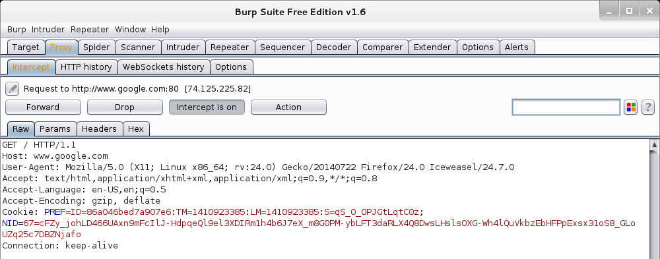
Now We Can Test
In browser, navigate to google.com
Browser will hang and look busy
Select the “Proxy” tab in burpsuite
Burpsuite is waiting for you, select forward

Slide 39
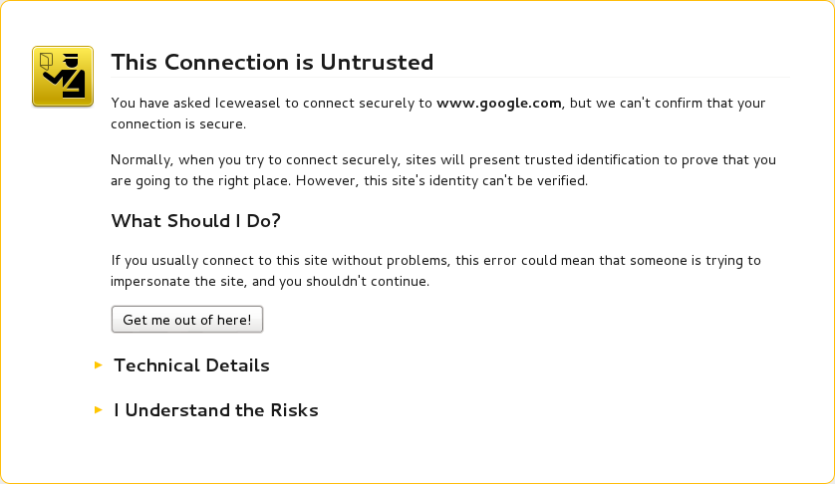
Browser Knows Something is Up
Select “I understand the Risks” and follow prompts to add an exception

Slide 40
Browser Knows Something is Up

Slide 41
Continuing
You may have to hit forward a number of times
You may want to click “Intercept is on” to turn it off and save hitting the forward button
Eventually, all traffic is forwarded.
Now, select “HTTP history” and see what you have

Slide 42
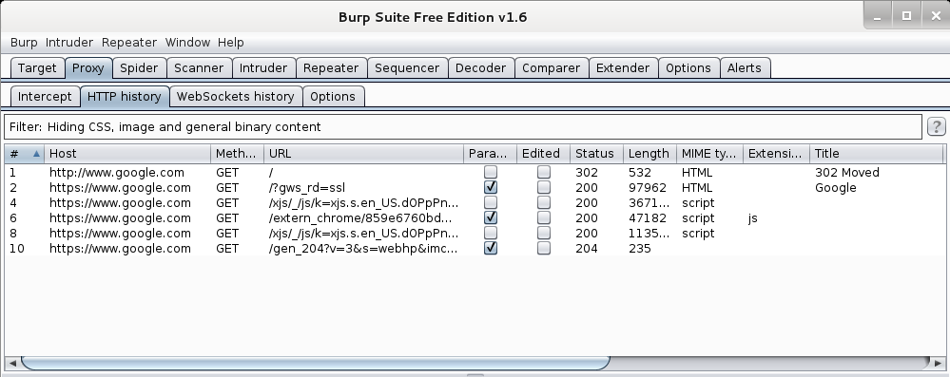
Results
Your traffic

Slide 43
More Results

Slide 44
More Results

Slide 45
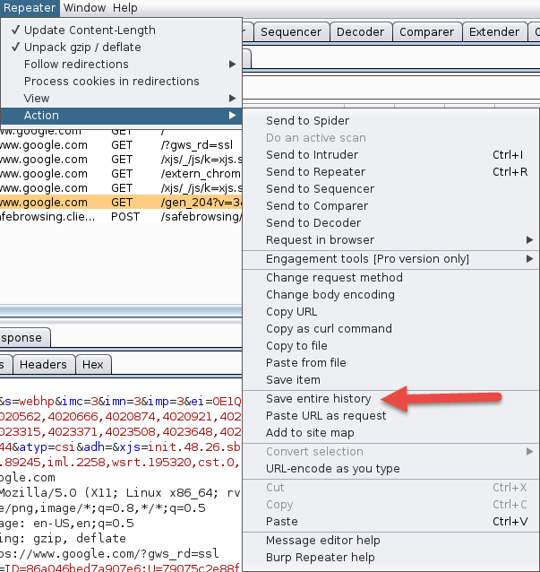
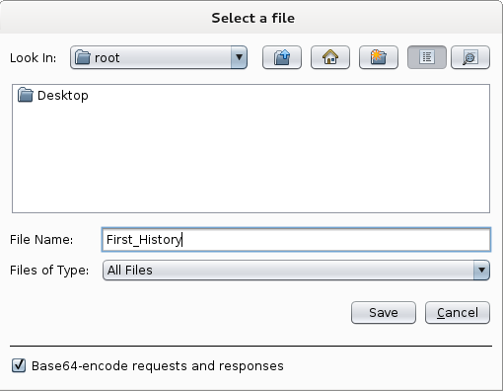
Saving Our Results
Under “Repeater”, select “Action”, then select “Save Entire History”

Slide 46
Now, Lets Go Somewhere More Interesting
Restart burpsuite and turn intercept off
Now navigate to temple.edu and look around the sitetemple.edu
Look over the results

Slide 47
Temple.edu

Slide 48
Some Basics
What can we tell from this?
First we can see what we are telling temple about us
Web Browser is Iceweasel, a derivative of Firefox
What versions we are running
Cookies
What exactly is If-None-Match: “1414416188-1”?

Slide 49
But Wait, There’s More
As Darth Vader says “Come to the Dark Side, We’ve got Cookies”
Or worse “Hex”

Slide 50
We’ve Got Both Sides
Note: There’s both a request and a response tab.

Slide 51
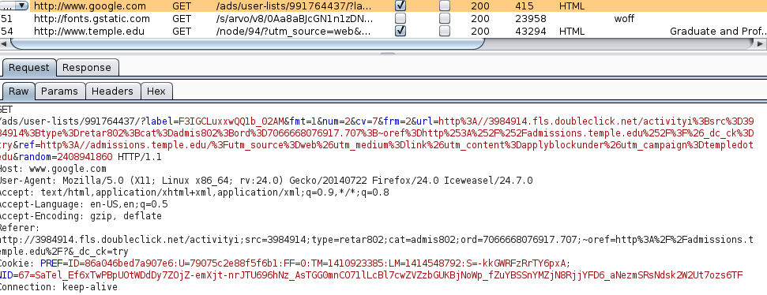
A Few Interesting Things
Google Adds
Other outside references

Slide 52
Check The Alerts
A few things to look at

Slide 53
What Now
If this was a real Web App Test
Navigate the web site recording everything
Review looking for interesting leads to follow
Set Proxy to crawl site
(DO NOT DO THIS FOR THIS COURSE)

Slide 54
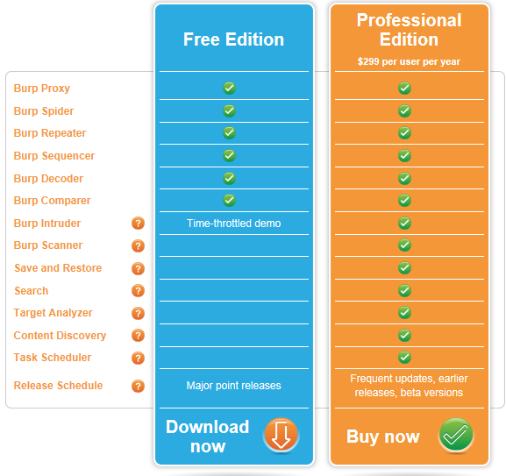
A Few More Things
This is the “Free” version of burpsuite
Some of the more interesting features are turned off or limited
Scanner
Intruder
http://portswigger.net/burp/download.html

Slide 55
A Few More Things
We covered just one proxy
Different proxies have different strengths and weaknesses
For instance, Webscarab will flag potential XSS automatically

Slide 56
Poor Man's Substitute
In Internet Explorer
F12 Developer Tools
Allows user to at least see the code loaded in browser
Often worth looking at as developers sometimes leave comments

Slide 57
Next Week
Introduction to SQL Injection

Slide 58
Questions
?

