Slide 1
Intro to Ethical Hacking
MIS 5211.001
Week 14
Site: http://community.mis.temple.edu/mis5211sec001fall17/

Slide 2
Tonight's Plan
Cloud Primer
VMWare Networking
Patching
Review
Questions?

Slide 3
Cloud
First things First
There is no cloud
It is just somebody else's computer
No magic
Nothing “Special”

Slide 4
Cloud vs Virtualization
First question I asked many years ago was “What is the difference between virtualization and Cloud. Here’s the answer I eventually got.
Cloud is just a virtualized environment with an additional layer of management tooling.
This answer still seems to make sense.

Slide 5
More Cloud Basics
From NIST:
“Cloud computing is a model for enabling ubiquitous, convenient, ondemand network access to a shared pool of configurable computing resources (e.g., networks, servers, storage, applications, and services) that can be rapidly provisioned and released with minimal management effort or service provider interaction.”

Slide 6
NISTs Picture
http://pleasediscuss.com/andimann/20110330/new-cloud-reference-architecture-from-nist/nist-cloud-ref-architecture/

Slide 7
Cloud Drivers
Elasticity
Virtualization
Scalability
Simplicity
Risk Reduction
Cost
Expandability
Mobility
Collaboration and Inovation

Slide 8
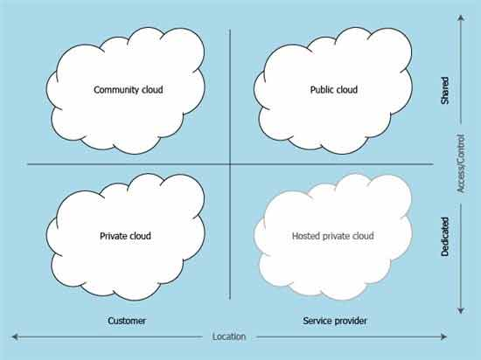
Cloud Definitions
Deployment Models
https://technet.microsoft.com/en-us/library/hh509051.aspx

Slide 9
Cloud Definitions
More on Deployment Models
Private – Provided for exclusive use of a single organization
Community – Provided for exclusive use of a specific community
Public – Open to use by all
Hybrid – Mix from above

Slide 10
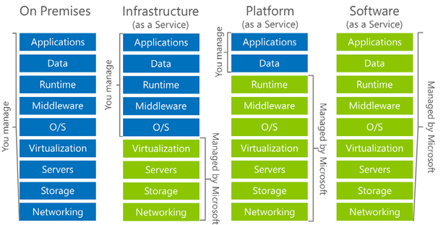
Cloud Definitions
Service Models
https://blogs.partner.microsoft.com/mpn-canada/transitioning-premise-virtual-machines-cost-effective-azure-cloud-models/

Slide 11
Cloud Definitions
Infrastructure
Cloud provider hosts your server build and may host virtual network components that you are responsible for
Platform
Cloud provider hosts their server and infrastructure and you can run your applications
Software as a Service (SaaS)
Provider runs everything, you just use the software
Think Office 365, Exchange in the cloud, etc…

Slide 12
Key Cloud Security Concept
Cloud provider is responsible for “Security of the Cloud”
Cloud user is responsible for “Security in the Cloud”
Example: If you build a server in the cloud, it is your job to harden the system and ensure proper access controls

Slide 13
Network Security
Generally provided by the Cloud Host
You will have very limited (read none) access to logging or info from the cloud providers systems
You can sometimes install virtual appliances inside of the cloud such as firewalls, load balancers, etc…

Slide 14
Cryptography
Cloud providers will generally encrypt data at rest
However, it is their key(s)
May want to also encrypt with your key(s)
Should also provide for encryption in transit
Should be evaluated during negotiations as to what is possible

Slide 15
Access Control
Need to cover
Provisioning and deprovisioning
Centralized directory services
Privileged user management
Authorization and access management
Especially the difference between authentication and authorization

Slide 16
Data Sanitation
Should discuss “before” signing the contract
Options:
Cryptographic erasure – encrypt and throw away the key
Overwriting
Note. Drive destruction is not really an option in a cloud environment as data from multiple clients may reside on the same drive and your data may be spread across many drives

Slide 17
Virtualization Security
Type I Hypervisor - Running directly on the hardware with virtual machine (VM) resources provided by the hypervisor. These are also referred to as “bare metal” hypervisors. Examples of these include VMware ESXi and Citrix XenServer.
Type II Hypervisor - Run on a host OS to provide virtualization services. Examples of Type II are VMware Workstation and Virtual Box.

Slide 18
Hackers view of Type I/II
Type II is still an OS, likely to have a greater attack surface

Slide 19
Common Threats
Breach
Data Loss
Account Hijacking
Insecure APIs
Malicious Insiders (Provider and User)
Abuse of Cloud Services *
Insufficient Due Diligence *
Shared Technology Vulnerabilities *

Slide 20
Abuse of Cloud Services
Think password cracking on steroids
Brute forcing encryption

Slide 21
Insufficient Due Deligence
Cloud development can out pace governance
Who’s creating guests
Are guest machines being shutdown
Was their even a business case
How much is being done on procurement cards and click through agreements
Can anyone in the company even answer the questions above

Slide 22
Shared Technology Vulnerabilities
Cloud provider business case requires sharing of resources.
Your guest machine is on the same host as your competitor (or your attacker)
Your data is on the same wire, just logically seperated

Slide 23
IaaS Concerns
Virtual machine attacks
Virtual network attacks
Switches
Routers
NICs
Hypervisor Attacks
Denial of Service

Slide 24
IaaS Concerns
Multitenancy
Workload Complexity
Network Topology
Logical Network Segmentation
No physical endpoints
Single Point of Access

Slide 25
PaaS
System and Resource Isolation
User Level Permissions
User Access Management

Slide 26
SaaS
Data Segregation
Data Access and Policies
Web Application Security

Slide 27
Data Security
Storage
Volume Storage – Think hard drive for a virtual machine like Amazon EBS
Object Storage – Think file share like Amazon S3
Database – As name implies, database as a service, think Amazon Database Services on EC2 or EBS
Big Data – Data Analytics

Slide 28
Amazon Storage Picure
https://pt.slideshare.net/AmazonWebServices/stg201-state-of-the-union-aws-storage-services

Slide 29
Key Management
Challenges
Access to Keys
Key Storage
Backup and Replication
Considerations
Random Number Generation
No transmission in clear text
No storage in clear text
Key escrow

Slide 30
Masking, Obfuscation, and Anonymization
Masking
Random substitution
Algorithmic substitution
Shuffle
Masking (Specific characters)
Deletion
Primary methods of masking data
Static: In static masking, a new copy of the data is created with the masked values. Static masking is typically efficient when creating clean, nonproduction environments.
Dynamic: Dynamic masking (sometimes referred to as on-the-fly masking) adds a layer of masking between the application and the database

Slide 31
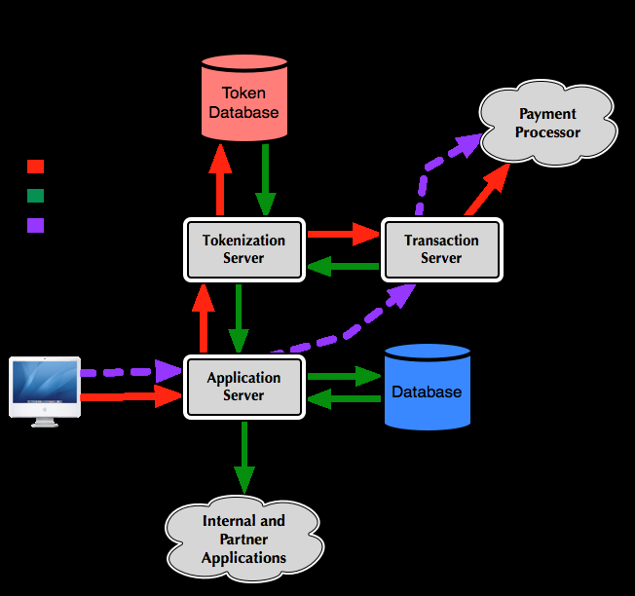
Tokenzation
Substitute with a token value
Token to real value table maintained internally in case you need to unravel it.
https://securosis.com/blog/tokenization-use-cases-part-1

Slide 32
Global
One cloud consideration is geographic
Many nations have rules about where their citizens data resides
This may restrict what can go in which cloud
Most major cloud providers offer regional data centers to address this issue.

Slide 33
Cloud Attack Vectors
Cloud computing introduces external service providers.
Guest escape
Identity compromise, either technical or social
API compromise, for example by leaking API credentials
Attacks on the provider’s infrastructure and facilities
Attacks on the connecting infrastructure (cloud carrier)

Slide 34
Identity and Access Management
Some form of LDAP (Active Directory)
Federated Identities
SAML (Security Assertion Markup Language)
WS-Federation
Open-ID
OAuth
Multifactor Authentication
Especially for privileged accounts

Slide 35
Other Technologies
WAF – Web Application Firewall
DAM – Database Activity Monitoring
XML Gateways
DLP
AV
Firewalls
API Gateways
Access control
Rate limiting
Metrics
Security Filtering

Slide 36
Application Virtualization
Sub-category of “Sand Boxing”
Application runs in a memory bubble (App-V) isolated from OS services and other applications

Slide 37
Cloud Vulnerabilities
Area to watch
Cloud Security Alliance – Cloud Vulnerability Working Group
https://cloudsecurityalliance.org/group/cloud-vulnerabilities/#_overview
Numerous WebEx Session
Chance to be in on the discussion as things are identified
RedLock Blog
https://blog.redlock.io/

Slide 38
OWASP Cloud ‐ 10 Project
Alpha Release – Still in discussion
Could be a good opportunity to get engaged

Slide 39
OWASP Cloud ‐ 10 Project
https://www.owasp.org/index.php/Category:OWASP_Cloud_%E2%80%90_10_Project

Slide 40
OWASP Cloud ‐ 10 Project
Other OWASP Cloud-10 Candidates
exposure to non-prod and internal environments
Integration between cloud and internally hosted services
Patching and Vulnerability Management
Lack of Transparency in Internal Security Controls and difficulty/complexity of auditing
Enterprise Intranets exposed directly on Internet (if they move on a Public Cloud)

Slide 41
Free Training
Amazon offers a free three hour online security course
https://aws.amazon.com/training/course-descriptions/security-fundamentals/
Course Outline:
Introduction to Cloud Computing and AWS Security
Access Control and Management
AWS Security: Governance, Logging, and Encryption
Compliance and Risk Management

Slide 42
Changing Gears

Slide 43
VMWare Networking
Virtual Network Editor
Bridged virtual network
The VM shares the MAC address of the host but will have a different IP address (just as if the VM and the host were on a hub together)
NAT Virtual Networking
The VM is connected via network address translation (NAT) to the host network adaptor)
Host only
The VM can only talk to the host
Custom
A private VM network that one or more VMs can be connected to; you can offer DHCP on this network
If you connect the host network adaptor to a custom network, it becomes a host-only network..

Slide 44
Patching and Disabled Service

Slide 45
Key Take Aways from Course
“Ethical” Hacking
Basic Command Line (Bash and cmd)
Reconnasaince
Nmap
Nessus
Intercepting Proxies
OWASP Top 10
Basic Crypto
Symmetric
Asymmetric
Encryption vs Encoding

Slide 46
Questions
?

