Slide 1
Intro to Ethical Hacking
MIS 5211.001
Week 3
Site: http://community.mis.temple.edu/mis5211sec001fall17/

Slide 2
Tonight's Plan
Network Components (Continued)
Google Hacking
Reconnaissance

Slide 3
Proxies
Intermediary between client machines and the rest of the network or internet
Can function as a NAT device
May be an embedded function of a firewall or may be stand alone
Uses
Content filtering
Logging and/or monitoring
Can obfuscate internal network details

Slide 4
Reverse Proxies
Similar to proxy, but typically sits in front of servers
Uses
Hides details of server infrastructure
Can perform SSL termination function
Can reduce server load by caching
Can be embedded in a load balancer or firewall, or may be a stand-alone device

Slide 5
DNS
Domain Name System
Consists of a tree of domain names
Example
Root -> .edu -> temple.edu
Basically the phone book for the internet

Slide 6
Servers
Examples
File
Web
Application
Database
Log

Slide 7
Typical Web Arrangement

Slide 8
Security Technologies
Intrusion Detection Systems (IDS)
Intrusion Prevention Systems (IPS)
Network Behavioral Anomaly Detection (NBAD)
Data Loss Prevention (DLP)
Host Intrusion Detection (HIDS)
Host Intrusion Prevention (HIPS)
Baseline and Host File Integrity

Slide 9
IDS and IPS
Analyzes packets and matches to known signatures to either alert or block traffic
Basically a burglar alarm for the network

Slide 10
NBAD
Network Flow Analysis
Flow is metadata about network traffic passing through the infrastructure
System profiles “Normal” behavior and alerts on deviation from normal

Slide 11
DLP
Monitors for activity against “sensitive” data.
Can be on servers and hosts
Can be on network
Typically knows what confidential or personally identifiable information PII looks like
Format of Social Security Numbers
Format of account numbers
Key words like Confidential, Account, etc…

Slide 12
HIDS and HIPS
Similar to IDS and IPS, but resides on individual servers or workstations
Augments AV software
Can generate a lot of noise
Can interfere with Scanning and Penetration Testing

Slide 13
Baseline and Host File Integrity
Establishes a baseline configuration for servers and monitors for deviation
Develops signature for key files on systems and monitors for change
Can help ensure systems stay configured as desired.
Last line of defense to detect compromise of a system.

Slide 14
Google Hacking
Search Bar Commands
-
Site:
Filetype:
Inurl:
Intitle:
Intext:
Allinurl:
Allintext:
Search Terms

Slide 15
-
Simple one that tells google to not include items that match what comes directly after “-”
Example:
Hacking –ethical – gives all results that include information about hacking as long as they do not include the term “ethical”

Slide 16
Site:
Site: restricts searches to a specific site
Examples
Site:edu – Restricts searches to only sites ending in .edu
Site:temple.edu – Restricts searches to a specific top level site
Site:mis.temple.edu –Restricts searches to a sub-site

Slide 17
Filetype:
Restricts searches to a specific file type
Examples
Filetype:pdf – Only responds with sites linked to Adobe documents with file extension of pdf
Filetype:xls – Only responds with sites linked to Microsoft spreadsheets documents with file extension of xls
Filetype:xlsx – Only responds with sites linked to Microsoft spreadsheets documents with file extension of xlsx – Excel’s newer file format

Slide 18
Inurl:
Restricts searches to sites where specific word or phrase is in the url
Examples
inurl:"/root/etc/passwd“
inurl:admin
inurl:j2ee/examples/jsp
inurl:backup

Slide 19
Intitle:
Restricts searches to sites where specific words are used in the title of a page
Examples
intitle:index.of
intitle:"Test Page for Apache"
intitle:"Apache Status"
intitle:"PHP Explorer"

Slide 20
Intext:
Restricts results to documents containing term in the text
Examples
intext:"root:x:0:0:root:/root:/bin/bash"
intext:"SteamUserPassphrase="
intext:"SteamAppUser=" -"username" -"user"
intext:"Usage Statistics for”

Slide 21
Allinurl:
Restricts results to those containing all the query terms you specify in the URL
Examples
allinurl:/hide_my_wp=
allinurl:"/main/auth/profile.php"
allinurl:"owa/auth/logon.aspx"
allinurl:forcedownload.php?file=

Slide 22
Allintext:
Restricts results to those containing all the query terms you specify in the text of the page
Examples:
allintext: /iissamples/default/
allintext: "Please login to continue..."
allintext:"Browse our directory of our members top sites or create your own for free!"
allintext:"fs-admin.php"

Slide 23
Search Terms
Key search terms
“index of /”
“Please re-enter your password it must match”

Slide 24
Google Hacking References
GoogleGuide
http://www.googleguide.com/advanced_operators_reference.html
Exploit Database
http://www.exploit-db.com/
Wikipedia
http://en.wikipedia.org/wiki/Google_hacking
Google Hacking Volume 3
https://www.amazon.com/Google-Hacking-Penetration-Testers-Third/dp/0128029641/ref=dp_ob_title_bk

Slide 25
Reconnaissance
Attacker gathers publicly available data
People
Corporate culture
Technologies in use
Terminology
This is an important step as it will help focus later activities

Slide 26
Inventory
Maintain an inventory of what you find
Keep a log bog
Create a spreadsheet
Whatever works for you
Record key information
IP Addresses
Target names
Search queries used
OSs in use
Known vulnerabilities
Any passwords found

Slide 27
More on Inventory
Leave room to annotate future information that may be discovered as you go
Examples:
Open ports from port scanning
Search from compromised hosts
Etc…

Slide 28
Competitive Intelligence
Think like a business competitor
Lines of business
Major products or services
Who’s in charge
Officers
VPs
Press Releases
Where are their physical locations
Who are the major competitors in there market place
The same kind of information you would gather for a job interview.

Slide 29
Search Engines
Don’t just use Google
Bing
Yahoo
Ask
DuckDuckGo
All search engines filter data, but they don’t all filter the same way

Slide 30
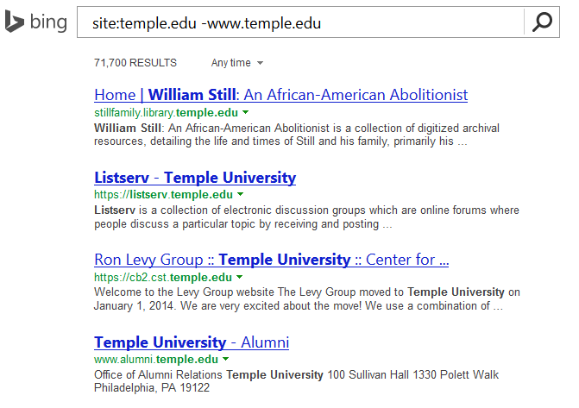
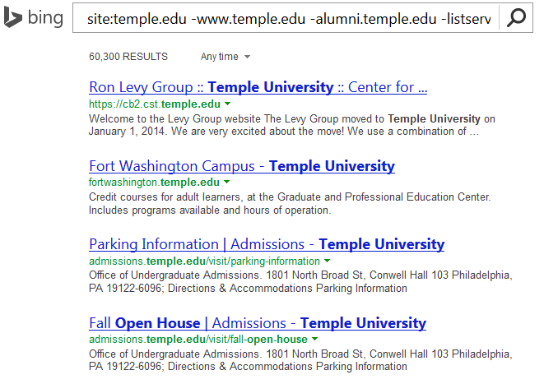
Google w/ “-”
Combine techniques from Google Hacking
Site:temple.edu -www.temple.edu

Slide 31
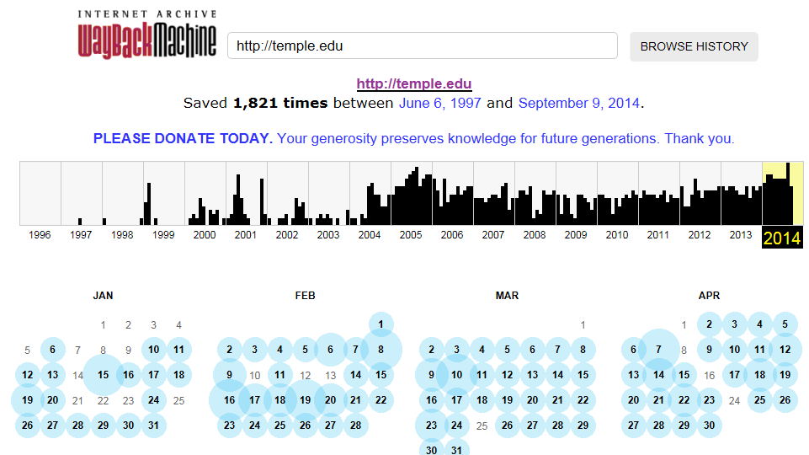
Older Versions of Websites
WayBack Machine
http://archive.org/web/web.php

Slide 32
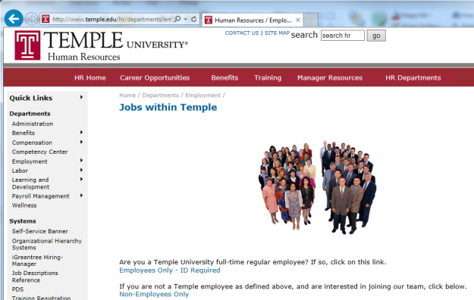
Open Job Posting
Job requirements can often provide insight into technologies in use, and where staffing shortages may result in weaknesses
Check multiple sites
Monster.com
Dice.com
Organizations site
http://www.temple.edu/hr/departments/employment/jobs_within.htm
Local job sites
http://regionalhelpwanted.com/philadelphia-jobs/?sn=83

Slide 33
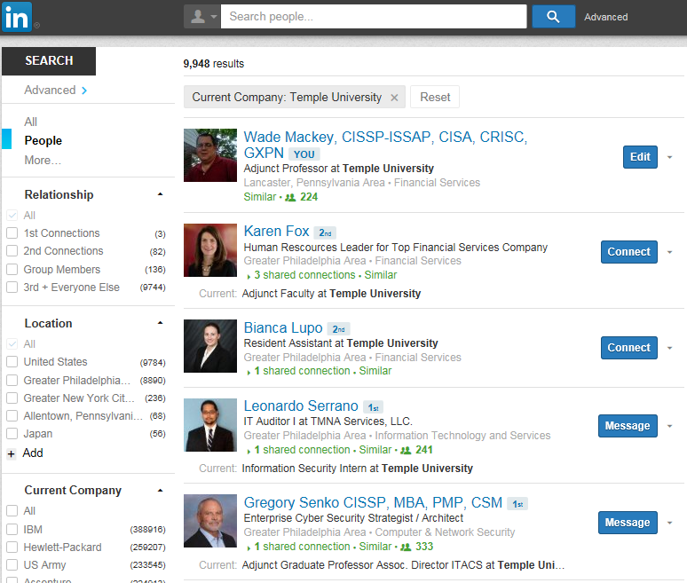
People
LinkedIn
Facebook

Slide 34
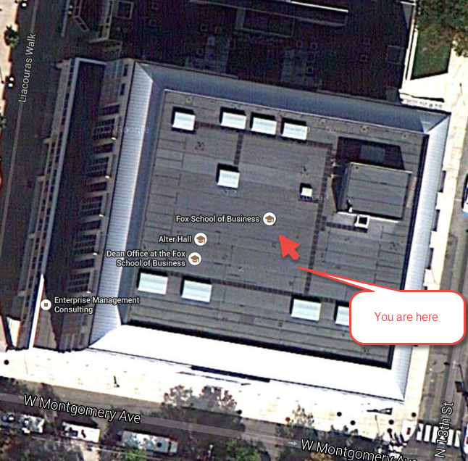
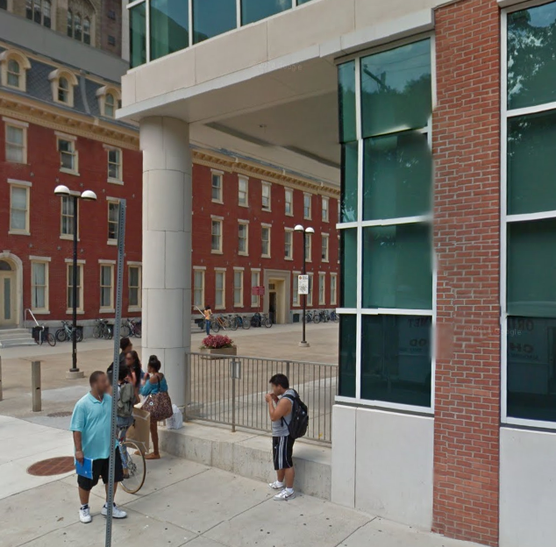
Don’t Forget About Maps
Google Maps
MapQuest
Google Earth

Slide 35
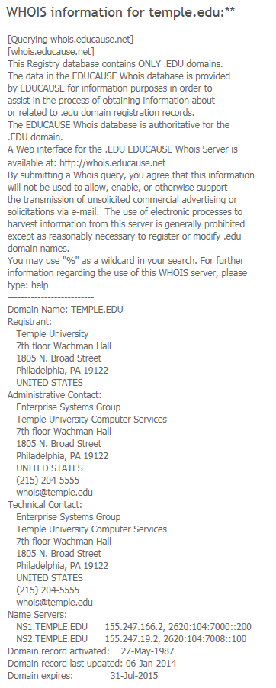
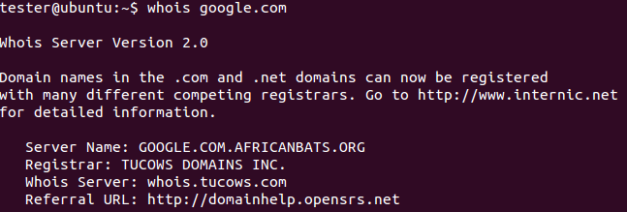
Whois
Whois
Database to lookup domain name, IP address and who registered the address
Web based or Command Line
whois google.com
http://www.networksolutions.com/whois/index.jsp

Slide 36
ARIN
American Registry for Internet Numbers
Regional Internet Registry for US, Canada, and many Caribbean islands
ARIN is one of five regional registries
Provides services related to the technical coordination and management of Internet number resources

Slide 37
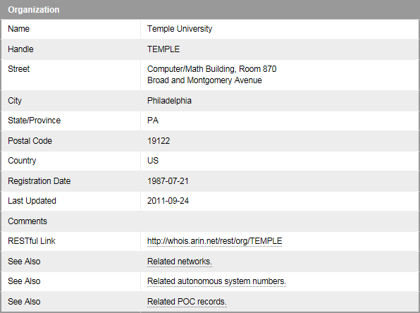
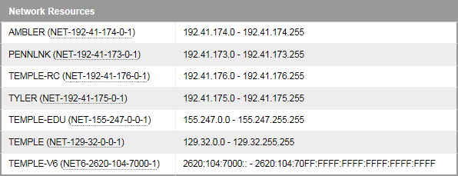
ARIN
Results

Slide 38
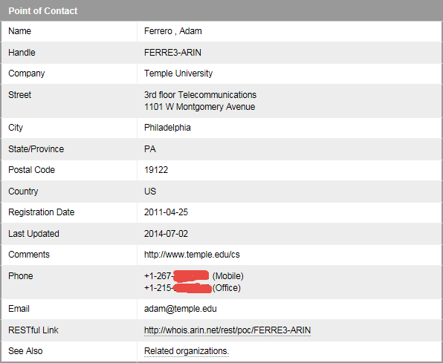
ARIN

Slide 39
DNS
Querying DNS Server
Examples
By domain name
Nslookup temple.edu OR nslookup ns1.temple.edu
Interactive
Nslookup
Followed by prompts
See next slide
Type exit to get out of interactive mode

Slide 40
DNS

Slide 41
Dig (Domain Information Groper)
The Dig command is used to gather additional DNS information
May also be used to make zone transfers.
Zone transfers may include details around other assets within an organization.
CAUTION, don’t go further then basic dig command on the next page as you may start triggering alerts in more security focused organizations.

Slide 42
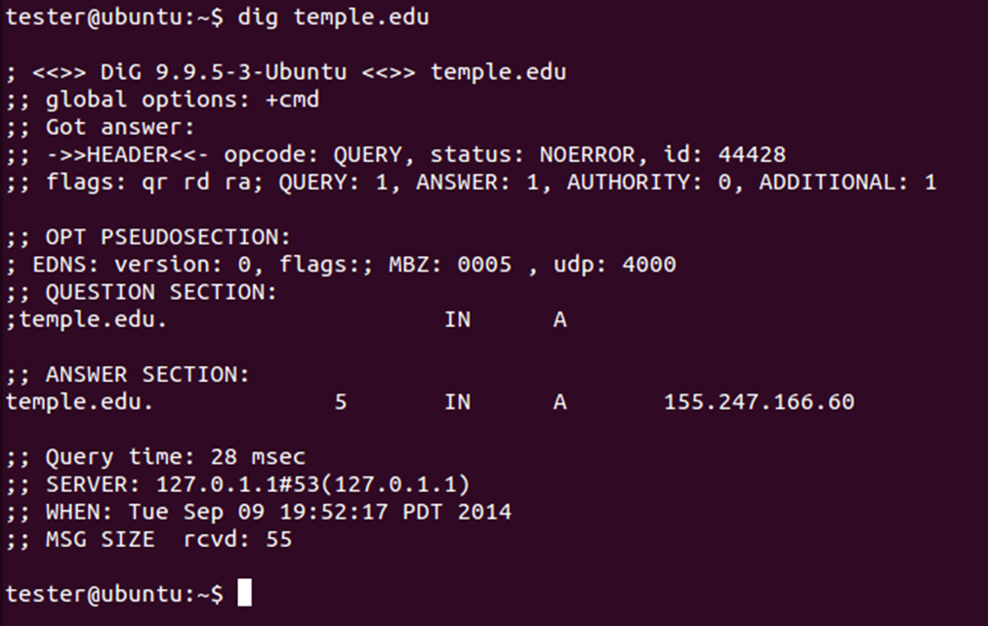
Dig
Example:

Slide 43
More on Dig
http://www.thegeekstuff.com/2012/02/dig-command-examples/
http://www.cyberciti.biz/faq/linux-unix-dig-command-examples-usage-syntax/

Slide 44
Windows Dig
Dig is available for windows 7
Site:
http://www.isc.org/downloads/bind/

Slide 45
DNS Query Websites
http://www.dnsstuff.com/tools
http://dnsquery.org/
http://network-tools.com/nslook/

Slide 46
More Tools
Sensepost
https://github.com/sensepost
BiLE-Suite – The Bi-directional Link Extractor
A suite of perl scripts to find targets related to a given site

Slide 47
Google Cache
The little green down arrow

Slide 48
Google Cache
&strip=1 – It’s magic
Right click the cache button and copy shortcut
Paste short cut into notepad and append &strip=1 to the end
Copy and paste into URL
Now you get Google’s cache without leaving a footprint in the target servers logs

Slide 49
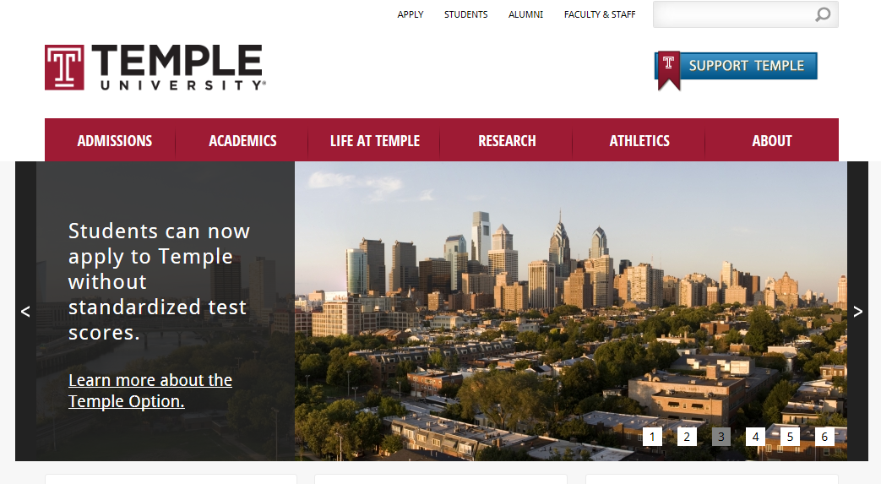
Google Cache (Example)
Without &strip=1

Slide 50
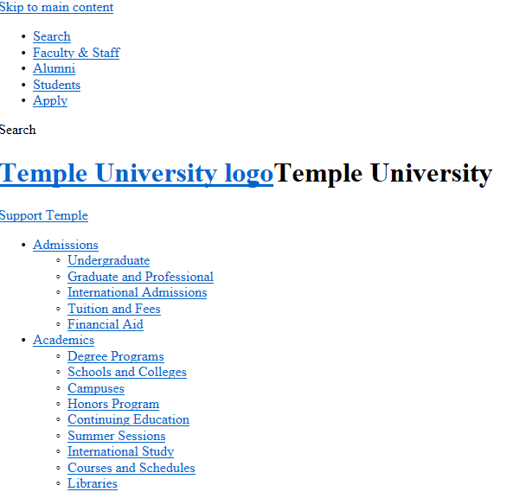
With &strip=1

Slide 51
Due for Next Week
1st formal assignment
From Syllabus
(student presentations) Reconnaissance exercise using only publicly available information, develop a profile of a public company or organization of your choosing
You may work in teams, or separately
One to two page Executive Summary
Short (no more then three slides, no welcome slide) presentation
See “Exercise Analysis” tab for more details

Slide 52
Next Week
Scanning

Slide 53
Questions
?

