Slide 1
Intro to Ethical Hacking
MIS 5211.001
Week 8
Site: http://community.mis.temple.edu/mis5211sec001fall17/

Slide 2
Tonight's Plan
Breaking Wireless News
Social Engineering
Encryption
Encoding

Slide 3
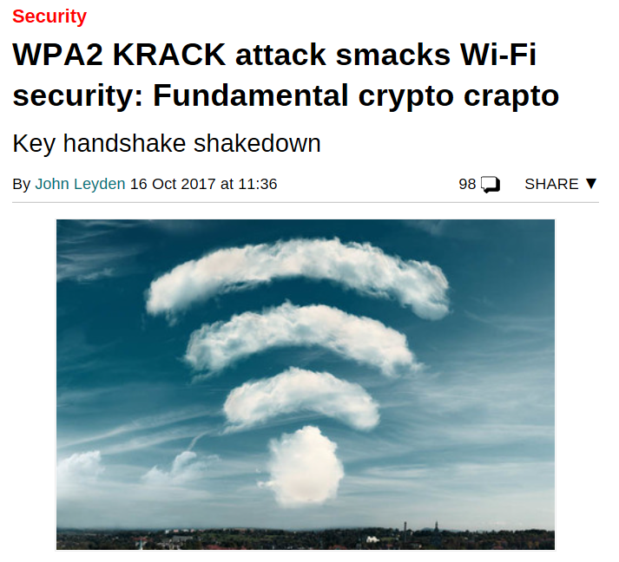
Source: https://www.theregister.co.uk/2017/10/16/wpa2_krack_attack_security_wifi_wireless/

Slide 4
Key Reinstallation Attacks
Breaking WPA2 by forcing nonce re-use
Bottom Line:
  Protocol allows for the replay of step 3 of a four way handshake that resets the encryption counter back to zero effectively re-installing the original key
  Once reset, the protocol re-uses the same encryption again
  Repeating the encryption creates a statistical flaw
Reference: https://www.krackattacks.com/

Slide 5
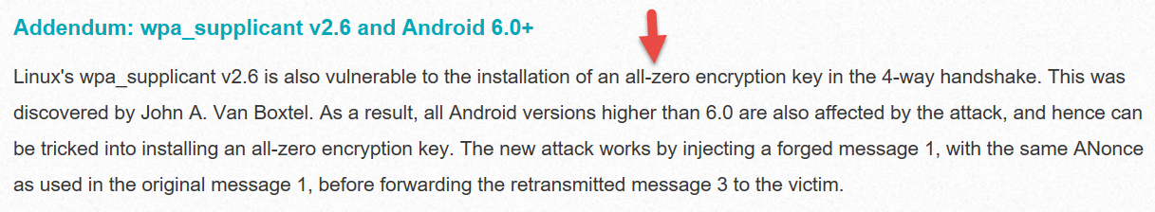
Even worse for Linux

Slide 6
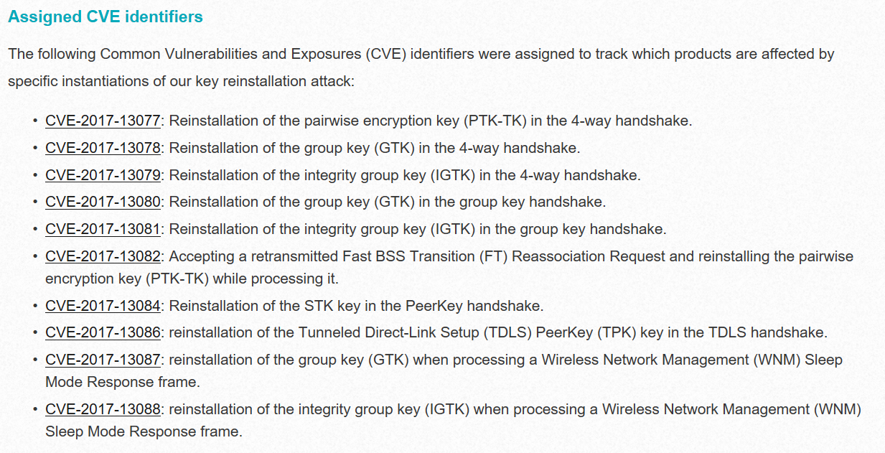

Slide 7
Social Engineering
Definition
  Getting people to do what you want
Alternatively
  Psychological manipulation of people into performing actions or divulging confidential information. - wikipedia.org
  Or
  Social engineering exploits people's emotions and their desire to help others – malware.wikia.com

Slide 8

Attitude
Confidence
  Act like you belong there
Friendliness
  Make people want to help you
Appearance
  Dress for the part

Slide 9
Categories
Can take a number of forms
  Pretexting
  Phishing
  Spear Phishing
  Vishing
  Tailgating
  Quid Pro Quo
  Baiting
  Diversion Theft

Slide 10
Pretexting
Inventing a scenario
  Do some recon
    Speak the language
    Impersonate someone who should be there
    Give information outsider would not have
      Legitimate name of supervisor or department
      Reference correct office location
      Project name or internal initiative
    Pretend to be police, FBI, TSA, or Homeland Security
      Note: this is a crime all by itself

Slide 11

Phishing
Email
  Again, starts with Recon
  Send legitimate looking email
  Request verification of information and warn of consequences for non-compliance
  Link to fraudulent web site
    Note: Larger organizations pay for monitoring services to catch this

Slide 12
Spear Phishing
Similar to phishing, but much more targeted
  Heavy recon
  Identify just the right target or targets
    Executive
    IT Admins
    Accounts payable
  Create content very specific to Target(s)

Slide 13
Phishing and Spear Phishing
Often used to deliver malware
  Tempting attachments:
    New bonus plan
    Layoff list
    Memorial notice for recently passed employee
  Web sites that deliver promised content
    But infect browser

Slide 14
Vishing
Similar to phishing, but by phone or fraudulent IVR
VOIP can be used to falsify source phone number (Caller ID Spoofing)
Swatting – Initiating a police raid

Slide 15
Tailgating
May or May Not be Social Engineering
  People feel a need to “Hold the door”
  Especially problematic in the south eastern US
Even man traps and roto-gates can be gotten around
  Show up with large packages or boxes
  Ask security for help

Slide 16
Quid Pro Quo
Call into company claiming to be Tech Support
  May take a number of calls
  Eventually you will hit someone that actually called for support
    Help them (Sort of)
    They’ll follow your directions
      Type commands
      Download software
      Provide data

Slide 17
Baiting
Spread USBs around parking lots
Mail official looking CDs
Send a token desk toy (with WiFi repeater installed)
Replacement mouse (with malware preloaded)
MP3 player

Slide 18
Diversion Theft
Fake ATM
Intercept delivery man
“Borrow” a FedEx or UPS truck and make a pickup

Slide 19

Dumpster Diving
More of a recon technique then actual Social Engineering
Gold Standards of Dumpster Diving
  Yellow Sticky
  Hand written notes
$

Slide 20
Questions

Slide 21
Encryption (Short Version)
Couple of points up front
  Real “Standards based” encryption is hard to break
  Proprietary encryption is usually not as hard to break
  When encryption is broken, it is usually the implementation, not the cypher suite that is broken
    Example: WEP and RC4
  Regardless of encryption, the computer has to decrypt the data to act on it. Therefore, clear text data is in memory
  Also true of browsers, browser must decrypt to act

Slide 22
Encryption (Short Version)
One exception to clear text in memory
Homomorphic Encryption
  Computations carried out on ciphertext
  Result is also encrypted
Problem:
  Very resource intensive
  Not fast enough for practical use (yet)

Slide 23
Terms
Algorithm – Mathematical rules used to encrypt and decrypt
Ciphertext – The encrypted data
Encipher – Encrypting
Decipher – Decrypting
Key – Sequence of bits and instruction that governs encryption and decryption
Plaintext – Unencrypted data

Slide 24

Symmetric vs Asymmetric
Symmetric – Both parties use the same key
  Anyone with a key can encrypt and decrypt
  Relatively fast, less intensive to use
Asymmetric – Keys linked mathematically, but cannot be derived from each other
  What one key encrypts, the other key decrypts
    Works both ways
  Also known as a key pair and associated with PKI or public key encryption
  Relatively slow, resource intensive

Slide 25
Stream and Block Ciphers
Block Ciphers
  Data is broken in to blocks
  Blocks are encrypted/decrypted individually
Stream Cipher
  Message is not broken up
  Encrypted/decrypted one bit at a time

Slide 26
Types of Symmetric Systems
DES
3DES
AES or Advanced Encryption Standard
Blowfish

Slide 27
Types of Asymmetric Ciphers
RC4
RSA
El Gamal
ECC or Elliptic Curve Cryptosystems

Slide 28
Public Key Encryption
A “Hybrid” encryption method
Symmetric key is used to perform bulk encryption/decryption of data
Asymmetric keys are used to pass the symmetric key securely

Slide 29
Session Keys
Basically just a secret key that is only used for one session between users (or systems) and is then disposed of.

Slide 30
Public Key Infrastructure (PKI)
Comprehensive process including:
  Programs
  Data formats
  Procedures
  Protocols
  Policies
  Mechanisms
All working together to secure communications

Slide 31
Certificate Authority
Certificate Authority (CA)
  Issues public keys
    Verifies you are who you say you are and provides certificate to prove it that can only come from a secret key you posses
Registration Authority (RA)
  Performs registration activities for a CA

Slide 32
One Way Function or Hashing
Provides for message integrity
Mathematical value calculated from data that cannot be reversed
  Sender and receiver can both calculate the value and verify that the data sent is the data received

Slide 33
Digital Signature
Encrypted hash value
  Data sent is data received
  Data can only have come from someone with the appropriate key(s)
  Reference: CISSP Certification, Shon Harris

Slide 34
The Unbreakable Code
Only one cipher is truly unbreakable
One-Time Pad
  Each pad is only used once
  Pad is XORd against cleartext data
  Ciphertext is XORd against pad at receiver
Generally not used due to difficulty in distributing non-recurring pads

Slide 35
Rules for Key Management
Longer keys are better
Keys need to be protected
Keys should be extremely random and use full spectrum of keyspace

Slide 36
Encoding
Encoding is NOT encrypting
Perfect example: Base64 encoding
  Well known
  Reversible
  Provide limited obfuscation
Other examples
  Morse code
  ASCII
  UTF-8, 16, 32
  EBCIDIC
  Unicode

Slide 37
Why we care about Encoding
Often used incorrectly as a substitute for encryption
Some “proprietary” encryption systems were nothing more then Base64 or Base64 with character substitution
  Even if you don’t recognize the encoding it is easily “cracked” with frequency analysis

Slide 38
Encoding and Web Attacks
We will see this again when we cover Web applications and intercepting proxies
  Base64 encoding is often used as an obfuscation technique

Slide 39

Blockchain
Distributed Ledger
  All parties have a copy
  Data can be added and is replicated across all copies
  Data cannot be modified or deleted
Benefits
  Distributed
  Lower transaction costs
  Faster transaction times
  Transparency & accountability & integrity
  Usage information and traceability
  Data security through encryption

Slide 40
Next Week
Malware

Slide 41
Questions
?

