Slide 1
Intro to Ethical Hacking
MIS 5211.001
Week 2
Site:
https://community.mis.temple.edu/mis5211sec001fall2019/

Slide 2
Tonight's Plan
Continue Intro
Network Components and their impact on penetration testing
Google Hacking
Linux fundamentals (Will not cover in class, review if you need it)

Slide 3
Infrastructure Firewalls
Firewalls may block or minimize the capabilities of penetration testing.
Pen testing activity, especially scanning, can cause performance issues in firewalls
HTTP Proxies may alter encoding
Next Generation firewalls (Like PaloAlto) may perform analysis and drop packets that are not well formed.

Slide 4
Host Firewalls
Avoid using firewalls on your test network and attack machines
May block activity before it ever leaves your systems
Since this exposes test machines to attack, use a separate, off-network machine to take notes.
Utilize USB drives to transfer information

Slide 5
Harden Test Machines
Machines in you testing network should be baselined and locked down as much as possible
Keep patching up to date
Turn off all unnecessary ports and services
Increase security settings where possible
Center for Internet Security provides some guidelines
http://www.cisecurity.org/
MicroSoft Baseline Security Analyzer also helps
https://www.microsoft.com/en-us/download/details.aspx?id=19892

Slide 6
Protecting Test Results
Consider encrypting test findings as they accumulate
Example
OpenPGP
https://www.openpgp.org
Symantec PGP
https://www.symantec.com/products/encryption
BitLocker
https://support.microsoft.com/en-us/search?query=bitlocker
Encryption technologies are changing, stay up to date on what works, and what has been broken

Slide 7
Clean Test Machines Between Tests
When an engagement ends
Move test results off of systems
Scrub systems thoroughly
Secure Deletion
Reimage
Revert to baseline
Note: Consider using Solid State Drive w/ Trim turned on, faster and deleted data auto zero’s

Slide 8
Penetration Testing Process
Preparation
NDAs if applicable
Client concerns
Rules of Engagement
Scope
Written Permission and Acknowledgement of Testing Risks
Testing
Perform Test
Conclusion
Analyze results and retest as needed
Develop report and presentation if needed

Slide 9
Permissions
Vital that written permission be obtained
Without this you could be held criminally responsible
Good intentions are no defense
Ensure individual granting permission has the authority to do so
Corporate Officer
Director
P&L Responsibility

Slide 10
Insurance & Limitation of Liability
Permission alone is not sufficient
If you are not working “In-House”
Contract language needs Limitation of Liability language
Time to call in the lawyers
You, or the company you work for will also need liability insurance

Slide 11
Rules of Engagement
At a minimum
Contact Information
Periodic Debriefing (Daily?)
Dates and Times for Testing
When to start
When to stop
Hours when testing is acceptable
Announced or Unannounced

Slide 12
Shunning
What if Sys Admins detect testing and attempt to block.
Is this good, or bad?
Stop test, or remove blocks and keep testing?
Verify if client IDS, IPS, or WAF may block attacks
This may be OK if test was focused on effectiveness of these systems
However:
Could cause Denial of Service
Resource consumption
May need to get you traffic excluded from protections to test systems behind these controls

Slide 13
Black Box vs Crystal Box
Black Box:
No data provided to tester other than target IP Address or URL
Mimics malicious attackers vantage point
Time and resource consuming
Crystal Box:
Tester provided detailed data on systems and architecture
Allows tester to quickly move to value added work
May not uncover data leaked into public space that would have been found during reconnaissance phase

Slide 14
Data on Compromised Systems
How far should test team go?
Configuration Data
User Info
PII
Should likely stop at configuration data
Testers do have a responsibility to not go past agreed to boundaries
Also applies to sniffer data
Will explain this in detail later in the course

Slide 15
Observed Tests
Is a client representative going to observe all testing
Ensure client data is protected
Inform testers that some area may be off limits
Is client staff going to work with testing team
Client may want their staff to become familiar with tolls and methodology

Slide 16
Completing Planning
Establish agreement on handling issues prior to starting
Document the agreement and get sign-off from all parties
Congratulations – You now have your Rules of Engagement

Slide 17
Scope
Identify Client Security Concerns
Disclosure?
Availability?
Reputation?
Financial Loss?
Other?
Only the client can tell you what they are really worried about

Slide 18
Additional Scope Questions
Identify known issues
Do you need to verify them?
Identify likely threats
State Actors
Disgruntled Employees
Determine what to focus on

Slide 19
What to Test
Determine clear and explicit scope
What to test
Which systems?
Which address space?
Individual hosts?
What to stay away from
Known “brittle” systems
Critical systems

Slide 20
Third Parties
If third parties are to be tested, they need to provide written permission
If out of scope, need to know who and what they are to avoid them
This is a particular concern in web application testing as sites routinely link or have content hosted form third parties

Slide 21
Production vs Test
Test environments offer lower risk of impact
May not match production
May respond slower, impacting test efficiency
May not be possible, as only a production system exists

Slide 22
How to Test
How hard are you going to try
Ping Sweeps
Port Scanning
Vulnerability Scanning
Penetration into Target
Application Level Attacks
Client Side Attacks
Business Logic
Physical
Social Engineering
Denial of Service

Slide 23
Internal or Near Internal Testing
What about insider threats
Possibilities
Official site visit and granted access
Onsite and breaks in
WiFi
Dial-In
VPN
Citrix
Teams
Public Kiosk

Slide 24
Client Side
Old process focused on servers and infrastructure
More and more focus on client side testing
Can I pivot through a compromised client browser (Think Target)
Can I target vulnerable staff? Or does the client organizing want to provide a willing target to accept the attack (and avoid embarrassing employees)

Slide 25
Social Engineering
Very powerful
Manipulating employees may impact morale, but also may serve an awareness function
Client needs to think through and consider pros and cons

Slide 26
Conducting a Social Engineering Test
Explicit written permissions
Defined goal, what are you after?
Develop several scripts and get them vetted by client
Select the right tester
People person
Someone others want to help
Sympathetic

Slide 27
Denial of Service
Dangerous to test
Often not done because it is already known that systems can be knocked down
If in scope, ensure specifically documented as “in scope”
Consider carving out a subsystem to test so as not to take down entire client

Slide 28
Dangerous Exploits
Some tests are known to be dangerous
Nessus has separate category of vulnerabilities it can scan for that are known to knock targets of line
Some Metasploit attacks will either succeed or crash the target system
Access testing can lock out users inadvertently

Slide 29
Reporting Results
Always create a report
It may be the only evidence you where there
Will likely be around a long time
Therefore, make sure it is clean, correct, and reflects well on the effort you put in
Report may make the difference between repeat engagement or no more engagements
Even if “In-House” create the report
Brands your team and their effort

Slide 30
Scan Results Are Not A Report
Scanning reports may be included in an appendix, but they should not constitute the body of the report
Description of findings, with impact and recommended mitigation go in the body of a report
Don’t accept scanning result ratings at face value.
May need to adjust based on other information developed during test

Slide 31
Suggested Format
Executive Summary
Introduction
Methodology
How did you do the testing
Findings
Ranked by severity
Recommendations
Conclusion
Clients often want to know how they stack up against their vertical
Appendices (if needed)

Slide 32
Executive Summary
Most important part of test
Management representatives may never read beyond the summary
Keep it short
1 page, 1.5 at most
Briefly acknowledge test team and client employees who participated
Summarize overall risk posture

Slide 33
Executive Summary
Include bulleted list of most significant findings
Three to six at most
Framed in terms of business impact
Why does the line of business care about the risks identified
Describe mitigation paths
People
Processes
Technology

Slide 34
Screenshots and Illustrations
Screenshots or illustrations help capture audience attention and make findings more “real”
Only include “useful” screenshots
Focus on important area, zoom in
Use mask to exclude sensitive information
Passwords
User Names
Employee or Customer Data

Slide 35
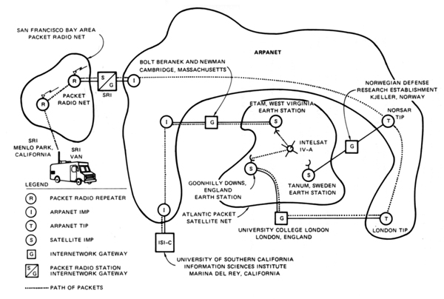
Networking
The very first internetworked connection:
Source: http://en.wikipedia.org/wiki/Internet_protocol_suite

Slide 36
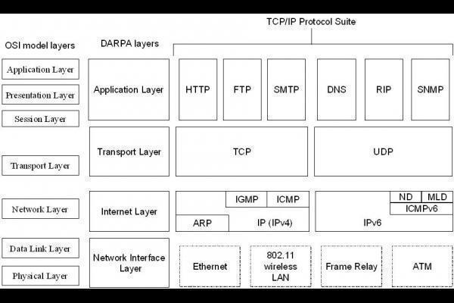
Internet Protocol Suite
How Data fits together:

Slide 37
A word about Ports
Ports – logical assignment to packets of data
Used to distinguish between different services that run over transport protocols such as TCP and UDP
IANA Registry:
http://www.iana.org/assignments/service-names-port-numbers/service-names-port-numbers.xhtml?&page=1

Slide 38
Protocols
What we will cover
IP
ICMP
UDP
TCP
ARP

Slide 39
IP Protocol
Internet Protocol
Primary protocol of the Internet Layer of the Internet protocol
Three main functions
For outgoing packets – Select the next hop host (Gateway)
For incoming packets – Capture the packet and pass up the protocol stack as appropriate
Error detection

Slide 40
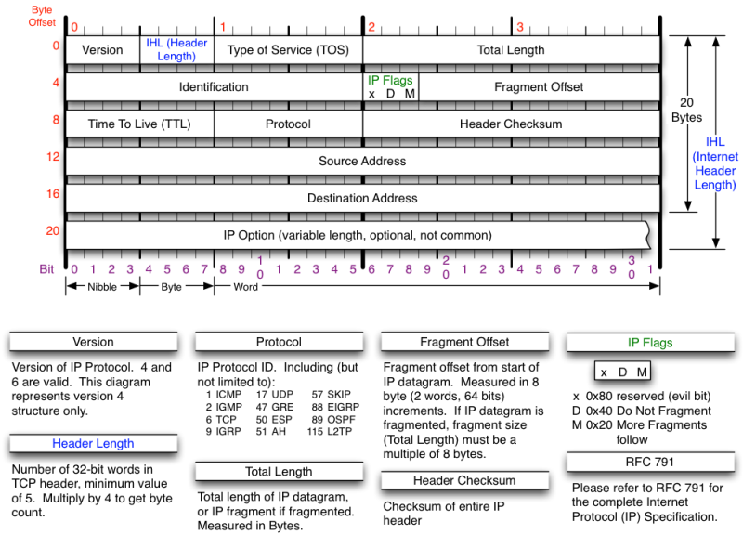
IP Protocol
Source: http://nmap.org/book/tcpip-ref.html

Slide 41
ICMP Protocol
Internet Control Message Protocol
Used by network devices to communicate status
Not “typically” used to exchange data
Does not have a “port” assignment
Not usually accessed by end-users accept for:
ping
traceroute

Slide 42
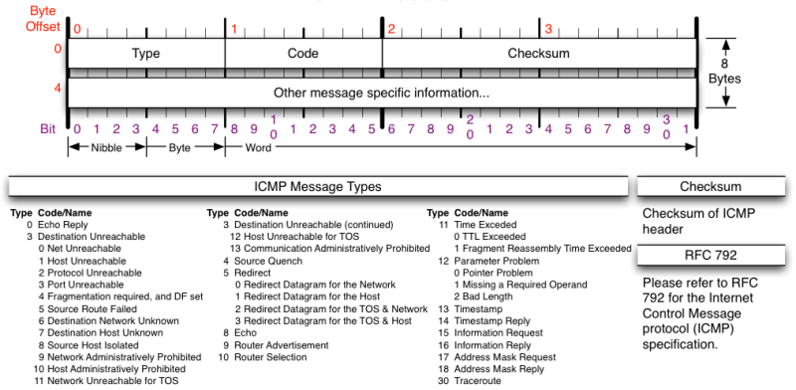
ICMP Protocol
Source: http://nmap.org/book/tcpip-ref.html

Slide 43
UDP Protocol
User Datagram Protocol
Simple transmission model with limited mechanisms
No guarantee of delivery
No acknowledgement of receipt
Does include checksum and port numbers

Slide 44
UDP Protocol
Source: http://nmap.org/book/tcpip-ref.html

Slide 45
TCP Protocol
Transmission Control Protocol
Sometimes called TCP/IP
Provides reliable, ordered and error checked delivery of a stream of data (or Octets) across local area networks, intranets, and public internet
This is the protocol used for HTTP, HTTPS, SMTP, POP3, IMAP, SSH, FTP, Telnet, and others

Slide 46
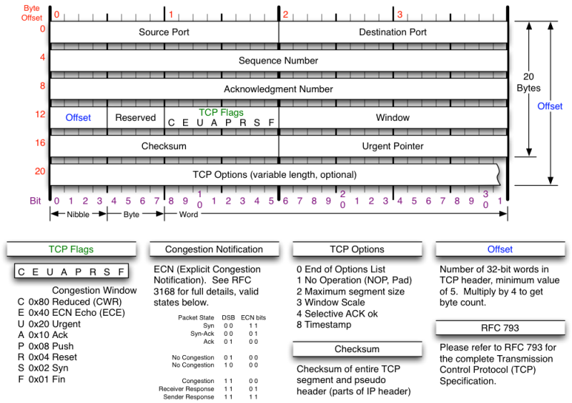
TCP Protocol
Source: http://nmap.org/book/tcpip-ref.html

Slide 47
ARP Protocol
Address Resolution Protocol
Used to convert an IP address to a MAC Address
MAC Address is the unique hardware address written into the hardware of every network card
Example: 6C-62-6D-05-F9-18
Tells me my Network Card comes from Micro-Star INTL CO., LTD in Taiwan (based on 6C-62-6D)
Can be altered by software

Slide 48
Network Components
Switches
Routers
Firewalls
Standard
Next Generation
Web Application
Load Balancers
Proxies
Reverse Proxies
DNS

Slide 49
Switches
Used to connect devices together on a network
Depending on functionality can operate at different layers of the OSI model
“Layer 1” – Hub – Traffic is not managed – Every packet repeated to every port
“Layer 2” – Data Link Layer – Some management – Switch knows MAC Address of locally connected devices and sends appropriate packets
“Layer 3” – Switch understands “routing” and knows what packets to pass out of the local segment
Microsoft Explanation of OSI Model : http://technet.microsoft.com/en-us/library/cc959881.aspx

Slide 50
Routers
Forwards packets between computer networks
Works to keep localized traffic inside and only passes traffic intended for targets outside the local network
Boundary between “Routable” and “Non-Routable” IP addressing

Slide 51
Non-Routable Addressing (Private)
10.0.0.0 to 10.255.255.255
Class A
16,777,216 addresses
172.16.0.0 to 172.31.255.255
Class B
1,048,576 addresses
192.168.0.0 to 192.168.255.255
Class C
65,536 addresses

Slide 52
Firewalls (Standard)
Standard Enterprise Firewalls are “2nd Generation”, implies stateful
Filters traffic based on:
Address
Port
Stateful: Retains enough data about previous packets to understand connection state

Slide 53
Firewalls (Next Generation)
Extend operation into the Application layer
Provides for Application layer filtering
Understands certain applications and protocols
Can determine if data inside a packet is consistent with the application or protocol

Slide 54
Firewalls (Web Application)
Similar to Next Generation, but retains even more information around “normal” web site activity
Builds a profile of how users interact with a website, and what the traffic should look like
Generates alerts when patterns change
Can generate false positives if web site undergoes high volumes of change

Slide 55
Network Address Translation (NAT)
Modifies network addresses in the IP datagram
Translation – Replaces the IP address in the packet with another address
Obscures addressing behind the NAT device, typically a firewall
Can convert non-routable addresses to routable addresses
Means the address you see is not necessarily the address of the target device

Slide 56
Load Balancers
Distributes sessions across multiple server
User does not “Know” what server is in use
May terminate SSL connection for server, improving server performance
May apply additional SSL restrictions outside of certification rules
Internal tester can usually direct access to a particular machine or cell via alternate port

Slide 57
Google Hacking
Search Bar Commands
-
Site:
Filetype:
Inurl:
Intitle:
Intext:
Allinurl:
Allintext:
Search Terms

Slide 58
-
Simple one that tells google to not include items that match what comes directly after “-”
Example:
Hacking –ethical – gives all results that include information about hacking as long as they do not include the term “ethical”

Slide 59
Site:
Site: restricts searches to a specific site
Examples
Site:edu – Restricts searches to only sites ending in .edu
Site:temple.edu – Restricts searches to a specific top level site
Site:mis.temple.edu –Restricts searches to a sub-site

Slide 60
Filetype:
Restricts searches to a specific file type
Examples
Filetype:pdf – Only responds with sites linked to Adobe documents with file extension of pdf
Filetype:xls – Only responds with sites linked to Microsoft spreadsheets documents with file extension of xls
Filetype:xlsx – Only responds with sites linked to Microsoft spreadsheets documents with file extension of xlsx – Excel’s newer file format

Slide 61
Inurl:
Restricts searches to sites where specific word or phrase is in the url
Examples
inurl:"/root/etc/passwd“
inurl:admin
inurl:j2ee/examples/jsp
inurl:backup

Slide 62
Intitle:
Restricts searches to sites where specific words are used in the title of a page
Examples
intitle:index.of
intitle:"Test Page for Apache"
intitle:"Apache Status"
intitle:"PHP Explorer"

Slide 63
Intext:
Restricts results to documents containing term in the text
Examples
intext:"root:x:0:0:root:/root:/bin/bash"
intext:"SteamUserPassphrase="
intext:"SteamAppUser=" -"username" -"user"
intext:"Usage Statistics for”

Slide 64
Allinurl:
Restricts results to those containing all the query terms you specify in the URL
Examples
allinurl:/hide_my_wp=
allinurl:"/main/auth/profile.php"
allinurl:"owa/auth/logon.aspx"
allinurl:forcedownload.php?file=

Slide 65
Allintext:
Restricts results to those containing all the query terms you specify in the text of the page
Examples:
allintext: /iissamples/default/
allintext: "Please login to continue..."
allintext:"Browse our directory of our members top sites or create your own for free!"
allintext:"fs-admin.php"

Slide 66
Search Terms
Key search terms
“index of /”
“Please re-enter your password it must match”

Slide 67
Google Hacking References
GoogleGuide
http://www.googleguide.com/advanced_operators_reference.html
Exploit Database
http://www.exploit-db.com/
Wikipedia
http://en.wikipedia.org/wiki/Google_hacking
Google Hacking Volume 3
https://www.amazon.com/Google-Hacking-Penetration-Testers-Third/dp/0128029641/ref=dp_ob_title_bk

Slide 68
Questions
?

Slide 69
Next Week
Reconnasaince

Slide 70
Linux
What is Linux
Open source operating system
Many similarities with UNIX
Why do we care
Some tools only available in Linux
Some tools work better in Linux
Best open source attack suites are built on Linux
Kali
Samurai WTF (Web Testing Framework)
SIFT (SANS Investigative Forensic Toolkit)

Slide 71
Logging In
For Kali the default password is toor
For Samurai the default password is samurai

Slide 72
root
“root” is the base admin account on a Linux system.
Should not be used for routine operations

Slide 73
SUDO
Used to execute commands that require root privilege
Requires user to supply their password, not the root password

Slide 74
Changing Passwords (passwd)
“passwd” command is used to change passwords
Any user can change their password by typing passwd at the command prompt.
Will be prompted to enter new password twice
“root” or sudo user can change others passwords with command:
passwd [login_name]

Slide 75
Changing Accounts
“su” command allows you to jump to another user account (with appropriate password of course)
“whoami” command tells you who you are logged in as

Slide 76
Linux File System

Slide 77
Navigating File System
Command cd [directory_name] changes directory
Command cd.. Moves up one level
Command pwd tells you were you are
Command cd by itself takes you to your home directory

Slide 78
Viewing Directories
Command ls lists directory content
Flags
-l – details including permissions
-a – shows all files
When in doubt use command “man ls”, this gives you the manual or man page for the command

Slide 79
Output from ls -la

Slide 80
Make and Remove Directories
Command mkdir creates directory
As before man mkdir gives you the manual
Command rmdir removes directory

Slide 81
Make and Remove Directories

Slide 82
Locate and Find
Command locate checks an index on system to look for common items
Command find searches file system
On my test implementation, find required sudo privileges

Slide 83
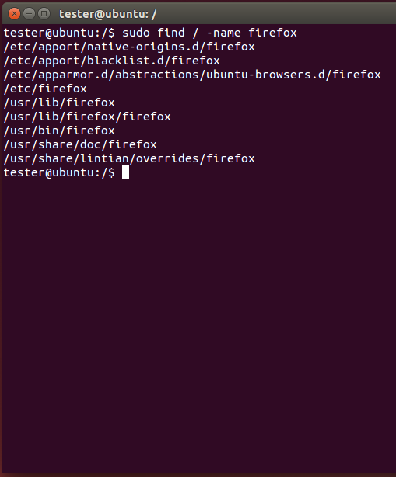
Locate and Find

Slide 84
Editing Files
Lots of choices, lets keep it simple
Command gedit opens a text editor
Command gedit test opens an existing file named test. If no such file exists, the file is created
Edit as wish, save when done

Slide 85
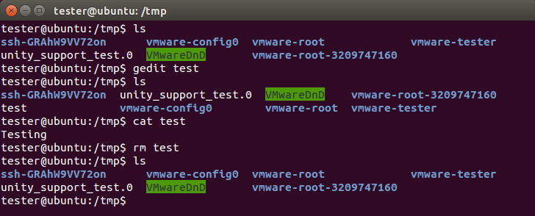
Editing Files

Slide 86
Viewing Files
Command cat shows content of a file

Slide 87
Looking at Output
Output often larger then screen
Commands less and more
Work similarly
less requires you hit q when done to return to command prompt
more dumps to command prompt when last screen is completed

Slide 88
Miscellaneous Commands
Command ps shows running processes
Lots of switches to refine results
Command CTRL-z interrupts running com
Command bg restores interrupted command to run in background
Command & tells job to run in background from the beginning
Command jobs shows jobs running
Command fg moves job to foreground

Slide 89
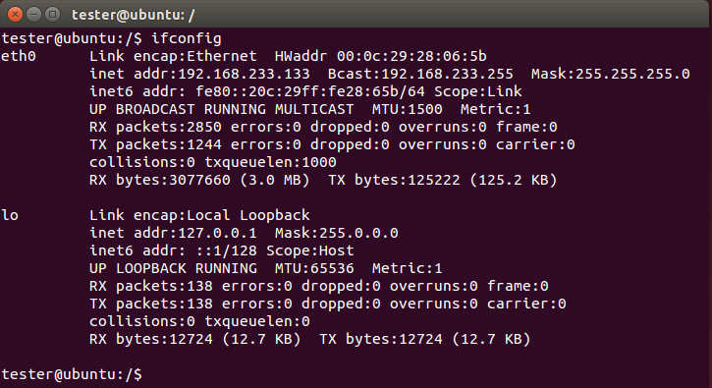
Network
Command ifconfig shows network configuration. Similar to ipconfig in windows

Slide 90
Netstat
Netstat prints information about the Linux networking subsystem. The type of information printed is controlled by the first argument, as follows:
(none) – By default, netstat displays a list of open sockets. If you don't specify any address families, then the active sockets of all configured address families will be printed.
--route , -r – Display the kernel routing tables. See the description in route(8) for details. netstat -r and route -e produce the same output.
--groups , -g – Display multicast group membership information for IPv4 and IPv6.
--interfaces, -I – Display a table of all network interfaces.
--masquerade , -M – Display a list of masqueraded connections.
--statistics , -s – Display summary statistics for each protocol.

Slide 91
Netstat

Slide 92
grep
grep searches the named input FILEs for lines containing a match to the given PATTERN. By default, grep prints the matching

Slide 93
Grep w/ netstat and ps
Try grep with netstat to see what is using http
netstat -nap | grep http
Try grep with ps to see if cron is running
ps aux | grep cron

Slide 94
Grep w/ netstat and ps

Slide 95
Going Further
Get VMWare and a Linux ISO
Kali
http://www.kali.org/downloads/
Ubuntu
http://www.ubuntu.com/download/desktop
Samurai
http://www.samurai-wtf.org
Give it a try
All examples here where created in a clean, plain vanilla Ubuntu install

