Slide 1
Intro to Ethical Hacking
MIS 5211.001
Week 3
Site:
https://community.mis.temple.edu/mis5211sec001fall2019/

Slide 2
Tonight's Plan
Reconnaissance

Slide 3
Reconnaissance
Attacker gathers publicly available data
People
Corporate culture
Technologies in use
Terminology
This is an important step as it will help focus later activities

Slide 4
Inventory
Maintain an inventory of what you find
Keep a log bog
Create a spreadsheet
Whatever works for you
Record key information
IP Addresses
Target names
Search queries used
OSs in use
Known vulnerabilities
Any passwords found

Slide 5
More on Inventory
Leave room to annotate future information that may be discovered as you go
Examples:
Open ports from port scanning
Search from compromised hosts
Etc…

Slide 6
Competitive Intelligence
Think like a business competitor
Lines of business
Major products or services
Who’s in charge
Officers
VPs
Press Releases
Where are their physical locations
Who are the major competitors in there market place
The same kind of information you would gather for a job interview.

Slide 7
Search Engines
Don’t just use Google
Bing
Yahoo
Ask
DuckDuckGo
All search engines filter data, but they don’t all filter the same way

Slide 8
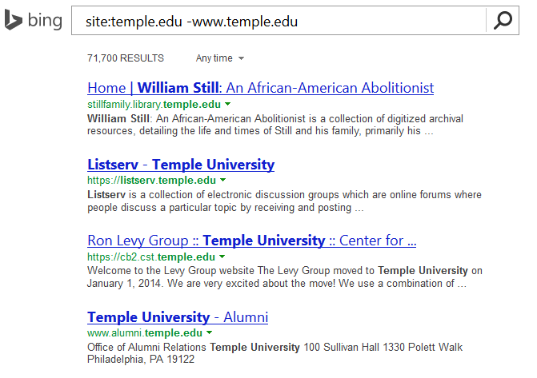
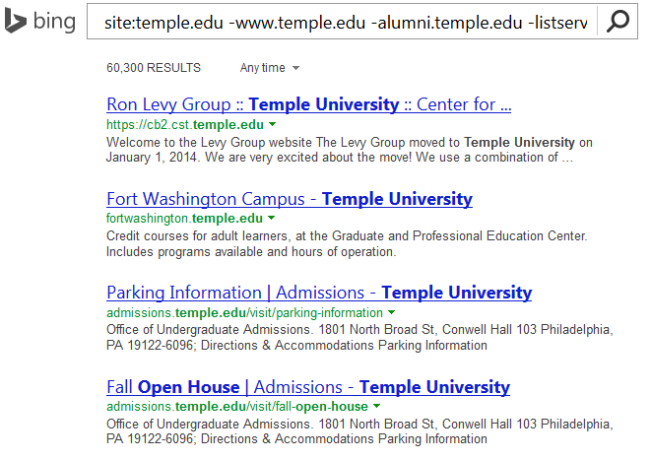
Google w/ “-”
Combine techniques from Google Hacking
Site:temple.edu -www.temple.edu

Slide 9
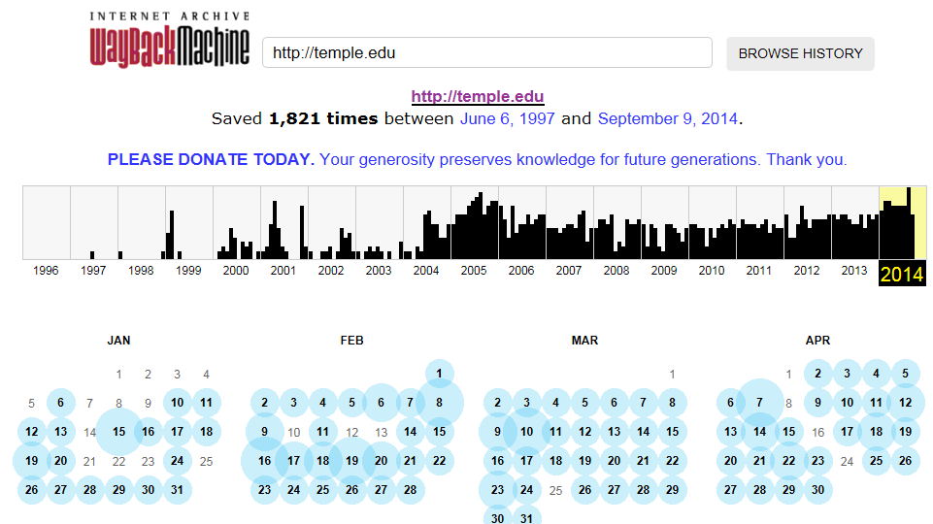
Older Versions of Websites
WayBack Machine
http://archive.org/web/web.php

Slide 10
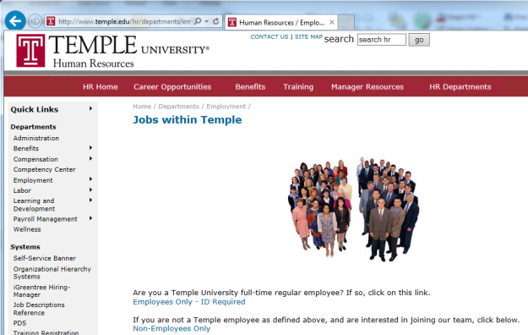
Open Job Posting
Job requirements can often provide insight into technologies in use, and where staffing shortages may result in weaknesses
Check multiple sites
Monster.com
Dice.com
Organizations site
http://www.temple.edu/hr/departments/employment/jobs_within.htm
Local job sites
http://regionalhelpwanted.com/philadelphia-jobs/?sn=83

Slide 11
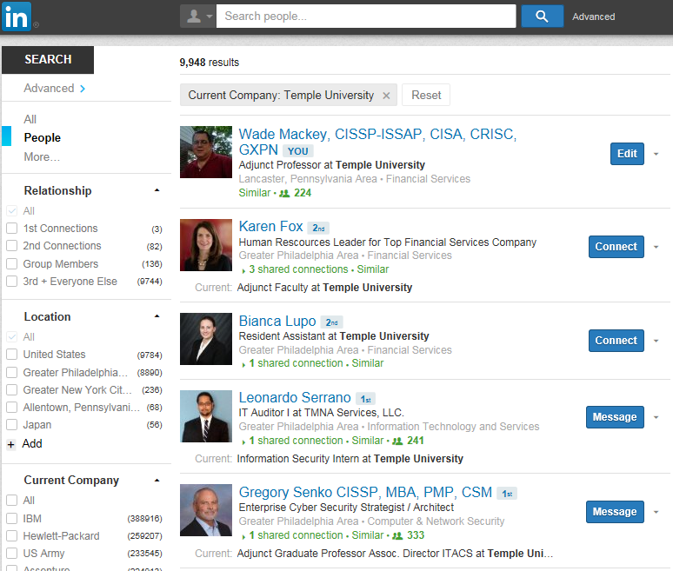
People
LinkedIn
Facebook

Slide 12
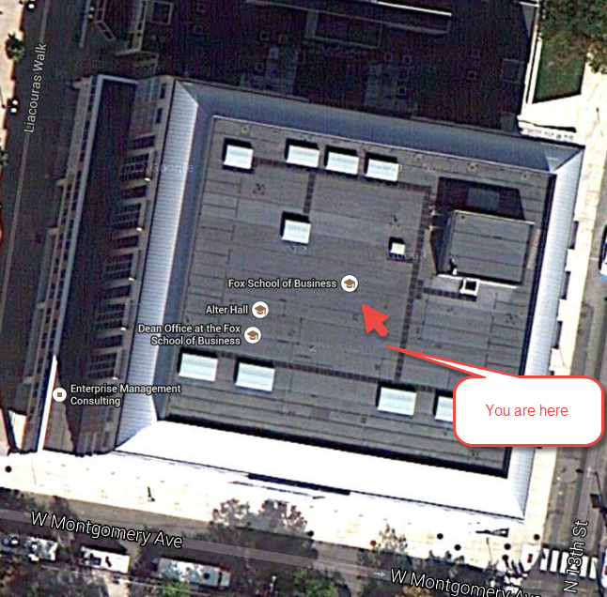
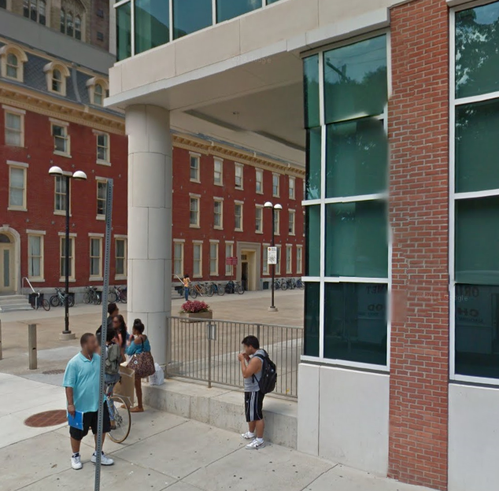
Don’t Forget About Maps
Google Maps
MapQuest
Google Earth

Slide 13
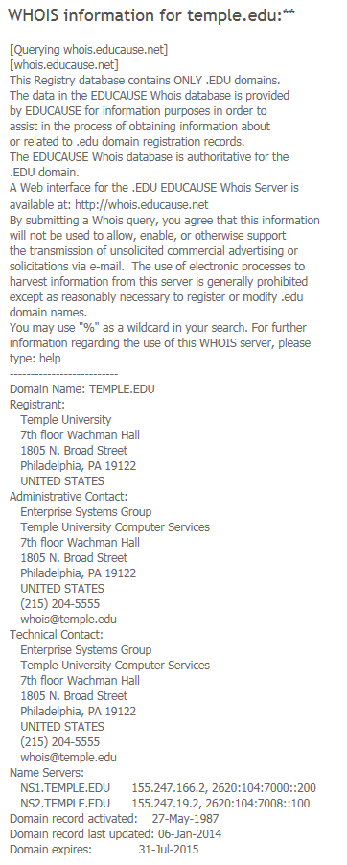
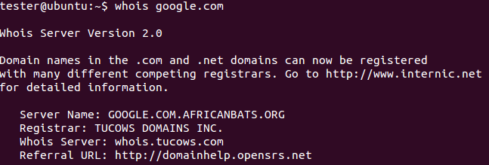
Whois
Whois
Database to lookup domain name, IP address and who registered the address
Web based or Command Line
whois google.com
http://www.networksolutions.com/whois/index.jsp

Slide 14
ARIN
American Registry for Internet Numbers
Regional Internet Registry for US, Canada, and many Caribbean islands
ARIN is one of five regional registries
Provides services related to the technical coordination and management of Internet number resources
https://www.arin.net

Slide 15
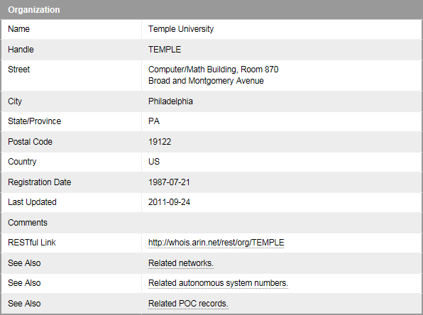
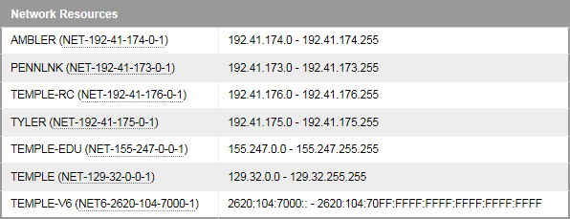
ARIN
Results

Slide 16
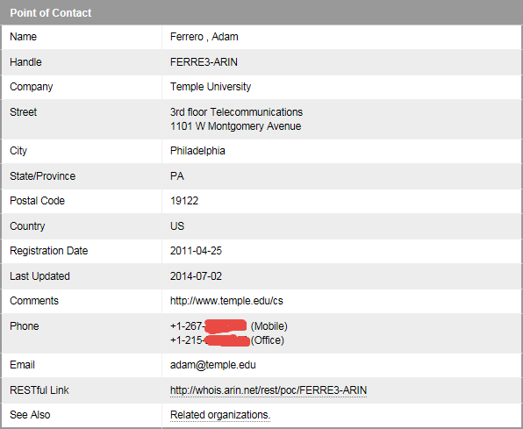
ARIN

Slide 17
DNS
Querying DNS Server
Examples
By domain name
Nslookup temple.edu OR nslookup ns1.temple.edu
Interactive
Nslookup
Followed by prompts
See next slide
Type exit to get out of interactive mode

Slide 18
DNS

Slide 19
Dig (Domain Information Groper)
The Dig command is used to gather additional DNS information
May also be used to make zone transfers.
Zone transfers may include details around other assets within an organization.
CAUTION, don’t go further then basic dig command on the next page as you may start triggering alerts in more security focused organizations.

Slide 20
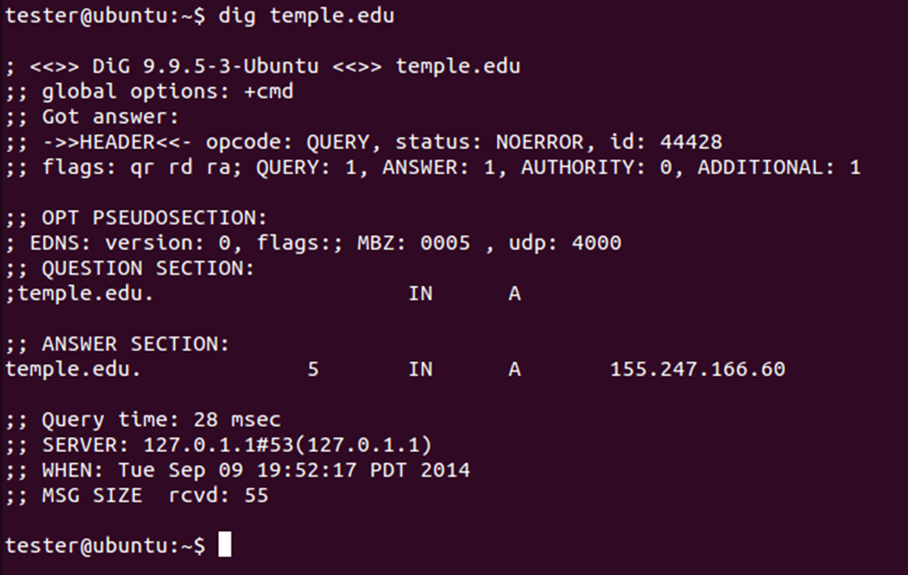
Dig
Example:

Slide 21
More on Dig
http://www.thegeekstuff.com/2012/02/dig-command-examples/
http://www.cyberciti.biz/faq/linux-unix-dig-command-examples-usage-syntax/

Slide 22
Windows Dig
Dig is available for windows 7
Site:
https://help.dyn.com/how-to-use-binds-dig-tool/

Slide 23
DNS Query Websites
http://dnsquery.org/
http://network-tools.com/nslook/

Slide 24
More Tools
Sensepost
https://github.com/sensepost
BiLE-Suite – The Bi-directional Link Extractor
A suite of perl scripts to find targets related to a given site

Slide 25
Google Cache
The little green down arrow

Slide 26
Google Cache
&strip=1 – It’s magic
Right click the cache button and copy shortcut
Paste short cut into notepad and append &strip=1 to the end
Copy and paste into URL
Now you get Google’s cache without leaving a footprint in the target servers logs

Slide 27
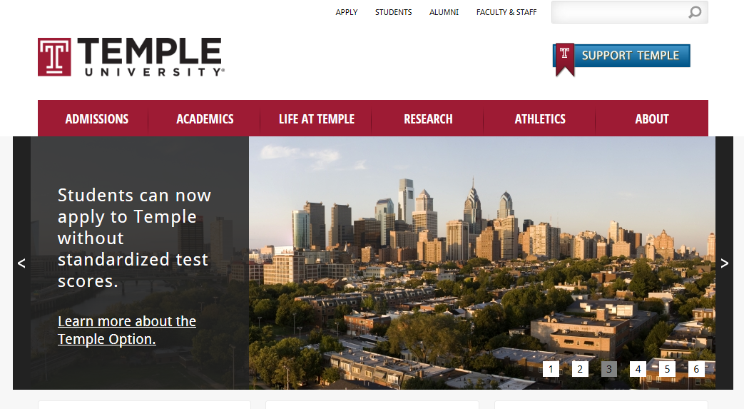
Google Cache (Example)
Without &strip=1

Slide 28
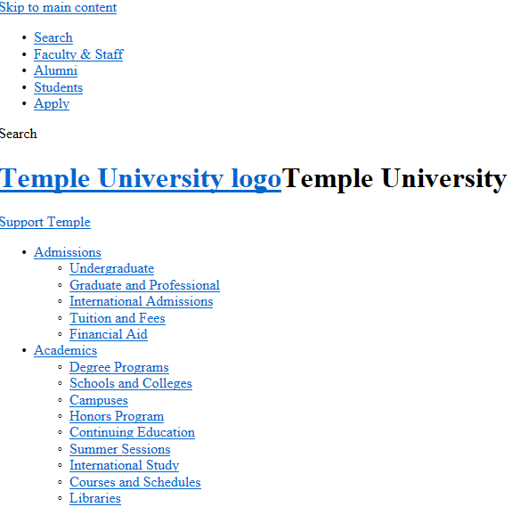
With &strip=1

Slide 29
Ruby
If interested in learning a bit about Ruby, try the below. This is not an assignment for the class. Just something you might find useful.
Link to Language
https://www.ruby-lang.org/en/
Link to Interactive Ruby Website
https://ruby.github.io/TryRuby/

Slide 30
Due for Next Week
1st formal assignment
From Syllabus
(student presentations) Reconnaissance exercise using only publicly available information, develop a profile of a public company or organization of your choosing
You may work in teams, or separately
One to two page Executive Summary
Short (no more then three slides, no welcome slide) presentation
See “Exercise Analysis” tab for more details

Slide 31
Next Week
Scanning

Slide 32
Questions
?

