Slide 1
Intro to Ethical Hacking
MIS 5211.001
Week 4
Site: https://community.mis.temple.edu/mis5211sec001fall2019/

Slide 2
Tonight's Plan
Scanning
  Types
  TcpDump
  Nmap
  Start Vulnerability Scanning

Slide 3
Scanning
Goals
  Find live network hosts, Firewalls, Routers, Printers, etc…
  Work out network topology
  Operating systems used
  Open ports
  Available network services
  Potential vulnerabilities
  While minimizing the chance of disrupting operations

Slide 4
Type of Scans
Sweep – Send a series of probes (ICMP ping) to find live hosts
Trace – Use tools like traceroute and/or tracert to map network
Port Scanning – Checking for open TCP or UDP ports
Fingerprinting – Determine operating system
Version Scanning – Finding versions of services and protocols
Vulnerability Scanning

Slide 5
More on Types
Order works from less to more intrusive
  Sweeps are unlikely to disrupt anything, probably will not even alert security systems
  Vulnerability scans may cause system disruptions, and will definitely light up even a marginally effective security system

Slide 6
Targeting
Always target by IP address
Round Robbin DNS (Think basic load balancing) may spread packets to different machines and corrupt your results

Slide 7
Big Scans
Targeting a large number of addresses and/or ports will create a very long scan
Need to focus on smaller scope of addresses and a limited number of ports
If you have to scan large addresses space or all ports consider:
  Multiple scanners
  Distributed scanners (Closer to Targets)

Slide 8
Sniffers for Scanning
Some Pen Testers suggest running a sniffer to watch activity
  Detect errors
  Visualize what is happening

Slide 9
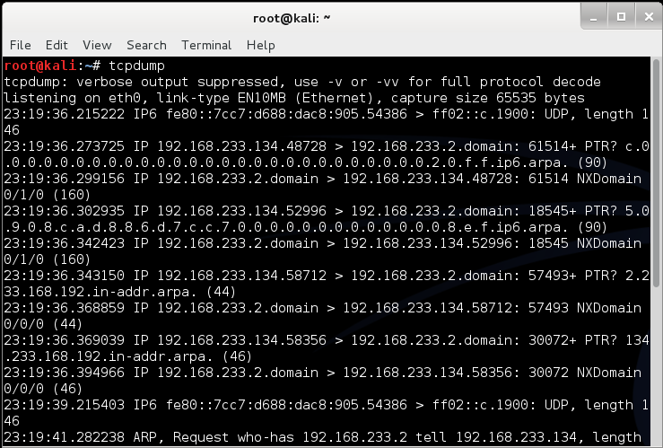
tcpdump
Linux sniffer tool is tcpdump

Slide 10
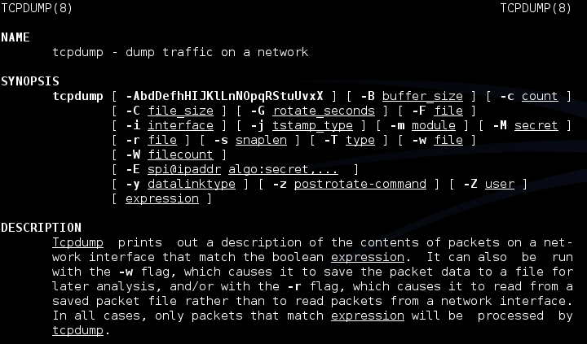
tcpdump
Remember Man page for tcpdump is already installed

Slide 11
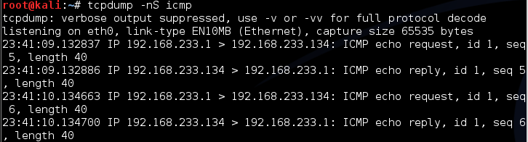
tcpdump
Basic Communications
  Try tcpdump -nS
Looking for pings

Slide 12
tcpdump
If you are not root:
  Remember: sudo tcpdump
Can filter for specific IP
  Try: tcpdump –nn tcp and dst 10.10.10.10
  Try: tcpdump –nn udp and src 10.10.10.10
  Try: tcpdump –nn tcp and port 443 and host 10.10.10.10
  FYI
    -n : Don’t resolve hostnames.
    -nn : Don’t resolve hostnames or port names.
More detailed How To:
  http://danielmiessler.com/study/tcpdump/

Slide 13
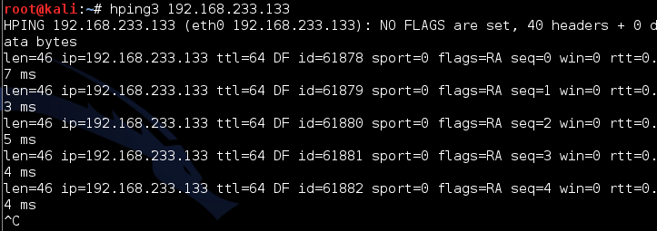
Network Sweeps
Hping3
  One target at a time
Caution: Windows firewalls may block functionality

Slide 14
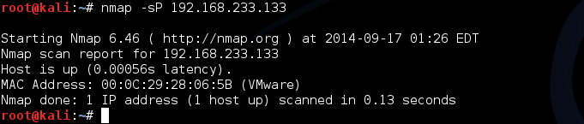
Nmap
Nmap is a network mapper
Very basic example
Just pings a machine and confirms it exists

Slide 15
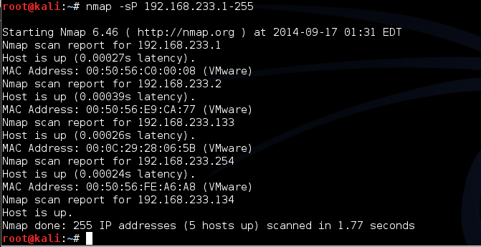
Nmap
Now we take it up a notch
Lets check an entire class “C” address
Example:
  Try: nmap –sP 192.168.1-255

Slide 16
Sniffers for Scanning
Some Pen Testers suggest running a sniffer to watch activity
  Detect errors
  Visualize what is happening

Slide 17
A Little Refresher
Recall, two principle packet types
  TCP (Transmission Control Protocol)
    Connection oriented
    Reliable
    Sequenced
  UDP (User Datagram Protocol)
    Connectionless
    Best effort (Left to higher level application to detect loss and request retransmission if needed)
    Independent (un-sequenced)

Slide 18
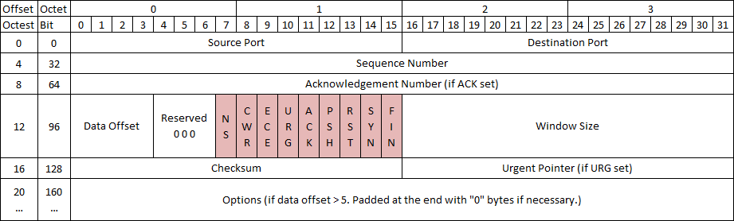
TCP Protocol
Number of flags have grown over the years, adding flags to the left as new ones are approved
With nine flags, there are 512 unique combinations of 1s and 0s
Add the three reserved flags and the number grows to 4096

Slide 19
TCP Control Bits
Control bits also called “Control Flags”
Defined by RFCs 793, 3168, and 3540
Currently defines 9 bits or flags
  See: http://en.wikipedia.org/wiki/Transmission_Control_Protocol

Slide 20
Three Way Handshake
Every “Legal” TCP connection begins with a three way handshake.
Sequence numbers are exchanged with the Syn, Syn-Ack, and Ack packets

Slide 21
How This Applies to Scanning
Per the RFC (793)
A TCP listener on a port will respond with Ack, regardless of the payload
Listener responds with a Syn-Ack
Therefore, if you get a Syn-Ack, something that speaks TCP was listening on that port

Slide 22
Behaviors
Port Open
Port Closed or Blocked by Firewall

Slide 23
Behaviors 2
Port Inaccessible (Likely Blocked by Firewall)
Port Inaccessible (Likely Blocked by Firewall)
Note: Nmap will mark both as “filtered”

Slide 24
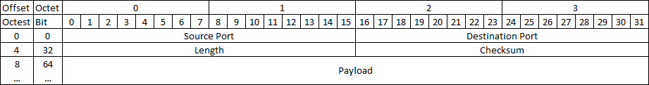
UDP Protocol
As you can see, UDP is a lot simpler.
  No Sequence Numbers
  No flags or control bits
  No “Connection”
As a result
  Slower to scan
  Less reliable scanning

Slide 25
Behaviors
Port Open
Port Closed or Blocked by Firewall

Slide 26
Behaviors 2
Port Inaccessible
Could be:
  Closed
  Blocked going in
  Blocked coming out
  Service not responding (Looking for a particular payload)
  Packet simply dropped due to collision

Slide 27
On to Nmap the Tool
Written and maintained by Fyodor
http://nmap.org/
Note: Lots of good info on the site, but the tutorial is a bit out of date. Latest info was put in a book and is sold on Amazon
  http://www.amazon.com/Nmap-Network-Scanning-Official-Discovery/dp/0979958717/ref=sr_1_1?ie=UTF8&qid=1411443925&sr=8-1&keywords=nmap

Slide 28
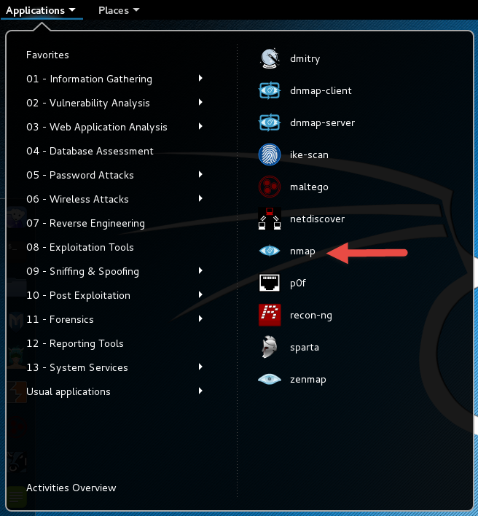
NMAP New

Slide 29
A Suitable Target
Metasploitable
  Deliberately vulnerable version of Linux developed for training on Metasploit
  We’ll use it here since there will be worthwhile things to find with nmap.
https://sourceforge.net/projects/metasploitable/files/latest/download
  May download immediately upon landing on page
UserID: msfadmin Password: msfadmin

Slide 30
Heads Up
After downloading the zip file, extract to a convenient location. VMWare should have created a folder in “My Documents” called “Virtual Machines”
Let Kali get started first
Then, select “Open a Virtual Machine” and navigate to the folder for metasploitable. Then launch.
You get a prompt asking if you moved or copied the VM, select “Copied”
Once started, login and issue command ifconfig to get you IP address and your done.

Slide 31
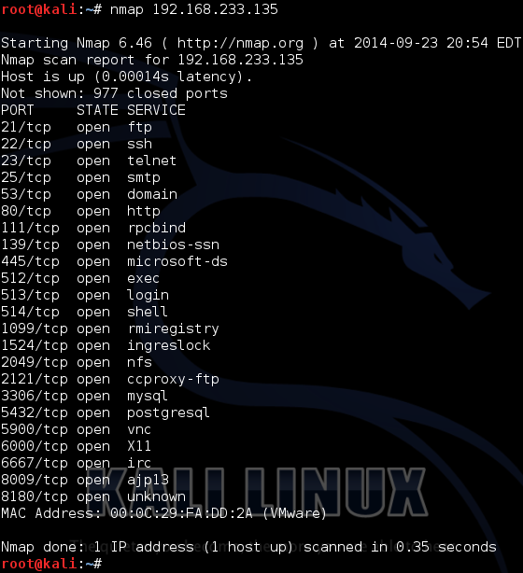
Back to Nmap
Lets try something simple
Nmap 192.168.233.135

Slide 32
What This Tells Us
There are a number of interesting ports here
  ftp
  Ssh
  telnet
  Smtp (Mail)
  domain (DNS)
  http (Web Server)
Keep in mind, ports are “commonly associated” with these services, but not guaranteed
http://www.iana.org/assignments/service-names-port-numbers/service-names-port-numbers.xhtml

Slide 33
Points to Remember
-n – Don’t resolve host names
-nn – Don’t resolve host names OR port names
-v – Verbose, tell me more
-vv – Really Verbose, tell me lots more
-iL – Input from list, get host list from a text file
--exclude – Don’t scan a particular host
--excludefile – Don’t scan hosts from a text file
Remember – “man nmap”

Slide 34
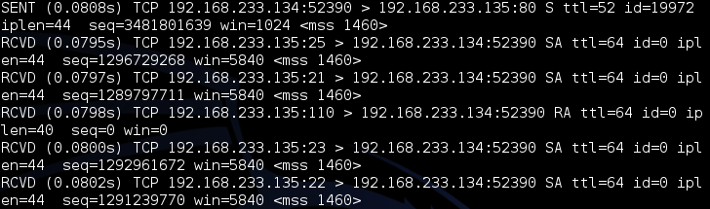
--packet-trace
Nmap prints a summary of every packet sent or received
May want to limit ports “-p1-1024” or less
There are also
  --version-trace
  --script-trace

Slide 35
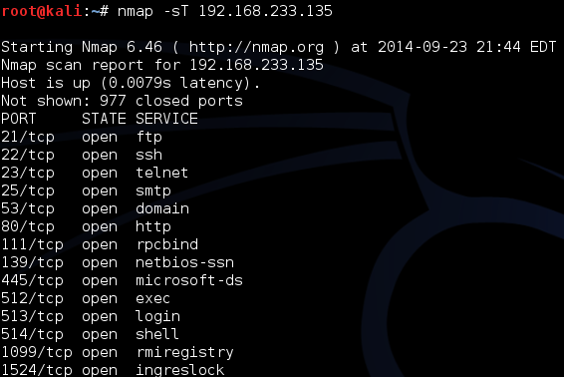
Basic Scan Types
-sT – TCP connect() scanning
  If connect succeeds, port is open

Slide 36
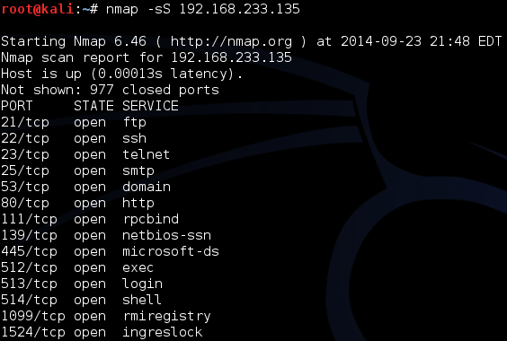
Basic Scan Types
-sS – SYN stealth Scan
  If SYN-ACK is received, port is open

Slide 37
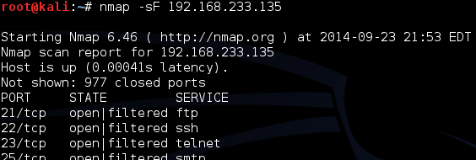
FIN Scan
-sF – Like SYN Scan, less likely to be flagged
  Closed port responds w/ RST, Open port drops
  Works on RFC 793 compliant systems
    Windows not compliant, could differentiate a Windows system

Slide 38
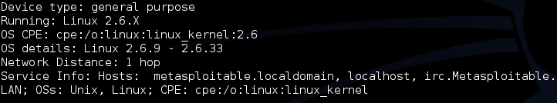
Other Options
-sN – Null scan
  Similar to FIN
-sX – Xmas tree scan
  Sets FIN, PSH, and URG
-sM – Maiman scan
  sets FIN and ACK
All work by looking for the absence of a RST

Slide 39
Roll Your Own
--scanflags
  Example:
    Nmap –scanflags SYNPSHACK –p 80 19

Slide 40
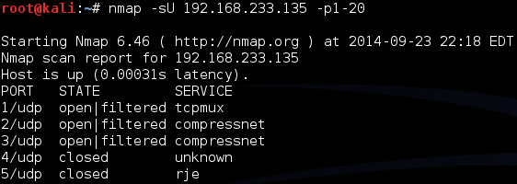
UDP Scans
-sU – 0 Byte UDP Packet
  Port unreachable – Port is closed
  No response – Port assumed open
  Very time consuming
  20 ports took 5.46 seconds, -sT scan only took 0.15

Slide 41
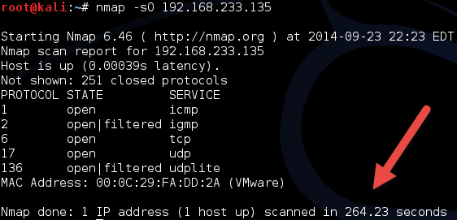
Protocol Scan
-sO – Looks for IP Protocols supported
  Sends raw IP packets without additional header information
  Takes time

Slide 42
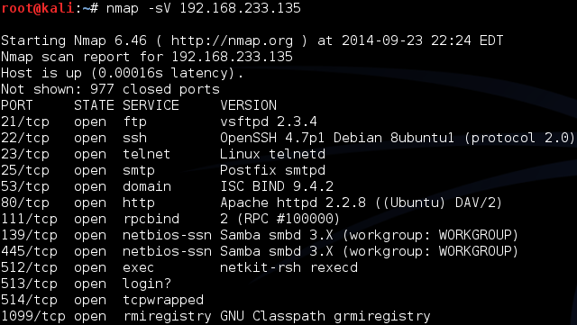
Version Detection
-sV – Attempts to determine version of services running

Slide 43
More on Version
-A – Looks for version of OS as well

Slide 44
Still More on Version Scan
-O – Fingerprint the operating system
-A = -sV + -O

Slide 45
Nmap Scripting Engine
Also known as NSE
  Written in “Lua”
  Activated with “-sC” or “- - script”
Categories
  Safe
  Intrusive
  Malware
  Version
  Discovery
  Vulnerability

Slide 46
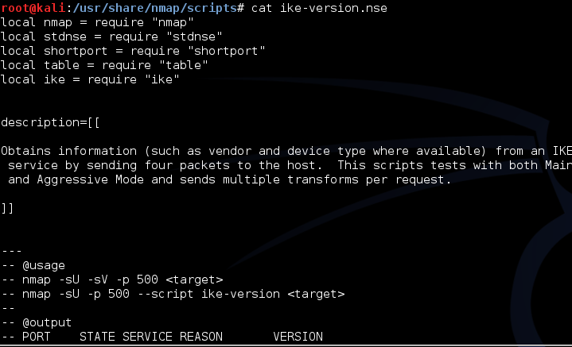
Script Location
In Kali, nmap scripts are located in:
  /usr/share/nmap/scripts
Can view using either “cat” OR gedits

Slide 47
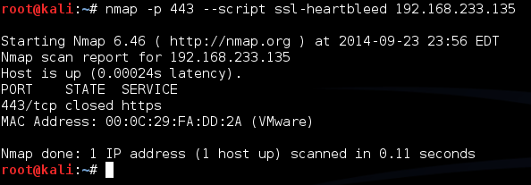
Script Example
SSL-Heartbleed
Try: nmap –p 443 --script ssl-heartbleed {target}
In this case, 443 is not even open

Slide 48
Zenmap
Graphical User Interface for nmap
Why did we just spend that time on the command line?
  Better control
  Better understanding

Slide 49
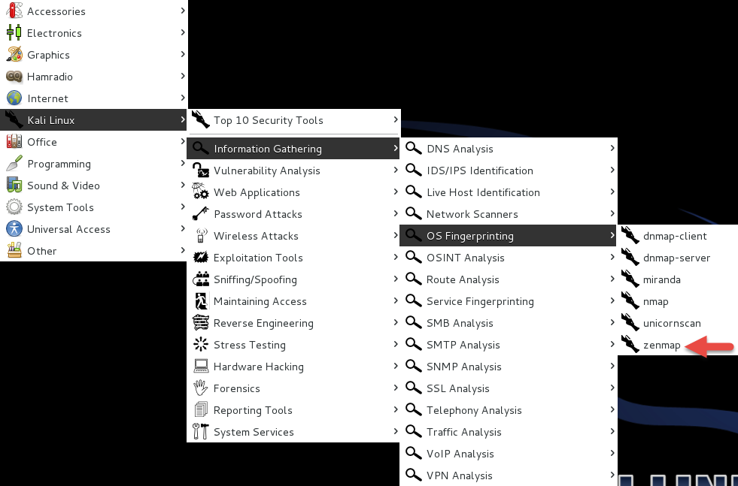
Zenmap Location

Slide 50
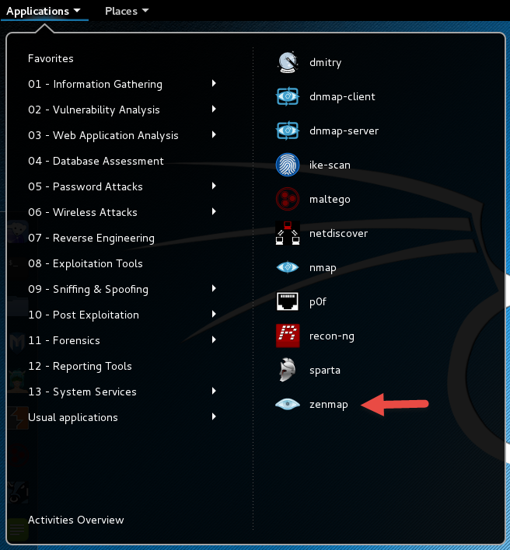
Zenmap New

Slide 51
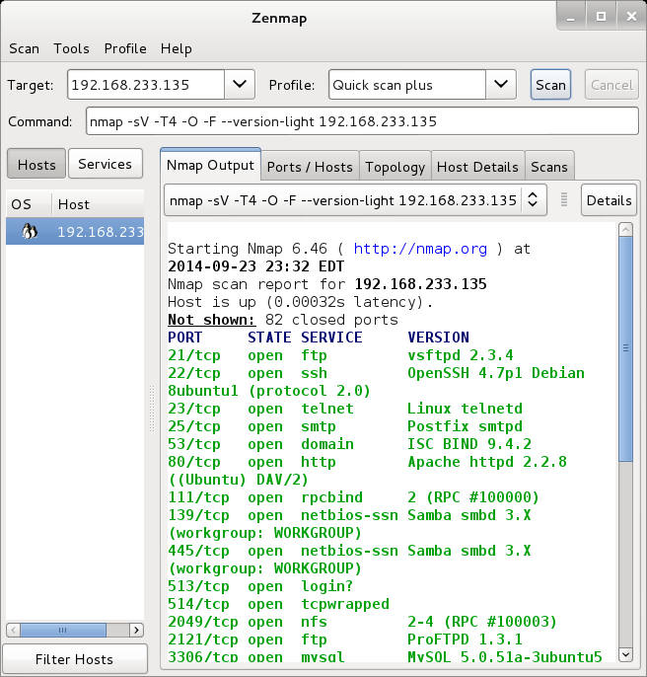
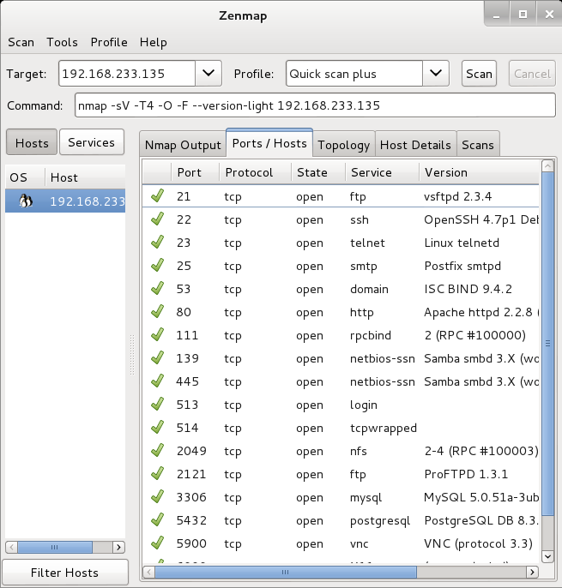
Zenmap Scan

Slide 52
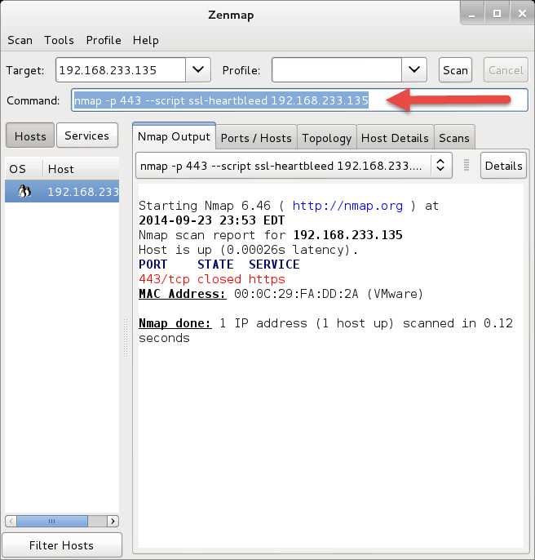
Still Really a Command Line
Look at the arrow
You can add to command line
Remember that SSL-hearbleed script

Slide 53
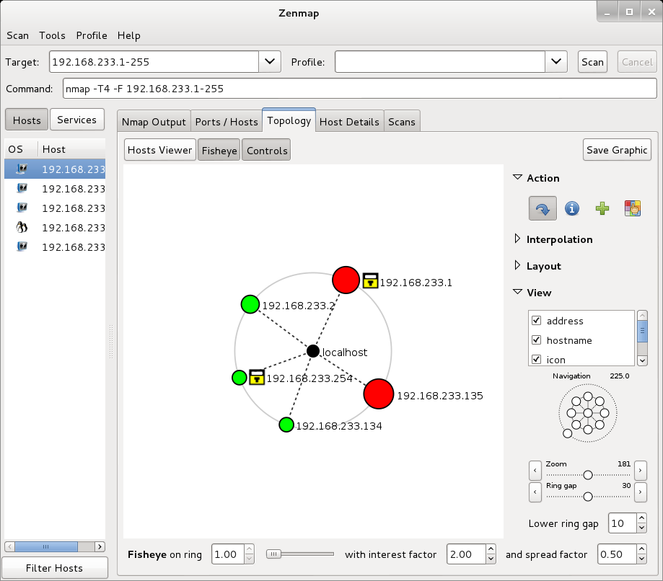
With a few Extras

Slide 54
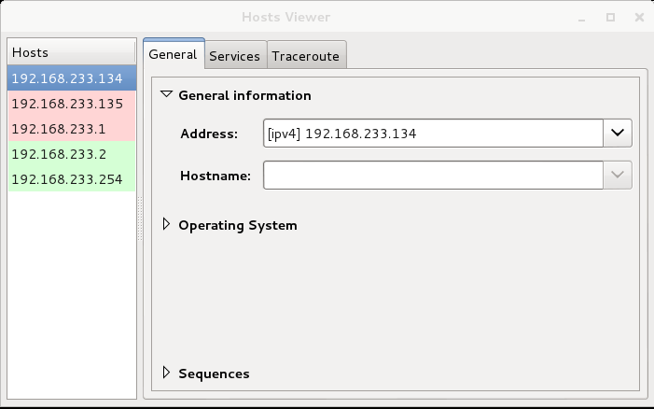
And More

Slide 55
Zenmap Reference
https://www.linux.com/learn/tutorials/381794-audit-your-network-with-zenmap?format=pdf

Slide 56
Nessus
Started in 1998 as an open source security scanning tool
Changed to a close sourced tool in 2005, but has remained “free” for personal use.
Surveys by sectools.org indicate Nessus remains the most popular vulnerability scanners
Not installed with Kali

Slide 57
The Nessus Server
Four basic parts to the Nessus server:
  Nessus-core
  Nessus-libraries
  Libnasl
  Nessus-plugins

Slide 58
Plugins
Plugins are the scripts that perform the vulnerability tests.
NASL – This is the Nessus Attack Scripting Language which can be used to write your own plugins.

Slide 59
Defining Targets
Hosts
  Server.domain.edu
  172.21.1.2
Subnet
  192.168.100.0
Address range
  192.168.1.1-192.168.1.10

Slide 60
Vulnerability Scanning
Scanning methods:
  Safe
  Destructive
Service recognition – Will determine what service is actually running on a particular port.
Handle multiple services – Will test a service if it appears on more then one port.
Will test multiple systems at the same time.

Slide 61
Viewing Reports
Nessus will indicate the threat level for services or vulnerabilities it detects:
  Critical
  High
  Medium
  Low
  Informational
Description of vulnerability
Risk factor
CVE number

Slide 62
Common Vulnerabilities and Exposures
CVE created by https://cve.mitre.org
  Attempting to standardize the names for vulnerabilities.
CVE search engine at http://icat.nist.gov/
Notes:
SANS Institute Weekly Critical Vulnerability Analysis Report http://www.sans.org, also Reading Room and Internet Storm Center

Slide 63
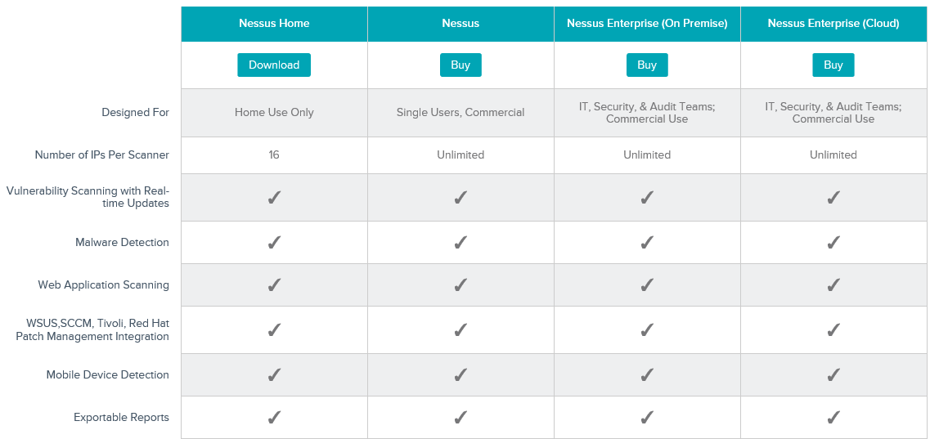
Options

Slide 64
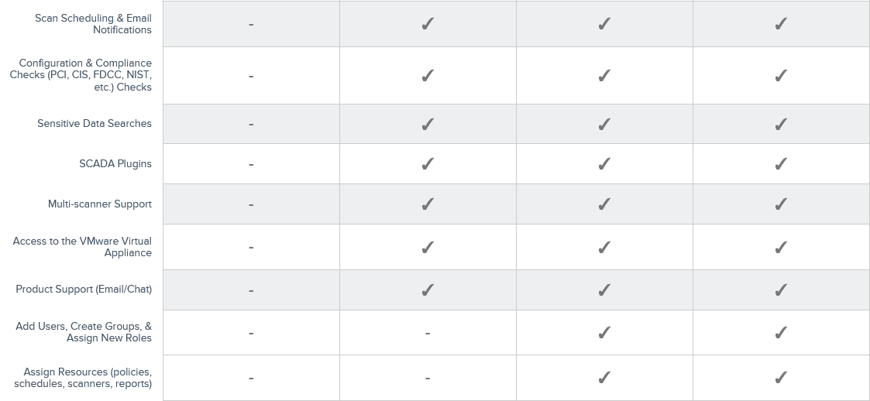
Options
http://www.tenable.com/products/nessus/select-your-operating-system

Slide 65
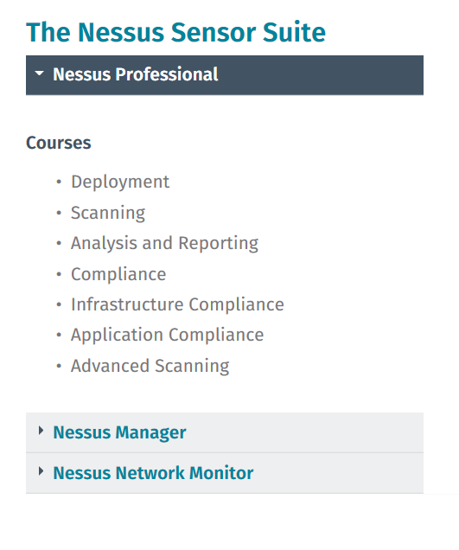
Free Training
http://www.tenable.com/education/on-demand-courses

Slide 66
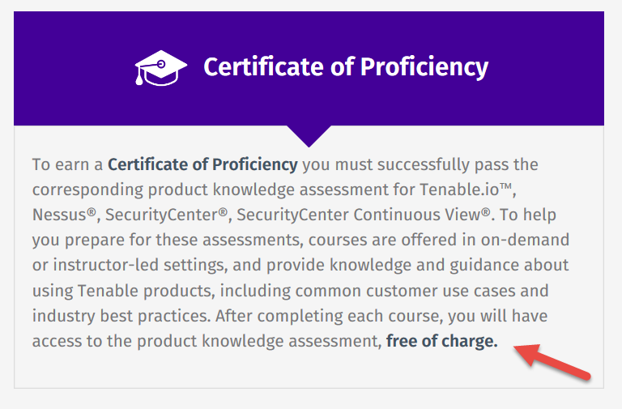
Certification Options
http://www.tenable.com/education/certification

Slide 67
Architecture
Nessus is built on a classic client/server model.
The server portion may reside on a separate machine, or on the same machine as the client
The client is the interface that you will interact with to execute scans

Slide 68
Getting Nessus
Download from Tenable Security
  https://www.tenable.com/products/nessus
  Before installing, go to registration page and get the activation code
  http://www.tenable.com/products/nessus-home
Run the MSI package and follow the prompts
Install will also install PCAP and then take you to the registration page.
Enter activation code and follow the prompts to get updates and plugins

Slide 69
Documentation
Documentation for Nessus is available here:
  https://docs.tenable.com/Nessus.htm
You should also get a link to this location during the install.

Slide 70
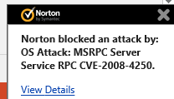
AV and Firewalls
You will need to turn off Anti-Virus and Firewall in order to get an effective scan or you will see this:
Before you do this, disconnect from any and all networks.
You will likely still get some blocking as AV doesn’t like to give up.

Slide 71
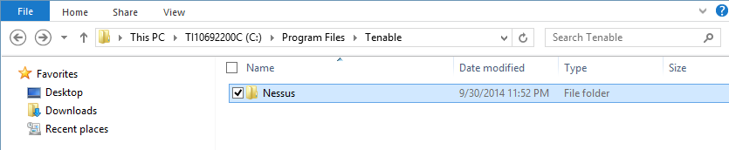
Location
Nessus is installed here:

Slide 72
STOP
We will continue next week.

Slide 73
Next Week
Complete Nessus
Begin Metasploit

Slide 74
Questions
?

