Slide 1
Intro to Ethical Hacking
MIS 5211.001
Week 5
Site: https://community.mis.temple.edu/mis5211sec001fall2019/

Slide 2
Tonight's Plan
consulting event on campus at Upenn
Nessus (Continued)
Metasploit

Slide 4
Rapid 7 Meeting
Next Thursday Evening
I will have class that evening, but feel free to attend if interested. Class will be recorded.
https://information.rapid7.com/rapid7-nj-panel-cherry-hill-2019.html

Slide 5
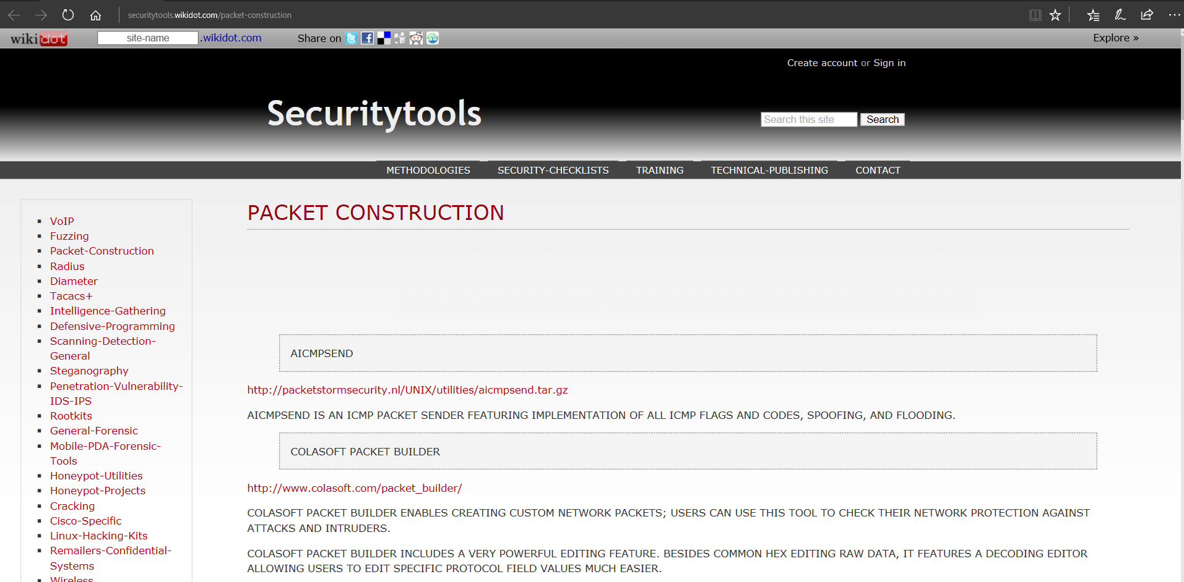
Packet Construction Tools
http://securitytools.wikidot.com/packet-construction

Slide 6
IPv6 Scanning
IPv6 fingerprinting
Nmap has a similar but separate OS detection engine specialized for IPv6
Use the -6 and –O options

Slide 7
IPv6 Scanning
Nping – Comes with Nmap
https://nmap.org/book/nping-man-ip6-options.html
From the site
Nping is an open-source tool for network packet generation, response analysis and response time measurement. Nping allows users to generate network packets of a wide range of protocols, letting them tune virtually any field of the protocol headers. While Nping can be used as a simple ping utility to detect active hosts, it can also be used as a raw packet generator for network stack stress tests, ARP poisoning, Denial of Service attacks, route tracing, and other purposes.

Slide 9
Now What
Consider picking up “Red Team Field Manual”
https://www.amazon.com/Rtfm-Red-Team-Field-Manual/dp/1494295504/ref=sr_1_1?ie=UTF8&qid=1538587040&sr=8-1&keywords=red+team+field+manual+2018
Reference guide of terminal commands for various systems and applications.
Embed in batch files and execute

Slide 10
RTFM Coverage Areas
*NIX
Windows
Networking
Tips and Tricks
Tool Syntax
Web
Databases
Programming
Wireless

Slide 11
Nessus (Continued)

Slide 12
Getting Nessus
Download from Tenable Security
http://www.tenable.com/products/nessus/select-your-operating-system
Before installing, go to registration page and get the activation code
http://www.tenable.com/products/nessus-home
Run the package and follow the prompts
Install will also install PCAP and then take you to the registration page.
Enter activation code and follow the prompts to get updates and plugins

Slide 13
Documentation
Documentation for Nessus is available here:
http://static.tenable.com/documentation/nessus_4.2_user_guide.pdf
You will also get a link to this location during the install.

Slide 14
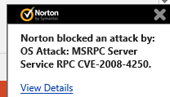
AV and Firewalls
You will need to turn off Anti-Virus and Firewall in order to get an effective scan or you will see this:
Before you do this, disconnect from any and all networks.
You will likely still get some blocking as AV doesn’t like to give up.

Slide 15
Getting Started
You should end up looking at web page hosted from your machine.
Book mark the page to save time getting back
URL will look like this:
https://localhost:8834/html5.html

Slide 16
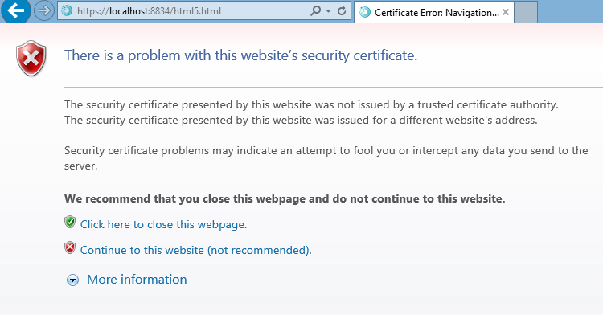
SSL Warning
When you first go to site, you will need to click on continue to the website.:

Slide 17
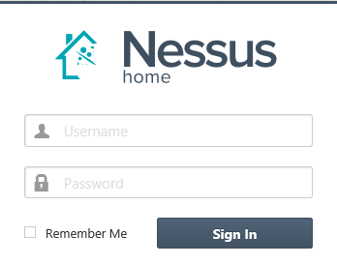
Logging In
Start

Slide 18
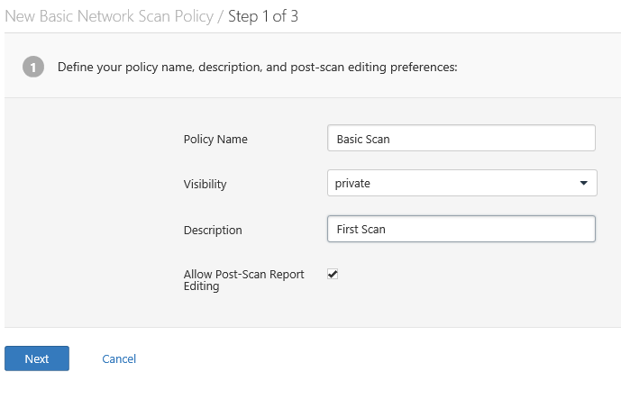
Policies
Scans are based on policies, you will need to create that first.

Slide 19
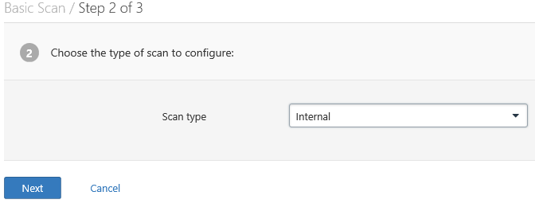
Policies 2
Next

Slide 20
Policies 3

Slide 21
There are many more options

Slide 22
Creating A Scan

Slide 23
Scheduling A Scan

Slide 24
Scan Status
Once your scan has started you will see a status field like this:

Slide 25
Scan Status
Once completed you will get the following notification:

Slide 26
Output From First Scan

Slide 27
Clicking on scan gives details

Slide 28
Continuing to drill down

Slide 29
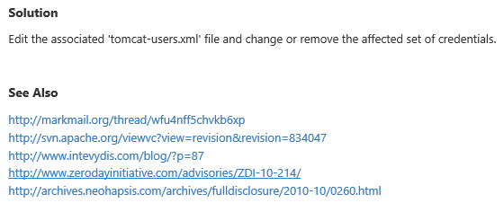
Good Information
Important to note:
Also

Slide 30
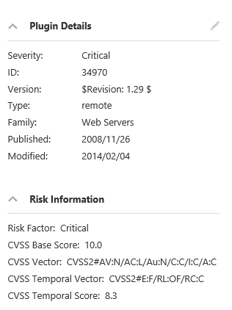
Criticality
Note on criticality
The “Critical” risk factor is without any mitigating controls being taken in to account
Vulnerabilities need to be evaluated in context

Slide 31
More on Results
These results were obtained, even though Anti-Virus continued blocking multiple techniques.
Consider setting up a scanning machine without any AV or Host Firewall.

Slide 32
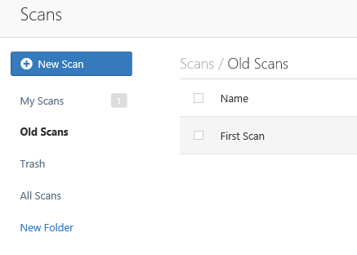
Organizing Scans
In short order you will gather a large collection of scans
Use the built in folder system to move scans off of the main page

Slide 33
Don’t Forget the Info

Slide 34
Info Vulnerabilities
The least significant vulnerabilities are classified as “Info” or informational.
These are often very useful in understanding details of the asset being scanned.

Slide 35
For Instance

Slide 36
Netcat
Netcat is a utility used by Penetration Tester and Hackers to establish network connections over UDP or TCP.
Takes “Standard In”, and sends it across the network as data
Receives network data and puts it on “Standard Out”
Messages from netcat itself go on “Standard Error”

Slide 37
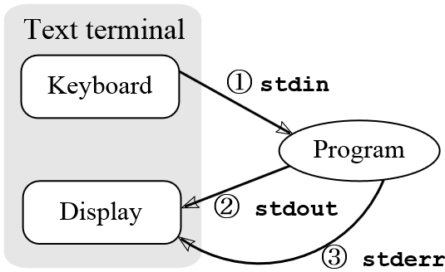
A Word About stdin, stdout, and stderror
These are terms from programming that refer to expected streams in software
As an example
stdin would be the keyboard
Stdout would be the screen
Stderror may be dropped or sent to logging
From: http://en.wikipedia.org/wiki/Standard_streams#Standard_error_.28stderr.29

Slide 38
Netcat in Linux and Windows
In Linux netcat is typically installed and can be activate simply by typing “nc” at the command line
In Windows, the file is not installed
A version can be downloaded from:
http://nmap.org/ncat/
Once downloaded and extracted type “ncat” at the command line to get started
Note – AV will likely automatically remove it

Slide 39
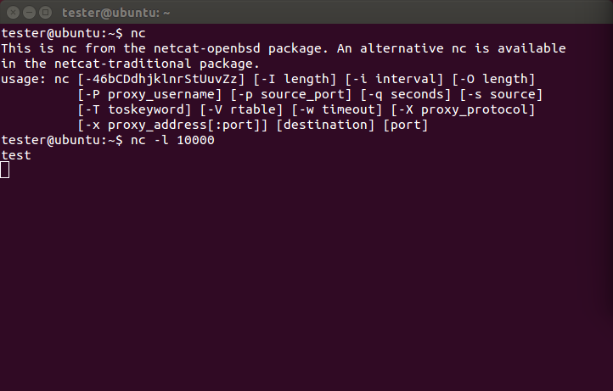
Simple Demo

Slide 40
Netcat Structure
Basic format is
Send
$nc [Target IP] [Remote Port]
Receive
$nc [flag(s)] [Local Port]
Assumes TCP unless –u flag is set forcing to UDP
Link to SANS Cheat Sheet
URL: http://www.sans.org/security-resources/sec560/netcat_cheat_sheet_v1.pdf

Slide 41
SANS NC Cheat Sheet

Slide 42
SANS NC Cheat Sheet

Slide 43
Pipes
So, netcat can send what I type to another machine. So what!
The pipe commands “|”, “>”, and “<“ let you do more interesting things
For example, transfer a file between systems
$nc –l –p [Local Port] > [Out File]
Listen on local port and store result in file
$nc –w3 [TargetIP] [Port] < [In File]
Push file to target IP on port
See SANS Cheat Sheet on previous page for more examples

Slide 44
Port Scanning
You can even use netcat as a simple port scanner
Example
$nc –v –n –z –w1 [Target IP] [Starting Port] – [Ending Port]
Systematically attempts to connect on each port within the defined range
Note:
-v – Verbose
-n – Do not resolve names
-z – Do not send data
-w1 – Wait no more then one second to connect

Slide 45
Metasploit

Slide 46
Metasploit
Metasploit is a penetration testing framework that integrates other tools we have seen with exploitation tools

Slide 47
Penetration Testing Execution Standard
Developers of Metasploit used the Penetration Testing Execution Standard (PTES) as their guide in developing the tool
http://www.pentest-standard.org/index.php/Main_Page
Contains a great deal of information and worth looking over

Slide 48
Process
Similar to what we covered earlier, Metasploit and PTES breaks activities down in to some basic categories
Pre-Engagement (Getting Permission)
Intelligence Gathering (Recon)
Threat Modeling (Using Intel to determine vulnerabilities)
Note: This is different then Threat Modeling in IT Security Space
Vulnerability Analysis
Exploitation
Post Exploitation (Clean up after yourself)
Reporting

Slide 49
Types of Penetration Tests
Overt Penetration Testing
Another term for “Crystal Box” testing
Working with target staff and with access to target documentation to fine tune testing
Quicker, but information may steer you away from things
Covert Penetration Testing
Another term for “Black Box” testing
You have the same opportunity to gather information as a real attacker
Time consuming and expensive, but you may find “nuggets” not obvious from the documentation if you had it

Slide 50
Vulnerability Scanners
We looked at these earlier
Remember Nmap and Nessus
Metasploit can interface with these tools (and others) to use their output as an input to it’s tool set.

Slide 51
A few words about Metasploit
Metasploit is included on Kali in several forms
There is a Web Based interface that requires activation as well as the terminal version built in.
Both forms are slow to launch. Your machine isn’t frozen, it just takes a while. There’s a lot going on and we’ll cover that as we go.
We will focus on the terminal version known as Metasploit Framework

Slide 52
Terminology
Exploit – Means by which an attacker takes advantage of a flaw
Payload – Code we want a system to execute
Shellcode – Set of instructions used as a payload when exploitation occurs
Module – Piece of software used by the Metasploit Framework
Listener – Component within Metasploit that waits for an incoming connection

Slide 53
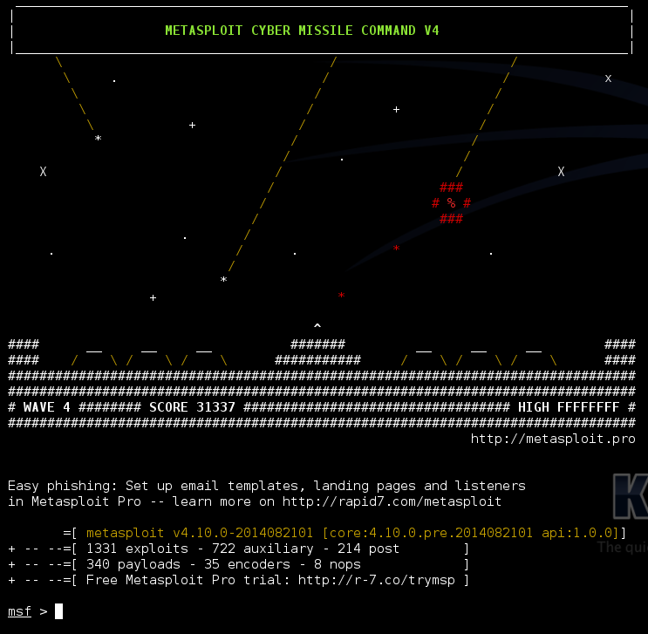
Metasploit Interfaces
MSFconsole - The way we will normally interact with Metasploit
Started by typing: msfconsole at terminal prompt
Note: You may need to provide path

Slide 54
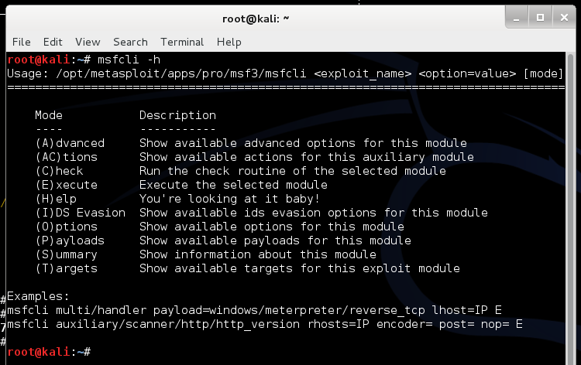
Metasploit Interfaces
MSFcli – Bypasses msfconsole menu process and allows direct selection of attack
Started by typing msfcli at terminal prompt

Slide 55
MSFcli Example

Slide 56
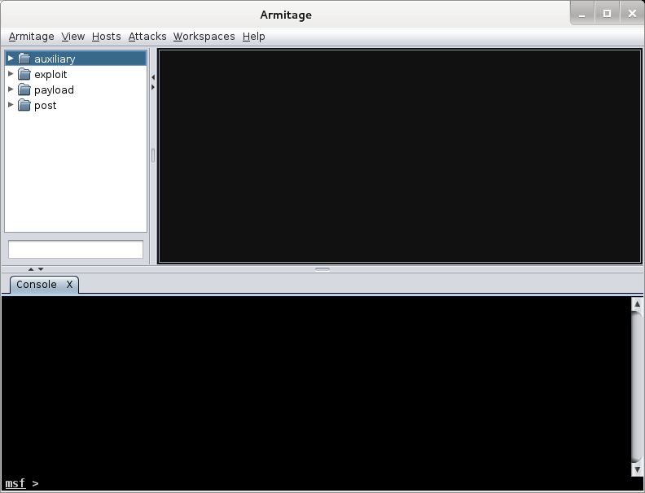
More Interfaces
Armitage – Graphic Interface to MSFconsole
Already Installed in Kali

Slide 57
Metasploit Utilities
MSFpayload – Generates shellcode, executables, and more
MSFencode – Encodes shellcode to eliminate problem characters and obfuscate code to evade IDS and IPS systems
Nasm Shell – Utility that provides assembly language help during scripting

Slide 58
Metasploit Express and Pro
Commercial versions of the Metasploit tool
We will stick with the community version in this class
Note: We ran through a lot of information and terms. We will cover details as the course continues.

Slide 59
Once More
One more time – The techniques covered in this class can damage your systems and the target systems. Make sure you use a test environment.

Slide 60
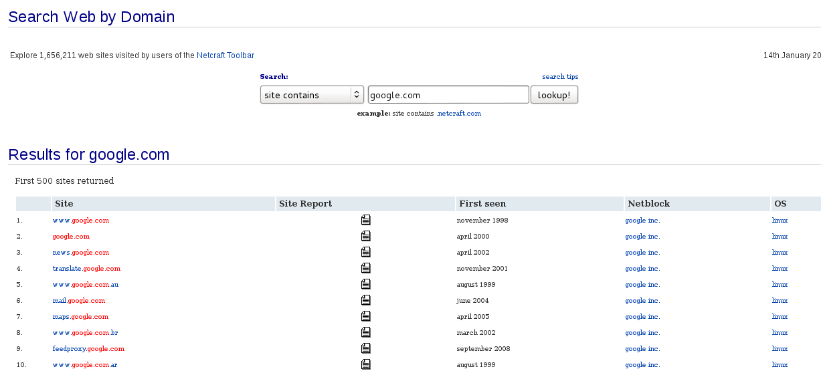
Netcraft
Web based tool for finding IPs
URL: searchdns.netcraft.com

Slide 61
Active Information Gathering
Port Scanning with Nmap
We covered this earlier
One new twist, we want to utilize the –oX option to have nmap save it’s output in xml

Slide 62
Metasploit and it’s Database
Metasploit has a built in database to support collecting data during a penetration test
Uses PostgresSQL
You can check status when MSFconsole is running by typing: db_status at the msf> prompt in Metasploit
Should respond with “postgress connected to msf3 (or something close to this)
Note: Before Kali 2.0, there were issues getting the database to work. Make sure you are on 2.0 or >

Slide 63
Database and Nmap
Run Nmap with a command something like: nmap –Pn –sS –A –oX Subnet1.xml 192.168.1.0/24
This will sweep the subnet and leave the results in a xml file ready for import
This may take a while, may want to narrow focus to a shorter list

Slide 64
Importing to Metasploit
At Metasploit prompt
Db_import Subnet1.xml
Hosts –c address
This will import the active hosts to Metasploit database

Slide 65
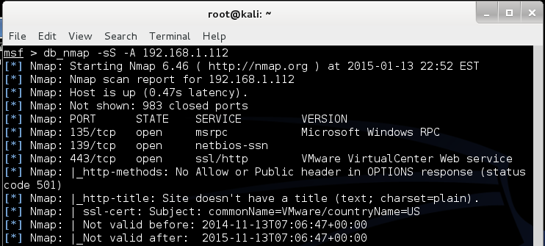
Nmap from Metasploit
Run command
Msf > db_nmap –sS –A [Target Address]
In my case:

Slide 66
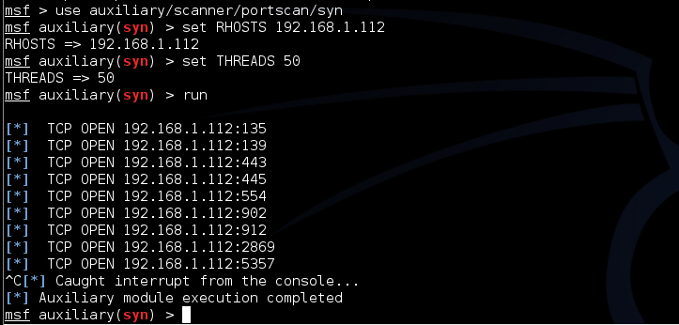
Built In Port Scanners
Run command:
Msf> use auxiliary/scanner/portscan/syn
Msf auxiliary(syn) > set RHOSTS [Target IP]
Msf auxiliary(syn) > set THREADS 50
In my case:

Slide 67
More Scanning Options
Server Message Blocks
Use auxiliary/scanner/smb/smb_version
MSSQL
Use auxiliary/scanner/mssql/mssql_ping
SSH
Use auxiliary/scanner/ssh/ssh_version
FTP
Use auxiliary/scanner/ftp/anonymous
SNMP
Use auxiliary/scanner/snmp/snmp_login

Slide 68
Writing a Custom Scanner
You can write your own
Uses Ruby
Example on following page

Slide 69
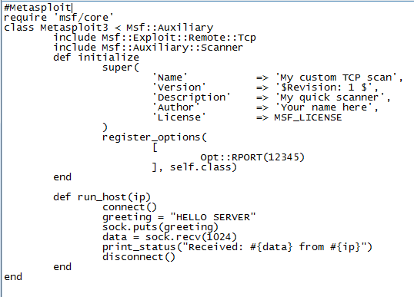
Simple Scanner

Slide 70
Vulnerability Scanning
Rapid 7 (Owner of commercial instance of Metasploit) makes a “community” version of their scanner available.
Called NeXpose
Not included in Kali
Available at:
http://www.rapid7.com/products/nexpose/compare-downloads.jsp
NOT REQUIRED FOR THIS CLASS

Slide 71
NeXpose
Similar to stand alone Nmap, NeXpose output can be saved as xml and imported into Metasploit via the db_import command
Example
Msf> db_import /tmp/hosts.xml

Slide 72
NeXpose
Once installed in Kali, can be setup to run from within the MSF Framework
See:
http://www.offensive-security.com/metasploit-unleashed/NeXpose_Via_Msfconsole

Slide 73
Nessus
See:
http://www.offensive-security.com/metasploit-unleashed/Nessus_Via_Msfconsole

Slide 74
Other Scanning Options
Open VNC Authentication
Msf> use auxiliary/scanner/vnc/vnc_none_auth
Open X11 Servers
Msf> use auxiliary/scanner/x11/open_x11

Slide 75
Next Week
WE will start with an example of using Metasploit to launch an attack.

Slide 76
Questions
?

Slide 77
Addendum

Slide 78
DOS Batch Scripting
First off, almost everything I present here started at:
http://blog.commandlinekungfu.com/

Slide 79
Reading Files w/o Editor
Similar to Linux, try these:
“type test.txt”
Or “type *.txt”

Slide 80
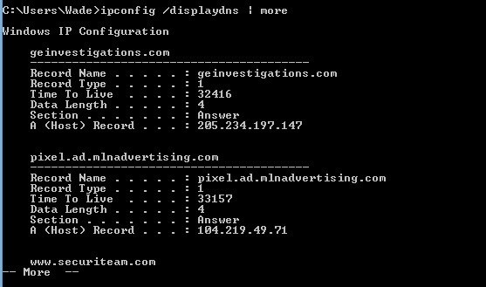
Finding Other Machines
Try: “ipconfig /displaydns
I added “| more” to avoid overflow

Slide 81
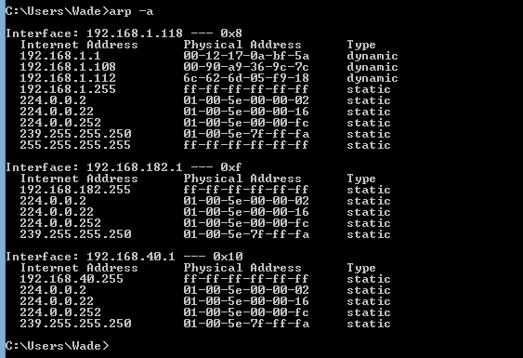
Finding Other Machines
Try “arp –a”

Slide 82
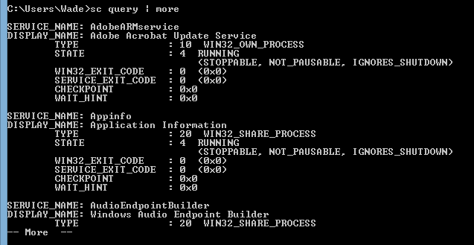
Find “Running” Services
Try “sc query”

Slide 83
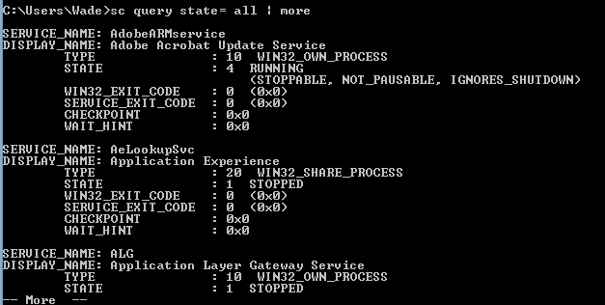
Find “All” Service
Try “sc query state=all”

Slide 84
Details on a Service
Try “sc qc [service_name]

Slide 85
Start/Stop Services
Try “sc start [service_name]” or “sc stop [service_name]
Remember, you can use “sc query state= all” to find the service names
If you have access to a similar machine, you could also look at the GUI

Slide 86
Basic Coding
For Loops
FOR /L -> Counter
FOR /F - > Iterates through a file

Slide 87
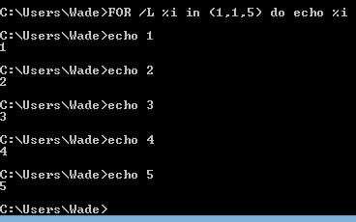
FOR /L -> Counter
Example
FOR /L %i in ([Start],[Step],[Stop]) do [command]
Translates to
FOR /L %i in (1,1,5) do echo %i

Slide 88
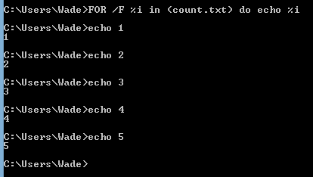
FOR /F - > Iterates through a file
FOR /F (“options”) %i in ([text_file]) do [command]
Translates to:
FOR /F %i in count.txt do echo %i

Slide 89
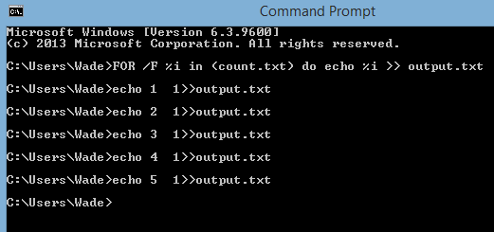
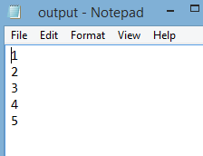
Sending to Outfile
Can add “ >> output.txt” to redirect to an output file
Try “FOR /F %i in (count.txt) do echo %i >> output.txt”

Slide 90
Reference
Lots more at:
http://blog.commandlinekungfu.com/

