Slide 1
Intro to Ethical Hacking
MIS 5211.001
Week 7
https://community.mis.temple.edu/mis5211sec001fall2019/

Slide 2
Tonight's Plan
Odds and Ends
Social Engineering
Social Engineering Toolkit
Encryption
Encoding
Next Week

Slide 3
Odds and Ends
Metasploit Database Issues
  Latest implementation of Kali does not create or start the database
  Details here:
    https://docs.kali.org/general-use/starting-metasploit-framework-in-kali
  service postgresql start
  msfdb init

Slide 4
Odds and Ends
Msfcli has been deprecated
Use msfconsole –x
Detailed info here:
  https://www.offensive-security.com/metasploit-unleashed/Msfcli/

Slide 5
Social Engineering
Definition
  Getting people to do what you want
Alternatively
  Psychological manipulation of people into performing actions or divulging confidential information. - wikipedia.org
  Or
  Social engineering exploits people's emotions and their desire to help others – malware.wikia.com

Slide 6

Attitude
Confidence
  Act like you belong there
Friendliness
  Make people want to help you
Appearance
  Dress for the part

Slide 7
Categories
Can take a number of forms
  Pretexting
  Phishing
  Spear Phishing
  Vishing
  Tailgating
  Quid Pro Quo
  Baiting
  Diversion Theft

Slide 8
Pretexting
Inventing a scenario
  Do some recon
    Speak the language
    Impersonate someone who should be there
    Give information outsider would not have
      Legitimate name of supervisor or department
      Reference correct office location
      Project name or internal initiative
    Pretend to be police, FBI, TSA, or Homeland Security
      Note: this is a crime all by itself

Slide 9

Phishing
Email
  Again, starts with Recon
  Send legitimate looking email
  Request verification of information and warn of consequences for non-compliance
  Link to fraudulent web site
    Note: Larger organizations pay for monitoring services to catch this

Slide 10
Spear Phishing
Similar to phishing, but much more targeted
  Heavy recon
  Identify just the right target or targets
    Executive
    IT Admins
    Accounts payable
  Create content very specific to Target(s)

Slide 11
Phishing and Spear Phishing
Often used to deliver malware
  Tempting attachments:
    New bonus plan
    Layoff list
    Memorial notice for recently passed employee
  Web sites that deliver promised content
    But infect browser

Slide 12
Vishing
Similar to phishing, but by phone or fraudulent IVR
VOIP can be used to falsify source phone number (Caller ID Spoofing)
Swatting – Initiating a police raid

Slide 13
Tailgating
May or May Not be Social Engineering
  People feel a need to “Hold the door”
  Especially problematic in the south eastern US
Even man traps and roto-gates can be gotten around
  Show up with large packages or boxes
  Ask security for help

Slide 14
Quid Pro Quo
Call into company claiming to be Tech Support
  May take a number of calls
  Eventually you will hit someone that actually called for support
    Help them (Sort of)
    They’ll follow your directions
      Type commands
      Download software
      Provide data

Slide 15
Baiting
Spread USBs around parking lots
Mail official looking CDs
Send a token desk toy (with WiFi repeater installed)
Replacement mouse (with malware preloaded)
MP3 player

Slide 16
Diversion Theft
Fake ATM
Intercept delivery man
“Borrow” a FedEx or UPS truck and make a pickup

Slide 17

Dumpster Diving
More of a recon technique then actual Social Engineering
Gold Standards of Dumpster Diving
  Yellow Sticky
  Hand written notes
$

Slide 18
Tips and Tricks
A couple of issues brought up in previous classes. Some may have already figured these out, but just in case.
Browser not connecting.
  Recall last semester we did some work with the intercepting proxy. You will need to change the Browser’s network settings to “No Proxy” when not running a proxy
Screen size
  Kali defaults to 600x480 or 800x600 which gives a very small screen
  Go to System Tools -> Preferences -> System Settings and then select “Displays” and select a larger screen size. I was able to use 1680x1050 on my system.

Slide 19
Note on “Hands On”
The tools covered (Kali, nmap, and Metasploit) along with what will be covered (WebGoat with Interception proxy) allow each student to work through all examples and many more in a safe environment within VMWare
This gives you the best chance of getting comfortable with these tools
To get the best value out of the material you need to “play” with them, try things, see what works and what doesn’t.

Slide 20
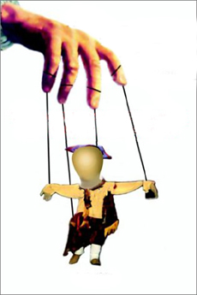
Social Engineer Toolkit
Social Engineering Toolkit or SET was developed by the same group that built Metasploit
SET provides a suite of tools specifically for performing social engineering attacks including:
  Spear Phishing
  Infectious Media
  And More
It is pre-installed on Kali

Slide 21
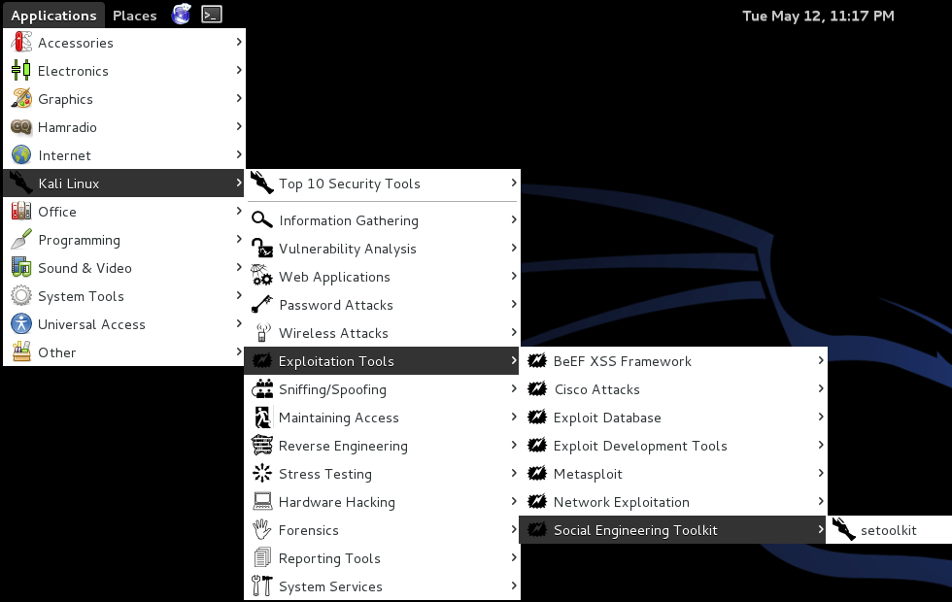
Finding SET in Kali

Slide 22
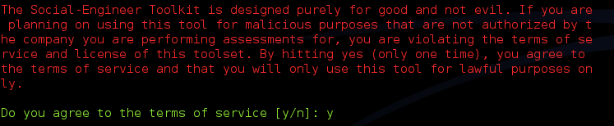
Exploring SET
Many feature of SET are turned off by default
To activate desired feature you will need to manually edit the set_config file found under /usr/share/set/config
To Launch: Kali Linux -> Exploitation Tools -> Social Engineering Toolkit -> setoolkit
The first time you launch SET you will see this:

Slide 23
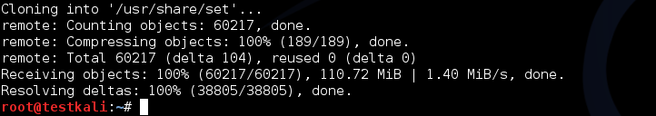
Updating SET
To get the latest update of set, enter the following from a terminal in Kali:
This removes all files and folder associated with SET and replaces them with a fresh copy. Executed correctly should give the following:

Slide 24
More on Updating
You can also get “bleeding Edge” updates with the following
Note: This may cause some instabilities and may force you to “Troubleshoot” some of the software. Hint: Take a snapshot first.

Slide 25
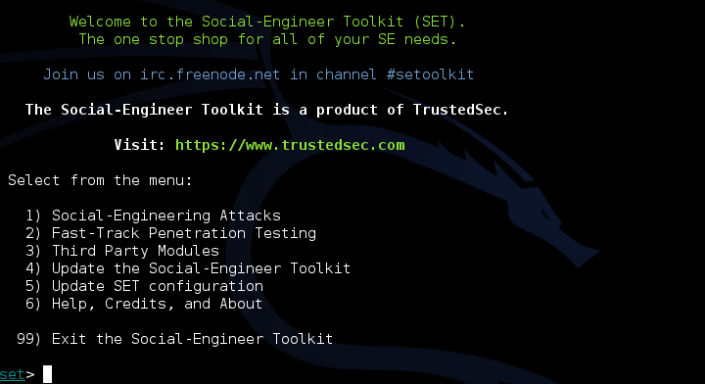
Initial Options
If you have not edited the set_config file you will see the following options:

Slide 26
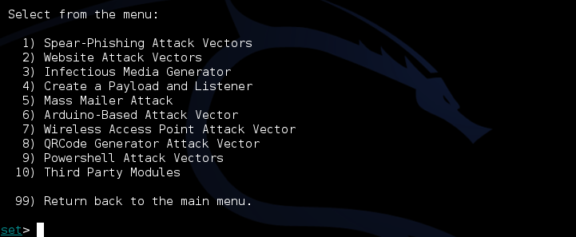
Drilling Down
Under “Social-Engineering Attacks”

Slide 27
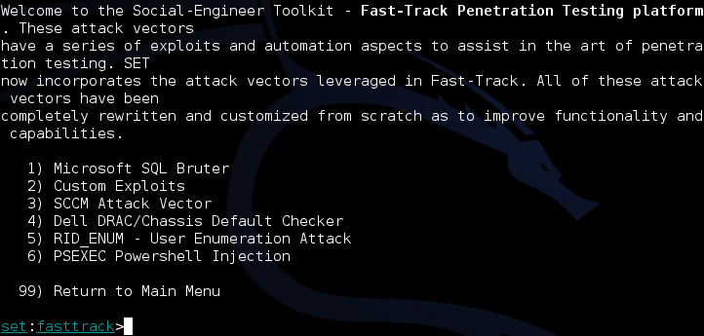
Drilling Down
Under “Fast-Track Penetration Testing “

Slide 28
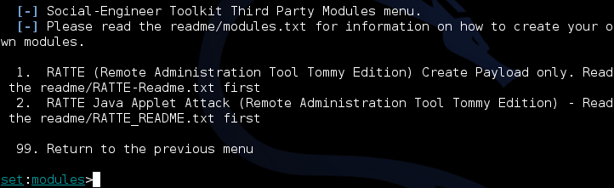
Drilling Down
Under “Third Party Modules

Slide 29
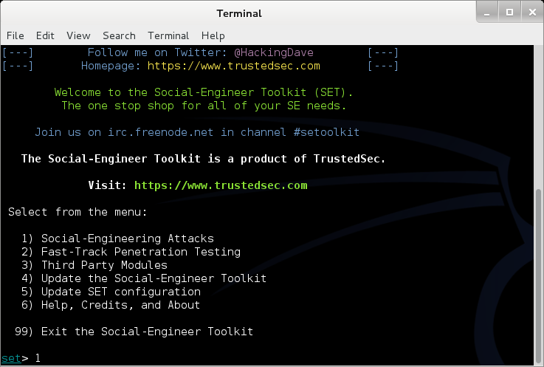
Walk Through of Attack
We will start back at the main menu for SET

Slide 30
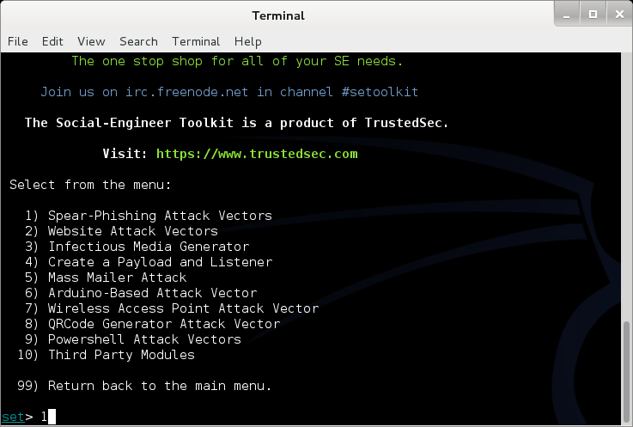
Walk Through of Attack
Select Option 1 for Spear-Phishing

Slide 31
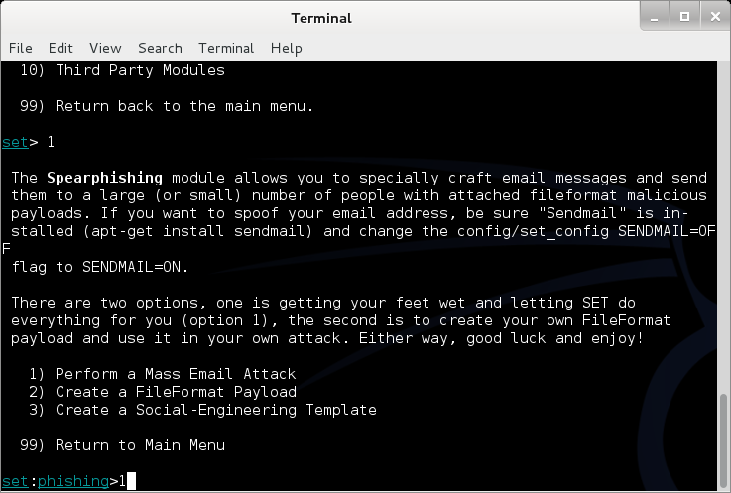
Walk Through of Attack
Select Option 1 for a Mass Email Attack

Slide 32
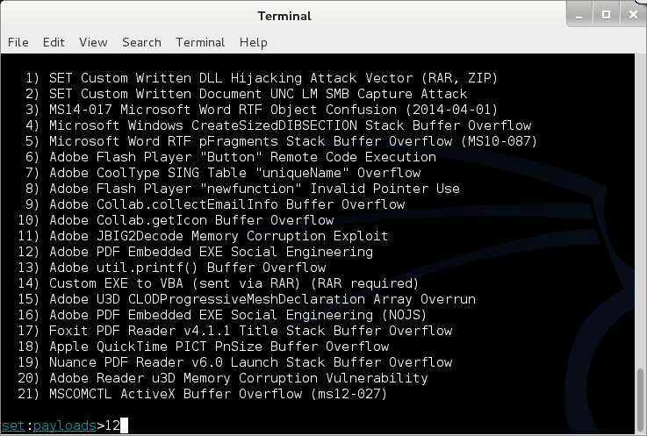
Walk Through of Attack
Select Option 12 for PDF embedded EXE

Slide 33
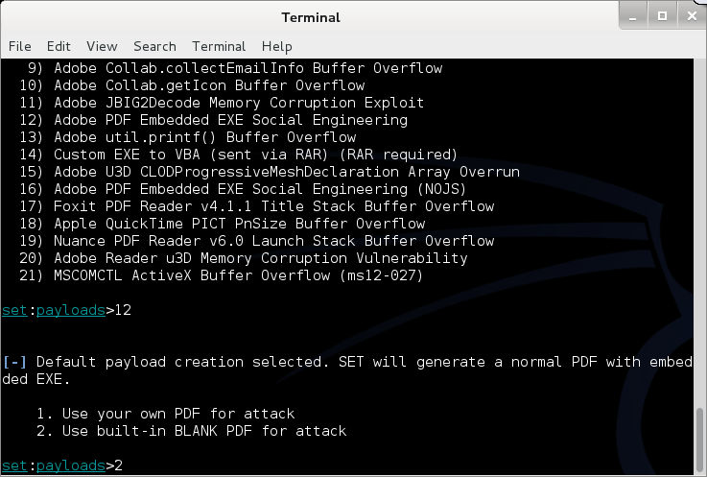
Walk Through of Attack
Select Option 2 for Built-in PDF

Slide 34
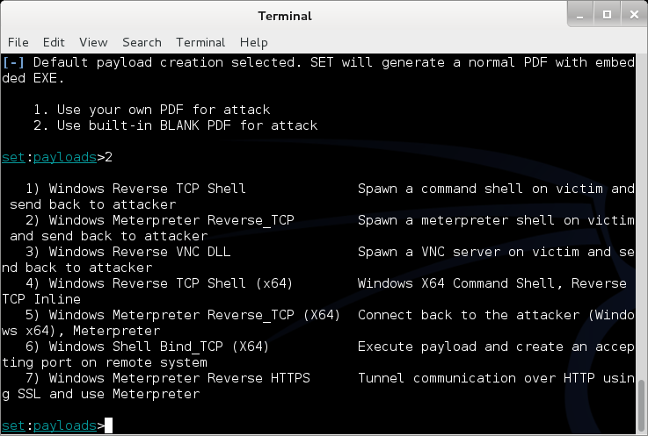
Walk Through of Attack
Select Payload 1

Slide 35
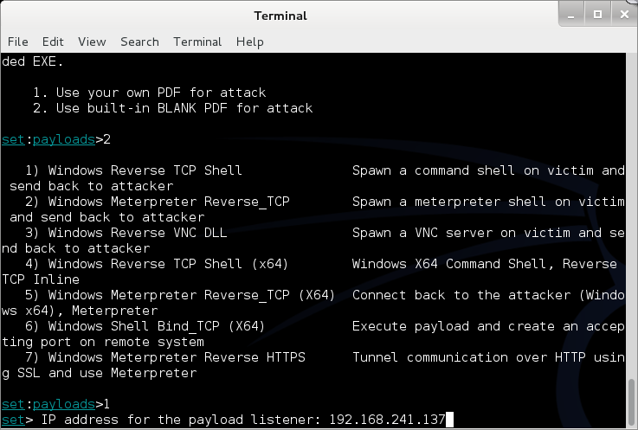
Walk Through of Attack
Add an IP Address to listen on

Slide 36
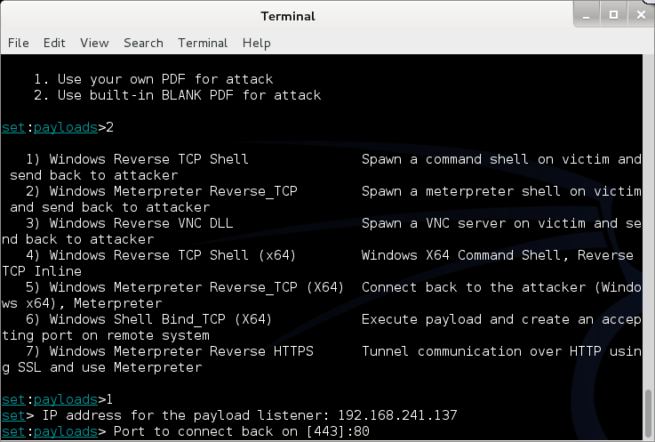
Walk Through of Attack
Select a port (Defaults to 443)

Slide 37
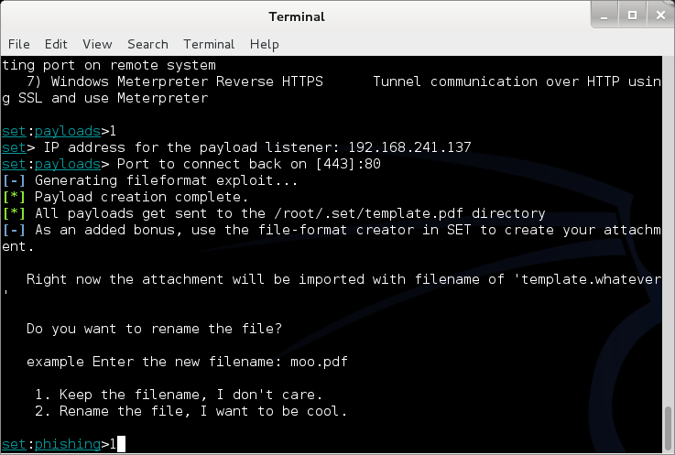
Walk Through of Attack
Select Option 1 to keep file name

Slide 38
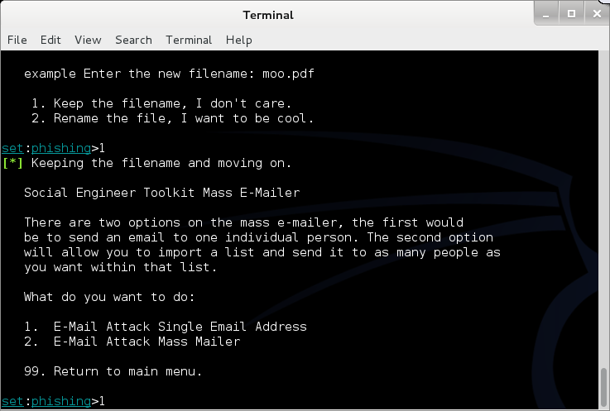
Walk Through of Attack
Select Option 1 for a single Email address

Slide 39
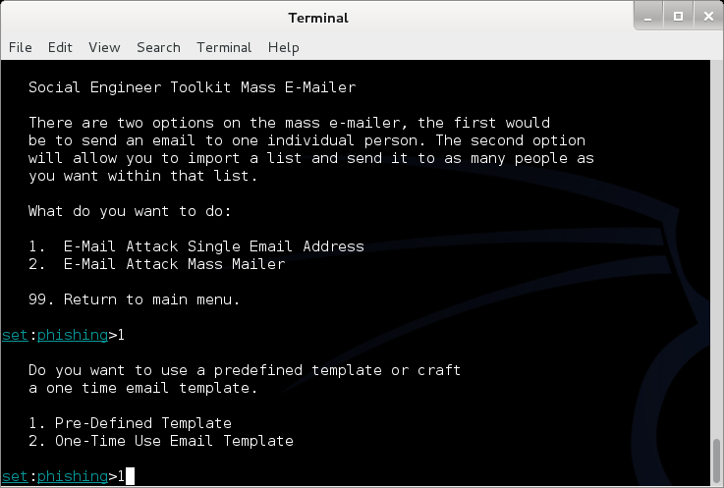
Walk Through of Attack
Select Option 1 for a Pre-Defined template

Slide 40
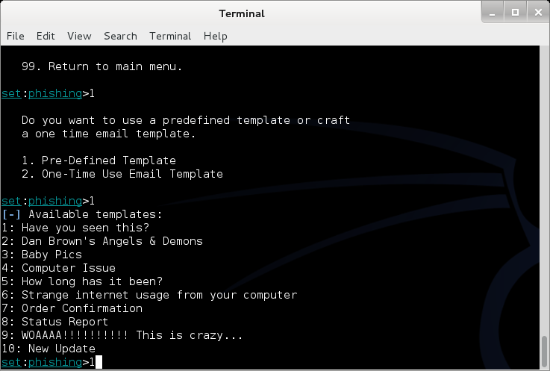
Walk Through of Attack
Select Option 1 for the first template

Slide 41
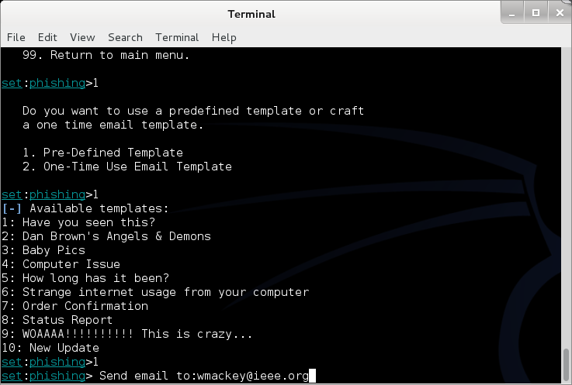
Walk Through of Attack
Enter an Email Address (Mine)

Slide 42
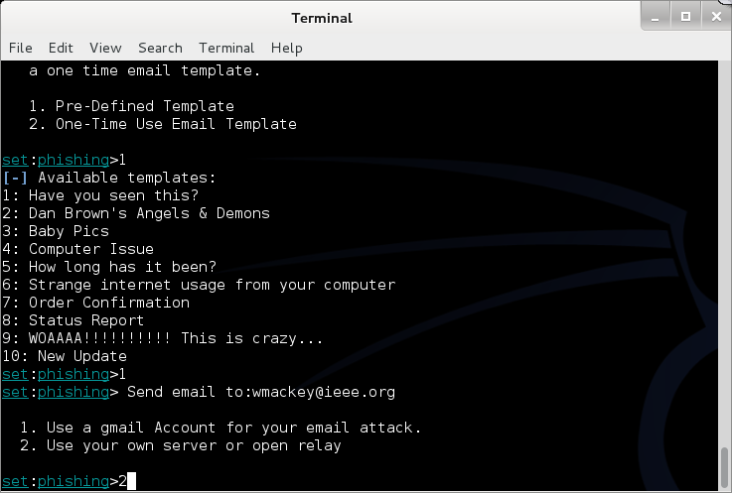
Walk Through of Attack
Select Option 2 for my own server

Slide 43
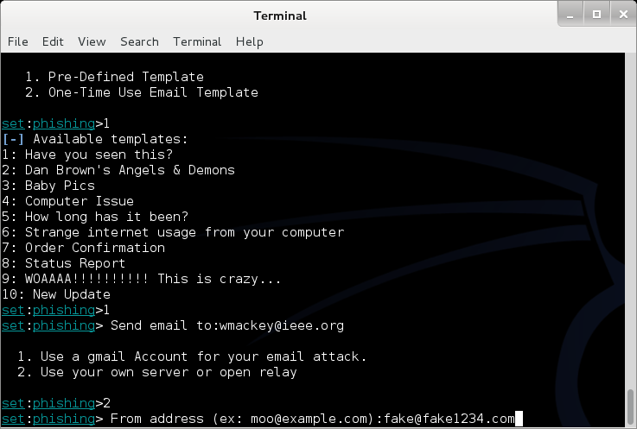
Walk Through of Attack
Enter a “From” address

Slide 44
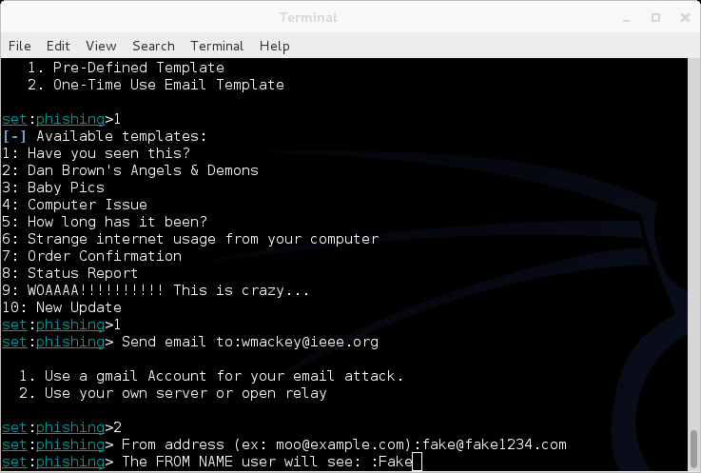
Walk Through of Attack
Enter a Name

Slide 45
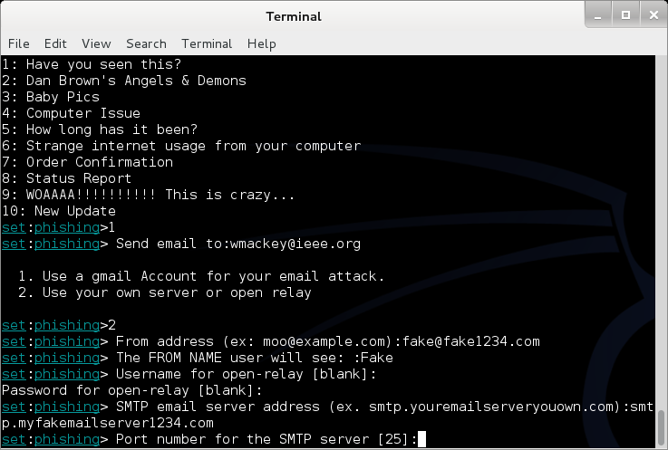
Walk Through of Attack
Enter Mail server information (Consolidated)

Slide 46
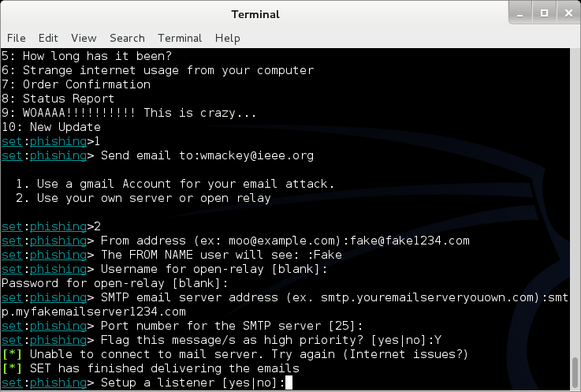
Walk Through of Attack
Launch Metasploit and setup listener

Slide 47
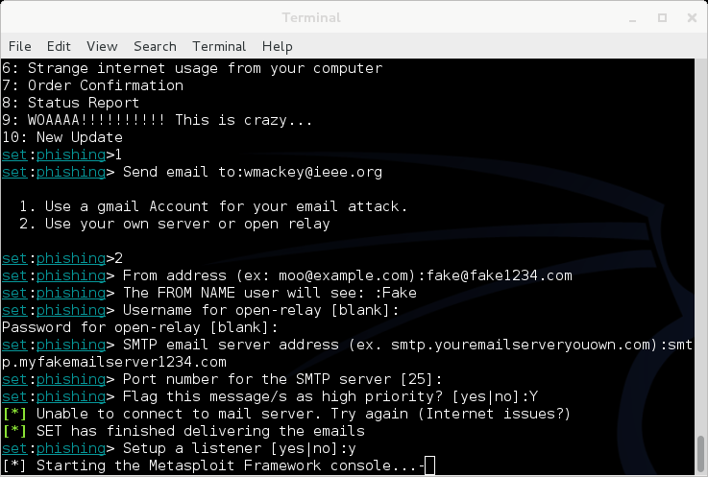
Walk Through of Attack
Will look like this for a bit

Slide 48
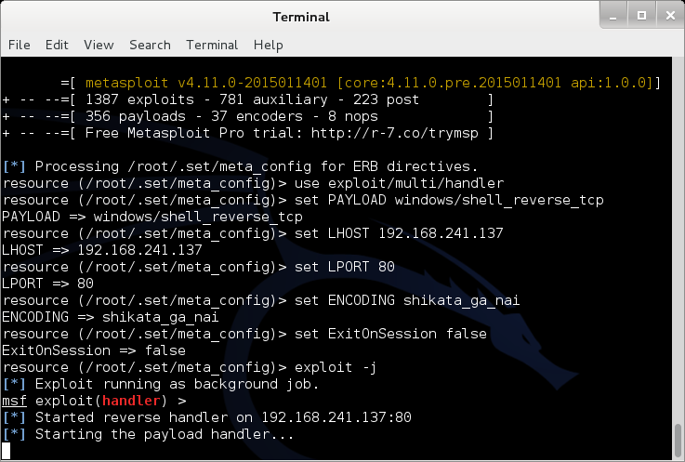
Walk Through of Attack
Eventually

Slide 49
Walk Through of Attack
At this point, Metasploit is listening for the packet coming from your victim once the attempt to open the attachment

Slide 50
Other Choices
You could clone a web site and set up your own copy hosting malicious attacks
You could clone a web site and just harvest credentials from unsuspecting visitors
You could use the mass e-mailer to “invite” victims to visit your freshly cloned site
You could build a link that shows a legitimate url when the mouse hovers over the link, but replaces the page with yours once clicked

Slide 51
Fast-Track
If you have the Metasploit book, you may see reference to a separate tool called Fast-Track
Fast-Track was rolled in to SET under “Fast-Track Penetration Testing “

Slide 52
Wrapping Up SET
Be careful. You could easily escape the boundary of your test systems
I covered this area so you would see what was available and how it interfaces to Metasploit

Slide 53
Encryption (Short Version)
Couple of points up front
  Real “Standards based” encryption is hard to break
  Proprietary encryption is usually not as hard to break
  When encryption is broken, it is usually the implementation, not the cypher suite that is broken
    Example: WEP and RC4
  Regardless of encryption, the computer has to decrypt the data to act on it. Therefore, clear text data is in memory
  Also true of browsers, browser must decrypt to act

Slide 54
Encryption (Short Version)
One exception to clear text in memory
Homomorphic Encryption
  Computations carried out on ciphertext
  Result is also encrypted
Problem:
  Very resource intensive
  Not fast enough for practical use (yet)

Slide 55
Terms
Algorithm – Mathematical rules used to encrypt and decrypt
Ciphertext – The encrypted data
Encipher – Encrypting
Decipher – Decrypting
Key – Sequence of bits and instruction that governs encryption and decryption
Plaintext – Unencrypted data

Slide 56

Symmetric vs Asymmetric
Symmetric – Both parties use the same key
  Anyone with a key can encrypt and decrypt
  Relatively fast, less intensive to use
Asymmetric – Keys linked mathematically, but cannot be derived from each other
  What one key encrypts, the other key decrypts
    Works both ways
  Also known as a key pair and associated with PKI or public key encryption
  Relatively slow, resource intensive

Slide 57
Stream and Block Ciphers
Block Ciphers
  Data is broken in to blocks
  Blocks are encrypted/decrypted individually
Stream Cipher
  Message is not broken up
  Encrypted/decrypted one bit at a time

Slide 58
Types of Symmetric Systems
DES
3DES
AES or Advanced Encryption Standard
Blowfish

Slide 59
Types of Asymmetric Ciphers
RC4
RSA
El Gamal
ECC or Elliptic Curve Cryptosystems

Slide 60
Public Key Encryption
A “Hybrid” encryption method
Symmetric key is used to perform bulk encryption/decryption of data
Asymmetric keys are used to pass the symmetric key securely

Slide 61
Session Keys
Basically just a secret key that is only used for one session between users (or systems) and is then disposed of.

Slide 62
Public Key Infrastructure (PKI)
Comprehensive process including:
  Programs
  Data formats
  Procedures
  Protocols
  Policies
  Mechanisms
All working together to secure communications

Slide 63
Certificate Authority
Certificate Authority (CA)
  Issues public keys
    Verifies you are who you say you are and provides certificate to prove it that can only come from a secret key you posses
Registration Authority (RA)
  Performs registration activities for a CA

Slide 64
One Way Function or Hashing
Provides for message integrity
Mathematical value calculated from data that cannot be reversed
  Sender and receiver can both calculate the value and verify that the data sent is the data received

Slide 65
Digital Signature
Encrypted hash value
  Data sent is data received
  Data can only have come from someone with the appropriate key(s)
  Reference: CISSP Certification, Shon Harris

Slide 66
The Unbreakable Code
Only one cipher is truly unbreakable
One-Time Pad
  Each pad is only used once
  Pad is XORd against cleartext data
  Ciphertext is XORd against pad at receiver
Generally not used due to difficulty in distributing non-recurring pads

Slide 67
Rules for Key Management
Longer keys are better
Keys need to be protected
Keys should be extremely random and use full spectrum of keyspace

Slide 68
Encoding
Encoding is NOT encrypting
Perfect example: Base64 encoding
  Well known
  Reversible
  Provide limited obfuscation
Other examples
  Morse code
  ASCII
  UTF-8, 16, 32
  EBCIDIC
  Unicode

Slide 69
Why we care about Encoding
Often used incorrectly as a substitute for encryption
Some “proprietary” encryption systems were nothing more then Base64 or Base64 with character substitution
  Even if you don’t recognize the encoding it is easily “cracked” with frequency analysis

Slide 70
Encoding and Web Attacks
We will see this again when we cover Web applications and intercepting proxies
  Base64 encoding is often used as an obfuscation technique

Slide 71

Blockchain
Distributed Ledger
  All parties have a copy
  Data can be added and is replicated across all copies
  Data cannot be modified or deleted
Benefits
  Distributed
  Lower transaction costs
  Faster transaction times
  Transparency & accountability & integrity
  Usage information and traceability
  Data security through encryption

Slide 72
Next Week
Malware

Slide 73
Questions
?

