Slide 1
Intro to Ethical Hacking
MIS 5211.001
Week 14

Slide 2
Tonight's Plan
Password Cracking
Notes on Enumeration
Fuzzing
RegEx
Spoofing / Poisoning
ARPSnoof
Ettercap
Reminder on Evasion

Slide 3
Password Cracking
Types
Brute force
Dictionary
Rainbow Table

Slide 4
John The Ripper (JtR)
John the Ripper password cracker
http://www.openwall.com/john/
Includes support for CUDA and OpenCL along with a wide variety of hash types (Not just WPA2-PSK)
Pre-installed in Kali
There is also a “Commercial” version available at:
http://www.openwall.com/john/pro/

Slide 5
JtR
For JtR to work, you need to provide it with file(s) containing hashes of user passwords - and those hashes have to be of a supported type.
JtR will successfully crack those hashes that correspond to weak passwords, but it will fail to crack those that are strong.

Slide 6
JtR and Kali
As several other tools have done, will not launch from drop down
Open terminal and type:
“john --test” this will launch a diagnostic and give you benchmarking numbers for how your system performs
Note: this is one instance where running in a VM is a bad idea. Performance will be poor
Consider installing directly on a test machine

Slide 7
JtR Usage
At it’s core, very simple
Find a file with hashes in it
Run: john passwordlist ~/file

Slide 8
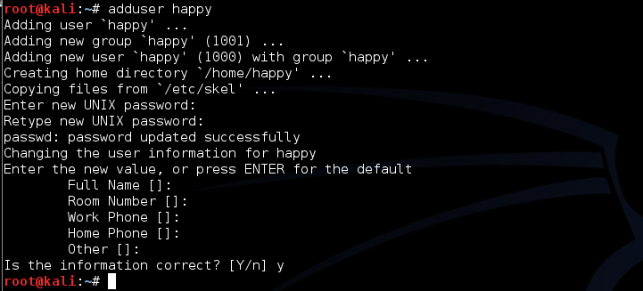
First Lets Add a User
Run command adduser happy
Use password chess when prompted

Slide 9
Now Extract Password File
Run command unshadow as follows
This extracts the passwd and shadow file and combines them together to create a file you can go after
If you were an attacker, this is what is meant by extracting or harvesting password files
In Windows you would go after the SAM file

Slide 10
Now we Crack
Run the john command as follows
This tells john to use a wordlist that is preinstalled in Kali (and has chess as an entry)
And tells john to apply it against the file: file_to_crack

Slide 11
Checking Work
Using the show command
Note: If you have not recently updated Kali 2.0 you may get errors.

Slide 12
Other Options
https://www.l0phtcrack.com
Commercial - Expensive – starts at $595
http://www.aircrack-ng.org
https://ophcrack.sourceforge.io
Other listed in Kali
If you find others on line – Be Afraid

Slide 13
Enumeration
Reference:
https://www.greycampus.com/opencampus/ethical-hacking/enumeration-and-its-types

Slide 14
NetBIOS Enumeration
Use the NetBIOS enumeration to obtain:
List of computers that belong to a domain
List of shares on the individual hosts on the network
Policies and passwords
Commands and tools used:
Nbtstat: utility used to find protocol statistics, NetBIOS name table and name cache details
Superscan: GUI tool used to enumerate windows machine
Net view: command line tool to identify shared resources on a network

Slide 15
SNMP Enumeration
SNMP enumeration is used to enumerate user accounts, passwords, groups, system names, devices on a target system.
Few tools:
OpUtils Network Monitoring Toolset - http://www.manageengine.com
SolarWinds ( best SNMP enumeration tool) - www.solarwinds.com
command line tools: SNMP-WALK, SNMP-CHECK

Slide 16
LDAP Enumeration
The Lightweight Directory Access Protocol is a protocol used to access directory listings within Active Directory or from other Directory Services.
Tools:
Jxplorer - http://www.jxplorer.org/
LDAP Admin Tool - http://www.ldapsoft.com

Slide 17
SMTP Enumeration
SMTP enumeration allows us to determine valid users on the SMTP server. This is done with the help built-in SMTP commands, they are
VRFY - This command is used for validating users.
EXPN - This command tells the actual delivery address of aliases and mailing lists.
RCPT TO - It defines the recipients of the message.
Tool:
NestScanTools Pro

Slide 18
DNS Enumeration
DNS enumeration is the process of locating all the DNS servers and their corresponding records for an organization.
Tools:
Nslookup
Maltego
Dnenum
dnsrecon

Slide 19
Fuzzing
Fuzz testing was developed at the University of Wisconsin Madison in 1989 by Professor Barton Miller and his students. Their (continued) work can be found at http://www.cs.wisc.edu/~bart/fuzz/ ; it's mainly oriented towards command-line and UI fuzzing, and shows that modern operating systems are vulnerable to even simple fuzzing.
Reference: https://www.owasp.org/index.php/Fuzzing

Slide 20
Fuzzer implementations
A fuzzer is a program which injects automatically semi-random data into a program/stack and detect bugs.
The data-generation part is made of generators, and vulnerability identification relies on debugging tools. Generators usually use combinations of static fuzzing vectors (known-to-be-dangerous values), or totally random data. New generation fuzzers use genetic algorithms to link injected data and observed impact. Such tools are not public yet.

Slide 21
Comparison with Cryptanalysis
The number of possible tryable solutions is the explorable solutions space. The aim of cryptanalysis is to reduce this space, which means finding a way of having less keys to try than pure brute force to decrypt something.
Most of the fuzzers are:
protocol/file-format dependent
data-type dependent

Slide 22
Attack types
A fuzzer would try combinations of attacks on:
numbers (signed/unsigned integers/float...)
chars (urls, command-line inputs)
metadata : user-input text (id3 tag)
pure binary sequences
Protocols and file formats imply norms, which are sometimes blurry, very complicated or badly implemented : that's why developers sometimes mess up in the implementation process (because of time/cost constraints).

Slide 23
Application Fuzzing
Whatever the fuzzed system is, the attack vectors are within it's I/O. For a desktop app:
the UI (testing all the buttons sequences / text inputs)
the command-line options
the import/export capabilities (see file format fuzzing below)
For a web app: urls, forms, user-generated content, RPC requests, ...

Slide 24
Protocol Fuzzing
A protocol fuzzer sends forged packets to the tested application, or eventually acts as a proxy, modifying requests on the fly and replaying them.

Slide 25
File Format Fuzzing
A file format fuzzer generates multiple malformed samples, and opens them sequentially. When the program crashes, debug information is kept for further investigation.
One can attack:
the parser layer (container layer): file format constraints, structure, conventions, field sizes, flags, ...
the codec/application layer: lower-level attacks, aiming at the program's deeper internals

Slide 26
Fuzzer Advantages
The great advantage of fuzz testing is that the test design is extremely simple, and free of preconceptions about system behavior (from Wikipedia http://en.wikipedia.org/wiki/Fuzz_testing).
The systematical/random approach allows this method to find bugs that would have often been missed by human eyes. Plus, when the tested system is totally closed (say, a SIP phone), fuzzing is one of the only means of reviewing it's quality.

Slide 27
Fuzzer Limitations
Fuzzers usually tend to find simple bugs; plus, the more a fuzzer is protocol-aware, the less weird errors it will find. This is why the exhaustive / random approach is still popular among the fuzzing community.
Another problem is that when you do some black-box-testing, you usually attack a closed system, which increases difficulty to evaluate the dangerosity/impact of the found vulnerability (no debugging possibilities).

Slide 28
Fuzzers
https://github.com/OpenRCE/sulley
https://github.com/jtpereyda/boofuzz
https://github.com/RootUp/BFuzz
https://www.owasp.org/index.php/WebScarab
https://www.owasp.org/index.php/JBroFuzz
https://www.owasp.org/index.php/WSFuzzer

Slide 29
Additional Refernces
https://bsidesvienna.at/slides/2017/the_art_of_fuzzing.pdf

Slide 30
Pattern-Matching in Data Validation
Many everyday values in society must match a particular pattern in order to be valid. For example:
Social Security Number: ddd-dd-dddd
Telephone number: ddd-dddd or (ddd) ddd-dddd, etc.
US Zip code: ddddd or ddddd-dddd
The fact that a value does match a pattern does not guarantee it is valid
If it fails to match the pattern, it cannot be valid
00000 matches the pattern for a Zip code, but no location uses that code
111-1111 matches the pattern for a phone number but that is not a US phone number assigned to any phone
On the other hand, 23 and 234567890123450987 do not match the patterns and so could not be valid social security numbers or valid Zip codes

Slide 31
Pattern Matching and Data Validation
Data validation is important in most real world applications (Garbage-in, garbage-out)
Some things (such as a person’s name) are impossible to fully validate unless we have a list of all possible valid values to compare against
Many times it is not possible to fully validate an input value because we don’t have a list of all valid values to compare
In those cases, if valid data is supposed to follow a particular pattern, we can at least assure that it could be valid because it matches the right pattern
This allows us to rule out much invalid input data

Slide 32
Introduction to Regular Expressions
One could have a full course on regular expressions
Not intended to be in-depth coverage
Many tools use regular expressions
Most work with a common set of rules
Some have their own extensions to the common rules that other tools may or may not support

Slide 33
Regular Expressions
Regular expressions provide a (somewhat) standard, formal way to specify patterns we want to match in unambiguous ways (we hope)
There is little intuitive about the ways in which regular expressions are written
There are tools that can help - more on this later

Slide 34
Regular Expressions
A regular expression is a string representing a specific pattern by use of an accepted notation
Each character in a regular expression has a specific meaning. It can represent an occurrence of the character itself, or it can have a more “generic” meaning
For example, a ‘d’ might be used to represent a digit
However, the same character might represent a specific lower-case letter (namely, the 4th letter in the alphabet) as in “abcdefg”

Slide 35
Regular Expressions
Thus, regular expressions use an “escape” character (‘\’) to signify when the next character has its literal meaning and when it has a special meaning
An Escape character is only needed when the next character is one that has both a literal meaning and an alternate meaning
This is similar to the use of ‘\n’ to represent a newline character rather than the letter ‘n’ and the use of ‘\t’ to represent a tab character instead of the letter ‘t’

Slide 36
Some Escape Sequences

Slide 37
Regular Expressions
In regular expressions, all characters that are not escaped match themselves except for the following special characters:
.[{()\*+?|^$
These characters have special meanings
Note that some opening symbols such as { and [ are included in this list, but their closing counterparts are not in the list

Slide 38
Wildcard in Regular Expressions
The single character '.' when used outside of a character set (see definition of character set in a later slide) will match any single character
It serves as a “wildcard” character
“x.z” matches “xyz”, “x1z”, “xkz”, or “x.z” but not “abc”, “xabcz”, or “xz”

Slide 39
Anchors in a Regular Expression
A '^' character will match the start of a line
It is used when the designated pattern must start at the beginning of a line
“^All” – The letters “All” must come at the beginning of the line to match this pattern
Examples (if at beginning of a line): “All good men . . .”, “Allen Likens”, “All-Star Game”
It would not match “Ball”, “CALL”, “TAll”, or “That’s All”

Slide 40
Anchors in Regular Expressions
A '$' character will match the end of a line
It is used when the designated pattern must match the characters at the end of a line
“end$” – the letters “end” must be at the end of the line to match this regular expression
Examples at the end of a line: “the end”, “around the bend”, “uranium comes from pitch blend”
But not “Send some men to end the fire”

Slide 41
Repetition in a Regular Expression
Any atom can be repeated some designated number of times through the use of one or more of the *, +, ?, and { } operators
The * operator will match the preceding atom zero or more times
For example the expression a*b will match any of the following:
b, ab, or aaaaaaaab but not “tom” or “ba”

Slide 42
Repetition
The ? operator will match the preceding atom zero or one time
For example, the expression ca?b will match either of the following:
cb
cab
but it will not match:
caab

Slide 43
Repetition in a Regular Expression
The + operator will match the preceding atom one or more times
For example the expression a+b will match either of the following items:
ab
aaaaaaaab
but it will not match:
b or ba

Slide 44
Bounded Repetition
An atom can also be repeated with a bounded repeat:
a{n} Matches 'a' repeated exactly n times
a{n,} Matches 'a' repeated n or more times
a{n, m} Matches 'a' repeated between n and m times, inclusively
For example:
^a{2,4}$
will match any of these:
aa
aaa
aaaa
but it will match neither of the following:
a
aaaaaa

Slide 45
Alternative values
The | operator will match either of its arguments (the values on its left hand side or those on its right hand side), so for example: a|d will match either "a" or "d"
Parenthesis can be used to group alternations, for example: ab(d|e) will match either of "abd" or "abe"
Empty alternatives are not allowed

Slide 46
Character sets
A character set is a bracketed expression starting with [ and ending with ], it defines a set of characters – those contained within the brackets, and it matches any single character that is a member of that set
There are several ways the characters in the brackets can be specified; the following slides show those ways

Slide 47
Character sets
Single characters
For example [abc], will match any of the single characters 'a', 'b', or 'c'
The desired characters are listed together with no separating characters such as commas
If commas or other separators are included, they become matching characters rather than separators
[a, b, c] would match an ‘a’, a ‘b’, a ‘c’, a comma, or a space

Slide 48
Character sets: ranges
Character ranges
A hyphen may be used to designate a range of characters
For example [a-m] will match any single character in the range 'a' to 'm' in the Unicode character sequence
This range includes both ‘a’ and ‘m’ as well as the lower case characters in the alphabet between the two

Slide 49
Character Sets: negation
Negation
If the bracketed expression begins with the ^ character, then it matches the complement of the characters it contains
The complement is every character not in the specified set
For example [^a-c] matches any single character that is not in the range a-c

Slide 50
Example
@"\b[0-1]?\d/[0-3]\d/(\d\d|19\d\d|200\d|201\d)\b”
\b represents a word boundary
[0-1]? represents zero or one occurrences of a 0 or a 1
\d represents a digit
/ represents a forward slash
Summary so far: matches “04/”, “4/”, “12/”, …at the beginning of a word - but also matches “18/” and “00/” at the beginning of a word
[0-3]\d/ matches a 0, 1, 2, or 3 followed by a digit followed by a forward slash
(\d\d|19\d\d|200\d|201\d)\b matches two digits or 19dd or 200d or 201d on a word boundary
Matches 04/18/92, 12/31/1982, 7/09/2007, and 11/11/2016
However, it also matches 18/36/2000

Slide 51
Regular Expression Tools on the Web
There are several tools that can be of use in developing regular expressions and in attempting to verify their accuracy
Some are free
At the time this was written, some useful tools were the RegExLibrary , Expresso , and Rubular
These provide regular expressions for common situations and give the ability to test regular expression candidates to see if they match the intended patterns
These are free tools but many of the regular expressions have been provided by the public at large with no rigorous verification of their accuracy

Slide 52
Expresso

Slide 53
Expresso

Slide 54
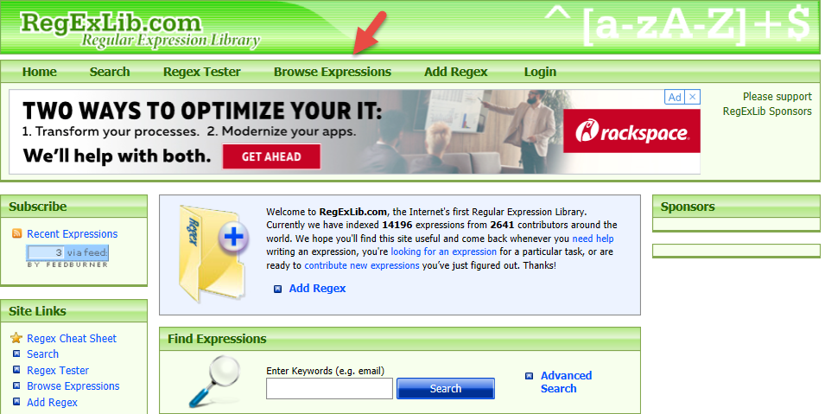
RegEx Library Contents

Slide 55
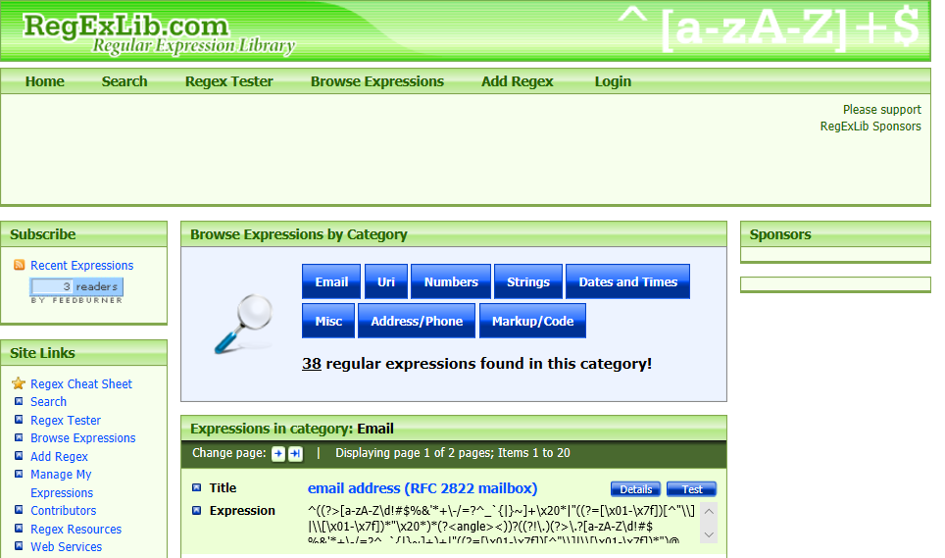
RegEx Library Contents

Slide 56
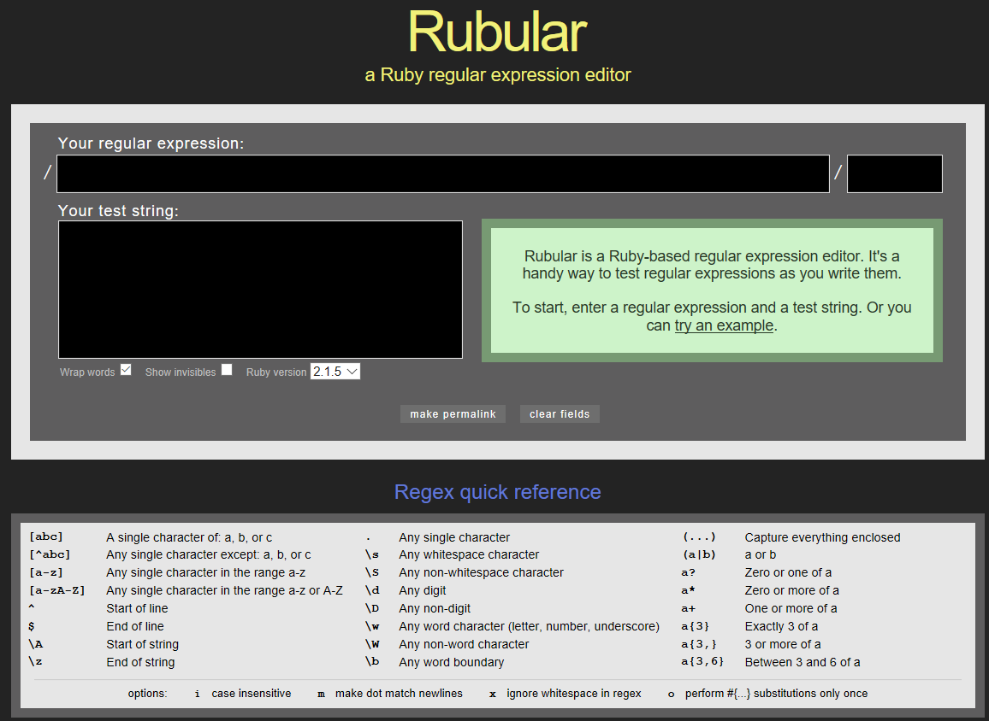
Rubular
http://rubular.com

Slide 57
More Ruby and Regex References
http://ruby-doc.com/docs/ProgrammingRuby/#UJ
https://www.regular-expressions.info/grep.html
https://www.regular-expressions.info/ruby.html
https://www.rubyguides.com/2015/06/ruby-regex/
http://ruby-for-beginners.rubymonstas.org/advanced/regular_expressions.html

Slide 58
Other Regex Options
On Linux: Grep
https://www.cyberciti.biz/faq/grep-regular-expressions/
http://www.robelle.com/smugbook/regexpr.html
Windows Command Line: findstr
https://www.windows-commandline.com/findstr-command-examples-regular/
https://docs.microsoft.com/en-us/windows-server/administration/windows-commands/findstr

Slide 59
Spoofing / Poisoning
Fake Replies to Requests
Modifying our MAC address.
Acting “as if” we’re the DNS server, Router, etc.

Slide 60
Examples
ArpSnoof (Dsniff)
https://www.monkey.org/~dugsong/dsniff
EtterCap
https://www.ettercap-project.org/
In Action:
https://www.youtube.com/watch?v=3aoufoF2-l0

Slide 61
Reminder on Evasion
During Attack
Components
Encryption
Clearing Logs
During Exfiltration
Blend In
Encryption
Fragmentation – Break Up Data – e.g. RAR
Multiple Protocols – DNS, Ping, Replies anyone?
Obfuscation – Remember RegEx?

Slide 62
Questions
?

