Slide 1
Intro to Ethical Hacking
MIS 5211.701
Week 12

Slide 2
Tonight's Plan
BSides DE
Introduction to Wireless Security
Next Week

Slide 3
Wireless Security
First, a small bit of trivia:
Who invented the technology we now think of as WiFi?

Slide 4
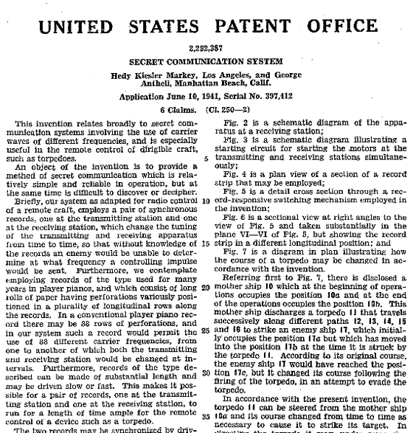
The Answer
The Actress Hedy Lamar
Source: http://www.pixmule.com/hedy-lamarr/ and https://en.wikipedia.org/wiki/Hedy_Lamarr#/media/File:Lamarr_patent.png

Slide 5
Security vs Mobility
Wireless is different
Physical security is no longer relevant
Access from outside perimeter
Users connecting to “other” networks
Users and Networks are vulnerable even when not in use

Slide 6
More Issues
Attack tools are cheap
Hardware is close to zero
Software is zero
Segregation doesn’t work
Even with “guest” networks, there still on your wires and can still cause you issues
Fallacy of “We don’t have any wireless”
No, you just don’t know about the wireless you have

Slide 7
Still More Issues
Encryption doesn’t protect you, at least not completely
Authentication doesn’t protect you, at least not completely
Firewalls? Really, we’re going to go their?
Why would anybody attack us?

Slide 8
Leakage
Signal required to use wireless access means you need to be relatively close
Signal required to “sniff” traffic means attacker could be miles away with the right conditions
Source: http://www.engadget.com/2007/06/19/venezuelans-set-new-wifi-distance-record-237-miles/

Slide 9
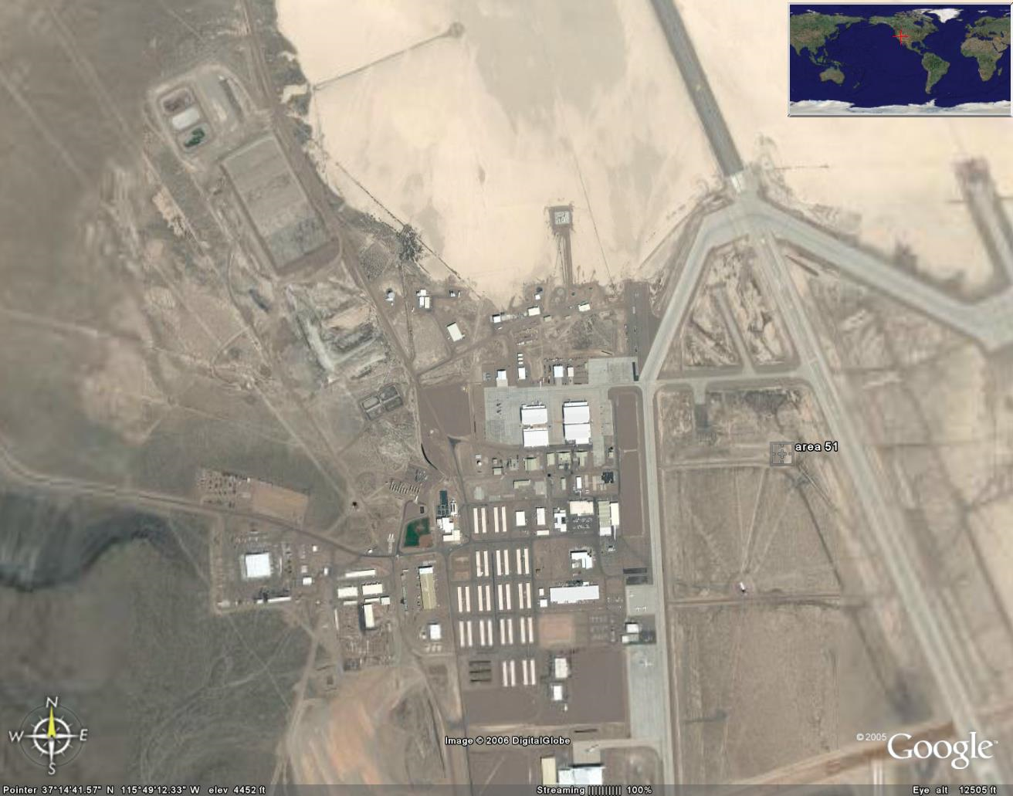
Old Ways Are The Worst Ways
Wireless networking is a shared segment
Think “Hub”, not “Switch”
Sniffing is passive
No access required
No forensic evidence attacker was there
Only need some level of physical proximity
So, you would need to be here, to be safe. Maybe!
Source: http://www.darkgovernment.com/news/wp-content/uploads/2009/04/area-51-satellite-image.jpg

Slide 10
Denial of Service
RF Jamming
Expensive
Traceable
802.11 attacks
Cheap (Free?)
Can look like regular traffic
Effective, and hard to locate

Slide 11
Protocol Issues
Long history of problems
WEP
LEAP
Bluetooth authentication
Preferred networks broadcast
Management frames cannot be encrypted
Easily captured
Geo Location

Slide 12
Standards
Multiple players
FCC – Federal Communications Commission
IEEE – Institute of Electrical and Electronics Engineers
IETF – Internet Engineering Task Force
WiFi Alliance

Slide 13
FCC
Government Regulatory Body
Sets output power limits
Investigates interference cases
Requires acceptance testing of new products prior to going on sale
Covers all of US including territories

Slide 14
IEEE
Develops the detailed “specifications” for layer 1 and 2
PHY
MAC
Complies with FCC and other country regulatory bodies
Membership made up of vendors, manufactures, etc…

Slide 15
IETF
Similar makeup to IEEE
Responsible for layer 3 and above
Standards are published as RFCs

Slide 16
WiFi Alliance
Trade Organization
Focused on interoperability
In early days, worked out pre-specification requirements due to vendor concerns over time required by IEEE and IETF

Slide 17
EAP
Extensible Authentication Protocol
Defines framework to authenticate users to the network (Not limited to Wireless)
Works with IEEE 802.1x
IETF provides extremely detailed information
http://tools.ietf.org/html/rfc3748

Slide 18
802.11i
The replacement for WEP
Provided for enhanced security
Introduces TKIP and CCMP
TKIP – Temporal Key Interchange Protocol
CCMP - Counter Mode Cipher Block Chaining Message Authentication Code Protocol, Counter Mode CBC-MAC Protocol or simply CCMP
Later rolled in to 802.11-2007

Slide 19
802.11 MAC Layer
Definitions
“dB” – Decibels
SSID – Service Set Identifier (Name Advertised)
BSSID – Basic Service Set Identifier (Think MAC Address)
EAP Extensible Authentication Protocol
EAPOL – EAP over LAN

Slide 20
802.11 MAC Layer
Basic access mechanism
Fragmentation support
Reliable data delivery
Network separation on same frequency (BSSID)
Mobility between BSSs (Roaming)
Power Management

Slide 21
Architectures
Not just Access Points
Peer to Peer (Ad-Hoc)
Point to Point (Typically proprietary to bridge locations where cabling is not feasible, also known as Wireless Distribution Networks)
Mesh (Think massive ad-hoc)
Wireless Switches

Slide 22
802.1x
IEEE Specification for network authentication
Originally designed for wired networks
Used for NAC (Network Access Control)
Requires
Supplicant (End point agent)
Authenticator (Typically a 802.1x capable switch)
Authentication Server (LDAP, AD, etc…)

Slide 23
802.11 Framing
802.11-2007 defines MAC layer
Three types of frames
Management (Beacon, Probe, Authentication)
Data
Control (Confirmation of packet reception)
Defines addressing and features
Designed to accommodate roaming, power management

Slide 24
More Wireless Security
Open WiFi Networks vs Encrypted WiFi Networks
In an open network, your browsing can be monitored
Every thing is sent in the clear
WPA2-PSK fixes this “Somewhat”

Slide 25
WPA2-PSK
Uses a pre-shared key (hence the acronym PSK)
The pre-shared key is known to all authorized users
Anyone with the pre-shared key has what they need to decrypt traffic
Wireshark has a built in option to decrypt traffic if you have the key
This means WPA2-PSK is not much more secure than no encryption, unless you trust everyone on the network

Slide 26
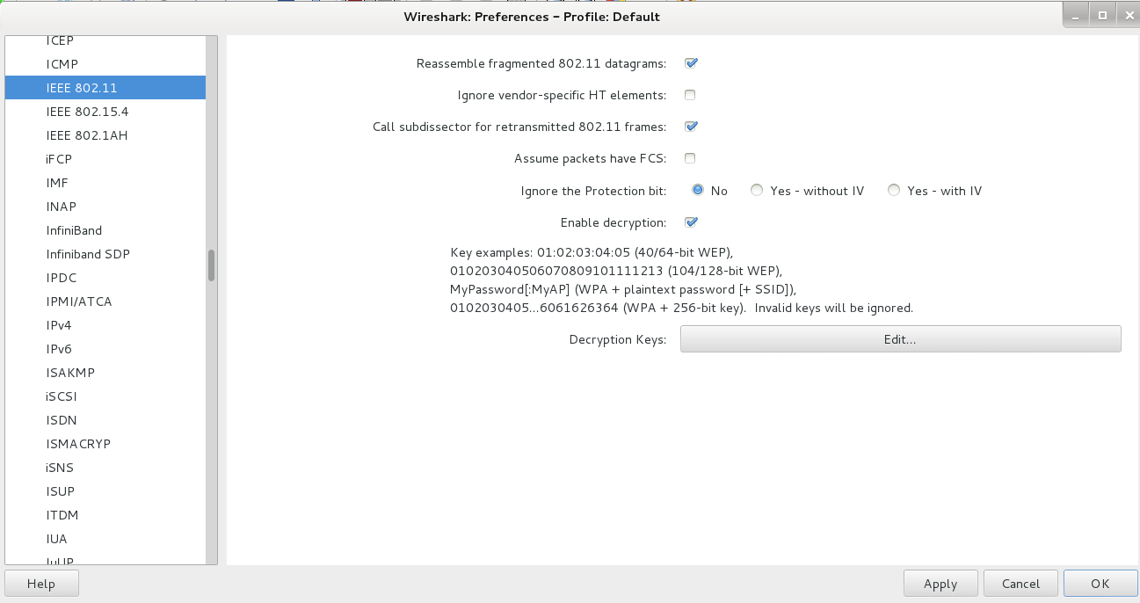
Wireshark WPA2-PSK Decryption
Edit->Preferences->IEEE 802.11

Slide 27
PTK or Pairwise Transient Key
WPA2-PSK tries to address this issue by use of PTK
However, the PTK is derived from the PSK
So… It is easy to capture the PTK if you have the PSK

Slide 28
WPA2-Enterprise
WPA2-Enterprise corrects these issues for large networks
EAP authentication along with a Radius server ensures each client gets a unique key
Other authenticated users no longer have a master key to decrypt the traffic

Slide 29
WPA2 Hole196 Vulnerability
Even in WPA2-Enterprise there is still a potential vulnerability from other authorized users (Abuses GTK or Group Temporal Key)
Limited to:
ARP poisoning
Injecting malicious code
Denial of Service w/o using de-auth packets
More detailed description
https://community.arubanetworks.com/t5/Community-Tribal-Knowledge-Base/Analysis-of-quot-Hole-196-quot-WPA2-Attack/ta-p/25382

Slide 30
Key Reinstallation Attack
Also known as KRACK
The attack works against all modern protected Wi-Fi networks
https://www.krackattacks.com
Basically takes advantage of weakness in protocol to reinstall keys

Slide 31
Kismet
802.11 wireless:
Network detector
Sniffer
Intrusion detection system
Works with any wireless card which supports raw monitoring mode (not all do)
Can sniff:
802.11b
802.11a
802.11g
802.11n

Slide 32
Kismet
Supports a plugin architecture allowing for additional non-802.11 protocols to be decoded
Identifies networks by passively collecting packets and detecting networks, which allows it to detect (and given time, expose the names of) hidden networks and the presence of non-beaconing networks via data traffic

Slide 33
Kismet in Kali
Pre-installed in Kali
Did not launch from drop down menu in my instance
Needed to start from command line
Be patient, it will walk through configuration
You can automate via configuration files, but for now just follow prompts

Slide 34
Getting Started
We will
Get USB Wireless Adapter working with Kali
Launch and configure Kismet
Explore a little bit

Slide 35
Connecting Wireless Card

Slide 36
Checking Card
Use the command: iwconfig
This should give something like the following:

Slide 37
Kismet
Kismet is a wireless network detector, sniffer, and intrusion detection system. Kismet works predominately with Wi-Fi (IEEE 802.11) networks, but can be expanded via plug-ins to handle other network types.
Features
802.11 sniffing
Standard PCAP logging (compatible with Wireshark, TCPDump, etc)
Client/Server modular architecture
Plug-in architecture to expand core features
Multiple capture source support
Live export of packets to other tools via tun/tap virtual interfaces
Distributed remote sniffing via light-weight remote capture
XML output for integration with other tools
http://kismetwireless.net/

Slide 38
Starting Kismet

Slide 39
Kismet Example

Slide 40
Wireshark
Pre-installed in Kali

Slide 41
Wireshark

Slide 42
Or

Slide 43
Startup of Wireshark
Will throw an error due to running as root in Kali, just click OK and move on
Will need to turn wireless menu on by going to View tab and clicking on “Wireless Toolbar”

Slide 44
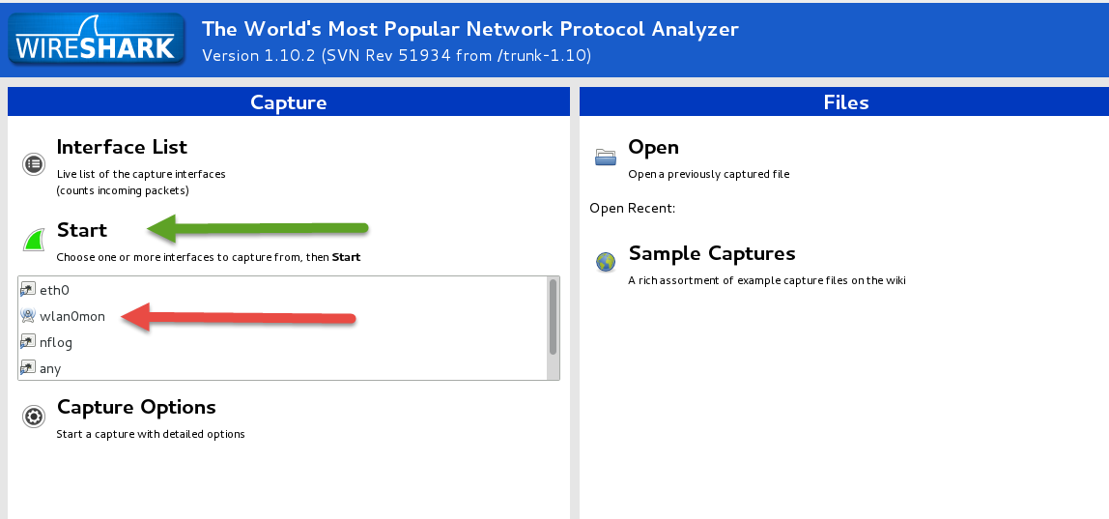
Configuring Interface
Select “wlan0mon”
Click on “Start”
Be patient, it will take a minute or so to update

Slide 45
More Wireshark

Slide 46
Questions
?

