Slide 1
Advanced Penetration Testing
MIS 5212.001
Week 1
Site: http://community.mis.temple.edu/mis5212sec001s15/

Slide 2
Tonight's Plan
Introduction
Reminder of the basics
In the news
Metasploit
Next Week

Slide 3
Introduction
Wade T Mackey
Wade.mackey@temple.com
717-682-2925

Slide 4
About the Course
Our focus will be to provide you with an understanding of the process involved in penetration testing focusing on Metasploit, WebGoat, and Wireless Security and the tool sets used
Organized around the workflow of a professional tester
Tips for avoiding common pitfalls

Slide 5
About the Course (Cont)
Additional tools we will look at
Ettercap – A tool for performing Man in the Middle attacks
Wireshark – No a penetration tool, but important to have a basic knowledge
Cain and Able – Password cracking tool

Slide 6
Course Plan

Slide 7
Course Plan

Slide 8
Caution
The tools and techniques discussed and used in this course should only be used on systems you personally own, or have written permission to use.
Some of the tools used have the potential to disrupt or break computer systems.

Slide 9
Mindset
Successful penetration testers look at the world through a different lens
They think outside the box
They do things differently
They don’t look at the glass as half full or half empty, instead they look at the glass and think “If I hit the glass just right, I can crack it and drain out just what I want.

Slide 10
Mindset (Continued)
Successful penetration tester also need to have the following work habits
Methodical
Thorough
Careful
Ethical
habitual note taker and documentation fiend
If you can’t duplicate a finding, you didn’t find it!

Slide 11
In The News
What I noted
http://krebsonsecurity.com/2016/01/account-takeovers-fueling-warranty-fraud/
http://krebsonsecurity.com/2015/12/2016-reality-lazy-authentication-still-the-norm/
http://www.theregister.co.uk/2016/01/08/baseball_exec_cops_to_hacking/

Slide 12
Free Cloud Training
Amazon is offering a free 3 hour cloud security fundamentals course on line.
With “Cloud” being hot right now, my be worth the three hours.
https://aws.amazon.com/training/course-descriptions/security-fundamentals/

Slide 13
Metasploit
Metasploit is a penetration testing framework that integrates other tools we have seen with exploitation tools

Slide 14
Penetration Testing Execution Standard
Developers of Metasploit used the Penetration Testing Execution Standard (PTES) as their guide in developing the tool
http://www.pentest-standard.org/index.php/Main_Page
Contains a great deal of information and worth looking over

Slide 15
Process
Similar to what we covered in the first semester, Metasploit and PTES breaks activities down in to some basic categories
Pre-Engagement (Getting Permission)
Intelligence Gathering (Recon)
Threat Modeling (Using Intel to determine vulnerabilities)
Note: This is different then Threat Modeling in IT Security Space
Vulnerability Analysis
Exploitation
Post Exploitation
Reporting

Slide 16
Types of Penetration Tests
Overt Penetration Testing
Another term for “Crystal Box” testing
Working with target staff and with access to target documentation to fine tune testing
Quicker, but information may steer you away from things
Covert Penetration Testing
Another term for “Black Box” testing
You have the same opportunity to gather information as a real attacker
Time consuming and expensive, but you may find “nuggets” not obvious from the documentation if you had it

Slide 17
Vulnerability Scanners
We looked at these in the first semester
Remember Nmap and Nessus
Metasploit can interface with these tools (and others) to use their output as an input to it’s tool set.

Slide 18
A few words about Metasploit
Metasploit is included on Kali in several forms
There is a Web Based interface that requires activation as well as the terminal version built in.
Both forms are slow to launch. Your machine isn’t frozen, it just takes a while. There’s a lot going on and we’ll cover that as we go.
We will mostly focus on the terminal version known as Metasploit Framework

Slide 19
Terminology
Exploit – Means by which an attacker takes advantage of a flaw
Payload – Code we want a system to execute
Shellcode – Set of instructions used as a payload when exploitation occurs
Module – Piece of software used by the Metasploit Framework
Listener – Component within Metasploit that waits for an incoming connection

Slide 20
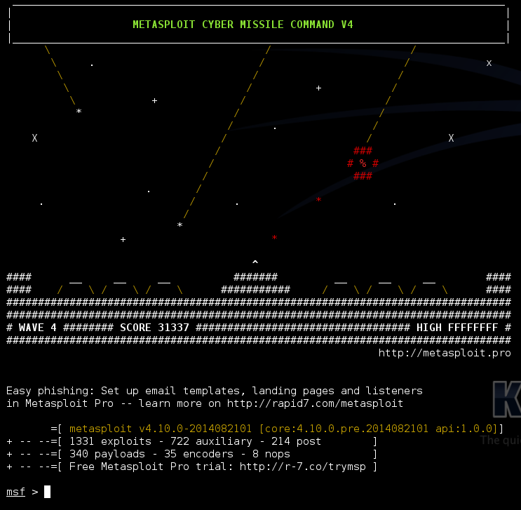
Metasploit Interfaces
MSFconsole - The way we will normally interact with Metasploit
Started by typing: msfconsole at terminal prompt
Note: You may need to provide path

Slide 21
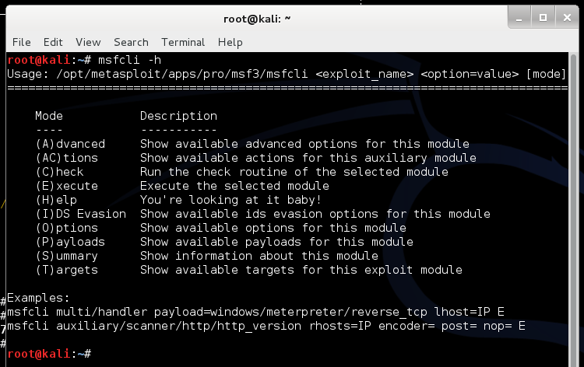
Metasploit Interfaces
MSFcli – Bypasses msfconsole menu process and allows direct selection of attack
Started by typing msfcli at terminal prompt

Slide 22
MSFcli Example

Slide 23
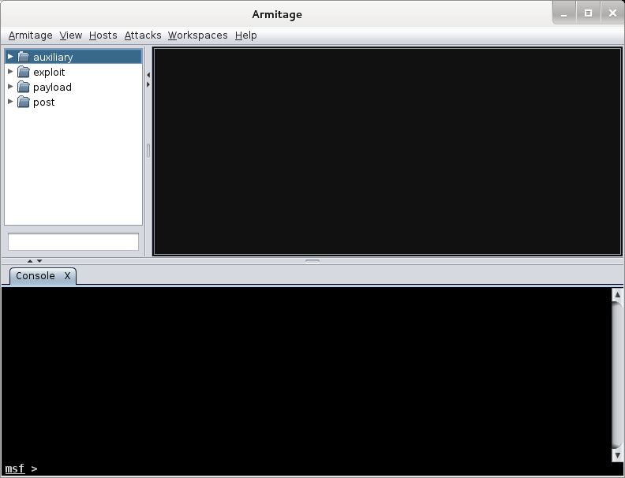
More Interfaces
Armitage – Graphic Interface to MSFconsole
Already Installed in Kali

Slide 24
Metasploit Utilities
MSFpayload – Generates shellcode, executables, and more
MSFencode – Encodes shellcode to eliminate problem characters and obfuscate code to evade IDS and IPS systems
Nasm Shell – Utility that provides assembly language help during scripting

Slide 25
Metasploit Express and Pro
Commercial versions of the Metasploit tool
We will stick with the community version in this class
Note: We ran through a lot of information and terms. We will cover details as the course continues.

Slide 26
Once More
One more time – The techniques covered in this class can damage your systems and the target systems. Make sure you use a test environment.

Slide 27
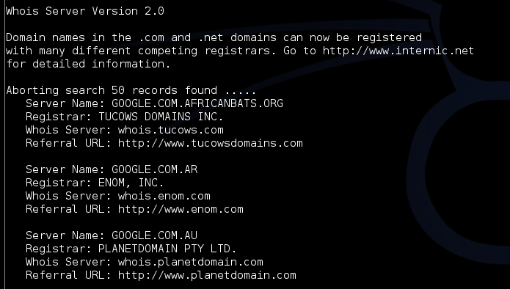
Intelligence Gathering
Whois – Unchanged from last semester

Slide 28
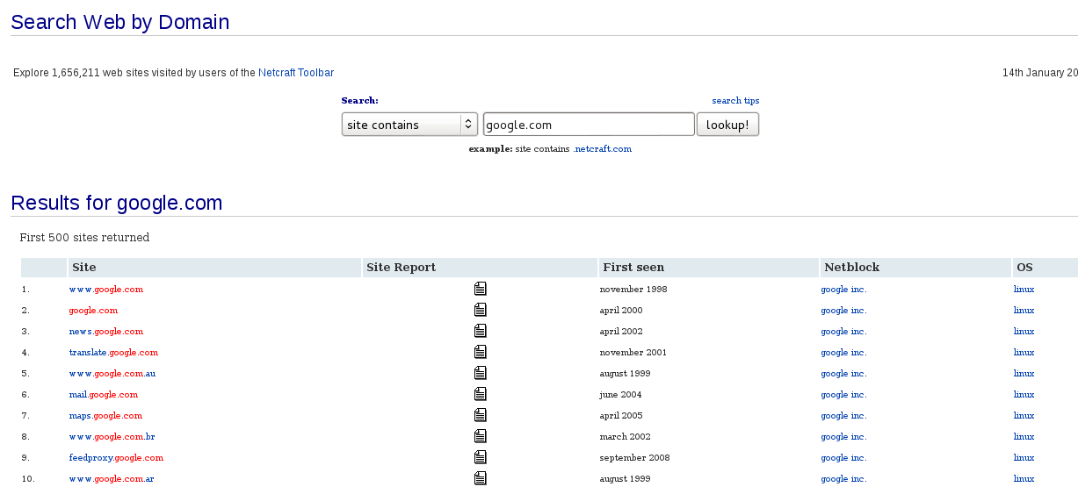
Netcraft
Web based tool for finding IPs
URL: searchdns.netcraft.com

Slide 29
NSLookup

Slide 30
Active Information Gathering
Port Scanning with Nmap
We covered this last semester
One new twist, we want to utilize the –oX option to have nmap save it’s output in xml

Slide 31
Metasploit and it’s Database
Metasploit has a built in database to support collecting data during a penetration test
Uses PostgresSQL
You can check status when MSFconsole is running by typing: db_status at the msf> prompt in Metasploit
Should respond with “postgress connected to msf3 (or something close to this)
Note: Before Kali 2.0, there were issues getting the database to work. Make sure you are on 2.0

Slide 32
Database and Nmap
Run Nmap with a command something like: nmap –Pn –sS –A –oX Subnet1.xml 192.168.1.0/24
This will sweep the subnet and leave the results in a xml file ready for import
This may take a while, may want to narrow focus to a shorter list

Slide 33
Importing to Metasploit
At Metasploit prompt
Db_import Subnet1.xml
Hosts –c address
This will import the active hosts to Metasploit database

Slide 34
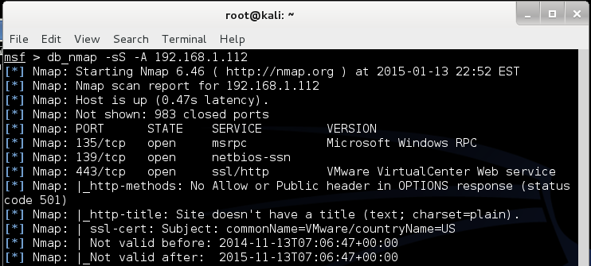
Nmap from Metasploit
Run command
Msf > db_nmap –sS –A [Target Address]
In my case:

Slide 35
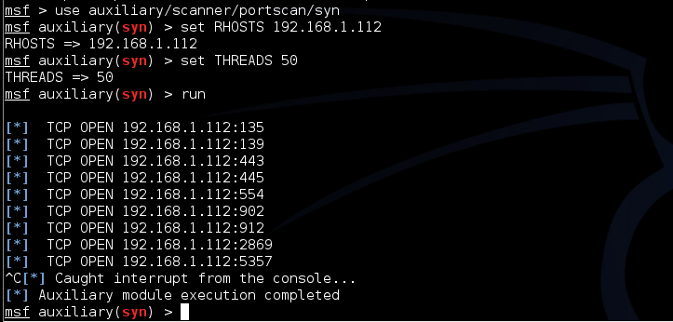
Built In Port Scanners
Run command:
Msf> use auxiliary/scanner/portscan/syn
Msf auxiliary(syn) > set RHOSTS [Target IP]
Msf auxiliary(syn) > set THREADS 50
In my case:

Slide 36
More Scanning Options
Server Message Blocks
Use auxiliary/scanner/smb/smb_version
MSSQL
Use auxiliary/scanner/mssql/mssql_ping
SSH
Use auxiliary/scanner/ssh/ssh_version
FTP
Use auxiliary/scanner/ftp/anonymous
SNMP
Use auxiliary/scanner/snmp/snmp_login

Slide 37
Writing a Custom Scanner
You can write your own
Uses Ruby
Example on following page

Slide 38
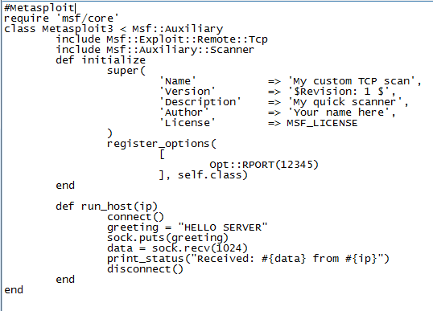
Simple Scanner

Slide 39
Vulnerability Scanning
Rapid 7 (Owner of commercial instance of Metasploit) makes a “community” version of their scanner available.
Called NeXpose
Not included in Kali
Available at:
http://www.rapid7.com/products/nexpose/compare-downloads.jsp

Slide 40
NeXpose
Similar to stand alone Nmap, NeXpose output can be saved as xml and imported into Metasploit via the db_import command
Example
Msf> db_import /tmp/hosts.xml

Slide 41
NeXpose
Once installed in Kali, can be setup to run from within the MSF Framework
See:
http://www.offensive-security.com/metasploit-unleashed/NeXpose_Via_Msfconsole

Slide 42
Nessus
See:
http://www.offensive-security.com/metasploit-unleashed/Nessus_Via_Msfconsole

Slide 43
Other Scanning Options
Open VNC Authentication
Msf> use auxiliary/scanner/vnc/vnc_none_auth
Open X11 Servers
Msf> use auxiliary/scanner/x11/open_x11

Slide 44
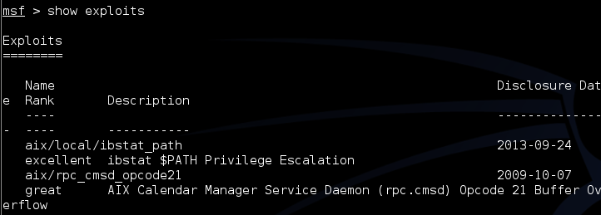
Exploits
Basics
Msf> show exploits
Msf> show auxiliary
Msf> show options

Slide 45
Search
Can search for specific exploits
Msf> search ms08_067

Slide 46
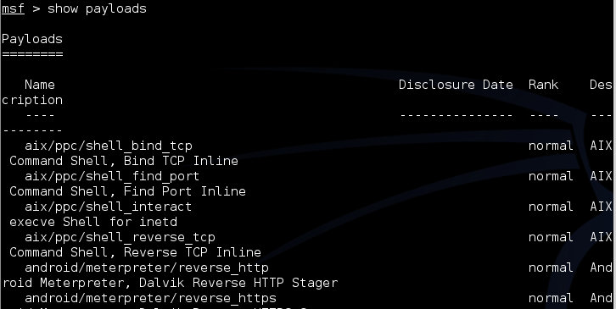
Payloads
Msf> show payloads

Slide 47
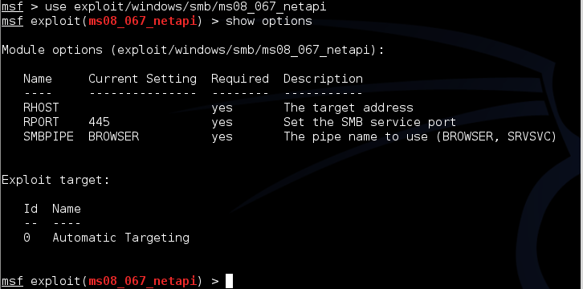
Selecting the Exploit
Once you know the exploit you want:
Show options

Slide 48
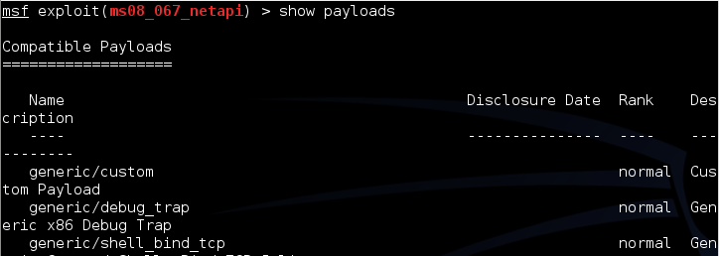
What Payload?
Now, show payloads makes more sense

Slide 49
Setting the Payload

Slide 50
Selecting a Target

Slide 51
Final Options
Set RHOST [Target IP]
Set target [Target Number from Previous Slide]
Show options will list your settings so you can verify

Slide 52
Looking at Ubuntu
Same process, we find a machine via scanning
Either select port found during scanning if it looks promising (Like open port with samba)
Or, run vulnerability scanner to find more options
Lets say we found samba

Slide 53
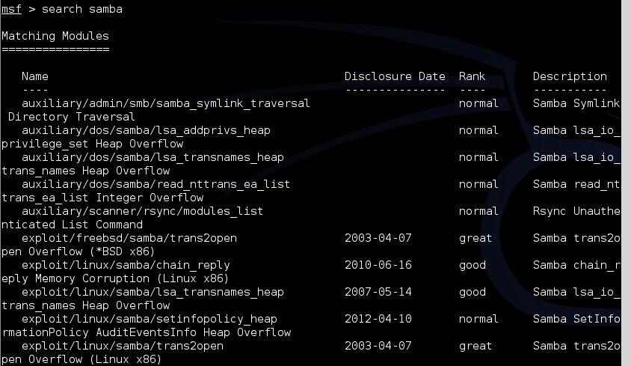
Looking for New Possibilities
Recall the search function

Slide 54
Same Process

Slide 55
More of the Same
Set LPORT 8080
Set RHOST 192.168.x.x
And finally
exploit

Slide 56
Reference
The Metasploit portion of the course draws heavily on “Metasploit – The Penetration Tester’s Guide” from No Starch Press
While not required for the class, it is worthwhile having, especially if you think you will continue to pursue penetration testing
http://www.offensive-security.com/metasploit-unleashed/Main_Page
Great online reference (Same people that wrote book above)

Slide 57
Before Next Week
Make sure your VMWare implementation is working
Start Kali and run msfconsole
Then check db_status and see if you are connected to your database
If not, reinstall Metasploit per directions on slide 30
Check Nessus and/or install NeXpose, will be helpful for Exercise
Syllabus and readings will be posted by Friday

Slide 58
Next Week
Meterpreter
Avoiding Detection
Client Side Attacks
Auxiliary Modules

Slide 59
Questions
?

