Slide 1
Advanced Penetration testing
MIS 5212.001
Week 10
Site: http://community.mis.temple.edu/mis5212sec001s16/

Slide 2
Tonight's Plan
In the news
Ettercap Lab
Introduction to Wireless Security
Next Week

Slide 3
In The News
Submitted
http://www.forbes.com/sites/thomasbrewster/2016/03/11/kkk-staminus-hacked/#832e3ba6942b
http://www.wsj.com/articles/cybersecurity-training-military-style-1457921566
http://www.ehackingnews.com/2016/03/drown-attack-risks-millions-of-popular.html
http://www.nbcnews.com/tech/tech-news/how-hacker-s-typo-helped-stop-billion-dollar-bank-heist-n536526
http://thehackernews.com/2016/03/isp-sells-data-to-advertisers.html
http://www.martinsvillebulletin.com/news/city-county-schools-awarded-grants-for-cybersecurity-camps/article_75000824-e988-11e5-b3cc-8bc49be61bed.html

Slide 4
In The News
Submitted
http://www.securityweek.com/android-trojan-posing-flash-player-targets-banking-apps
http://thehackernews.com/2016/03/ddos-protection.html
http://www.bbc.com/news/technology-34474883 (minecraft)
http://www.zdnet.com/article/if-apple-can-help-china-it-can-help-us-us-doj/
http://www.securityweek.com/drown-vulnerability-still-unpatched-most-cloud-services
http://www.securityweek.com/romanian-court-approves-extradition-hacker-guccifer-us

Slide 5
In The News
What I noted
https://www.aclu.org/blog/free-future/one-fbis-major-claims-iphone-case-fraudulent
https://ca.news.yahoo.com/obama-says-cannot-legal-case-apple-inc-223034884--finance.html
http://www.nytimes.com/2016/03/13/us/politics/whatsapp-encryption-said-to-stymie-wiretap-order.html?_r=0
http://krebsonsecurity.com/2016/03/hackers-target-anti-ddos-firm-staminus/

Slide 6
Wireless Security
First, a small bit of trivia:
Who invented the technology we now think of as WiFi?

Slide 7
Ettercap Lab

Slide 8
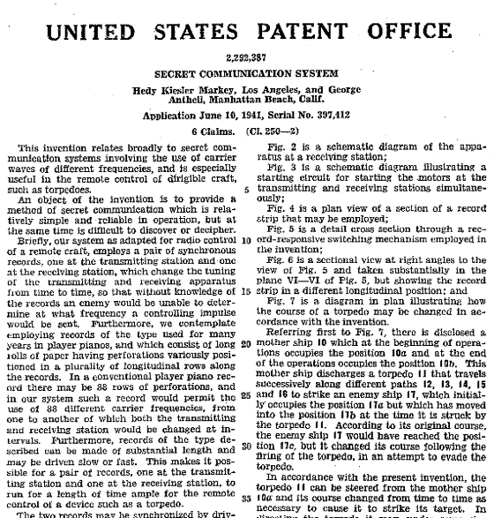
The Answer
The Actress Hedy Lamar
Source: http://www.pixmule.com/hedy-lamarr/ and https://en.wikipedia.org/wiki/Hedy_Lamarr#/media/File:Lamarr_patent.png

Slide 9
Security vs Mobility
Wireless is different
Physical security is no longer relevant
Access from outside perimeter
Users connecting to “other” networks
Users and Networks are vulnerable even when not in use

Slide 10
More Issues
Attack tools are cheap
Hardware is close to zero
Software is zero
Segregation doesn’t work
Even with “guest” networks, there still on your wires and can still cause you issues
Fallacy of “We don’t have any wireless”
No, you just don’t know about the wireless you have

Slide 11
Still More Issues
Encryption doesn’t protect you, at least not completely
Authentication doesn’t protect you, at least not completely
Firewalls? Really, we’re going to go their?
Why would anybody attack us?

Slide 12
Leakage
Signal required to use wireless access means you need to be relatively close
Signal required to “sniff” traffic means attacker could be miles away with the right conditions
Source: http://www.engadget.com/2007/06/19/venezuelans-set-new-wifi-distance-record-237-miles/

Slide 13
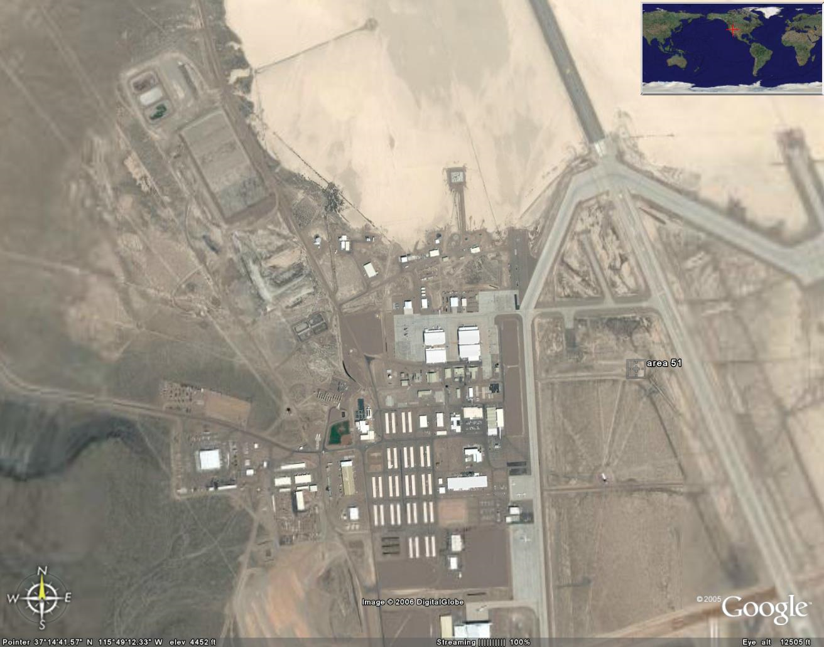
Old Ways Are The Worst Ways
Wireless networking is a shared segment
Think “Hub”, not “Switch”
Sniffing is passive
No access required
No forensic evidence attacker was there
Only need some level of physical proximity
So, you would need to be here, to be safe. Maybe!
Source: http://www.darkgovernment.com/news/wp-content/uploads/2009/04/area-51-satellite-image.jpg

Slide 14
Denial of Service
RF Jamming
Expensive
Traceable
802.11 attacks
Cheap (Free?)
Can look like regular traffic
Effective, and hard to locate

Slide 15
Protocol Issues
Long history of problems
WEP
LEAP
Bluetooth authentication
Preferred networks broadcast
Management frames cannot be encrypted
Easily capture
Geo Location

Slide 16
Standards
Multiple players
FCC – Federal Communications Commission
IEEE – Institute of Electrical and Electronics Engineers
IETF – Internet Engineering Task Force
WiFi Alliance

Slide 17
FCC
Government Regulatory Body
Sets output power limits
Investigates interference cases
Requires acceptance testing of new products prior to going on sale
Covers all of US including territories

Slide 18
IEEE
Develops the detailed “specifications” for layer 1 and 2
PHY
MAC
Complies with FCC and other country regulatory bodies
Membership made up of vendors, manufactures, etc…

Slide 19
IETF
Similar makeup to IEEE
Responsible for layer 3 and above
Standards are published as RFCs

Slide 20
WiFi Alliance
Trade Organization
Focused on interoperability
In early days work out pre-specification requirements due to vendor concerns over time required by IEEE and IETF

Slide 21
EAP
Extensible Authentication Protocol
Defines framework to authenticate users to the network (Not limited to Wireless)
Works with IEEE 802.1x
IETF provides extremely detailed information
http://tools.ietf.org/html/rfc3748

Slide 22
802.11i
The replacement for WEP
Provided for enhanced security
Introduces TKIP and CCMP
TKIP – Temporal Key Interchange Protocol
CCMP - Counter Mode Cipher Block Chaining Message Authentication Code Protocol, Counter Mode CBC-MAC Protocol or simply CCMP
Later rolled in to 802.11-2007

Slide 23
802.11 MAC Layer
Definitions
“dB” – Decibels
SSID – Service Set Identifier (Name Advertised)
BSSID – Basic Service Set Identifier (Think MAC Address)
EAP Extensible Authentication Protocol
EAPOL – EAP over LAN

Slide 24
802.11 MAC Layer
Basic access mechanism
Fragmentation support
Reliable data delivery
Network separation on same frequency (BSSID)
Mobility between BSSs (Roaming)
Power Management

Slide 25
Architectures
Not just Access Points
Peer to Peer (Ad-Hoc)
Point to Point (Typically proprietary to bridge locations where cabling is not feasible, also known as Wireless Distribution Networks)
Mesh (Think massive ad-hoc)

Slide 26
802.1x
IEEE Specification for network authentication
Originally designed for wired networks
Used for NAC (Network Access Control)
Requires
Supplicant (End point agent)
Authenticator (Typically a 802.1x capable switch)
Authentication Server (LDAP, AD, etc…)

Slide 27
802.11 Framing
802.11-2007 defines MAC layer
Three types of frames
Management (Beacon, Probe, Authentication)
Data
Control (Confirmation of packet reception)
Defines addressing and features
Designed to accommodate roaming, power management

Slide 28
Next Week
In the news
More wireless
Kismet
More about WEP
Intro to AirCrack

Slide 29
Questions
?

