Slide 1
Advanced Penetration testing
MIS 5212.001
Week 11a
Site: http://community.mis.temple.edu/mis5212sec001s16/

Slide 2
Tonight's Plan
In the news
WEP
Revisit Kismet
Introduction to Aircrack
Attacking WEP
WPA-PSK
Next Week

Slide 3
In The News
Submitted
  http://www.nytimes.com/2016/03/28/technology/american-tech-giants-face-fight-in-europe-over-encrypted-data.html?_r=0
  https://www.washingtonpost.com/news/the-intersect/wp/2016/03/24/the-internet-turned-tay-microsofts-fun-millennial-ai-bot-into-a-genocidal-maniac/
  http://thehackernews.com/2016/03/smtp-sts-email-security.html

Slide 4
In The News
Submitted
  http://www.theregister.co.uk/2016/03/24/us_charges_iranian_hackers/
  http://www.theregister.co.uk/2016/03/24/water_utility_hacked/
  http://www.securityweek.com/malvertising-campaign-hits-top-global-websites
  http://www.securitynewspaper.com/2016/03/26/18-million-stolen-ids-discovered-server-criminals-china-got-illegal-access/
  Temple Phishing Efforts
  http://thehackernews.com/2016/03/system-integrity-protection.html
  http://www.kb.cert.org/vuls/id/319816
  http://www.govinfosecurity.com/verizon-confirms-breach-affecting-business-customers-a-8991

Slide 5
In The News
What I noted
  https://www.shellterproject.com/
  https://github.com/giMini/PowerMemory
  http://www.theregister.co.uk/2016/03/24/see_a_pin_and_pick_it_up_for_the_sake_of_security/
  http://www.theregister.co.uk/2016/03/25/vnc_roulette/
  http://www.antipope.org/charlie/blog-static/2016/03/follow-the-money-apple-vs-the-.html
  http://www.wsj.com/article_email/the-encryption-meltdown-1458690131-lMyQjAxMTI2NTI1NDYyOTQ0Wj

Slide 6
Presentation (1)

Slide 7
WEP
Basic encryption for wireless networks
Specified in IEEE 802.11-1997
Required a minimum 40-bit key, usually set at 104-bit
Uses RC-4 encryption
Applied only to data frames (Payload)
Still widely used, especially on older gear

Slide 8
WEP Key
Described as 64 or 128 bit
  Reality is 40 or 104
The pre-shared key (Not the same as WPA-PSK) is either 5 or 13 bytes
Initialization vector is transmitted with each packet
  IV and key are concatenated to create a per packet key
IV is not a secret!
Four possible keys, index 0-3

Slide 9
WEP Framing
One bit field in the frame control field
Called by a number of different names
  WEP bit
  Privacy bit
  Secure bit
With this bit set, the receiving station expects to see a four byte WEP header immediately following the 802.11 header
Also expects to see a four byte trailer immediately following the payload or data portion

Slide 10
More on Framing
The four byte header is also the initialization vector or IV along with the index number to designate which WEP key was used
Again, this was used with the WEP key to encrypt the data packet
The four byte trailer is the Integrity Check Value or ICV
  This function similar to a CRC check to protect against packet modification

Slide 11
RC4
Stream cypher
  One byte at a time
  100 bytes of plaintext = 100 bytes of cypher text + eight bytes of WEP overhead
Requires a unique key (No re-use)
  Recall: concatenated from IV and shared secret
Uses a pseudo randomization function referred to as PRGA (Pseudo-random generation algorithm )
PRGA is XOR’d with the plaintext
  Recall article on XOR from in the news

Slide 12
Issues with WEP
Poor
  Key selection
  Message integrity check
  Initialization Vector (too short)
No replay protection
Challenge response reveals PRGA
Key is reversible from cypher test (XOR)

Slide 13
Key Selection
Restricted to 5 or 13 character pre-shared key
Reduced key efficiency to 2²⁴
Users often use dictionary words

Slide 14
More on WEP Failures
Weak IV selection leads to key recovery
Known plaintext reveals key information
  First two bytes of WEP payload are mandated by 802.11 header spec (0xAA 0xAA)
Once you have enough weak IVs, you can recover the key
We will look at the Aircrack-ng tool for this

Slide 15
Aircrack-ng
Pre-installed in Kali
Similar issue to Kismet, will need to launch from terminal, not from drop down
Aircrack-ng site has detailed information on installation, building from source, and use
  http://aircrack-ng.org/

Slide 16
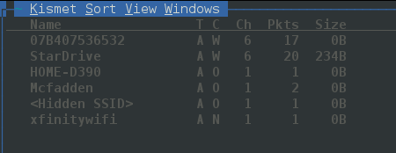
Recall Last Week
Need to connect wireless card to Kali
Need to verify using iwconfig command
Then launch Kismet for a little recon
  This will also force the wireless card in to monitor mode
Since StarDrive is my AP we’ll focus on it

Slide 17
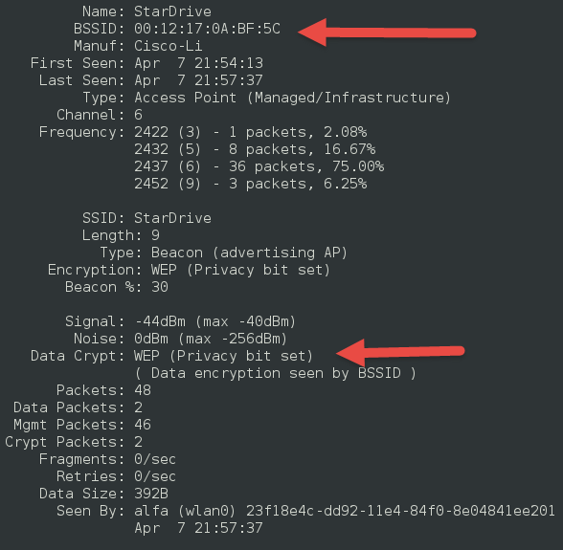
StarDrive
Double clicking on name gives me detail screen
Note
  MAC Address
  WEP bit
“Network” menu has option to close window and return to summary

Slide 18
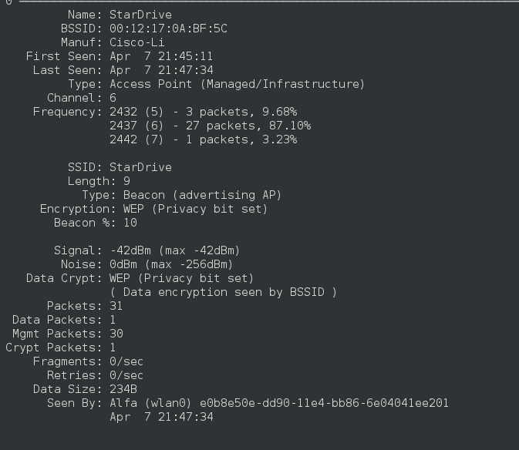

Slide 19
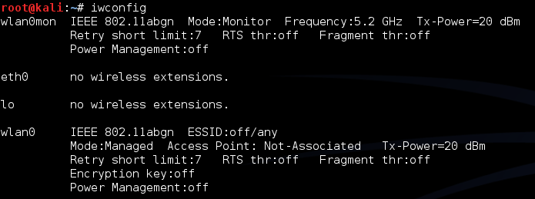
Done with Kismet
We found the AP we want to attack
Know Name (SSID), MAC Address (BSSID), WEP
This also had the affect of forcing wlan0 into monitor mode

Slide 20
Extra Help w/ Aricrack
Lots of extras at:
http://aircrack-ng.org/doku.php?id=simple_wep_crack&DokuWiki=6a160c439893f7cfb1e861fe023a1e9d
We’ll run through a few

Slide 21
Generarating Extra Traffic
Created ARP traffic to get data faster
  You do need access to wired network, so limited applicability in the wild
Used command:

Slide 22
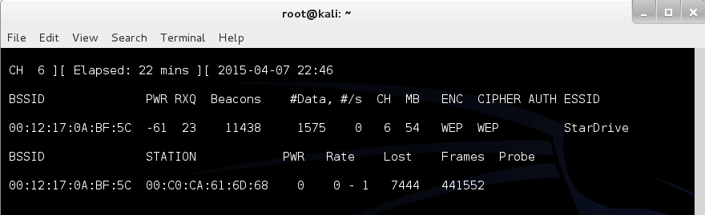
Running airodump-ng
Running command:
This will create log file capture*.cap for further analysis

Slide 23
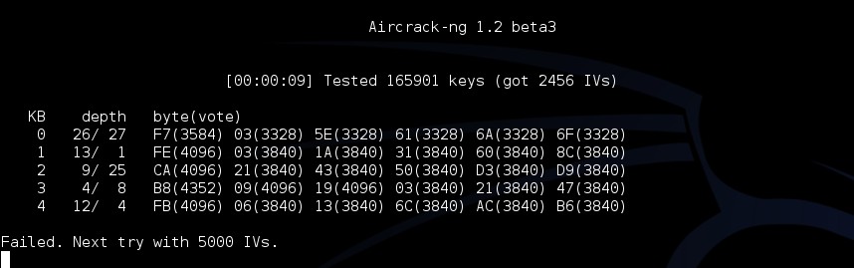
Finally, aircrack-ng
Once enough data has been collected, run
  aircrack-ng output*.cap
If you don’t have enough data you will see

Slide 24
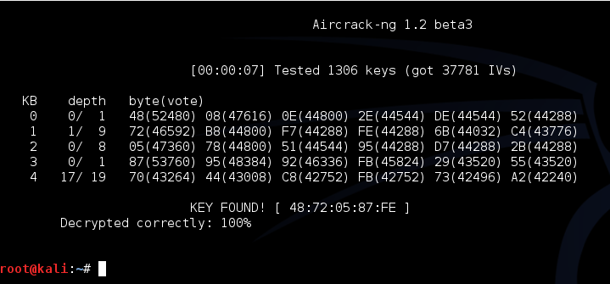
With Enough Data
Eventually, with enough IVs you can get to this:

Slide 25
WPA-PSK
Recall, WPA introduced TKIP
WPA2 introduced CCMP and kept TKIP
Both work with both personal and enterprise
  Personal – PSK, Enterprise 802.1x
WPA and WPA2 very similar for PSK

Slide 26
More Acronyms
PSK – Pre-Shared Key
KEK – Key Encryption Key
PMK – Pairwise Master Key – Comes from PSK or EAP method
PTK – Pairwise Temporal Key
  Two MIC keys (RX and TX
  EAPOL Key Encryption Key
  EAPOL Key Confirmation Key

Slide 27
WPA2-PSK PMK Derivation
PMK is 256 bits in length
PMK is derived using passphrase, ssid, and ssid length information
Hashed 4096 times using HMAC-SHA1
This means process cannot be reversed to extract passphrase

Slide 28
WPA2 PTK Derivation
Combines MAC of STA and AP with STA and AP nonces
Update nonces generate fresh keys
Uses PMK as additional input (Re: Key) along with the phrase “Pairwise Key Expansion” and combines with above and hashed w/ SHA1 to generate a PTK
Note: Nonce is a random value generated by both STA and AP

Slide 29
PTK Mapping
PTK is 384/512 bits in length
  First 16 bytes – HMAC MIC key
  Next 16 – EAPOL-Key KEK
  Next 16 – Temporal Encryption Key
  Next 8 – TX TKIP Michael (MIC) Key
  Next 8 – RX TKIP Michael (MIC) Key

Slide 30


WPA2 Four-Way Handshake
Step 1 | ANonce, start new PTK negotion
 | SNonce, MIC of Frame 2 | Step 2
Step 3 | MIC of frame 3
 | MIC of frame 4, ready to TX/RX | Step 4

Slide 31
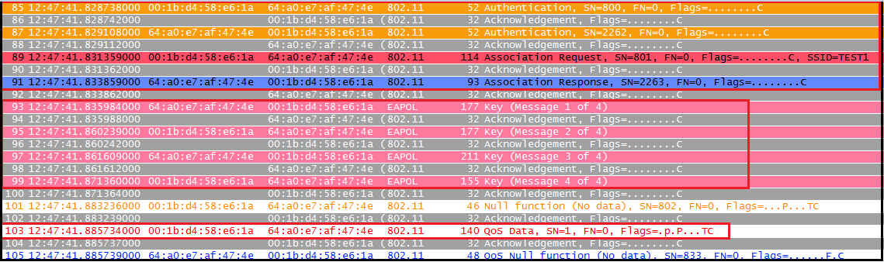
WPA2 Four-Way Capture
Example
  First four lines are 4-Way Handshake
Source has capture file if you want to look for yourself
Source: http://mrncciew.com/2014/08/16/decrypt-wpa2-psk-using-wireshark/

Slide 32
Identifying WPA2-PSK
AP beacon frames identify capability information
  Cypher suite support
  Auth key management
Wireshark can filter traffic, then manual inspection can identify

Slide 33
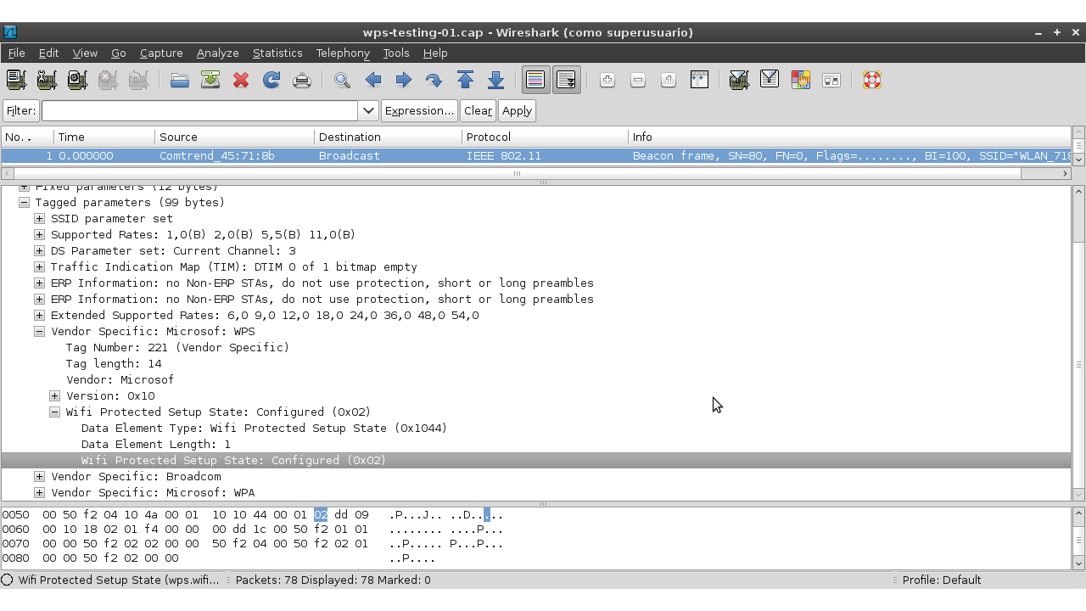
Identifying WPA2-PSK
Example of beacon frame in wireshark
http://www.hackxcrack.es/forum/hacking-wireless/cracking-wpawpa2-con-reaver/

Slide 34
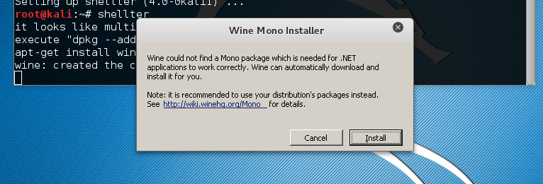
Shellter Exercise
Installing Shellter in Kali
Kali Linux:
apt-get update
apt-get install shellter

Slide 35
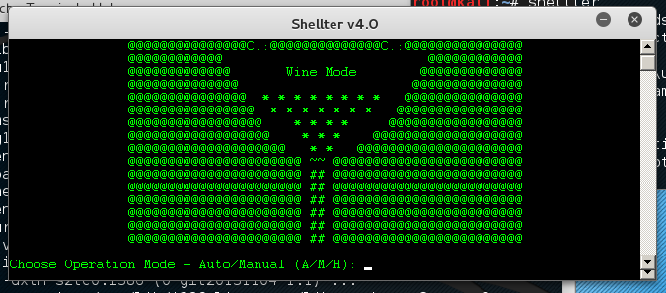
Shellter Exercise
After Wine, Shellter will still error out.
  Read the error message and execute the command it gives you
  If everything goes OK should see

Slide 36
Shellter Exercise
Examples from Shellter site
  https://youtu.be/Ye7Faa85GGc
  https://youtu.be/cihE8ctj1nM

Slide 37
Next Week
In the news
More wireless
  John the Ripper
  Attacking WPA-PSK
  Final thoughts

Slide 38
Questions
?

