Slide 1
Advanced Penetration testing
MIS 5212.001
Week 5/6
Site: http://community.mis.temple.edu/mis5212sec001sec701sp2018/

Slide 2
Tonight's Plan
Ettercap
WebGoat
Ettercap Exercise
Next Week

Slide 3
Reminders
Assignment 1 is due
Remember to post and comment on blog
No Class next Two weeks. Next time we meet is March 17
First test will be published after Spring break (week of March 11)

Slide 4
Upcoming Cloud Meeting
Cloud Security Alliance will be putting on a seminar at Temple
When: March 13, 2018
Time – 5 PM to 9 PM
I will share more details when I have them

Slide 5
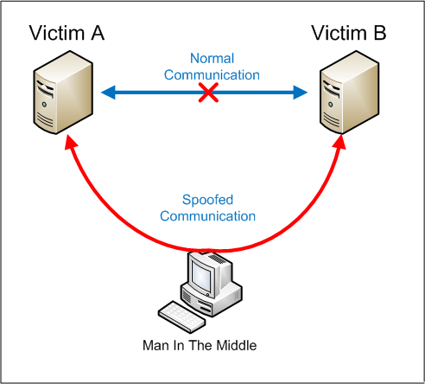
Man In The Middle
Intercepting traffic
Source: http://www.valencynetworks.com/articles/cyber-attacks-explained-man-in-the-middle-attack.html

Slide 6
ARP spoofing
What is ARP?
Address Resolution Protocol
IP->MAC mapping
Make machine(s) think that the IP address it is searching for is you.
How it works:
Broadcast and ask if anyone knows
Response is typically from that IP
or
Flood with unsolicited responses

Slide 7
ARP spoofing (more)
If 2 machines (real and fake) respond, effect depends on OS
some OS overwrite earlier response
other OS ignore unless it’s current entry expires
Original can be disconnected by
Power
Wiring (connectivity)

Slide 8
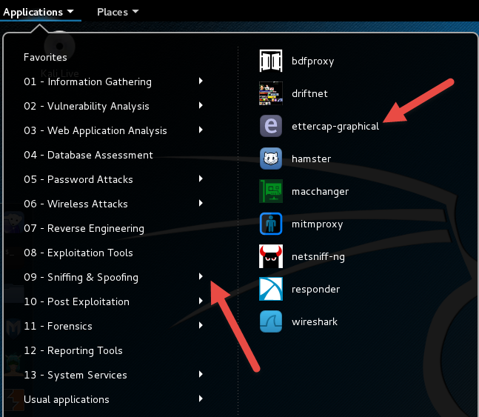
Ettercap
A tool for performing man in the middle attacks
Pre-installed in Kali

Slide 9
Ettercap Attacks
Ettercap supports active and passive dissection of many protocols (including ciphered ones).
Ettercap offers four modes of operation:
IP-based: packets are filtered based on IP source and destination.
MAC-based: packets are filtered based on MAC address, useful for sniffing connections through a gateway.
ARP-based: uses ARP poisoning to sniff on a switched LAN between two hosts (full-duplex).
Public ARP-based: uses ARP poisoning to sniff on a switched LAN from a victim host to all other hosts (half-duplex).

Slide 10
Ettercap
Other Features:
Character injection
SSH1 support: the sniffing of a username and password
HTTPS support: the sniffing of HTTP SSL secured data—even remote traffic through a GRE tunnel
Plug-in support
Password collectors for: TELNET, FTP, POP, IMAP, rlogin, SSH1, ICQ, SMB, MySQL, HTTP, NNTP, X11, Napster, IRC, RIP, BGP, SOCKS 5, IMAP 4, VNC, LDAP, NFS, SNMP, Half-Life, Quake 3, MSN, YMSG
Packet filtering/dropping
OS fingerprinting
Kill a connection
Passive scanning of the LAN
Hijacking of DNS requests

Slide 11
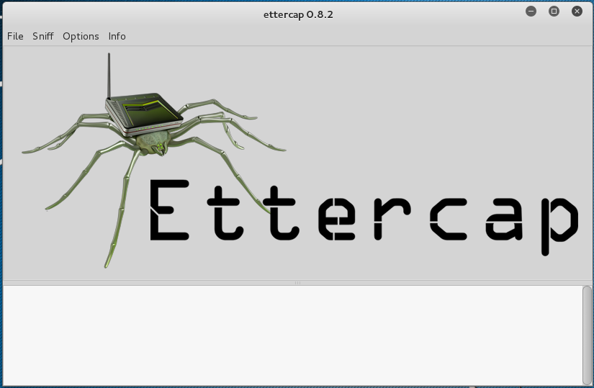
Ettercap
After Launch:

Slide 12
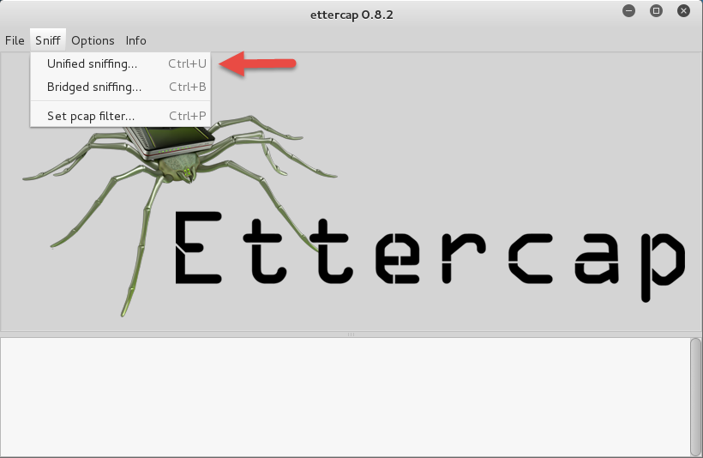
Ettercap
Click “Unified Sniffing”

Slide 13
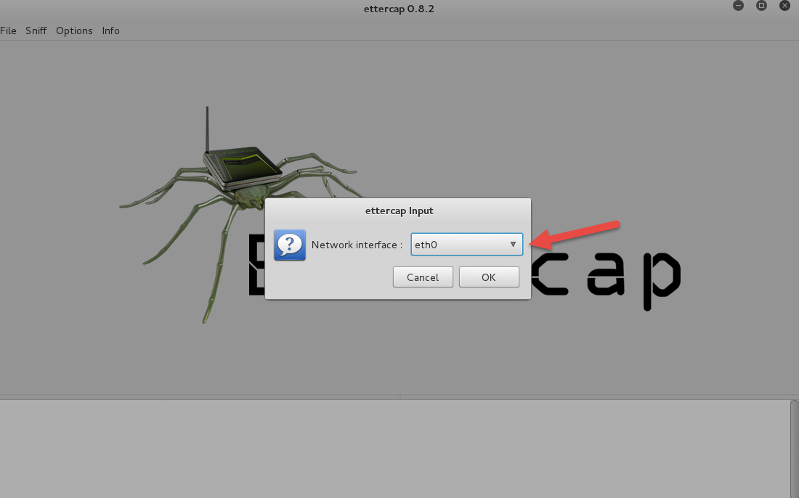
Ettercap
Select Your Network Connection (May not be same)

Slide 14
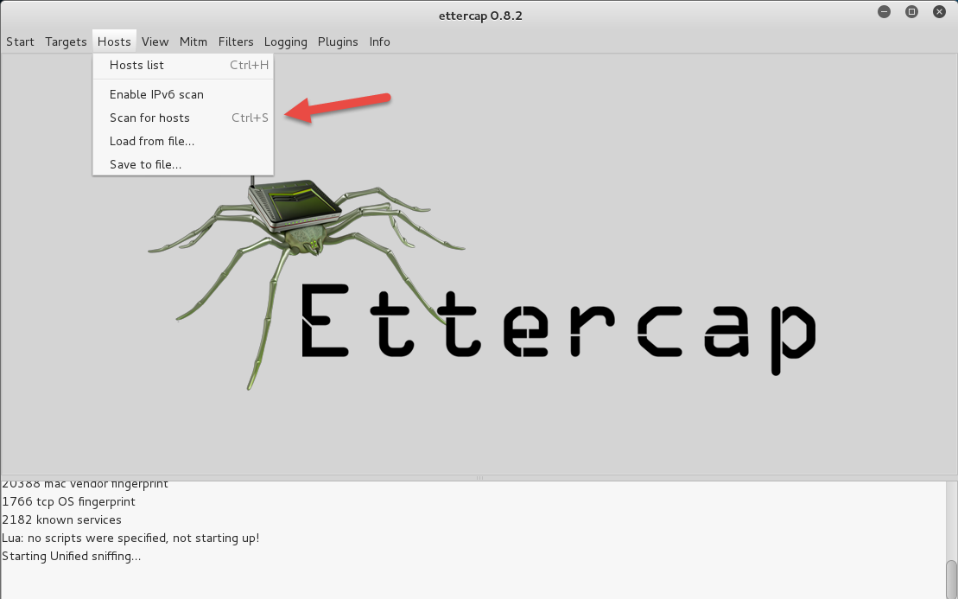
Ettercap
Now we will see who is out there:

Slide 15
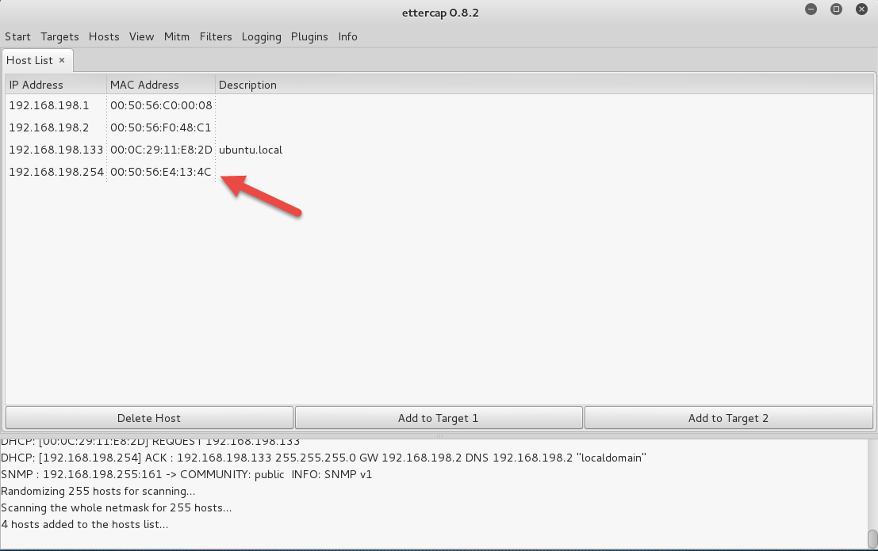
Ettercap
Available Hosts, I’m going after the last one!

Slide 16
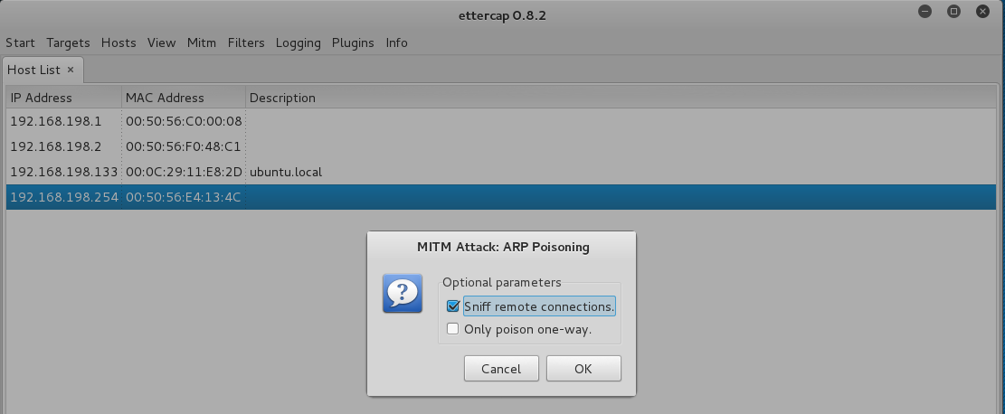
Ettercap
Setup to ARP Poison

Slide 17
Problem
Doesn’t Work in a VM
You will need real machines on a switch to get this fully functioning
A good walkthrough is
http://www.thegeekstuff.com/2012/05/ettercap-tutorial/

Slide 18
A Little About Browsers
What is a Web Browser?
Rendering Engine
JavaScript Engine
Network communications layer
…
May also include
Add-Ins
Browser Helper Objects
APIs to/for other applications

Slide 19
A Little About Browsers
Why are we talking about this?
Browser are fairly complicated
Browsers have many sub-components and features
Browsers need to understand many different forms of character encoding
All of this gives us something to work with when attacking Web Applications

Slide 20
Browser Internals
Good references for details
http://taligarsiel.com/Projects/howbrowserswork1.htm
https://www.html5rocks.com/en/tutorials/internals/howbrowserswork/#Rendering_engines

Slide 21
The OWASP Top 10
OWASP Top 10 – 2017 (New)
2017-A1 – Injection
2017-A2 – Broken Authentication and Session Management
2017-A3 – Sensitive Data Exposure
2017-A4 – XML External Entities (XXE)
2017-A5 - Broken Access Control
2017-A6 – Security Misconfiguration
2017-A7 – Cross Site Scripting (XSS)
2017-A8 – Insecure Deserialization
2017-A9 – Using Known Vulnerable Components
2017-A10 – Insufficient Logging & Monitoring
Source: https://www.owasp.org/index.php/Top_10-2017_Top_10

Slide 22
2017-A1 – Injection

Slide 23
2017-A2 – Broken Authentication and Session Management

Slide 24
2017-A3 – Sensitive Data Exposure

Slide 25
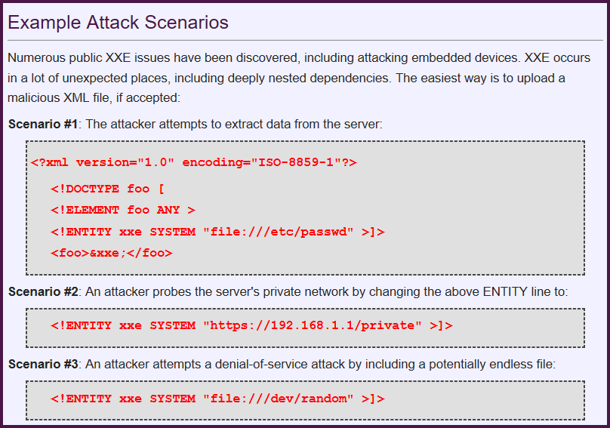
2017-A4 – XML External Entities (XXE)

Slide 26
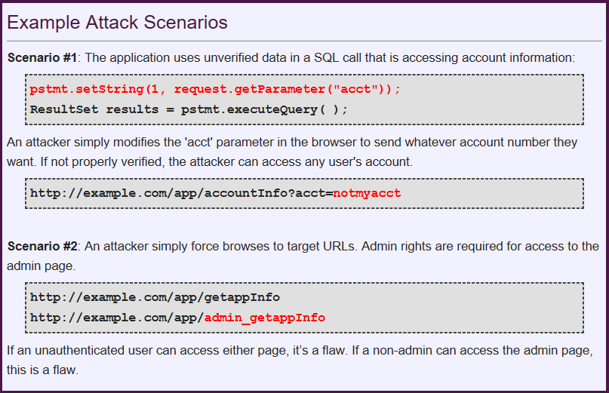
2017-A5 - Broken Access Control

Slide 27
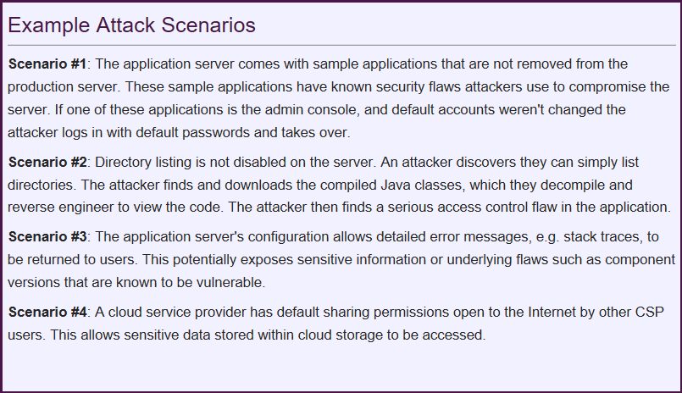
2017-A6 – Security Misconfiguration

Slide 28
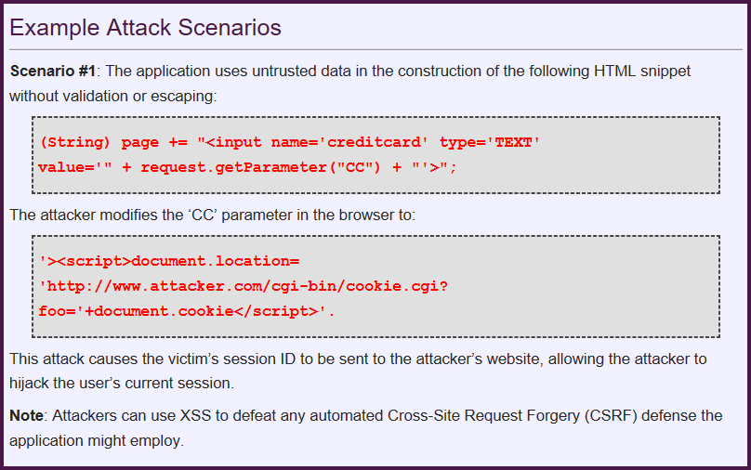
2017-A7 – Cross Site Scripting (XSS)

Slide 29
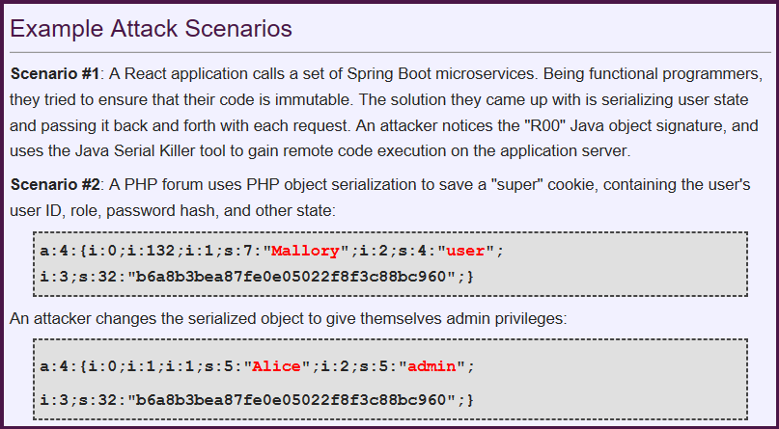
2017-A8 – Insecure Deserialization

Slide 30
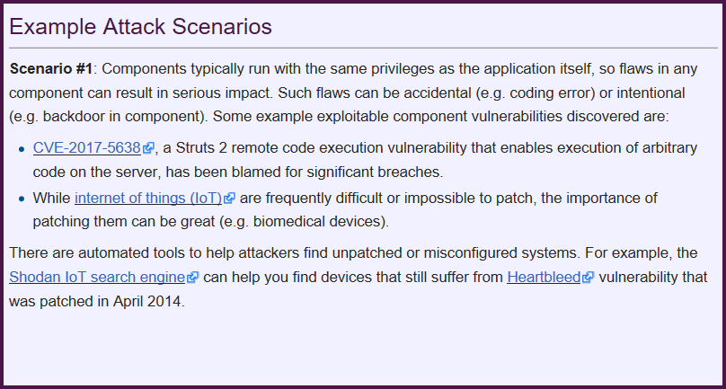
2017-A9 – Using Known Vulnerable Components

Slide 31
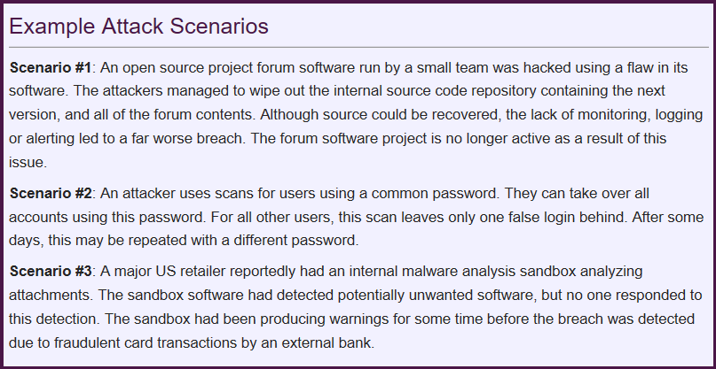
2017-A10 – Insufficient Logging & Monitoring

Slide 32
WebGoat
WebGoat is a deliberately insecure web application maintained by OWASP designed to teach web application security lessons
The current version is v8.0.0.M12, this is still a work in progress.
WebGoat for J2EE is written in Java and therefore installs on any platform with a Java virtual machine.

Slide 33
WebWolf
WebWolf is a completely separate web application which you **can** use to solve assignments.
In the current version a couple of assignment/challenges use WebWolf. More details can be found in the WebWolf lesson inside WebWolf.

Slide 34
How to get WebGoat
You can download WebGoat at:
https://www.owasp.org/index.php/Category:OWASP_WebGoat_Project
https://github.com/WebGoat/WebGoat/releases
You will also need Java >= 1.6 (JDK 1.7 Recommended)
http://www.oracle.com/technetwork/java/javase/downloads/index.html

Slide 35
Windows Version

Slide 36
WebGoat Download
Entering URL for WebGoat gives:
Use the down arrow and select “Save As” to save file to the location of your choice.

Slide 37
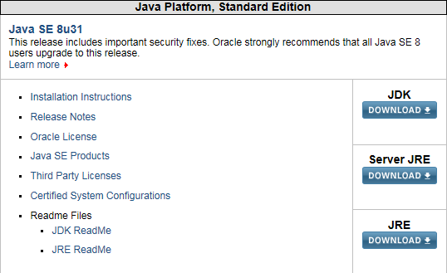
Installing Java JRE
Follow URL to:

Slide 38
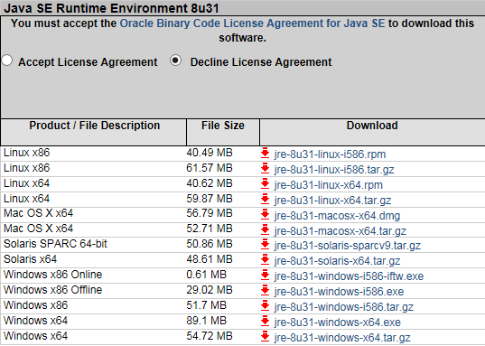
Installing Java JRE
Selecting “JRE” gives:

Slide 39
Installing Java JRE
Click “Accept” and select the OS
Same as WebGoat, use save as option to put the file where you want it
Once downloaded, run the file and follow the prompts
To launch in Windows, open the command line and type:
Java –jar webgoat-server-8.0.0.M12.jar
Command line will say busy and will look like it hangs at Initializing Spring ….

Slide 40
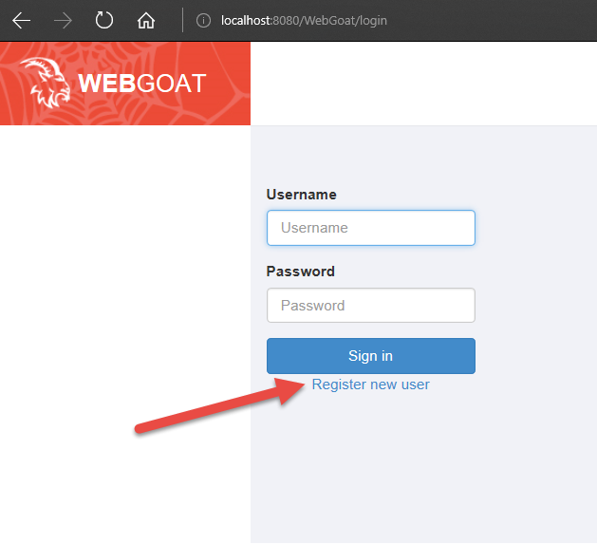
Verifying WebGoat is Up
Open a browser and type the following in the URL bar:
http://localhost:8080/WebGoat/

Slide 41
Basic Use

Slide 42
Remember
If the browser doesn’t appear to connect.
Check “Intercept On” is turned of in Proxy

Slide 43
Linux Version
Download the “jar” file as described on the earlier slide
Java JRE is already installed in Kali
Open a terminal and execute the same command
Java –jar WebGoat-6.0.1-war-exec.jar
Verify same as earlier slide

Slide 44
Now What
If you downloaded the jar file to Kali, you are ready to launch the Intercepting Proxy, point the browser at the proxy and start
If you want to work in Windows, you will need to get an intercepting proxy on to your windows machine
Go to:
http://portswigger.net/burp/
Select “Download” tab and then “Free”
This will bring down another jar file for BurpSuite

Slide 45
Caution
Once WebGoat is running, you are one of the most vulnerable systems on the internet!
Once you have downloaded the files consider disconnecting from the network

Slide 46
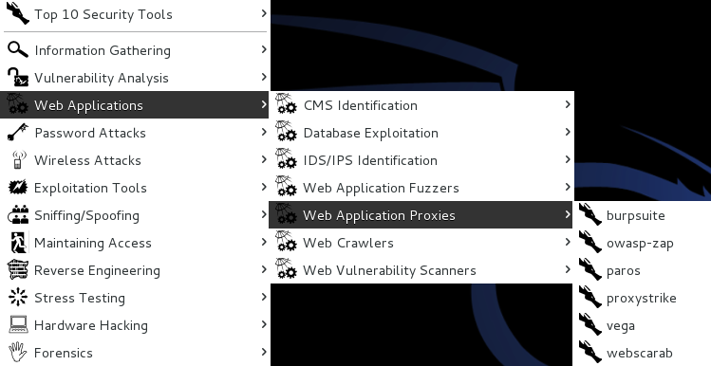
What’s an Intercepting Proxy
In this instance, an intercepting proxy is software that acts as a server and sits between the web browser and your internet connection
Examples
Burp Suite
Webscarab
Paros

Slide 47
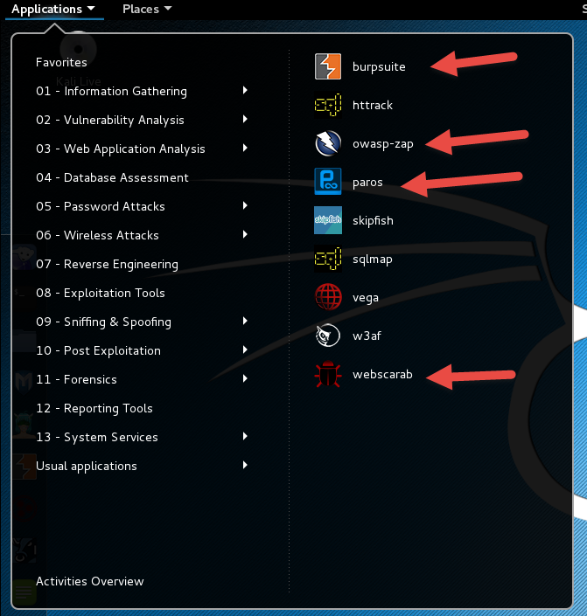
In Kali 2.0
Or

Slide 48
Some Rules for Our Use of Intercepting Proxies
For this course
Monitor and record ONLY for external sites
Do not inject or alter any traffic unless you personally own the web site.
Like your personal copy of WebGoat

Slide 49
Burp Suite
Start Burp Suite by logging in to Kali and selecting Burp Suite from:
Kali Linux > Web Applications > Web Application Proxies > BurpSuite
Kali 2.0 > Applications > Web Application Analysis > BurpSuite

Slide 50
Burp Suite

Slide 51
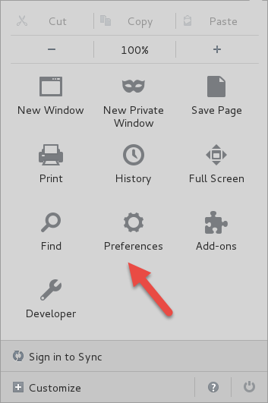
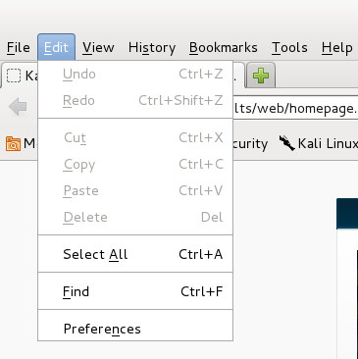
Getting Started
Once BurpSuite is running, you will need to start and configure a browser
Kali’s web browser is “Iceweasel”, an adaptation of Firefox
After starting Iceweasel, navigate to preferences
And select it

Slide 52
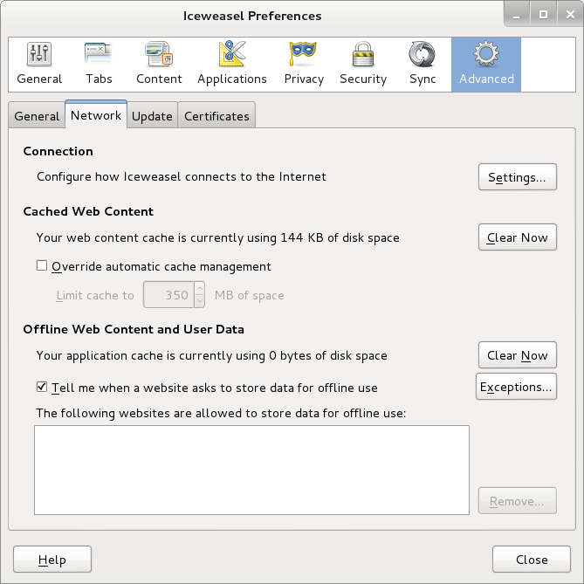
Configuring the Network Proxy
Navigate to the Network Tab and select settings… for Connection

Slide 53
Configuring the Network Proxy
Change selection from “Use system proxy settings” to “Manual proxy configuration and enter “127.0.0.1” for “HTTP Proxy” and “8080” for “Port”
Or any other port number that works for you
8080 is used by WebGoat, so we should pick something else
Also, select check box for “Use this proxy server for all protocols”
Select “OK” when done
Browser is now setup to use BurpSuite
See next slide for example

Slide 54
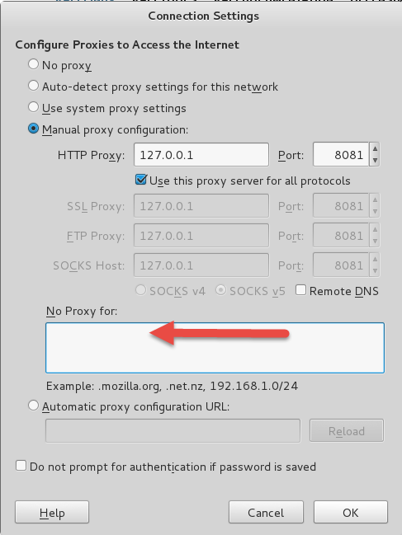
Configuring the Network Proxy

Slide 55
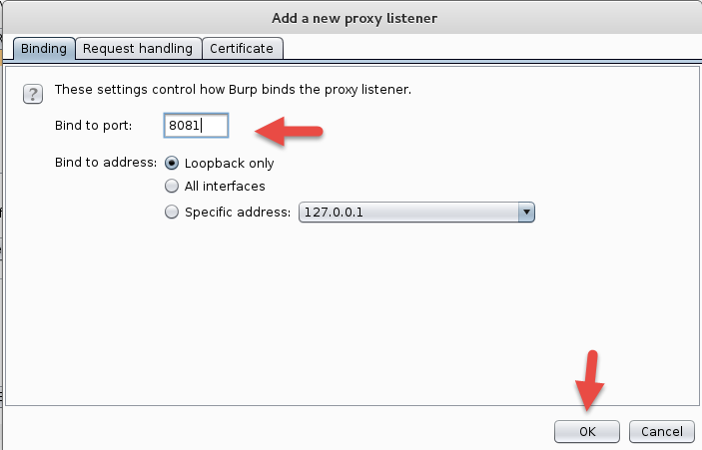
Configuring BurpSuite

Slide 56
BurpSuite Should Look Like This

Slide 57
Should Look Like This

Slide 58
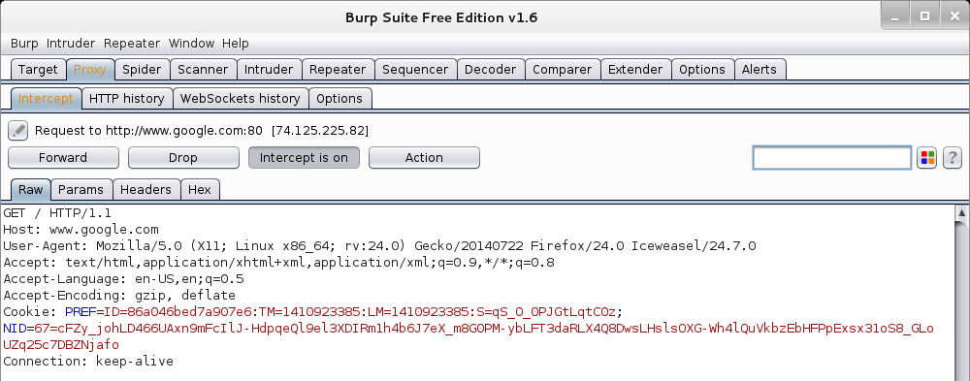
Now We Can Test
In browser, navigate to google.com
Browser will hang and look busy
Select the “Proxy” tab in BurpSuite
BurpSuite is waiting for you, select forward

Slide 59
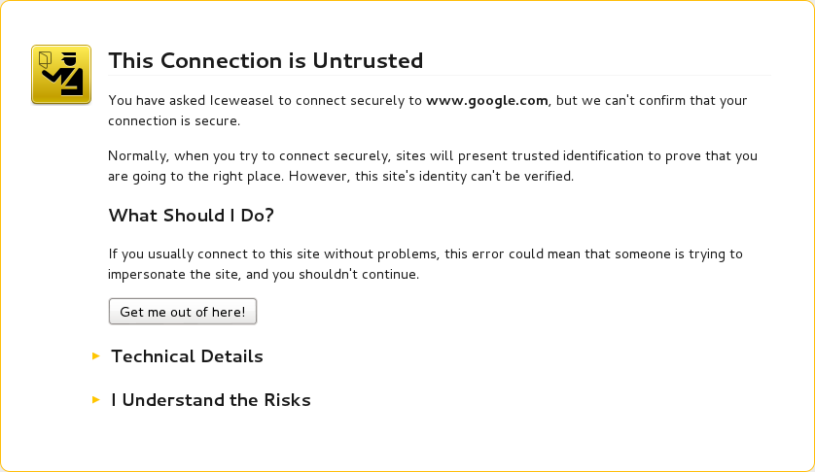
Browser Knows Something is Up
Select “I understand the Risks” and follow prompts to add an exception

Slide 60
Browser Knows Something is Up

Slide 61
Back to WebGoat

Slide 62
Landing Screen

Slide 63
WebGoat Exercises
HTTP Basics (Just to get a feel of how WebGoat works)
Injection Flaws
SQL Injection
Authentication Flaws
Authentication Bypass
Cross-Site Scripting
Access Control Flaws
Insecure Direct Object References
Missing Function Level Access Control
Insecure Communications
Request Forgeries
Client Side
Client Side Filtering (Requires FireBug, now built in as DevTools)

Slide 64
Next Week
No Class next Two weeks. Next time we meet is March 17
First test will be published after Spring break (week of March 11)
Do WebGoat Exercises and Submit Screen Caps of Success as Evidence of Completion.

Slide 65
Ettercap Practical

Slide 66
Questions
?

