Slide 1
Advanced Penetration testing
MIS 5212.001
Week 10
Site: http://community.mis.temple.edu/mis5212sec001sp2017/

Slide 2
Tonight's Plan
More Wireless Security
Getting wireless card working in Kali
Introduction to Kismet
Next Week

Slide 3
More Wireless Security
Open WiFi Networks vs Encrypted WiFi Networks
In an open network, your browsing can be monitored
Every thing is sent in the clear
WPA2-PSK fixes this “Somewhat”

Slide 4
WPA2-PSK
Uses a pre-shared key (hence the acronym PSK)
The pre-shared key is known to all authorized users
Anyone with the pre-shared key has what they need to decrypt traffic
Wireshark has a built in option to decrypt traffic if you have the key
This means WPA2-PSK is not much more secure than no encryption, unless you trust everyone on the network

Slide 5
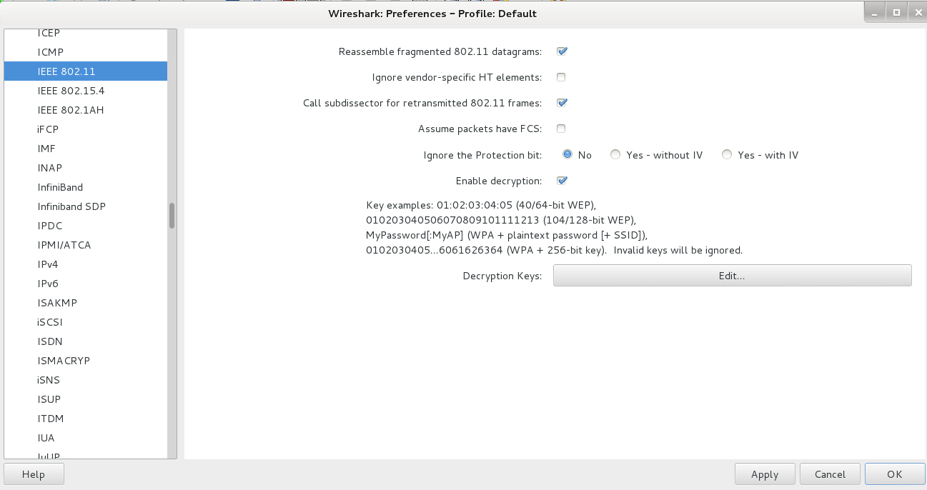
Wireshark WPA2-PSK Decryption
Edit->Preferences->IEEE 802.11

Slide 6
PTK or Pairwise Transient Key
WPA2-PSK tries to address this issue by use of PTK
However, the PTK is derived from the PSK
So… It is easy to capture the PTK if you have the PSK

Slide 7
WPA2-Enterprise
WPA2-Enterprise corrects these issues for large networks
EAP authentication along with a Radius server ensures each client gets a unique key
Other authenticated users no longer have a master key to decrypt the traffic

Slide 8
WPA2 Hole196 Vulnerability
Even in WPA2-Enterprise there is still a potential vulnerability from other authorized users (Abuses GTK or Group Temporal Key)
Limited to:
ARP poisoning
Injecting malicious code
Denial of Service w/o using de-auth packets
More detailed description
http://www.mojonetworks.com/wpa2-hole196-vulnerability

Slide 9
WPA2 KRACK
October 16, 2017 a public announcement made that a vulnerability was found in WPA2 Enterprise
Vulnerability is within the IEEE 802.11 standard
Standard allows for “replay” third message in four way handshake to perform a “key re-installation” attack
Requires attacker to “pretend” to be an Access Point.
Reference: https://www.kb.cert.org/vuls/id/228519

Slide 10
Kismet
802.11 wireless:
Network detector
Sniffer
Intrusion detection system
Works with any wireless card which supports raw monitoring mode (not all do)
Can sniff:
802.11b
802.11a
802.11g
802.11n

Slide 11
Kismet
Supports a plugin architecture allowing for additional non-802.11 protocols to be decoded
Identifies networks by passively collecting packets and detecting networks, which allows it to detect (and given time, expose the names of) hidden networks and the presence of non-beaconing networks via data traffic

Slide 12
Kismet in Kali
Pre-installed in Kali
Did not launch from drop down menu in my instance
Needed to start from command line
Be patient, it will walk through configuration
You can automate via configuration files, but for now just follow prompts

Slide 13
Getting Started
We will
Get USB Wireless Adapter working with Kali
Launch and configure Kismet
Explore a little bit

Slide 14
Connecting Wireless Card

Slide 15
Checking Card
Use the command: iwconfig
This should give something like the following:

Slide 16
Kismet
Kismet is a wireless network detector, sniffer, and intrusion detection system. Kismet works predominately with Wi-Fi (IEEE 802.11) networks, but can be expanded via plug-ins to handle other network types.
Features
802.11 sniffing
Standard PCAP logging (compatible with Wireshark, TCPDump, etc)
Client/Server modular architecture
Plug-in architecture to expand core features
Multiple capture source support
Live export of packets to other tools via tun/tap virtual interfaces
Distributed remote sniffing via light-weight remote capture
XML output for integration with other tools
http://kismetwireless.net/

Slide 17
Starting Kismet

Slide 18
Kismet Example

Slide 19
Kismet Reference
http://kismetwireless.net/documentation.shtml

Slide 20
Wireshark
Saw this briefly last semester
Pre-installed in Kali

Slide 21
Wireshark

Slide 22
Or

Slide 23
Startup of Wireshark
Will throw an error due to running as root in Kali, just click OK and move on
Will need to turn wireless menu on by going to View tab and clicking on “Wireless Toolbar”

Slide 24
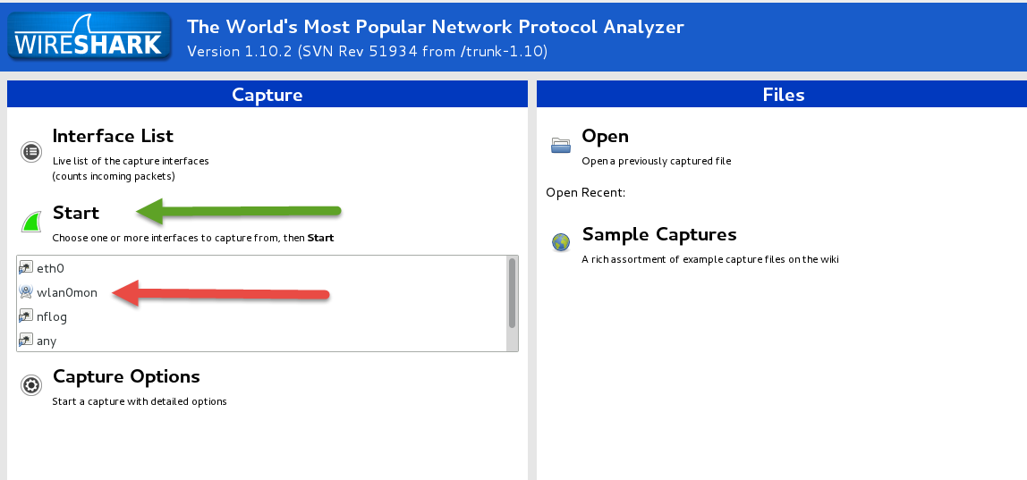
Configuring Interface
Select “wlan0mon”
Click on “Start”
Be patient, it will take a minute or so to update

Slide 25
More Wireshark

Slide 26
Next Week
In the news
More wireless
WEP in detail
Intro to AirCrack and breaking WEP

Slide 27
Questions
?

