Slide 1
Advanced Penetration testing
MIS 5212.001
Week 12
Site: http://community.mis.temple.edu/mis5212sec001sec701sp2018/

Slide 2
Tonight's Plan
Attacking WPA2-PSK
Rainbow Tables
John the Ripper
Next Week

Slide 3
WPA2-PSK
Recall from last week:
The PMK is generated using the following relatively processor intensive function, pseudo code:
PMK = PBKDF2(passphrase, ssid, ssidLength, 4096, 256)
This means that the concatenated string of the passphrase, SSID, and the SSID length is hashed 4096 times to generate a value of 256 bits

Slide 4
WPA2-PSK
Also, Recall from last week:
PTK = PRF-512(PMK, "Pairwise key expansion", Min(AP_Mac, Client_Mac) || Max(AP_Mac, Client_Mac) || Min(ANonce, SNonce) || Max(ANonce, SNonce))
The PTK is a keyed-HMAC function using the PMK on the two MAC addresses and the two nonces from the first two packets of the 4-Way Handshake.

Slide 5
WPA2-PSK
Finally, recall:
MIC = HMAC_MD5(MIC Key, 16, 802.1x data)
A MIC value is calculated, using the MIC Key from the PTK and the EAPoL message.

Slide 6
WPA2-PSK
So, we captured the Mac Addresses and the ANonce and SNonce from the four way handshake
Source: http://mrncciew.com/2014/08/16/decrypt-wpa2-psk-using-wireshark/

Slide 7
WPA2-PSK
Now, if we had the right passphrase, SSID, and SSID length; we have everything we need to generate our own key.
But we don’t have this information!
At least not directly

Slide 8
Process
Collect data from four handshake
Mac Addresses
ANonce and SNonce
MIC and EAP
Read in value from a dictionary list
Calculate PMK using dictionary word and SSID
Calculate PTK using above information
Calculate MIC of frame using PTK
Compare calculated MIC to observed MIC
If equal, done! If not equal read in next PMK and start over

Slide 9
Automation
Several tools exist to automate this process
Cowpatty
Pre-installed in Kali
http://www.willhackforsushi.com/?page_id=50
Aircrack-ng
Pre-installed in Kali
http://aircrack-ng.org/downloads.html

Slide 10
Limitations
Slow (Very slow)
Each time you want to check a passphrase you have to go through the 4,096 hashes
Each time you go after another SSID, you start over again
Calculations are limited by the capabilities of the CPU installed

Slide 11
A Better Way
Pre-Computed Hash Tables (Rainbow)
PMK is derived from the PSK and SSID
Possible to precompute PMK’s for a given SSID
Top 1000 most common SSIDs published
https://wigle.net/
Or
http://www.renderlab.net/projects/WPA-tables/
Cowpatty will accept precomputed hash tables
See genpmk in a couple of pages

Slide 12
WIGLE

Slide 13
From Wigle.net

Slide 14
More Tools (genpmk)
Basic tool to precompute hashes
Can speed up attacks by a factor of 1300
“genpmk” written by Josh Wright
Pre-installed in Kali
Packaged with Cowpatty

Slide 15
But I Want To Do This Myself
CUDA Acceleration
Parallel computing architecture developed by nVIDIA
http://www.nvidia.com/object/cuda_home_new.html
Pyrite – CUDA acceleration of Cowpatty PMK tables
Included in Kali
Pyrite also supports AMD/ATI 43XX cards (they typically cost less)
Could also go to the cloud

Slide 16
Rainbow Tables
In this instance, Pre-Computed hashes of likely combinations of passphrases, SSIDs, and SSID lengths stored in tables
These tables use two functions, the hashing function and a reduction function creating a chain and storing only the first and last passphrase (In this case the PMK)
The table is then sorted for faster lookups
See: http://en.wikipedia.org/wiki/Rainbow_table

Slide 17
John The Ripper (JtR)
John the Ripper password cracker
http://www.openwall.com/john/
Includes support for CUDA and OpenCL along with a wide variety of hash types (Not just WPA2-PSK)
Pre-installed in Kali
There is also a “Commercial” version available at:
http://www.openwall.com/john/pro/

Slide 18
JtR
For JtR to work, you need to provide it with file(s) containing hashes of user passwords - and those hashes have to be of a supported type.
JtR will successfully crack those hashes that correspond to weak passwords, but it will fail to crack those that are strong.

Slide 19
JtR and Kali
As several other tools have done, will not launch from drop down
Open terminal and type:
“john --test” this will launch a diagnostic and give you benchmarking numbers for how your system performs
Note: this is one instance where running in a VM is a bad idea. Performance will be poor
Consider installing directly on a test machine

Slide 20
JtR Usage
At it’s core, very simple
Find a file with hashes in it
Run: john passwordlist ~/file

Slide 21
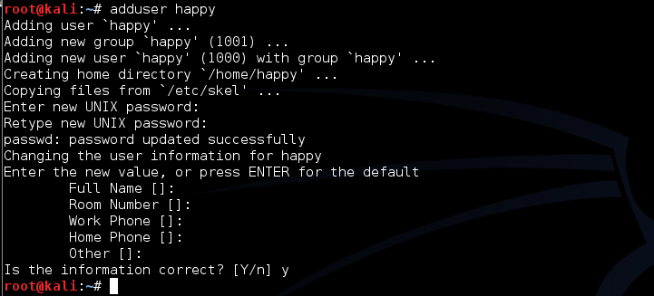
First Lets Add a User
Run command adduser happy
Use password chess when prompted

Slide 22
Now Extract Password File
Run command unshadow as follows
This extracts the passwd and shadow file and combines them together to create a file you can go after
If you were an attacker, this is what is meant by extracting or harvesting password files
In Windows you would go after the SAM file

Slide 23
Now we Crack
Run the john command as follows
This tells john to use a wordlist that is preinstalled in Kali (and has chess as an entry)
And tells john to apply it against the file: file_to_crack

Slide 24
Checking Work
Using the show command
Note: If you have not recently updated Kali 2.0 you may get errors.

Slide 25
Virtual Machines for Final Assignment
We will have VMs to test against
May work in teams of up to three or alone.
Email me with team or individual names between now and next Friday

Slide 26
Next Class
I will have a walk through of some WebGoat assignments.
Available to talk through issues with assignment

Slide 27
Questions
?

