Slide 1
Analysis Report
Kali Linux Metasploit
Assignment #1
Mis5212 Advance Penetration Testing
Wayne Wilson

Slide 2
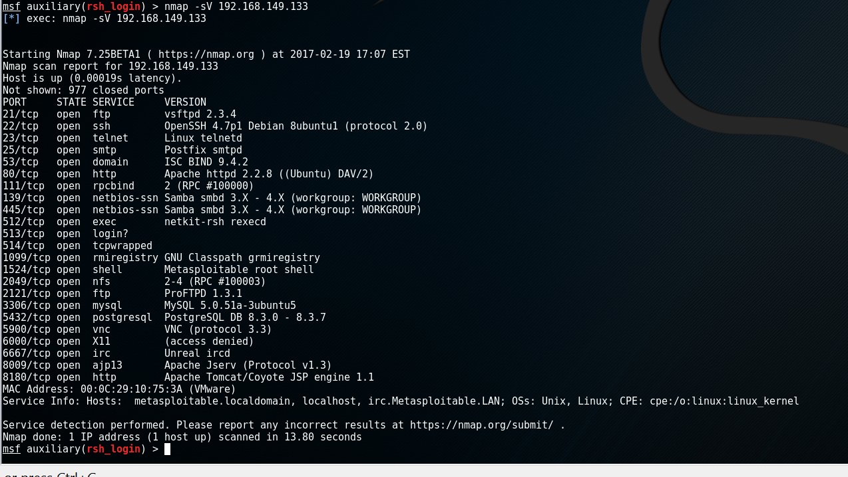
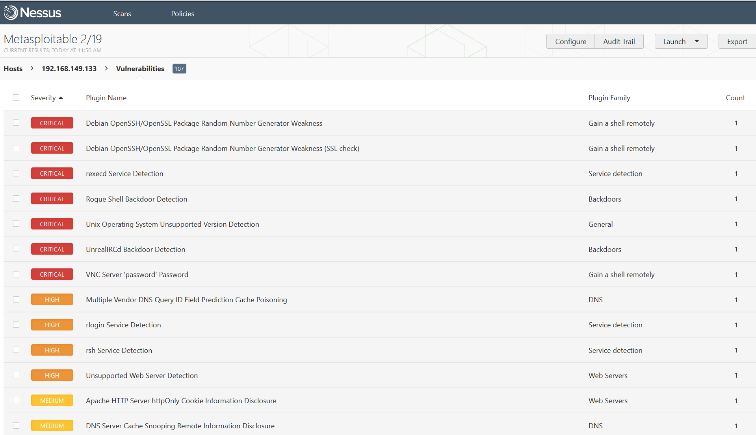
Analysis Report
Kali Linux Metasploit
Nmap command along with a Nessus vulnerability scan were used to search for weaknesses on metasploitable VM
MIS5212 Advance Penetration Testing Wayne Wilson

Slide 3
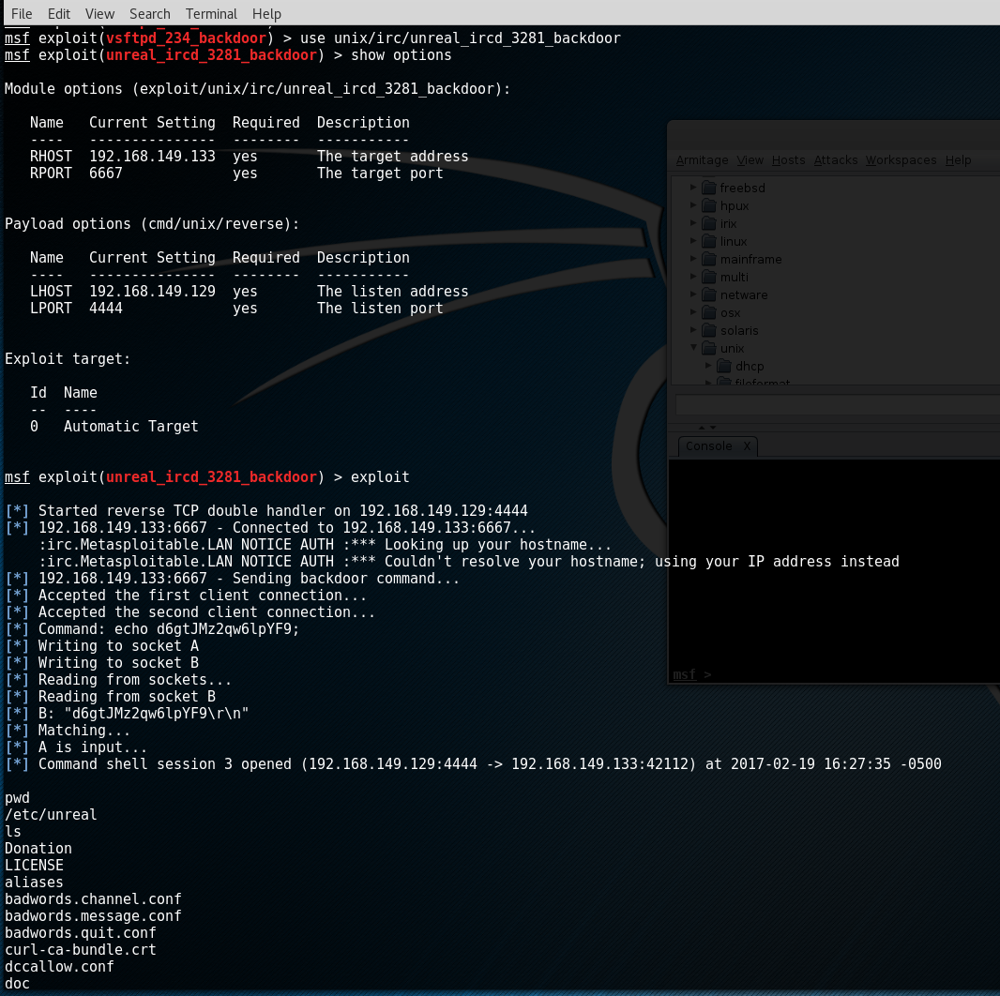
Analysis Report
Kali Linux Metasploit
Unreal_IRCD_3281 Backdoor was found which gave total access to file structure at root level. File access can be seen in image
MIS5212 Advance Penetration Testing Wayne Wilson

Slide 4
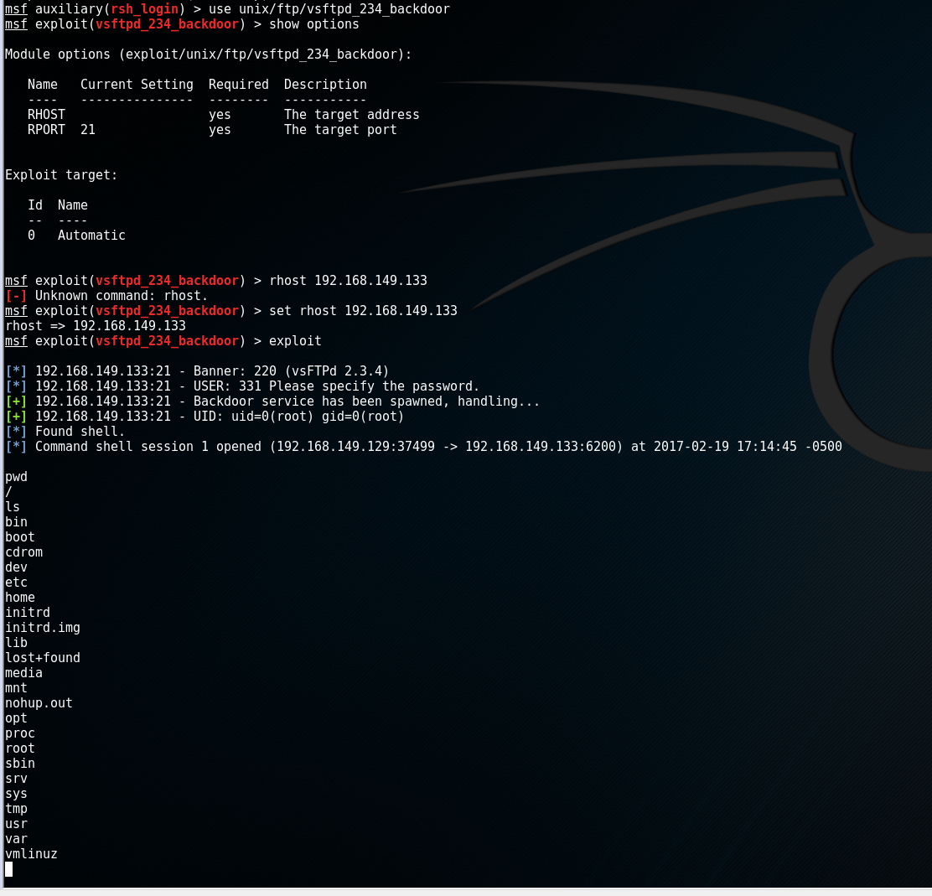
Analysis Report
Kali Linux Metasploit
VSFTPD_234 Backdoor was also found giving anyone access to file structure at root level. File access can be seen in image
MIS5212 Advance Penetration Testing Wayne Wilson

Slide 5
Analysis Report
Kali Linux Metasploit
Other Vulnerabilities found which are exploitable with Metasploit
  1. Rlogin Service (rlogin Authentication Scanner)
  2. rsh Service Detection (rlogin Authentication Scanner)
  3. NFS Exported Share Information Disclosure (NFS Mount Scanner)
MIS5212 Advance Penetration Testing Wayne Wilson

