Slide 1
Analysis Report
Brent L. Easley
Advance penetration testing
Mis-5212

Slide 2
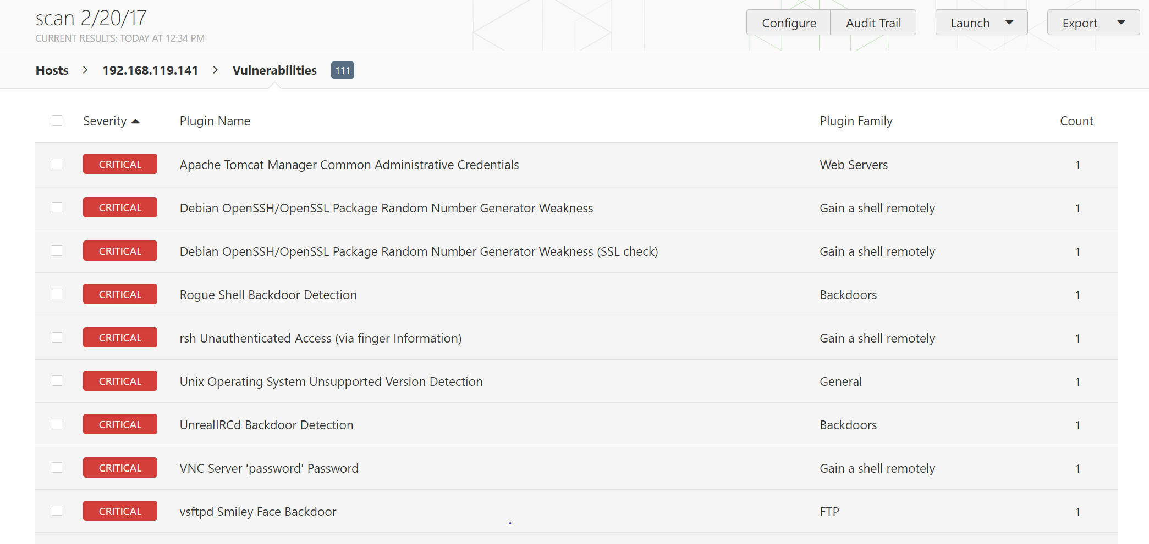
Nessus and Nmap scan reports

Slide 3
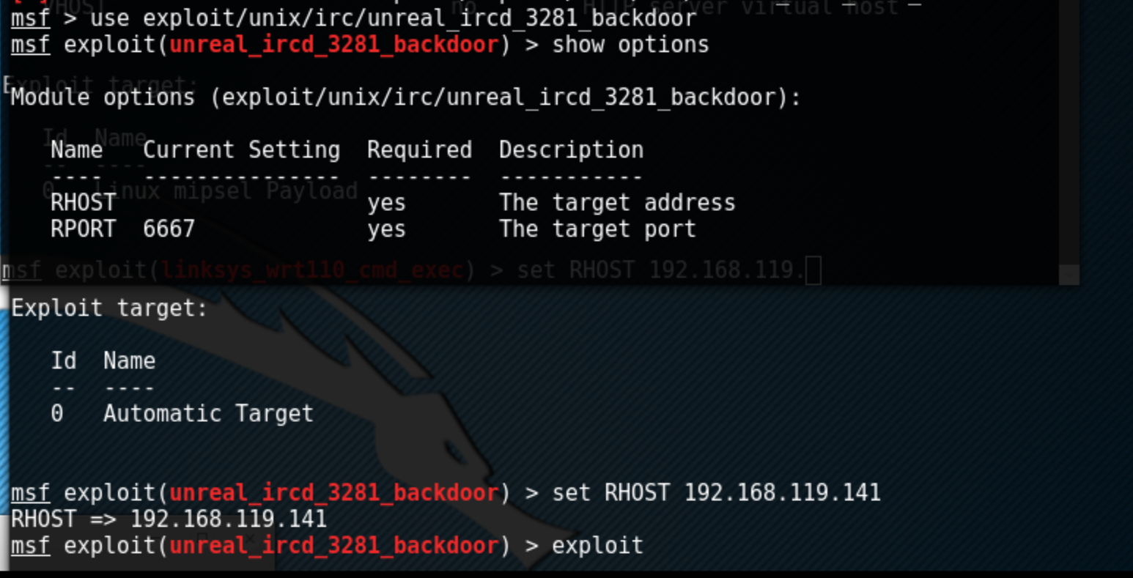
Running the commands to exploit Metasploitable

Slide 4
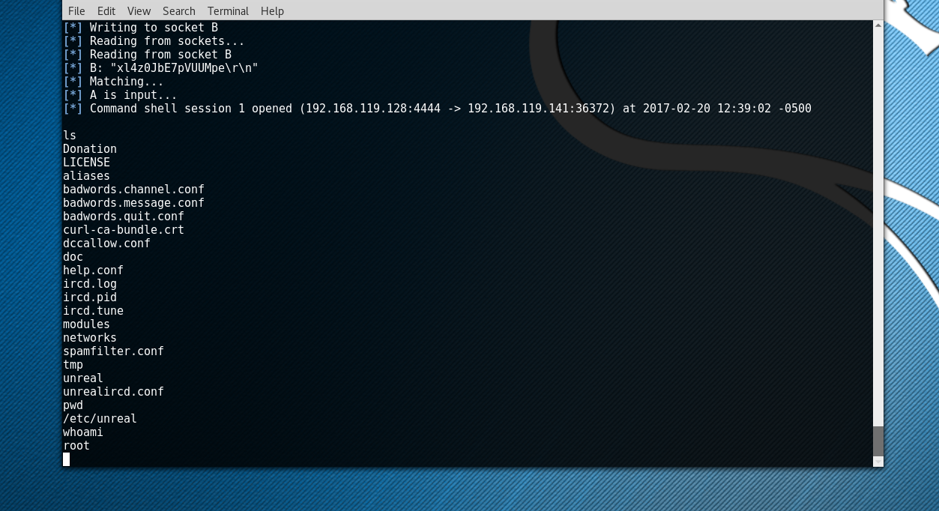
Results from running the exploit on the vulnerability

