Slide 1
Metasploit
By:
Vaibhav Shukla

Slide 2
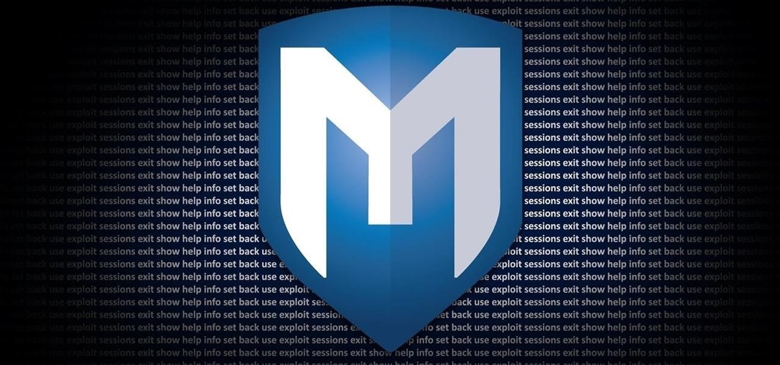
Machines
Scanner
Attacker 192.168.152.139 (Linux kali metasploit)
Remote Host 192.168.152.140 (Metasploitable)

Slide 3
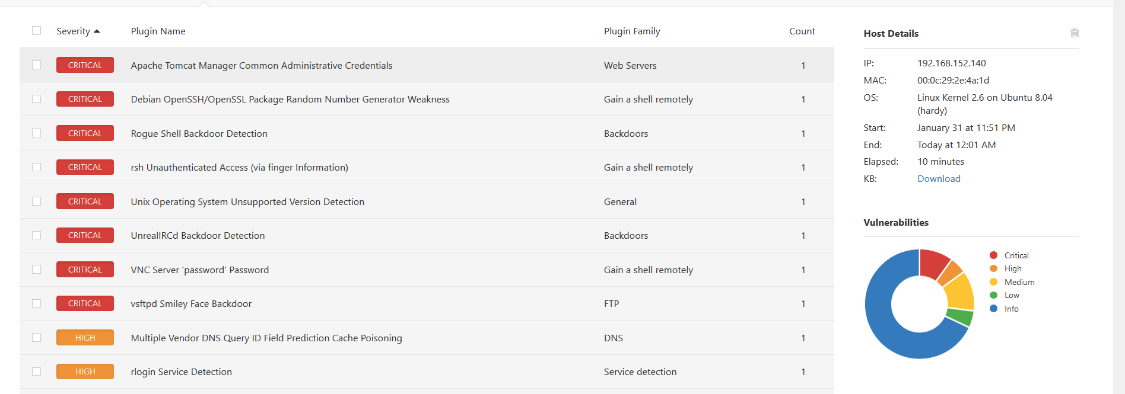
Nessus Scan using the IP of host

Slide 4
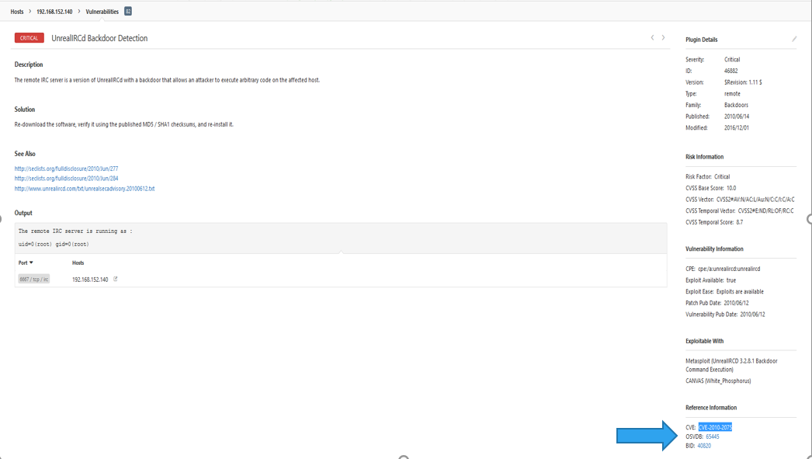
UnrealRCD backdoor detection and finding out its CVE

Slide 5
Using CVE-No of vulnerability to search for exploit

Slide 6
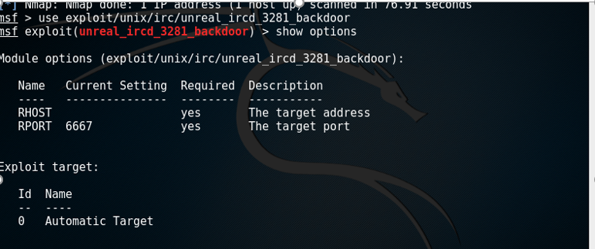
Using the exploit path searched

Slide 7
SETTING HOST and exploiting it

Slide 8
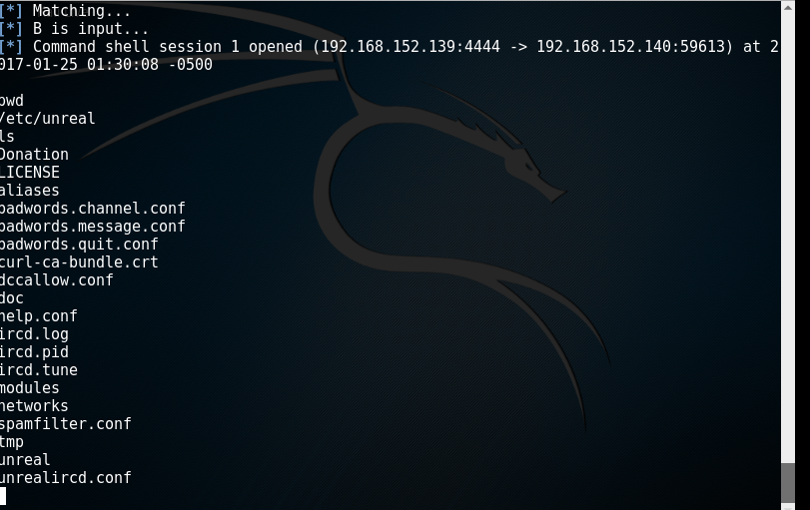
Backdoor Access

