Slide 1
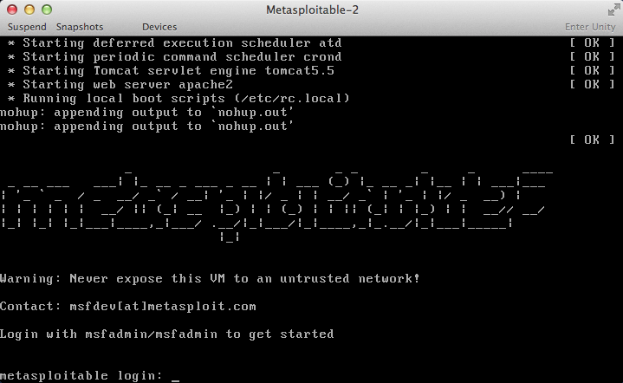
Metasploit Analysis Report Overview
Objective: Utilize Metasploit to successfully run an exploit against a vulnerable host
Tools Used
Metasploitable
Target

Slide 2
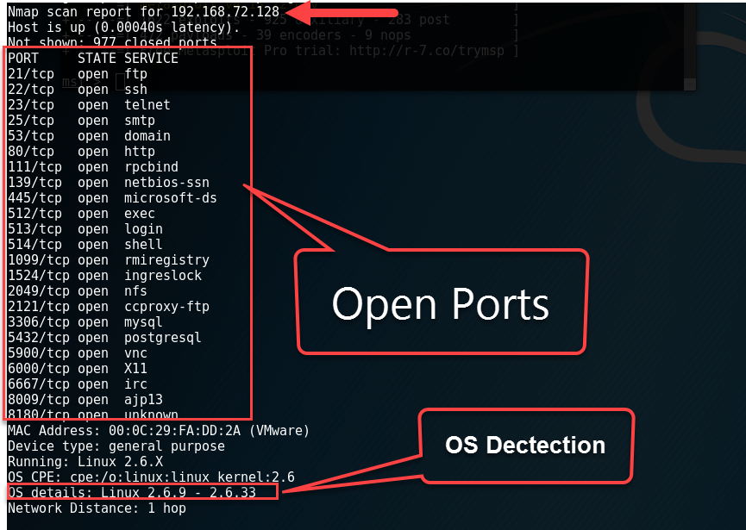
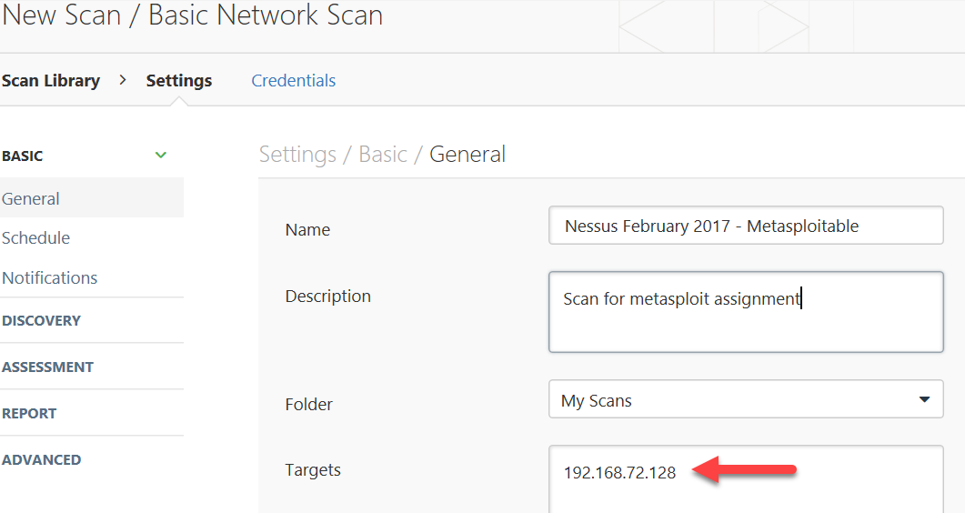
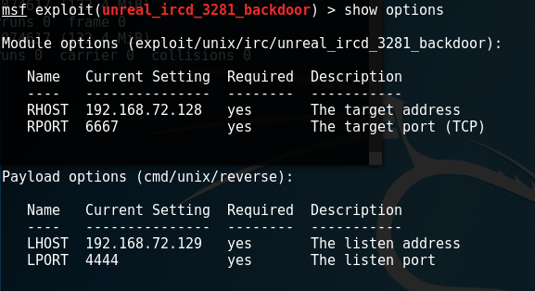
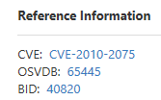
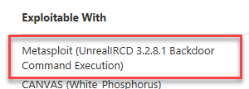
Approach
Info Gathering
Use NMAP to identify target host IP Address, open ports, and OS version
Vulnerability Scanning
Perform Nessus Basic Network Scan to identify vulnerabilities
Exploitation
Use Metasploit to identify exploit and payload, set options, and deliver exploit to target

Slide 3
Exploitation Results
Identified the UnrealIRCD 3.2.8.1 Backdoor Command Execution vulnerability using Nessus Basic Network Scanner
Identified exploit in Metasploit with “Excellent” rank
Executed exploit to establish double Reverse TCP Unix Command Shell
Ran “whoami” command to identify my user identity as “root”
Obtained a list of users on target host (via “cat etc/passwd” command)

