Slide 1
Exploiting Metasploitable
Marcus Wilson
Advanced Penetration Testing
MIS 5212

Slide 2
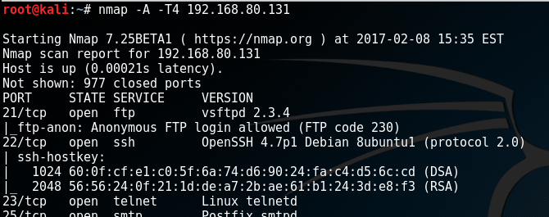
Exploit Background
Source Operating System: Kali Linux VM
Source IP Address: 192.168.80.128
Target Operating System: Metasploitable 2 VM
Target IP Address: 192.168.80.131
NMAP Reconnaissance
Source System
Source System
Port 3306 for MySQL service is open and running MySQL 5.0.51a
Port 21 for ftp service is open and running vsftpd 2.3.4

Slide 3
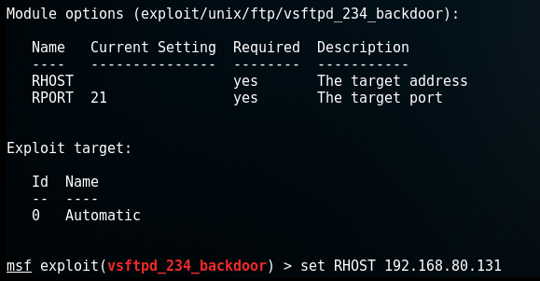
The FTP Exploit
Source System
Used Metasploit search to find any exploits related to vsftpd
Found an exploit for vsftpd 2.3.4
Set the RHOST to the target IP address for Metasploitable
Used a “whoami” and “pwd” commands to determine what privilege level
Found an exploit for vsftpd 2.3.4
Successfully used the backdoor and gained access to a shell
Determined it was root access in the root directory
Source System

Slide 4
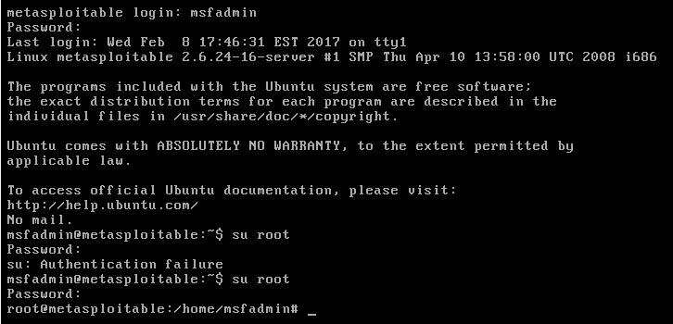
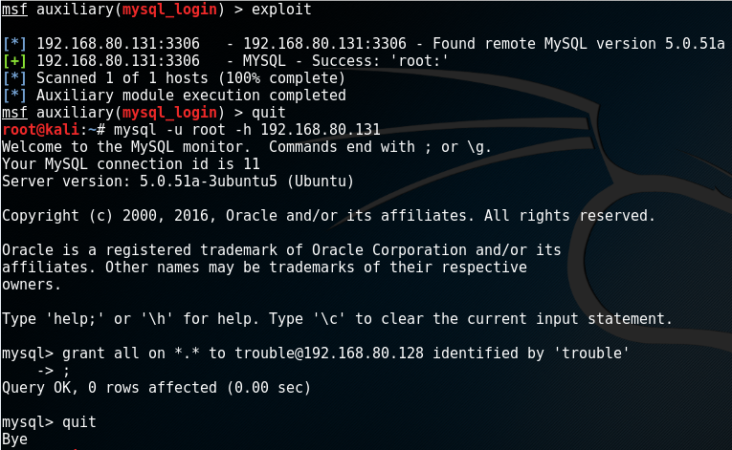
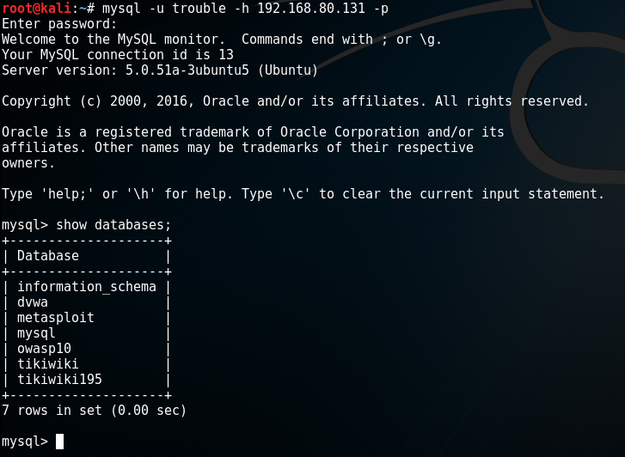
FTP Exploit Continued
Source System
Target System
Used the root shell access to change the root password to the system
Attempted to SU to root user on the Metasploitable VM using original default password and failed. Root password was successfully changed using exploited shell
msfadmin
TempleOwls
Source System
Source System
MySQL Exploit
Additionally used the mysql_login exploit to check for MySQL root access which was successful due to a blank root password
Successfully gained root access and created a new MySQL user with root access

