Slide 1
Metasploit Assignment
Anthony Fecondo

Slide 2
NMAP
Ifconfig on metasploitable
Nmap –sS –A 192.168.171.141
Showed Open Ports, OS info, etc

Slide 3
Exploits – unreal ircd 3281 backdoor
Opened the exploit
Set the RHOST
Ran the exploit
Opened a terminal in Target

Slide 4
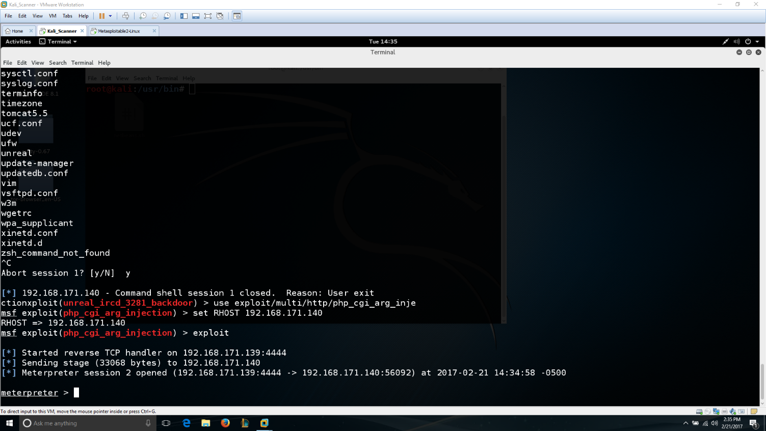
Exploits – php_cgi_arg_injection

