Slide 1
Metasploit Assignment
Jimmy Jouthe
5212.001 Advanced Penetration Testing

Slide 2
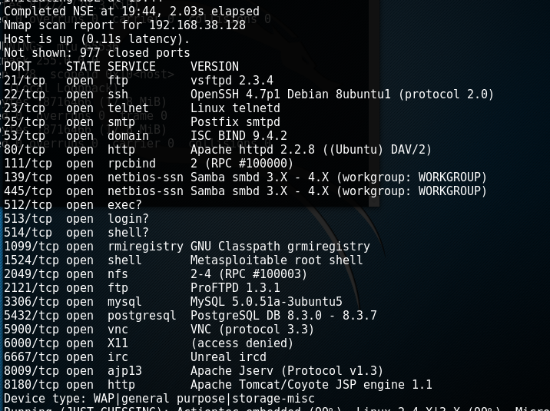
Target Host: Metasploitable 2
A NMAP was performed on the target host
A closer look reveals that the postgresql service is running on port 5432 in the target host machine

Slide 3
PostgreSQL Vulnerability
Searched and found some PostgreSQL exploits
Decided to use the ‘/linux/postgres/postgre_payload’ exploit
Set the payload to ‘linux/x86/meterpreter/bind_tcp

Slide 4
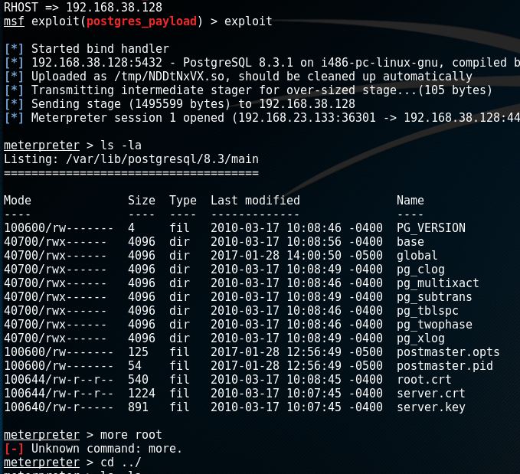
Run Exploit Results
Options were set, in this case the only option was RHOST
Successfully entered the system

