Slide 1
Metasploit Project
For this exploit I will be using the following strategy
Create backdoor exe file
Upload file to website
Have victim computer download file
Obtain remote access and enumerate file system
Tools used:
Metasploit Framework
Msfconsole
Meterpreter
Msfvenom
Attacking Computer: Kali Linux
Victim Computer: Windows 7 Home Premium

Slide 2
First we download the latest version of Putty..
We then add our payload to the exe file..once opened by the victim it will give us a meterpreter shell on their machine.

Slide 3
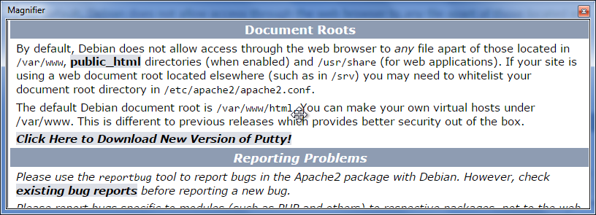
We now add our malicious file to the html file on our kali machine..we will add the file to our website. The file will be downloaded when a user clicks the “Click Here…” link.

Slide 4
We set up a multi handler in msfconsole, this will launch our meterpreter shell on the victim’s machine when our malicious exe file is opened.
Our exploit has succeeded and we have a shell on the victim’s machine..we run “ls” to enumerate the file system.

