Slide 1
MIS 5212 Jon Whitehurst Exploit Exercise
Simplified Attack Method:
Identify the Target– Using NMAP to identify the workstation and its OS and its open ports
Identify the Target’s weakness – Using Nessus as a tool to identify the vulnerabilities of the workstation
Exploit the Target’s weakness – Using Metasploit to carry out the vulnerability and expose the weakness.

Slide 2
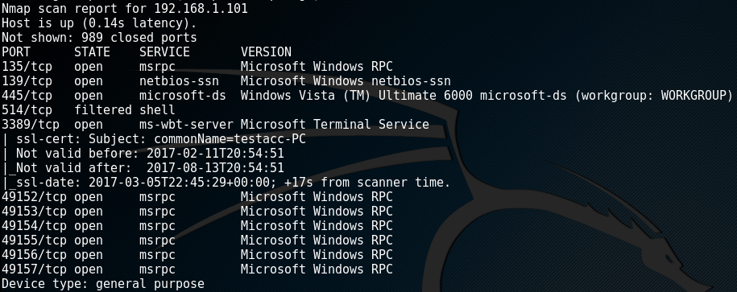
NMAP –

Slide 3
Nessus –

Slide 4
MetaSploit –

