Slide 1
Advanced Penetration testing
MIS 5212.001
Week 10
Site: http://community.mis.temple.edu/mis5212sec001sp2017/

Slide 2
Tonight's Plan
More Wireless Security
Getting wireless card working in Kali
Introduction to Kismet
Next Week

Slide 3
More Wireless Security
Open WiFi Networks vs Encrypted WiFi Networks
  In an open network, your browsing can be monitored
  Every thing is sent in the clear
  WPA2-PSK fixes this “Somewhat”

Slide 4
WPA2-PSK
Uses a pre-shared key (hence the acronym PSK)
  The pre-shared key is known to all authorized users
  Anyone with the pre-shared key has what they need to decrypt traffic
  Wireshark has a built in option to decrypt traffic if you have the key
  This means WPA2-PSK is not much more secure than no encryption, unless you trust everyone on the network

Slide 5
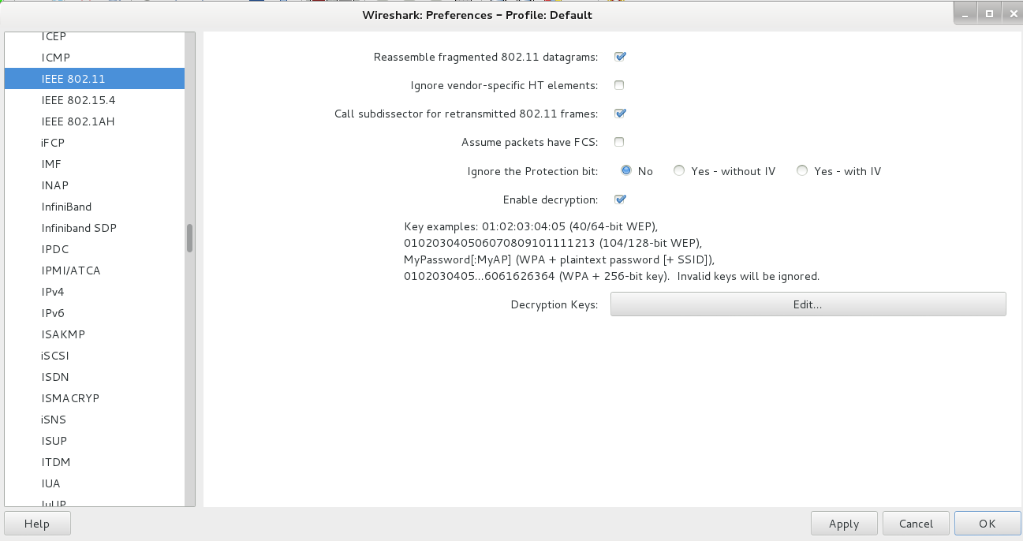
Wireshark WPA2-PSK Decryption
Edit->Preferences->IEEE 802.11

Slide 6
PTK or Pairwise Transient Key
WPA2-PSK tries to address this issue by use of PTK
However, the PTK is derived from the PSK
So… It is easy to capture the PTK if you have the PSK

Slide 7
WPA2-Enterprise
WPA2-Enterprise corrects these issues for large networks
  EAP authentication along with a Radius server ensures each client gets a unique key
  Other authenticated users no longer have a master key to decrypt the traffic

Slide 8
WPA2 Hole196 Vulnerability
Even in WPA2-Enterprise there is still a potential vulnerability from other authorized users (Abuses GTK or Group Temporal Key)
Limited to:
  ARP poisoning
  Injecting malicious code
  Denial of Service w/o using de-auth packets
More detailed description
  http://www.mojonetworks.com/wpa2-hole196-vulnerability

Slide 9
Kismet
802.11 wireless:
  Network detector
  Sniffer
  Intrusion detection system
Works with any wireless card which supports raw monitoring mode (not all do)
Can sniff:
  802.11b
  802.11a
  802.11g
  802.11n

Slide 10
Kismet
Supports a plugin architecture allowing for additional non-802.11 protocols to be decoded
Identifies networks by passively collecting packets and detecting networks, which allows it to detect (and given time, expose the names of) hidden networks and the presence of non-beaconing networks via data traffic

Slide 11
Kismet in Kali
Pre-installed in Kali
Did not launch from drop down menu in my instance
Needed to start from command line
Be patient, it will walk through configuration
You can automate via configuration files, but for now just follow prompts

Slide 12
Getting Started
We will
  Get USB Wireless Adapter working with Kali
  Launch and configure Kismet
  Explore a little bit

Slide 13
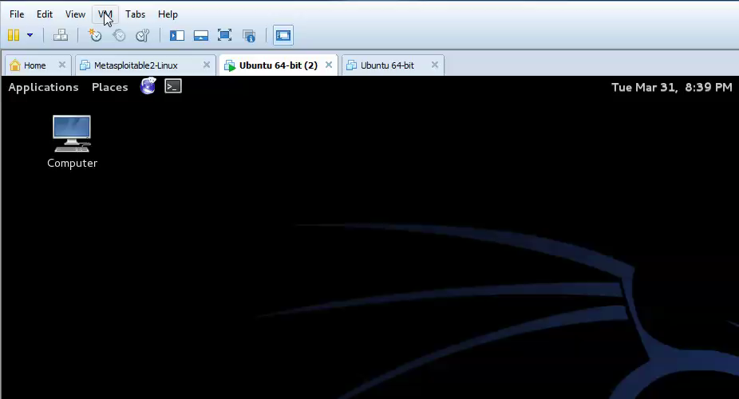
Connecting Wireless Card

Slide 14
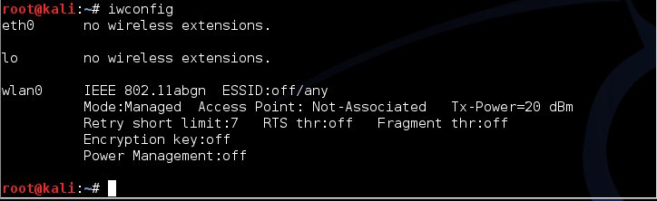
Checking Card
Use the command: iwconfig
This should give something like the following:

Slide 15
Kismet
Kismet is a wireless network detector, sniffer, and intrusion detection system. Kismet works predominately with Wi-Fi (IEEE 802.11) networks, but can be expanded via plug-ins to handle other network types.
Features
  802.11 sniffing
  Standard PCAP logging (compatible with Wireshark, TCPDump, etc)
  Client/Server modular architecture
  Plug-in architecture to expand core features
  Multiple capture source support
  Live export of packets to other tools via tun/tap virtual interfaces
  Distributed remote sniffing via light-weight remote capture
  XML output for integration with other tools
http://kismetwireless.net/

Slide 16
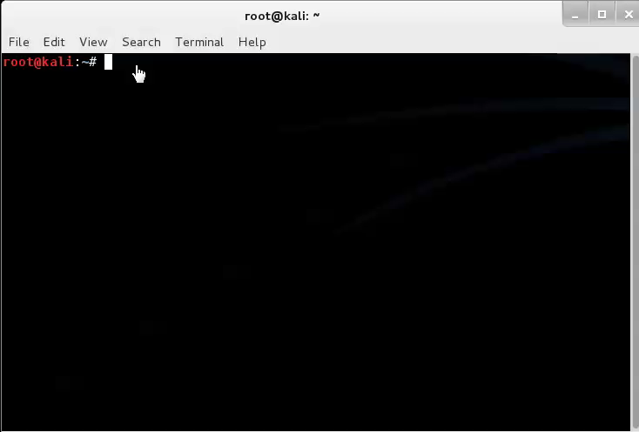
Starting Kismet

Slide 17
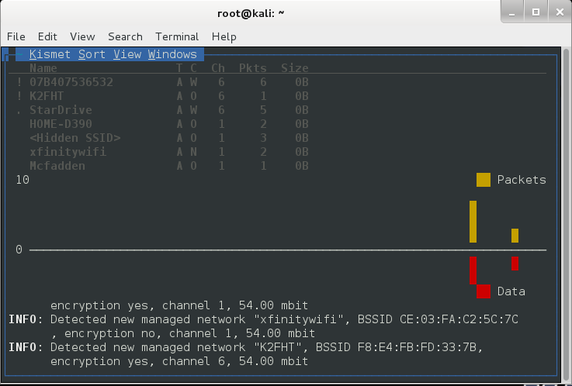
Kismet Example

Slide 18
Kismet Reference
http://kismetwireless.net/documentation.shtml

Slide 19
Wireshark
Saw this briefly last semester
Pre-installed in Kali

Slide 20
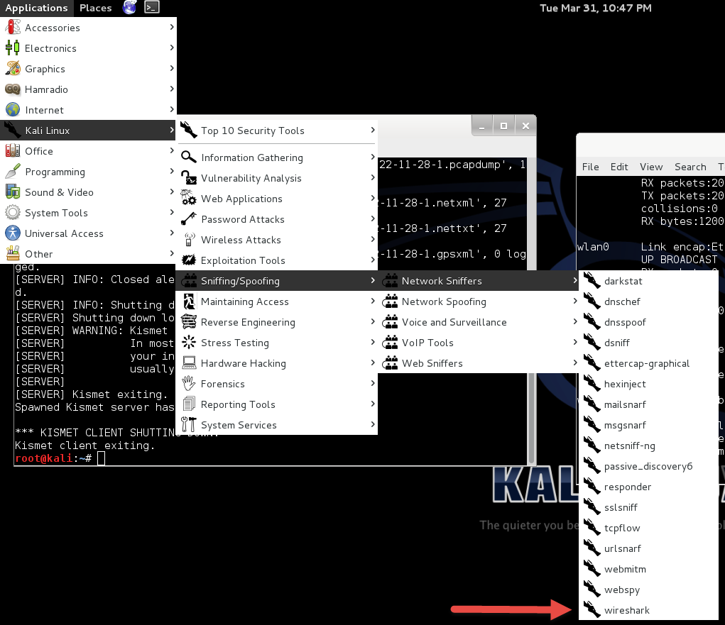
Wireshark

Slide 21
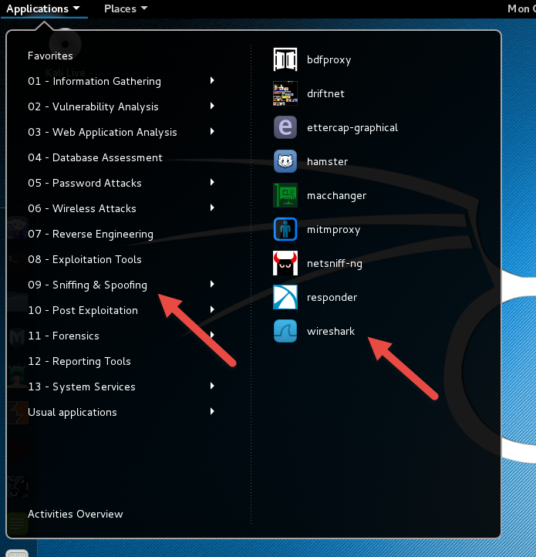
Or

Slide 22
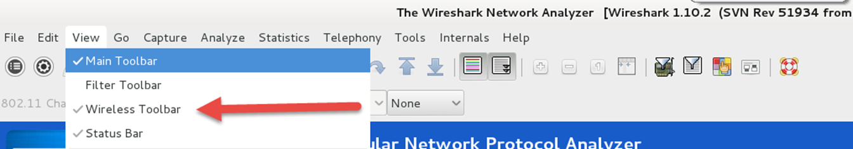
Startup of Wireshark
Will throw an error due to running as root in Kali, just click OK and move on
Will need to turn wireless menu on by going to View tab and clicking on “Wireless Toolbar”

Slide 23
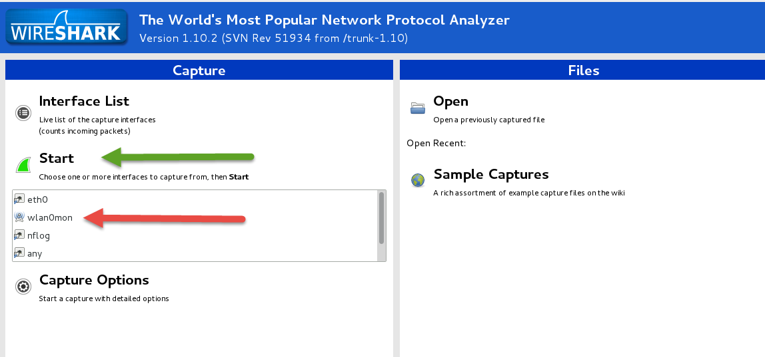
Configuring Interface
Select “wlan0mon”
Click on “Start”
Be patient, it will take a minute or so to update

Slide 24
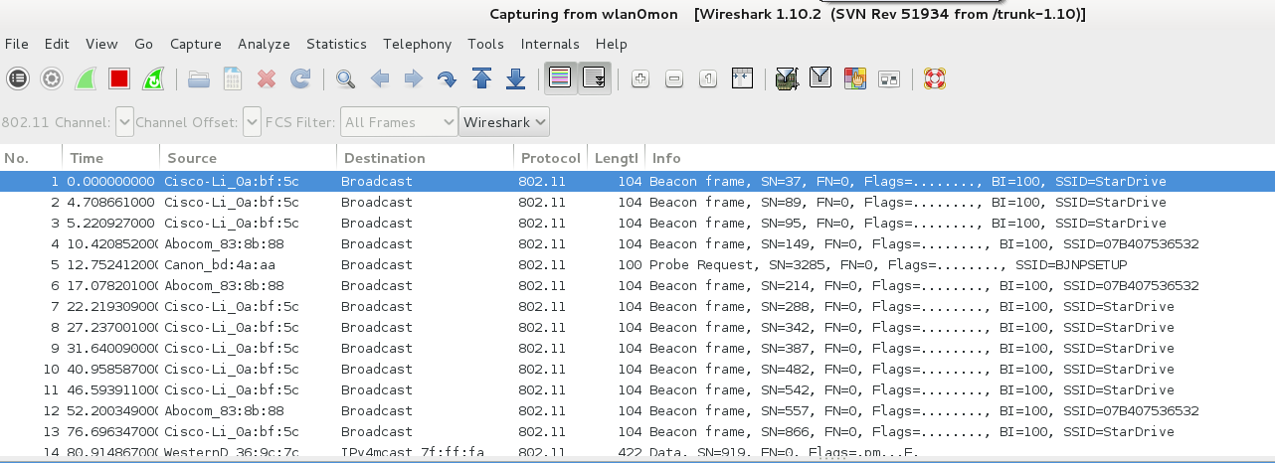
More Wireshark

Slide 25
Next Week
In the news
More wireless
  WEP in detail
  Intro to AirCrack and breaking WEP

Slide 26
Questions
?

