Slide 1
Advanced Penetration testing
MIS 5212.001
Week 7
Site: http://community.mis.temple.edu/mis5212sec001sp2017/

Slide 2
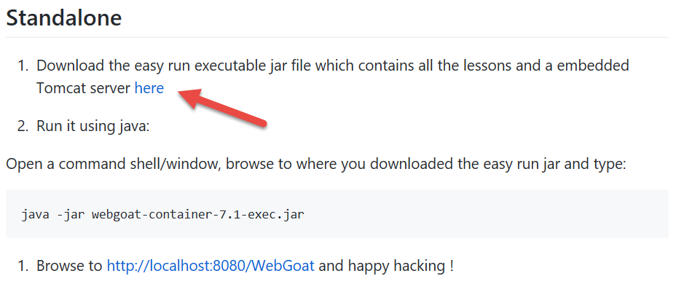
How to get WebGoat
You can download WebGoat at:
https://github.com/WebGoat/WebGoat/wiki/Running-WebGoat
You will also need Java >= 1.6 (JDK 1.7 Recommended)
http://www.oracle.com/technetwork/java/javase/downloads/index.html

Slide 3
WebGoat Exercises
Access Control Flaws
Stage 1
Stage 3
Authentication Flaws
Cross-Site Scripting
Phishing
Stage 1
Stage 5
Reflected XSS Attacks
Improper Error Handling
Fail Open Authentication Scheme

Slide 4
WebGoat Exercises
Injection Flaws:
Command Injection: " & netstat -ant & ifconfig“
Numerical SQL Injection: or 1=1
Log Spoofing
XPATH Injection
String SQL Injection
Modifying Data with SQL Injection
Adding Data with SQL Injection
Blind Numeric SQL Injection
Blind String SQL Injection

Slide 5
Next Week
No Class
Do WebGoat Exercises and Submit Screen Caps of Success Banners as Evidence of Completion.

Slide 6
Questions
?

