Slide 1
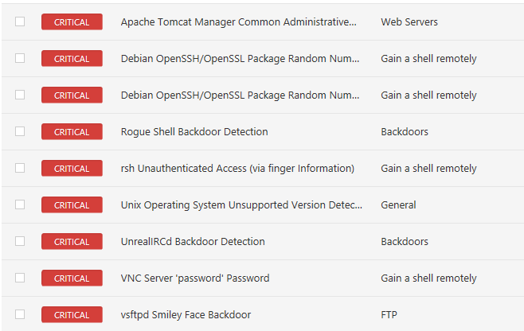
Metasploit assignment – Arkadiy Kantor – Mis-5212
Tools used:
Windows 10 Host – Vmware Pro
Nessus Scanner - Running in a Windows 10 VM
Metasploitable Linux VM
Critical vulnerabilities discovered:

Slide 2
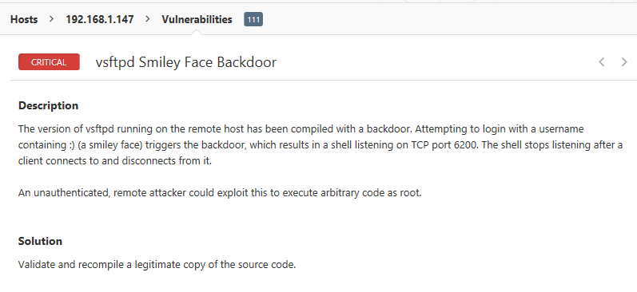
After finding a vulnerability I was interested in:
Exported Nessus scan
Imported into Metaexploit
Performed exploit using Metaexploit
Vulnerability of interest -
I was able to exploit it with:

Slide 3
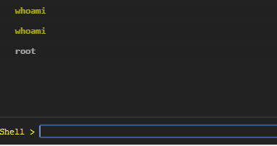
After executing the exploit was able to confirm that I had gained access to the shell with ROOT!

