Slide 1
ANALYSIS REPORT: Metasploit
Mengxue Ni
MIS5212

Slide 2
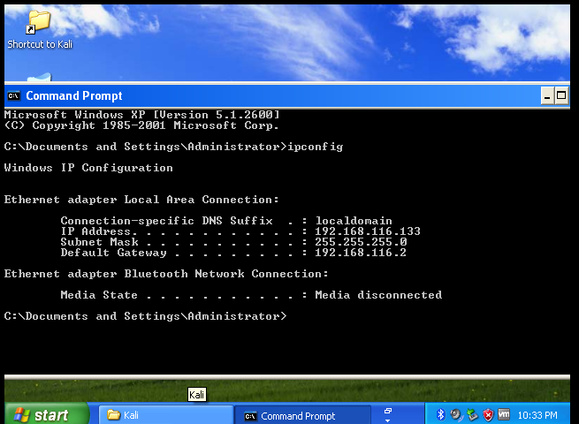
Target IP Address: 192.168.116.133
Download and Set Windows XP 32 bit ISO as my target computer

Slide 3
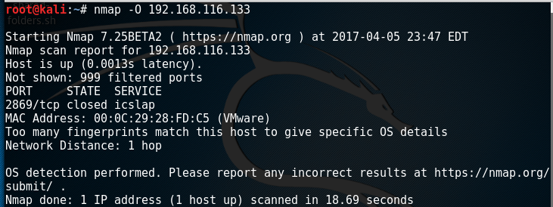
Nmap

Slide 4
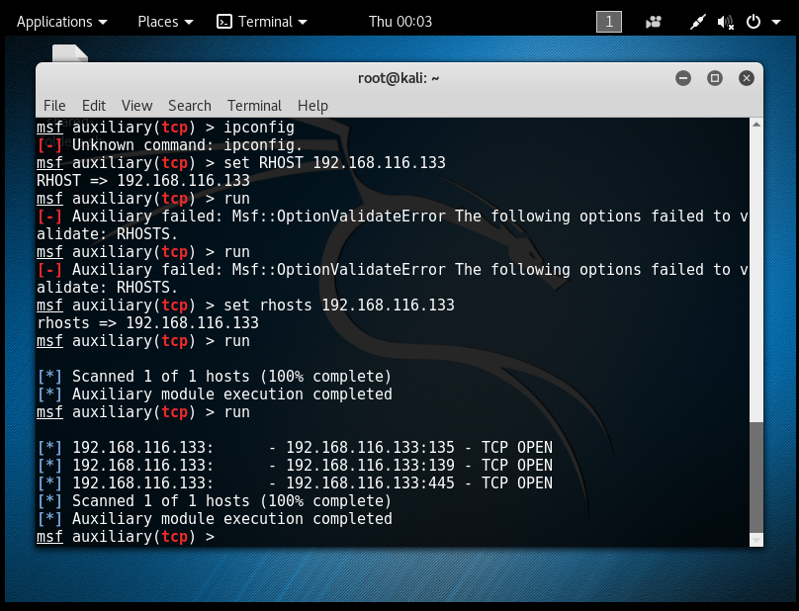
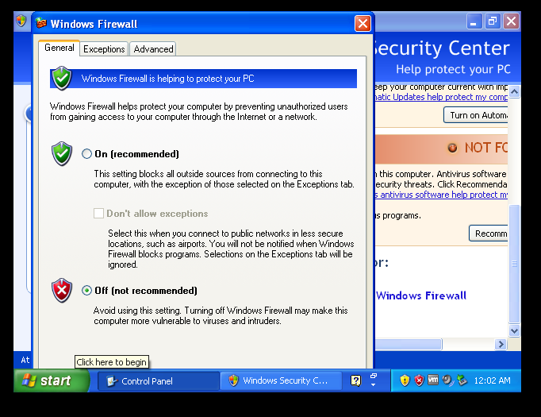
METASPLOIT--msfconsole
Before turn off windows firewall
After turn off windows firewall

Slide 5
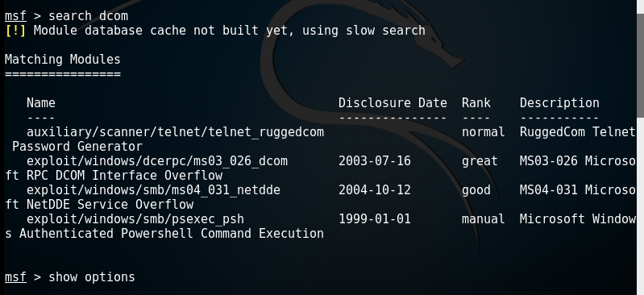
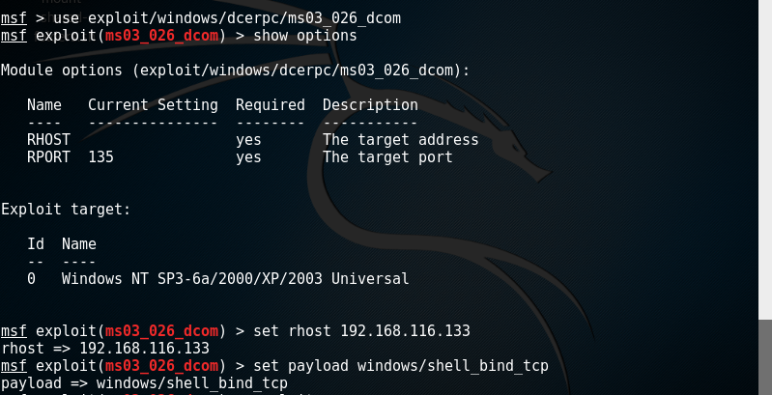
Port Scan
1
2
3

Slide 6
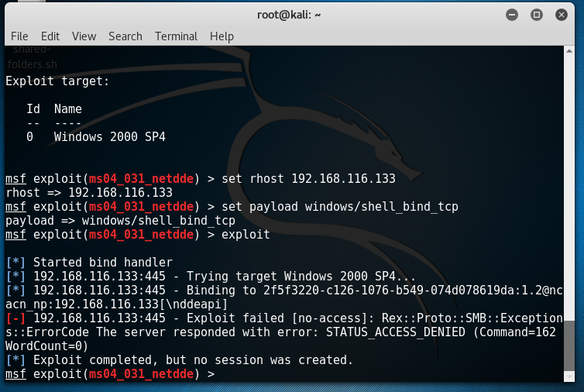
Another port scan

