Slide 1
Intro to Ethical Hacking
MIS 5212.001
Week 3
Site: http://community.mis.temple.edu/mis5212sec001sp2017/

Slide 2
Tonight's Plan
Introduction
In the news
Metasploit Database Issues Solved
Live Demonstrations
Social Engineering Toolkit
SQL Injection
Karmetasploit
Building Modules in Metasploit
Creating Exploits
Next Week

Slide 3
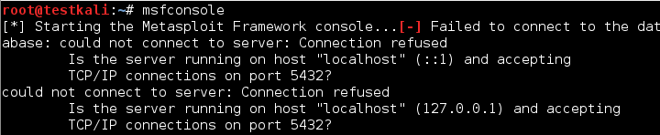
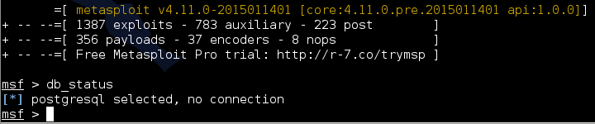
Metasploit Database Issues Solved
Recall Symptoms
  And

Slide 4
Metasploit Database Issues Solved
What is actually happening
  The msfconsole command is only starting the console.
  The command is not starting the underlying services required by the Metasploit Framework
  Also, the install of Metasploit did not place the required services in the ”rc.d” file which is the configuration file that tells Linux what services to launch at startup.

Slide 5
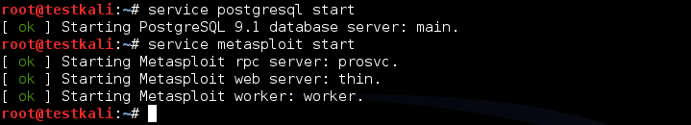
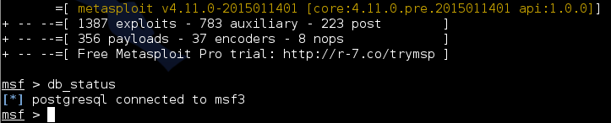
Fixing The Issue
1st method
  Manually launch the services
  Result

Slide 6

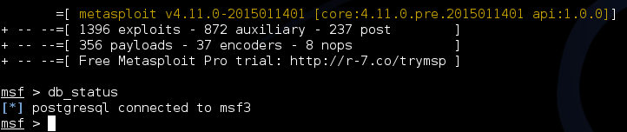
Fixing The Issue
  Add the services to the Kali configuration file to auto start services on startup
    Reboot and launch msfconsole

Slide 7
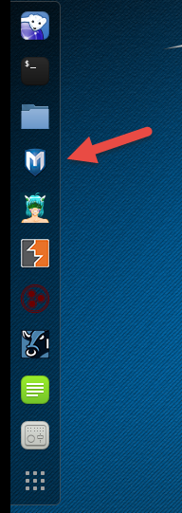
Third Option
Always use Icon to launch
Icon runs services at launch

Slide 8
Result
With any of these solutions, the database service is available and works reliably

Slide 9
Tips and Tricks
A couple of issues brought up in previous classes. Some may have already figured these out, but just in case.
IceWeasel not connecting.
  Recall last semester we did some work with the intercepting proxy. You will need to change the Browser’s network settings to “No Proxy” when not running a proxy
Screen size
  Kali defaults to 600x480 or 800x600 which gives a very small screen
  Go to System Tools -> Preferences -> System Settings and then select “Displays” and select a larger screen size. I was able to use 1680x1050 on my system.

Slide 10
Live Demos

Slide 11
Note on “Hands On”
The tools covered (Kali, nmap, and Metasploit) along with what will be covered (WebGoat with Interception proxy) allow each student to work through all examples and many more in a safe environment within VMWare
This gives you the best chance of getting comfortable with these tools
To get the best value out of the material you need to “play” with them, try things, see what works and what doesn’t.

Slide 12

Social Engineer Toolkit
Social Engineering Toolkit or SET was developed by the same group that built Metasploit
SET provides a suite of tools specifically for performing social engineering attacks including:
  Spear Phishing
  Infectious Media
  And More
It is pre-installed on Kali

Slide 13
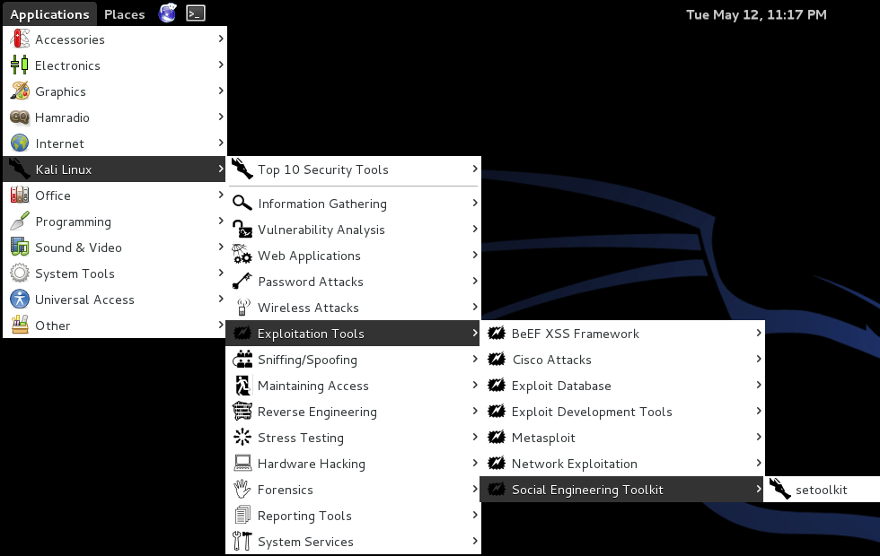
Finding SET in Kali

Slide 14
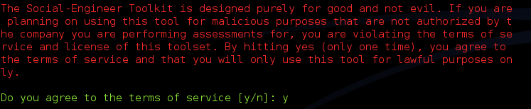
Exploring SET
Many feature of SET are turned off by default
To activate desired feature you will need to manually edit the set_config file found under /usr/share/set/config
To Launch: Kali Linux -> Exploitation Tools -> Social Engineering Toolkit -> setoolkit
The first time you launch SET you will see this:

Slide 15
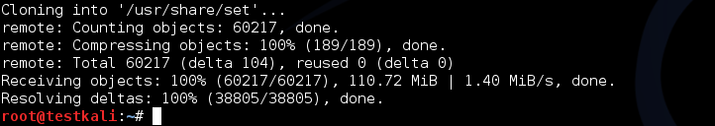
Updating SET
To get the latest update of set, enter the following from a terminal in Kali:
This removes all files and folder associated with SET and replaces them with a fresh copy. Executed correctly should give the following:

Slide 16
More on Updating
You can also get “bleeding Edge” updates with the following
Note: This may cause some instabilities and may force you to “Troubleshoot” some of the software. Hint: Take a snapshot first.

Slide 17
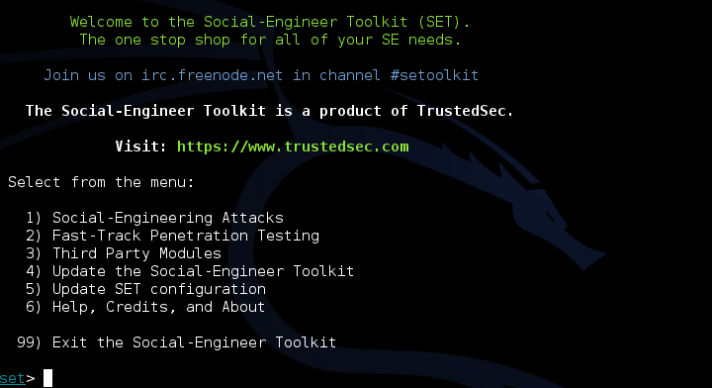
Initial Options
If you have not edited the set_config file you will see the following options:

Slide 18
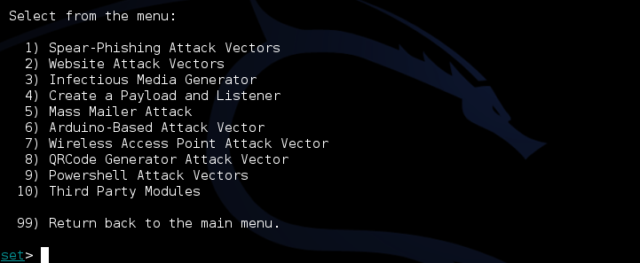
Drilling Down
Under “Social-Engineering Attacks”

Slide 19
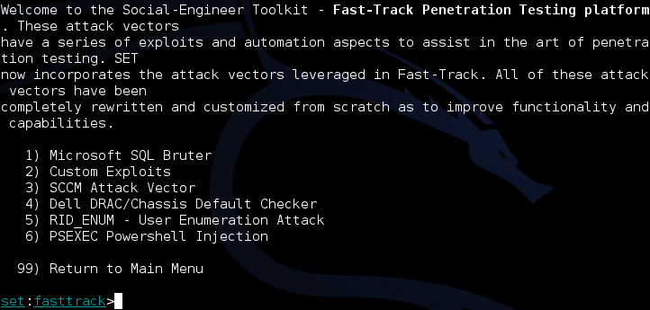
Drilling Down
Under “Fast-Track Penetration Testing “

Slide 20
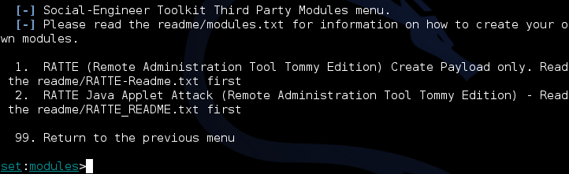
Drilling Down
Under “Third Party Modules

Slide 21
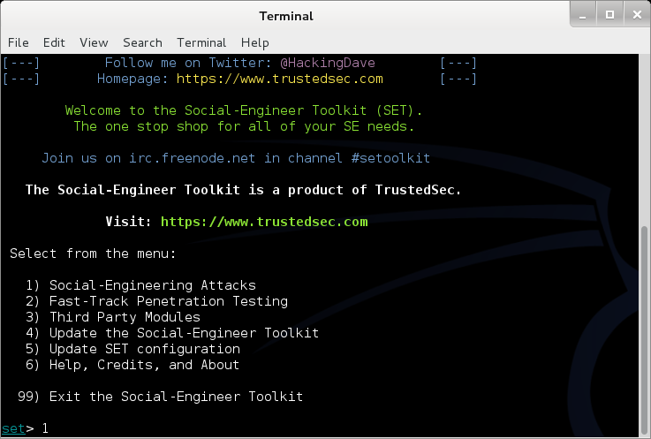
Walk Through of Attack
We will start back at the main menu for SET

Slide 22
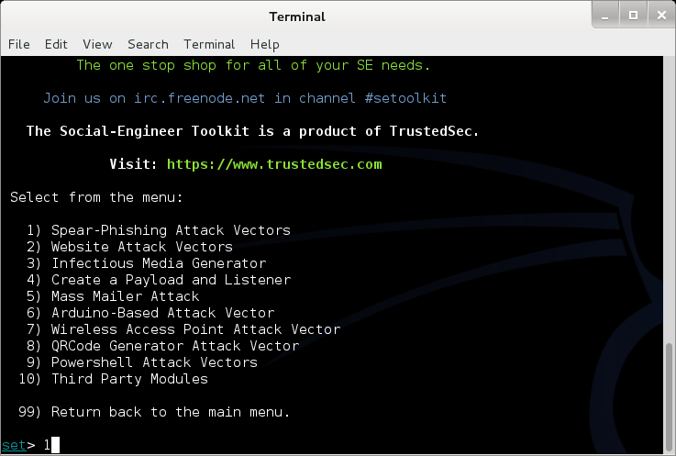
Walk Through of Attack
Select Option 1 for Spear-Phishing

Slide 23
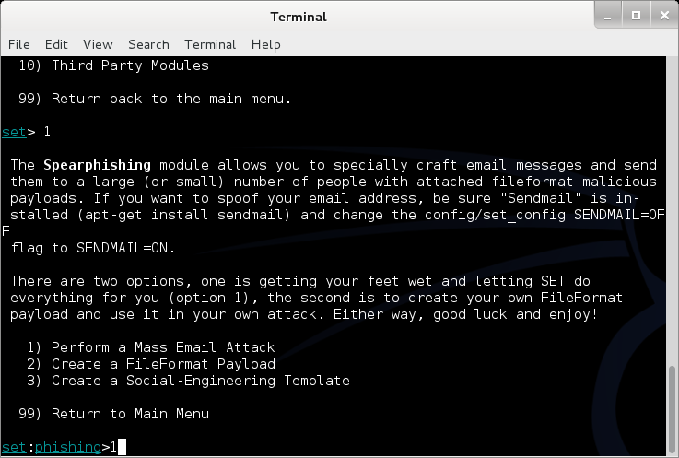
Walk Through of Attack
Select Option 1 for a Mass Email Attack

Slide 24
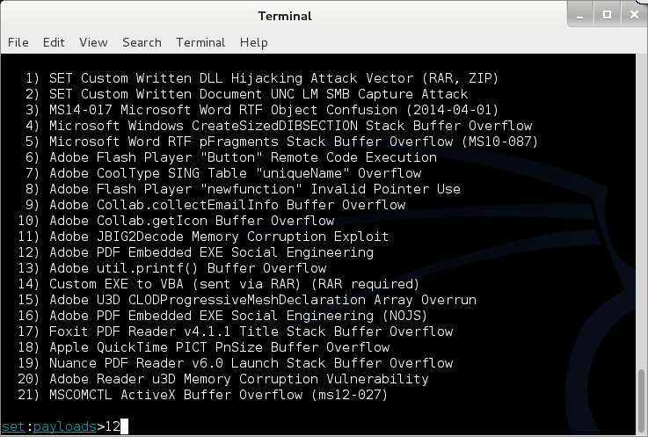
Walk Through of Attack
Select Option 12 for PDF embedded EXE

Slide 25
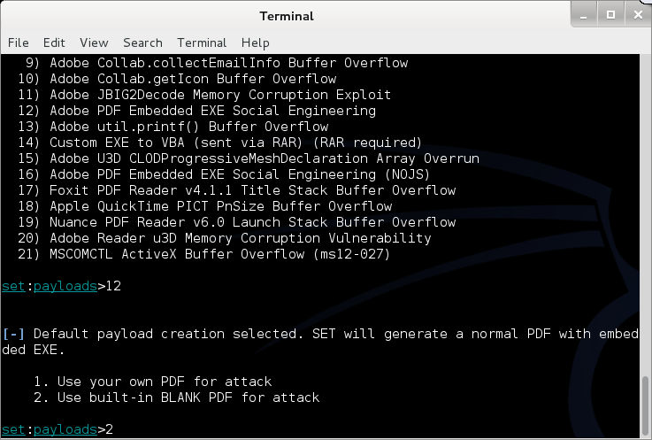
Walk Through of Attack
Select Option 2 for Built-in PDF

Slide 26
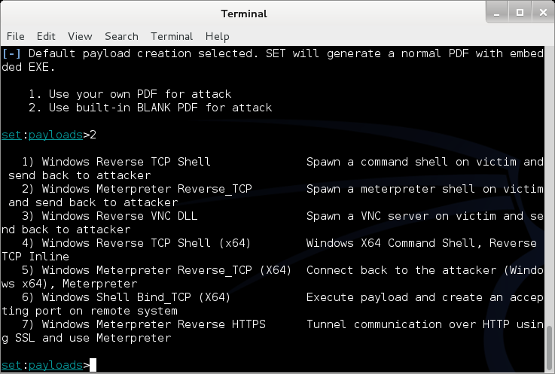
Walk Through of Attack
Select Payload 1

Slide 27
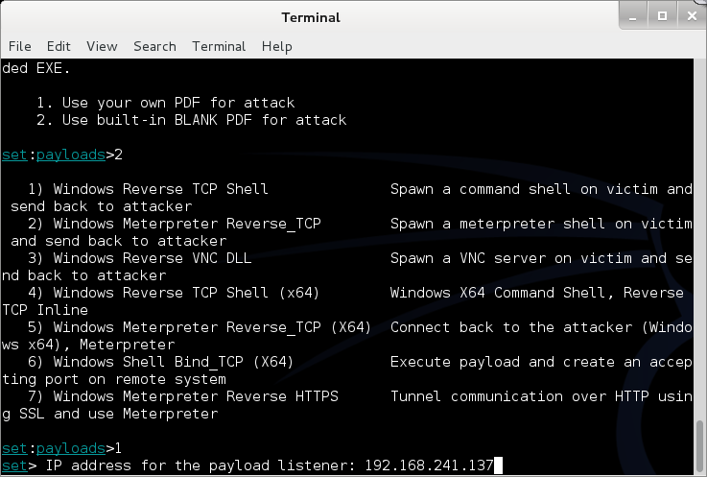
Walk Through of Attack
Add an IP Address to listen on

Slide 28
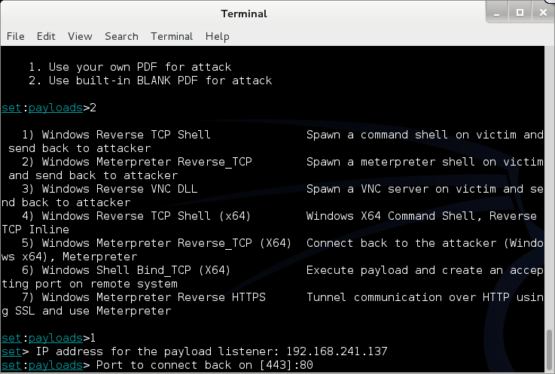
Walk Through of Attack
Select a port (Defaults to 443)

Slide 29
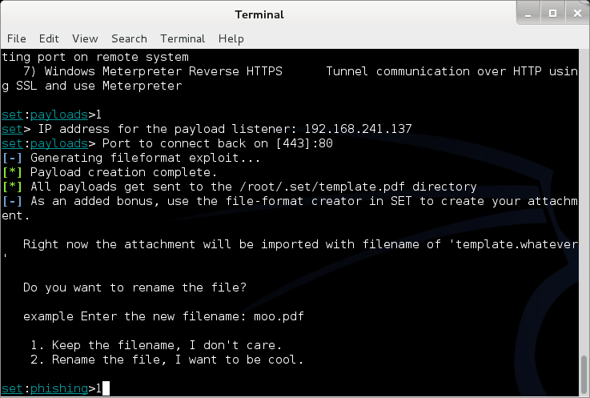
Walk Through of Attack
Select Option 1 to keep file name

Slide 30
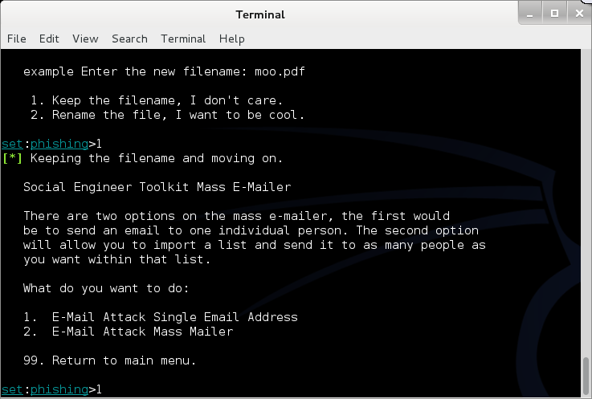
Walk Through of Attack
Select Option 1 for a single Email address

Slide 31
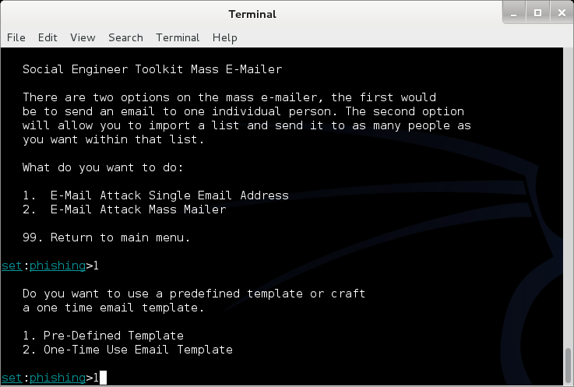
Walk Through of Attack
Select Option 1 for a Pre-Defined template

Slide 32
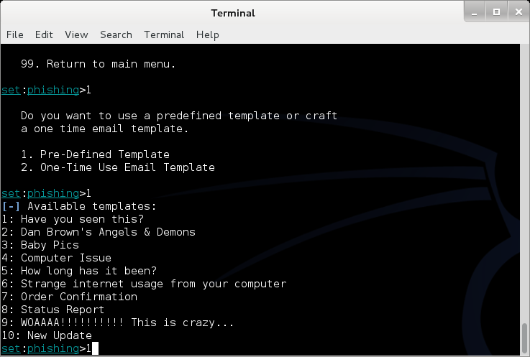
Walk Through of Attack
Select Option 1 for the first template

Slide 33
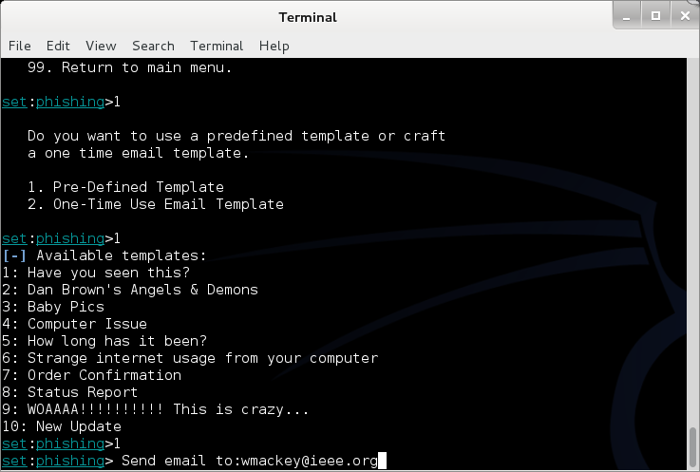
Walk Through of Attack
Enter an Email Address (Mine)

Slide 34
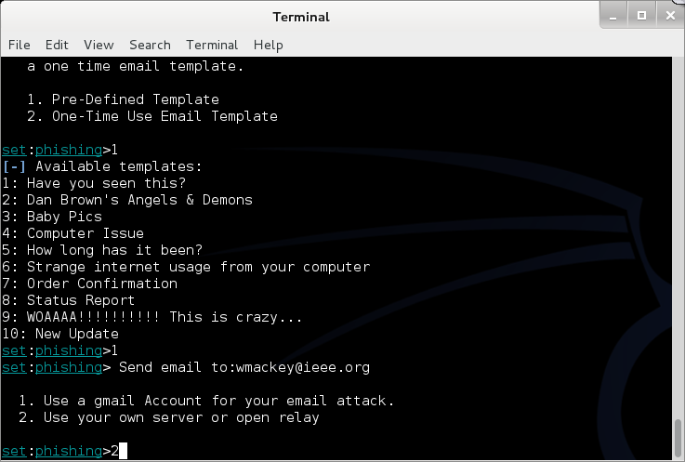
Walk Through of Attack
Select Option 2 for my own server

Slide 35
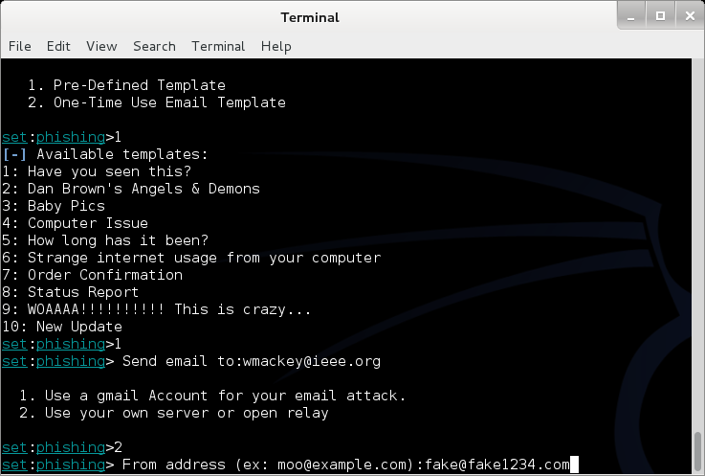
Walk Through of Attack
Enter a “From” address

Slide 36
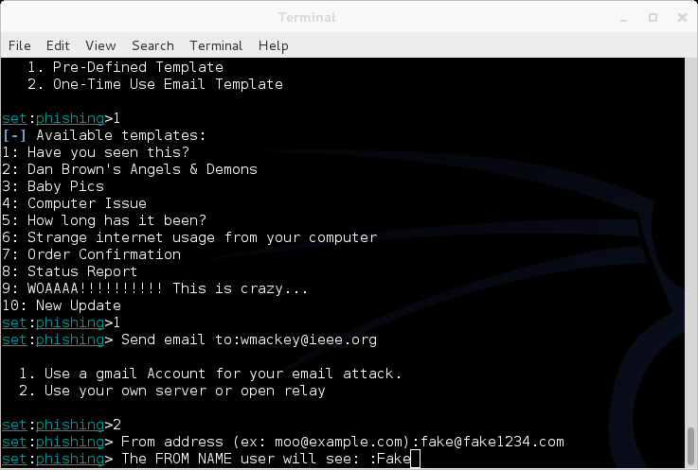
Walk Through of Attack
Enter a Name

Slide 37
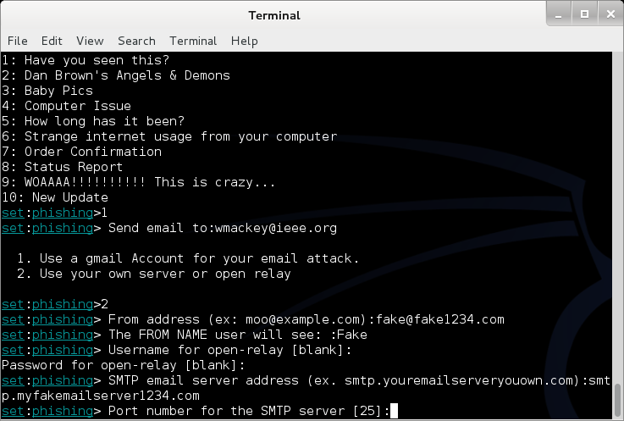
Walk Through of Attack
Enter Mail server information (Consolidated)

Slide 38
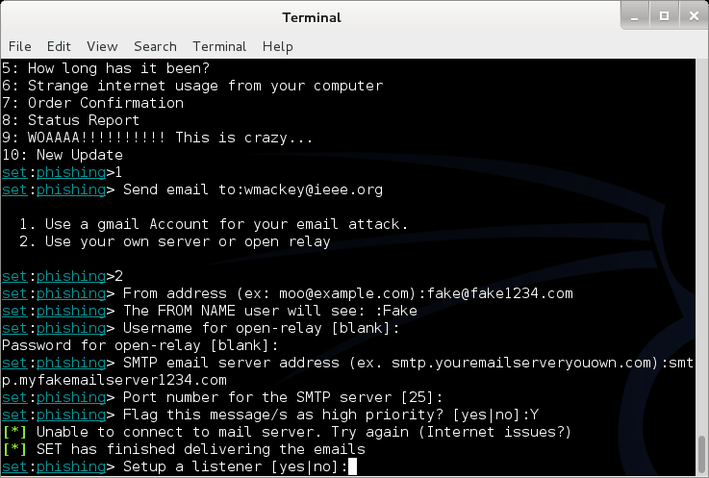
Walk Through of Attack
Launch Metasploit and setup listener

Slide 39
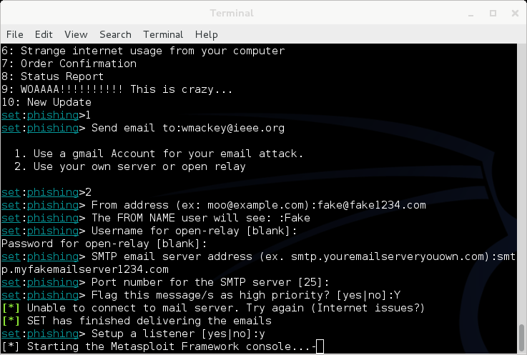
Walk Through of Attack
Will look like this for a bit

Slide 40
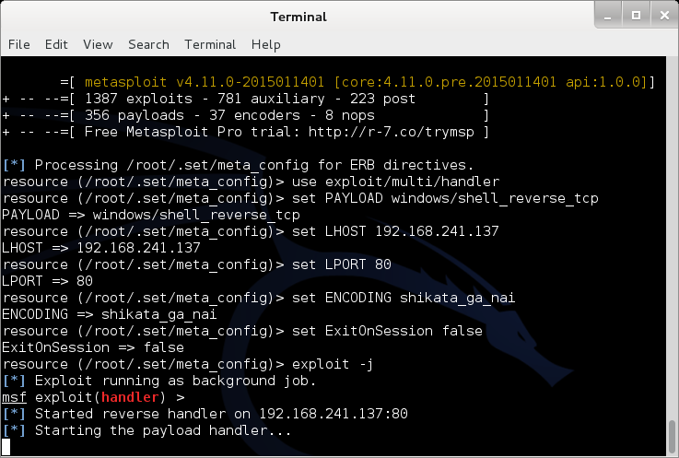
Walk Through of Attack
Eventually

Slide 41
Walk Through of Attack
At this point, Metasploit is listening for the packet coming from your victim once the attempt to open the attachment

Slide 42
Other Choices
You could clone a web site and set up your own copy hosting malicious attacks
You could clone a web site and just harvest credentials from unsuspecting visitors
You could use the mass e-mailer to “invite” victims to visit your freshly cloned site
You could build a link that shows a legitimate url when the mouse hovers over the link, but replaces the page with yours once clicked

Slide 43
Fast-Track
If you have the Metasploit book, you may see reference to a separate tool called Fast-Track
Fast-Track was rolled in to SET under “Fast-Track Penetration Testing “

Slide 44
Wrapping Up SET
Be careful. You could easily escape the boundary of your test systems
I covered this area so you would see what was available and how it interfaces to Metasploit

Slide 45
Karmetasploit
The Basics
  Metasploit’s implementation of basic wireless attacks
  Require installation of a DHCP server
  Require update of Metasploit to include the Karma exploits – They are not installed in the default
  Once set up you can launch your own fake AP serving up a wireless connection that responds to any request to connect
We will cover this in more detail in the last section of the course when we talk about wireless in detail

Slide 46
Next Week
Building Modules in Metasploit
Creating Exploits
Porting Exploits
Scripting
Simulating Penetration Testing

Slide 47
Questions
?

