Slide 1
Intro to Ethical Hacking
MIS 5212.001
Week 4
Site: http://community.mis.temple.edu/mis5212sec001sp2017/

Slide 2
Tonight's Plan
Introduction to Ruby
Modules
Scripting
Next Week

Slide 3
A Few Words on Programming
Metasploit is primarily written in Ruby
The book “Metasploit” also uses a lot of PowerShell in it’s examples
We are not going to try and make you either Ruby or PowerShell developers here tonight
Rather, we will look at some of the basic structure and steps you might go through to modify modules for you own purposes.

Slide 4
Interactive Ruby Shell
Interactive Ruby Shell (IRB or irb) is a REPL for programming in the object-oriented scripting language Ruby.
The program is launched from a command line and allows the execution of Ruby commands with immediate response, experimenting in real-time. It features command history, line editing capabilities, and job control, and is able to communicate directly as a shell script over the Internet and interact with a live server.
Source: https://www.ruby-lang.org/en/documentation/quickstart/

Slide 5
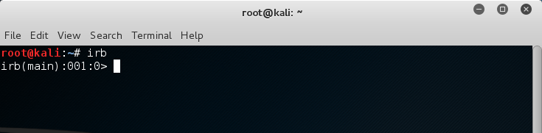
Interactive Ruby Shell
Example

Slide 6
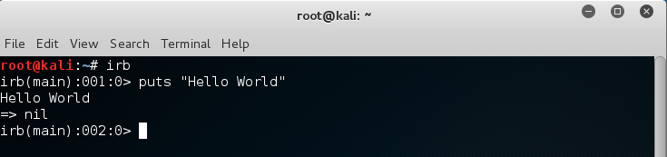
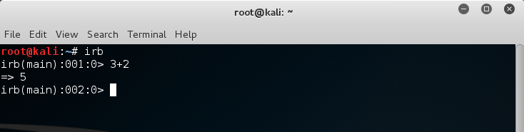
Ruby
Hello World
Calculator

Slide 7
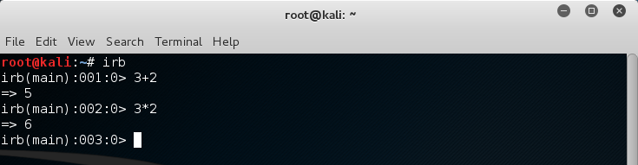
Ruby
Use up arrow and edit + to *
Square

Slide 8
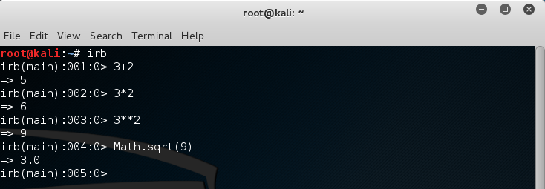
Ruby
Square Root

Slide 9
Ruby Math Module
Math is a built-in module for mathematics. Modules serve two roles in Ruby. This shows one role: grouping similar methods together under a familiar name. Math also contains methods like sin() and tan().
Next is a dot. What does the dot do? The dot is how you identify the receiver of a message. What’s the message? In this case it’s sqrt(9), which means call the method sqrt, shorthand for “square root” with the parameter of 9.
The result of this method call is the value 3.0. You might notice it’s not just 3. That’s because most of the time the square root of a number won’t be an integer, so the method always returns a floating-point number.

Slide 10
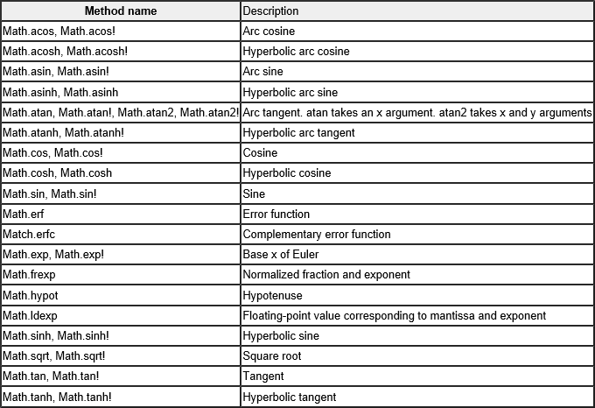
Ruby Math Functions
Source: http://www.techotopia.com/index.php/Ruby_Math_Functions_and_Methods

Slide 11
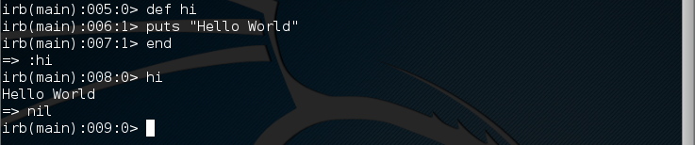
Defining a Method
Defining the method “Hi” as a shortcut to “Hello World”
Now, when we type hi ruby knows we mean Hello World

Slide 12
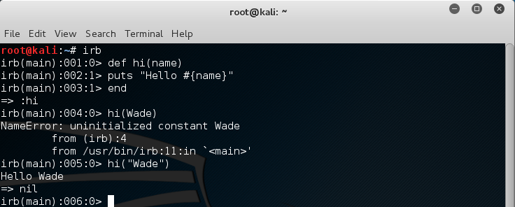
Using an Input
Lets say we want to customize a bit. Say Hello to one person
Note the error. That was me not remember to use “input”

Slide 13
Using an Input
Holding Spots in a String
  What’s the #{name} bit? That’s Ruby’s way of inserting something into a string. The bit between the braces is turned into a string (if it isn’t one already) and then substituted into the outer string at that point.

Slide 14
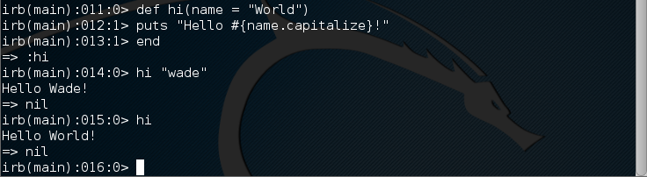
Default Parameters
You can also use this to make sure that someone’s name is properly capitalized:
A couple of other tricks to spot here. One is that we’re calling the method without parentheses again. If it’s obvious what you’re doing, the parentheses are optional. The other trick is the default parameter World. What this is saying is “If the name isn’t supplied, use the default name of "World"”.

Slide 15
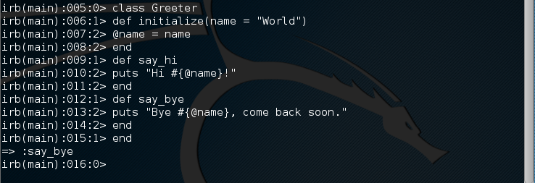
Class
Defining a class
The new keyword here is class. This defines a new class called Greeter and a bunch of methods for that class. Also notice @name. This is an instance variable, and is available to all the methods of the class. As you can see it’s used by say_hi and say_bye.

Slide 16

Invoking Class

Slide 17
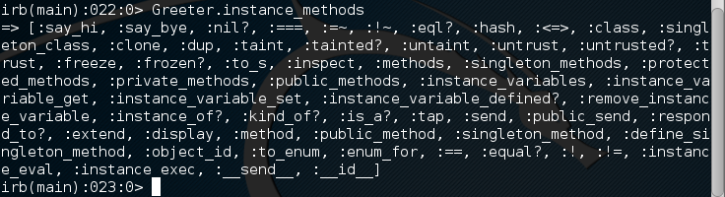
Looking Inside the Class
Use .instance_methods to say methods available
Lots of inherited (Ancestry) methods are also listed

Slide 18
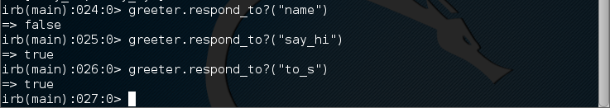
Looking Inside the Class
To see just the methods we defined (filter out inherited methods) us .instance_methods (false)
What methods will greeter respond to?
"to_s" (meaning convert something to a string, a method that’s defined by default for every object).

Slide 19

Altering a Class
Lets add name
Using attr_accessor defined two new methods for us, name to get the value, and name= to set it.

Slide 20
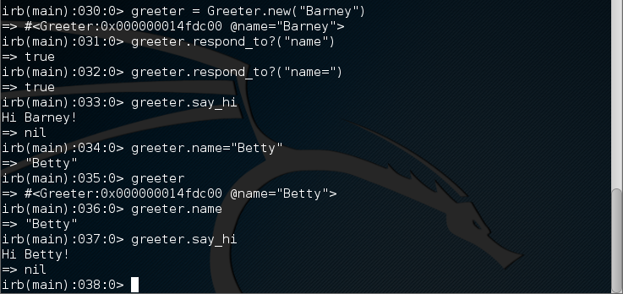
Looking Inside Again
After ours change we get:

Slide 21
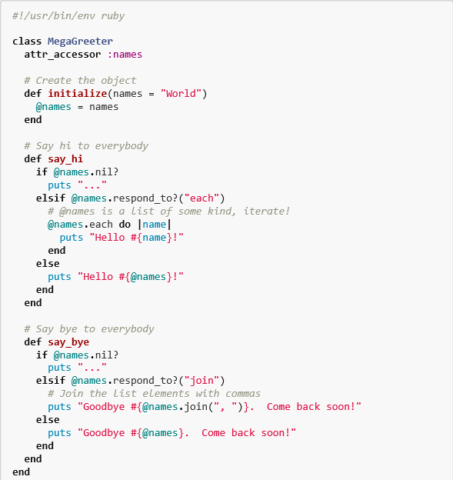
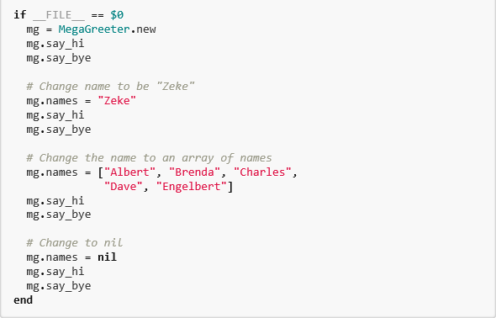
Creating a Program File
I’ll show snippets here.
Full text will be loaded to blog

Slide 22
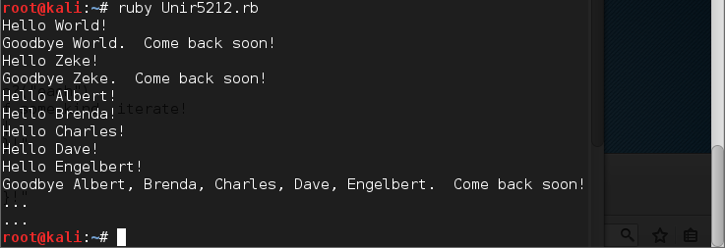
Save to root and run by typing
  “ruby [file_name]
  In my case “ruby Unir5212.rb”

Slide 23
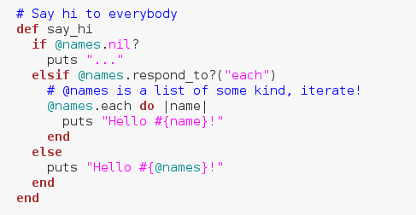
A Few Things to Notice
Lines in the script beginning with # are comments and are ignored by the interpreter
The first line is a special case and tells the interpreter how to und the script
“say_hi” looks at @names to make decisions

Slide 24

Iterations
Now lets look at looping
From the script
“each” is a method that accepts a block of code then runs that block of code for every element in a list, and the bit between do and end is just such a block. The variable between pipe characters is the parameter for this block.

Slide 25
Iteration in Other Languages
If you were doing this in C it might look like this:
for (i=0; i<number_of_elements; i++)
{
do_something_with(element[i]);
}

Slide 26
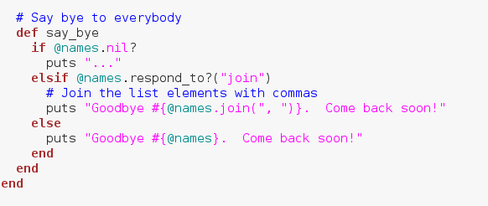
Another Way
“say_bye” doesn’t use do list
Instead, it tests to see is a list exists “if @names.nil? Or does @names not exist. If so, just use “…”

Slide 27
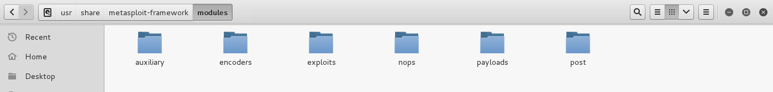
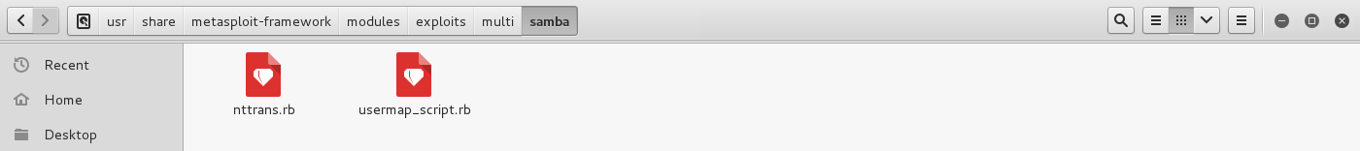
Changing Gears
Now we move from Ruby back to Metasploit
Metasploit is written in Ruby
Ruby is the language used in the modules through out Metasploit

Slide 28
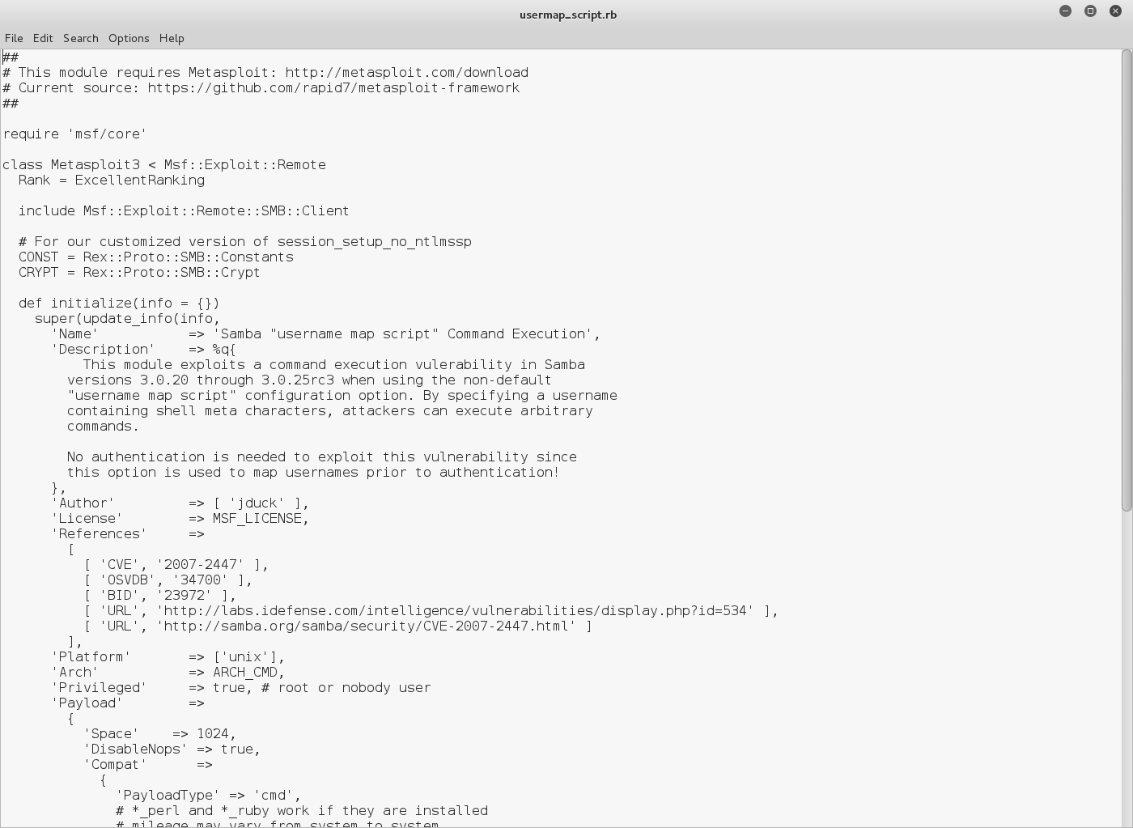
First Look at a Ruby Module
Here is what the start of this module looks like:

Slide 29
Items to Note
The previous page has some interesting lines to consider
“require ‘msf/core’”
  Module will include all functionality from Metasploit’s core libraries
“class Metasploit3 , Msf::Exploit::Remote
  Defines this as an “Exploit” module
“include Msf::Exploit::Remote::SMB::Client”
  Pulls in the SMB Client module that includes functionality to handle client interaction

Slide 30
Basic Idea
Grab a module close to what you want to do
Tweak it to get the functionality you need
This may involve sharpening your coding skills first

Slide 31
Additional Skills
Depending on the Exploit, you may need to know:
  MSSQL
  Oracle
  PowerShell
  Bash
  Etc…

Slide 32
Side Note on Penetration Testers
Modifying the tools is one of the distinguishing skills in top flight Consultants
Lots of people can run nmap, Nessus, and Metasploit, but to distinguish yourself in the field, this needs to be your jumping off point.
Please Note: I’m not saying I am any good at this, there’s a reason I’m teaching the course instead of consulting ;-)

Slide 33
Scripting
For Metasploit, scripting is basically modules for meterpreter
Same concept as earlier, but specific to meterpreter sessions
This is also a point where the book contains older information
  Scripts are no longer being accepted for Metasploit
  Script functionality is being ported to modules.

Slide 34
Final Thoughts on Metasploit
Metasploit is constantly evolving
To stay on top you may want to follow on twitter:
  HD Moore @hdmoore
  Metasploit Project @metasploit
  Andréz LAMOUROUX @DarkOperator
Check in on Rapid7 and DarkOperator
  https://community.rapid7.com/welcome
  http://www.darkoperator.com/

Slide 35
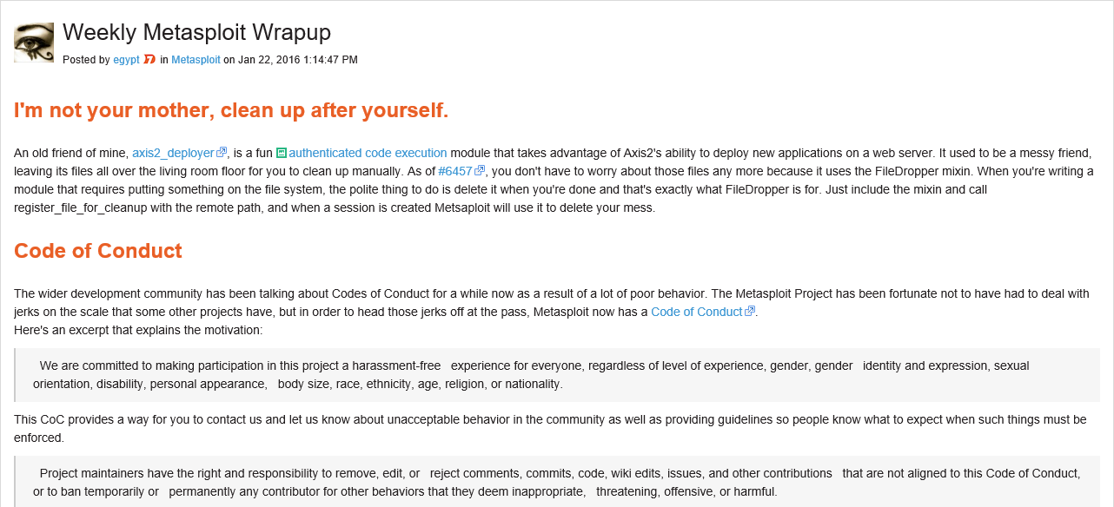
Example From This Week
https://community.rapid7.com/community/metasploit/blog/2016/01/22/weekly-metasploit-wrapup

Slide 36

Competitors
http://www.coresecurity.com/core-impact-pro

Slide 37
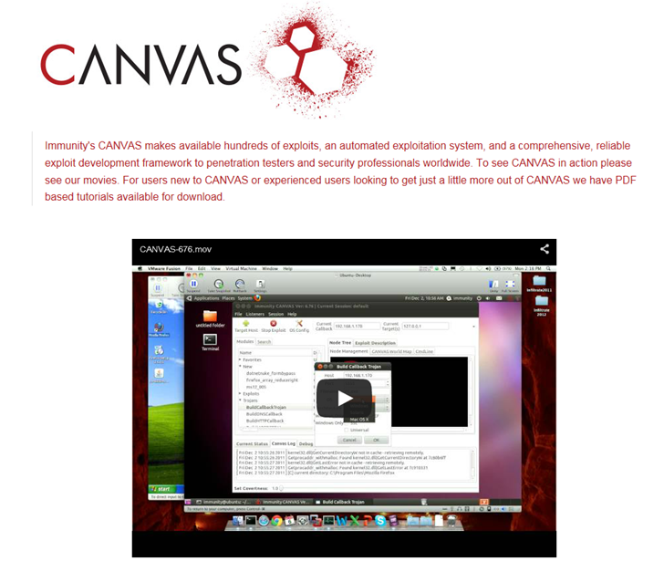
Competitors
http://immunitysec.com/products/canvas/

Slide 38
Something to keep in mind
We spent almost all of our time in the open source Metasploit Framework due to licensing
Metasploit Pro looks just as good and works just as well as the commercial products just mentioned

Slide 39
Next Week
In the news
Introduction to WebGoat
Exam will be postponed one week.

Slide 40
Questions
?

