Slide 1
Advanced Penetration testing
MIS 5212.001
Week 6
Site: http://community.mis.temple.edu/mis5212sec001sp2017/

Slide 2
Tonight's Plan
Ettercap
Some WebGoat
Ettercap Exercise
Next Week

Slide 3
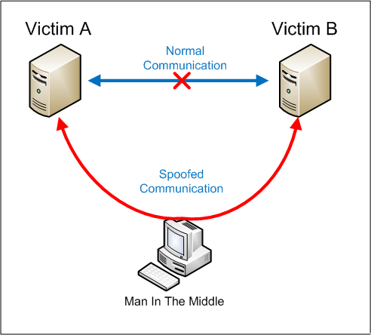
Man In The Middle
Intercepting traffic
Source: http://www.valencynetworks.com/articles/cyber-attacks-explained-man-in-the-middle-attack.html

Slide 4
Ettercap Attacks
Ettercap supports active and passive dissection of many protocols (including ciphered ones).
Ettercap offers four modes of operation:
IP-based: packets are filtered based on IP source and destination.
MAC-based: packets are filtered based on MAC address, useful for sniffing connections through a gateway.
ARP-based: uses ARP poisoning to sniff on a switched LAN between two hosts (full-duplex).
PublicARP-based: uses ARP poisoning to sniff on a switched LAN from a victim host to all other hosts (half-duplex).

Slide 5
Ettercap
Other Features:
Character injection
SSH1 support: the sniffing of a username and password
HTTPS support: the sniffing of HTTP SSL secured data—even
Remote traffic through a GRE tunnel
Plug-in support
Password collectors for: TELNET, FTP, POP, IMAP, rlogin, SSH1, ICQ, SMB, MySQL, HTTP, NNTP, X11, Napster, IRC, RIP, BGP, SOCKS 5, IMAP 4, VNC, LDAP, NFS, SNMP, Half-Life, Quake 3, MSN, YMSG
Packet filtering/dropping
OS fingerprinting
Kill a connection
Passive scanning of the LAN
Hijacking of DNS requests

Slide 6
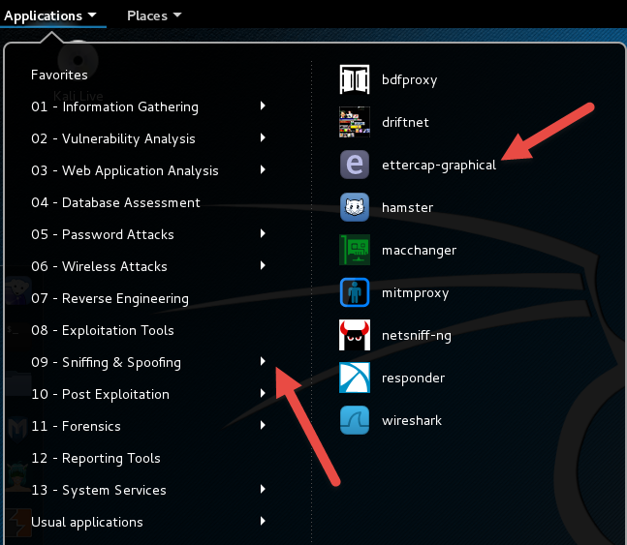
Ettercap
A tool for performing man in the middle attacks
Pre-installed in Kali

Slide 7
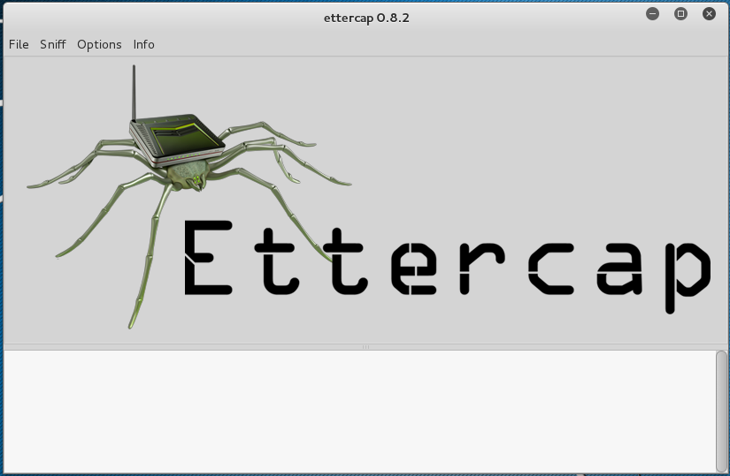
After Launch:

Slide 8
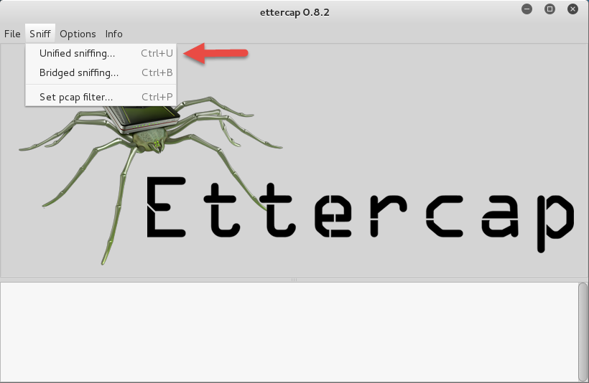
Click “Unified Sniffing”

Slide 9
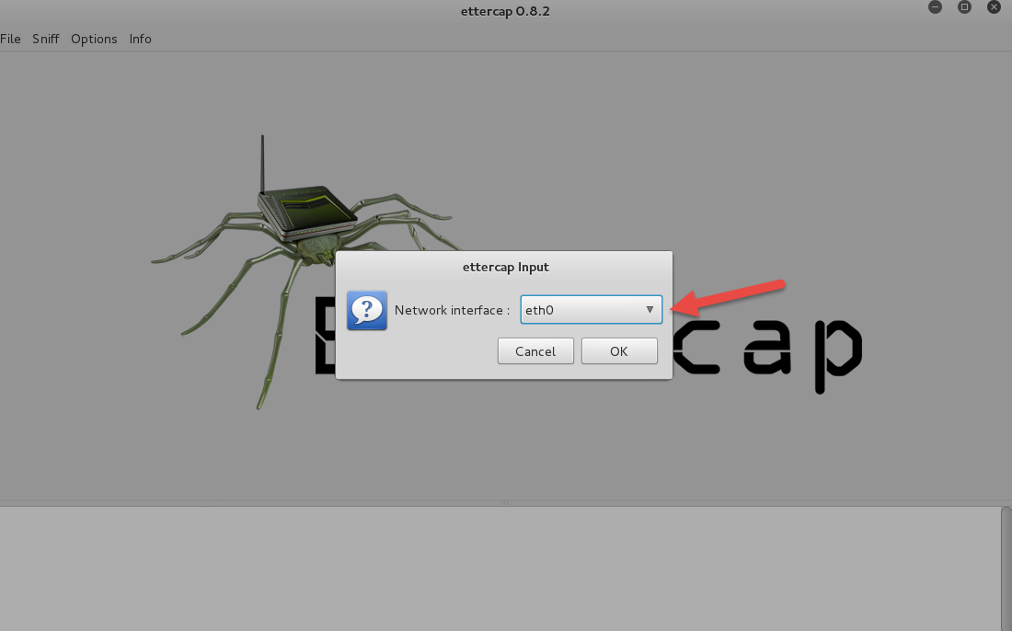
Select Your Network Connection (May not be same)

Slide 10
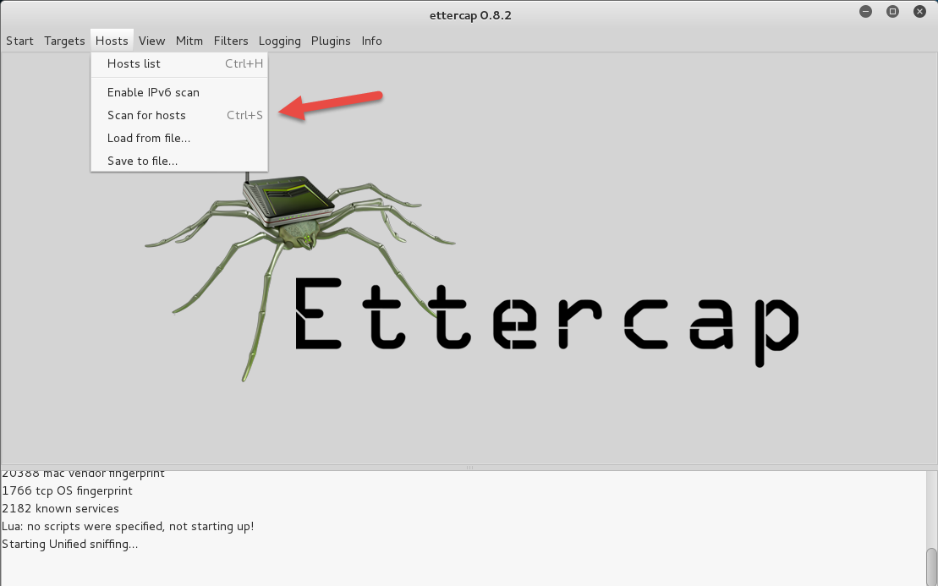
Now we will see who is out there:

Slide 11
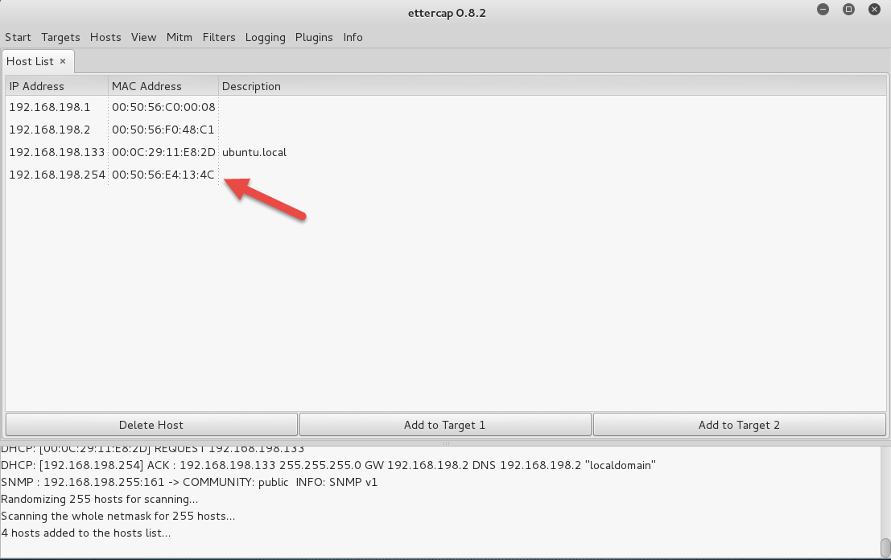
Available Hosts, I’m going after the last one!

Slide 12
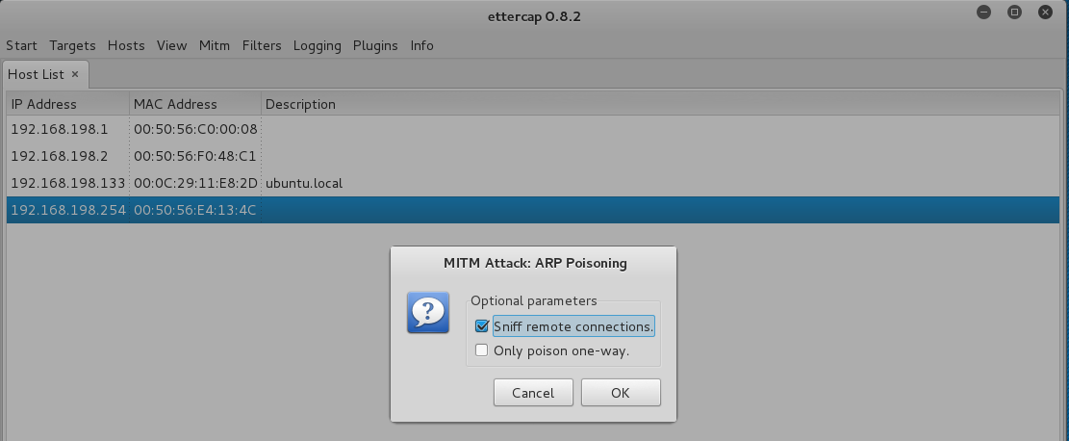
Setup to ARP Poison

Slide 13
Problem
Doesn’t Work in a VM
You will need real machines on a switch to get this fully functioning
A good walkthrough is
http://www.thegeekstuff.com/2012/05/ettercap-tutorial/

Slide 14
A Little About Browsers
What is a Web Browser?
Rendering Engine
JavaScript Engine
Network communications layer
…
May also include
Add-Ins
Browser Helper Objects
APIs to/for othere applications

Slide 15
A Little About Browsers
Why are we talking about this?
Browser are fairly complicated
Browsers have many sub-components and features
Browsers need to understand many different forms of character encoding
All of this gives us something to work with when attacking Web Applications
Good reference for details
http://taligarsiel.com/Projects/howbrowserswork1.htm

Slide 16
WebGoat
WebGoat is a deliberately insecure web application maintained by OWASP designed to teach web application security lessons
The current version is 6.0.1, this is still a work in progress.
WebGoat for J2EE is written in Java and therefore installs on any platform with a Java virtual machine.

Slide 17
How to get WebGoat
You can download WebGoat at:
https://webgoat.atlassian.net/builds/browse/WEB-WGM/latestSuccessful/artifact/shared/WebGoat-Embedded-Tomcat/WebGoat-6.0.1-war-exec.jar
You will also need Java >= 1.6 (JDK 1.7 Recommended)
http://www.oracle.com/technetwork/java/javase/downloads/index.html

Slide 18
Windows Version

Slide 19
WebGoat Download
Entering URL for WebGoat gives:
Use the down arrow and select “Save As” to save file to the location of your choice.

Slide 20
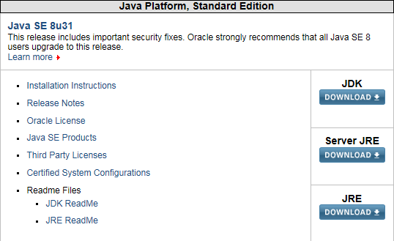
Installing Java JRE
Follow URL to:

Slide 21
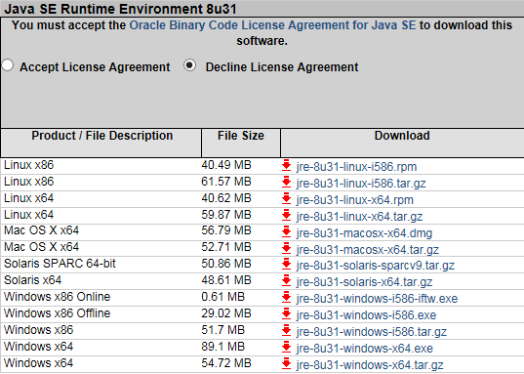
Installing Java JRE
Selecting “JRE” gives:

Slide 22
Installing Java JRE
Click “Accept” and select the OS
Same as WebGoat, use save as option to put the file where you want it
Once downloaded, run the file and follow the prompts
To launch in Windows, open the command line and type:
Java –jar WebGoat-6.0.1-war-exec.jar
Command line will say busy and will look like it hangs at Initializing Spring ….

Slide 23
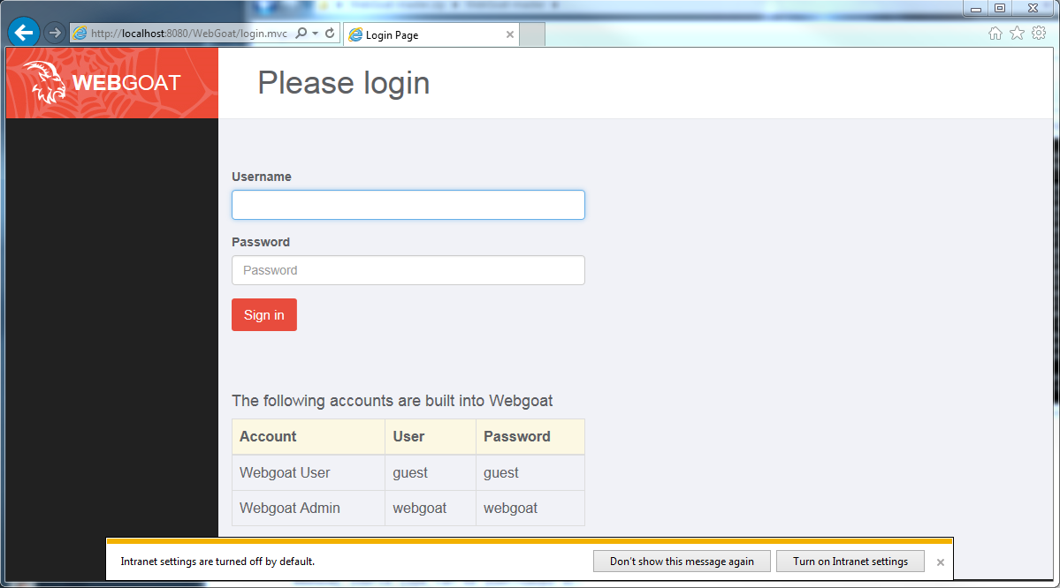
Verifying WebGoat is Up
Open a browser and type the following in the URL bar:
http://localhost:8080/WebGoat/

Slide 24
Remeber
If the browser doesn’t appear to connect.
Check “Intercept On” is turned of in Proxy

Slide 25
Linux Version
Download the “jar” file as described on the earlier slide
Java JRE is already installed in Kali
Open a terminal and execute the same command
Java –jar WebGoat-6.0.1-war-exec.jar
Verify same as earlier slide

Slide 26
Now What
If you downloaded the jar file to Kali, you are ready to launch the Intercepting Proxy, point the browser at the proxy and start
If you want to work in Windows, you will need to get an intercepting proxy on to your windows machine
Go to:
http://portswigger.net/burp/
Select “Download” tab and then “Free”
This will bring down another jar file for BurpSuite

Slide 27
Caution
Once WebGoat is running, you are one of the most vulnerable systems on the internet!
Once you have downloaded the files consider disconnecting from the network

Slide 28
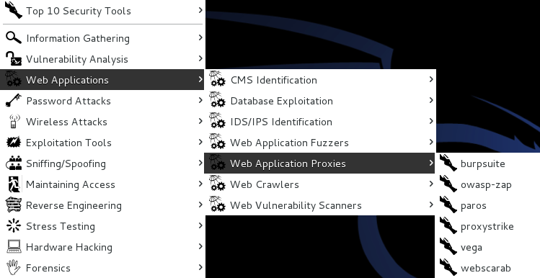
What’s an Intercepting Proxy
In this instance, an intercepting proxy is software that acts as a server and sits between the web browser and your internet connection
Examples
Burp Suite
Webscarab
Paros

Slide 29
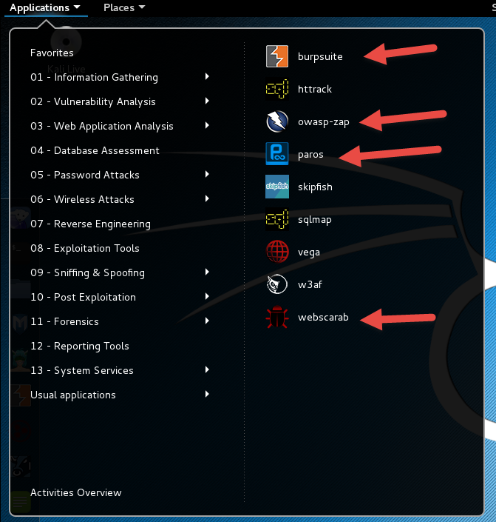
In Kali 2.0
Or

Slide 30
Some Rules for Our Use of Intercepting Proxies
For this course
Monitor and record ONLY
Do not inject or alter any traffic unless you personally own the web site.
Like your personal copy of WebGoat

Slide 31
Burp Suite
Start Burp Suite by logging in to Kali and selecting Burp Suite from:
Kali Linux > Web Applications > Web Application Proxies > burpsuite
Kali 2.0 > Applications > Web Application Analysis > burpsuite

Slide 32
Burp Suite

Slide 33
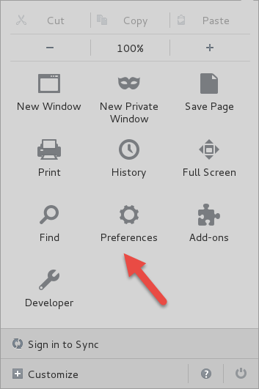
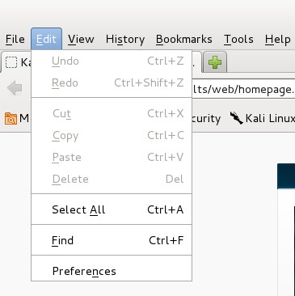
Getting Started
Once burpsuite is running, you will need to start and configure a browser
Kali’s web browser is “Iceweasel”, an adaptation of Firefox
After starting Iceweasel, navigate to preferences
And select it

Slide 34
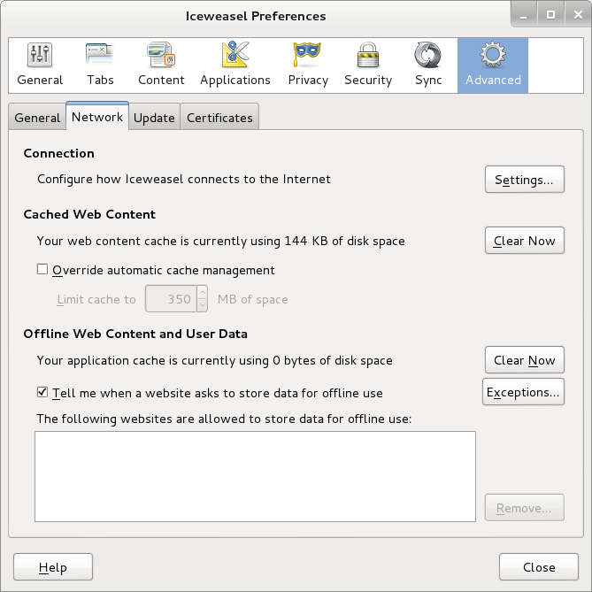
Configuring the Network Proxy
Navigate to the Network Tab and select settings… for Connection

Slide 35
Configuring the Network Proxy
Change selection from “Use system proxy settings” to “Manual proxy configuration and enter “127.0.0.1” for “HTTP Proxy” and “8080” for “Port”
Or any other port number that works for you
8080 is used by WebGoat, so we should pick something else
Also, select check box for “Use this proxy server for all protocols”
Select “OK” when done
Browser is now setup to use burpsuite
See next slide for example

Slide 36
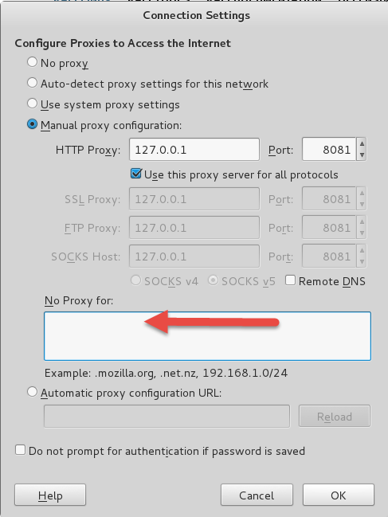
Configuring the Network Proxy

Slide 37
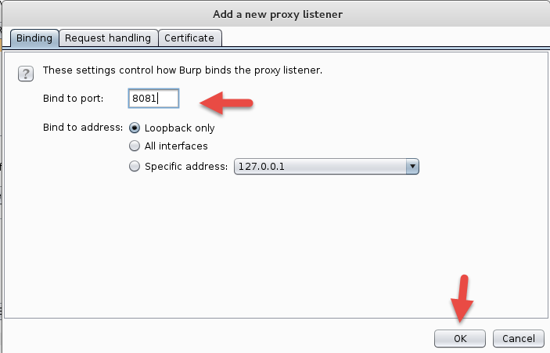
Configuring Burpsuite

Slide 38
BurpSuite Should Look Like This

Slide 39
Should Look Like This

Slide 40
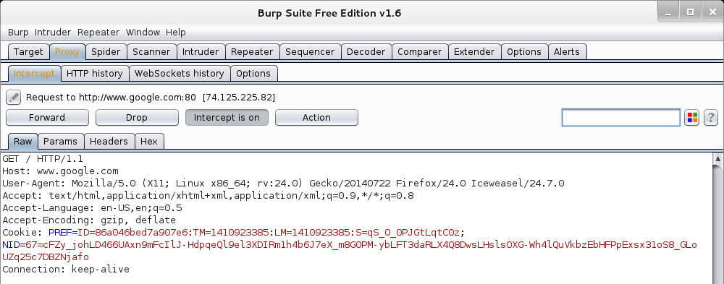
Now We Can Test
In browser, navigate to google.com
Browser will hang and look busy
Select the “Proxy” tab in burpsuite
Burpsuite is waiting for you, select forward

Slide 41
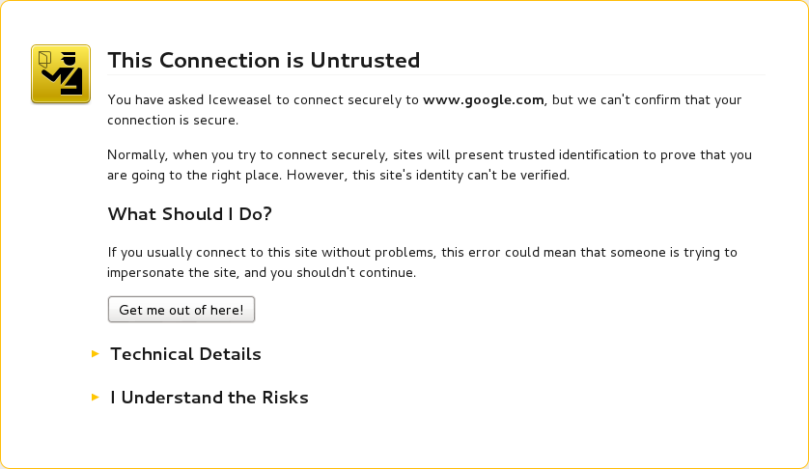
Browser Knows Something is Up
Select “I understand the Risks” and follow prompts to add an exception

Slide 42
Browser Knows Something is Up

Slide 43
Back to WebGoat

Slide 44
Landing Screen

Slide 45
WebGoat Exercises
Access Control Flaws
Stage 1
Stage 3
Authentication Flaws
Cross-Site Scripting
Phishing
Stage 1
Stage 5
Reflected XSS Attacks
Improper Error Handling
Fail Open Authentication Scheme

Slide 46
WebGoat Exercises
Injection Flaws:
Command Injection: " & netstat -ant & ifconfig“
Numerical SQL Injection: or 1=1
Log Spoofing
XPATH Injection
String SQL Injection
Modifying Data with SQL Injection
Adding Data with SQL Injection
Blind Numeric SQL Injection
Blind String SQL Injection

Slide 47
Ettercap Practical

Slide 48
Next Week
Follow Up on WebGoat

Slide 49
Questions
?

