Slide 1
Analyzing OS Sample
Windows 7 image provided by different class
Installed on VMware
Used NMAP and Nessus to scan for vulnerabilities
Unfortunately no vulnerabilities were found

Slide 2
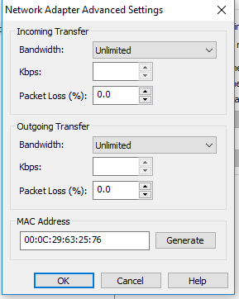
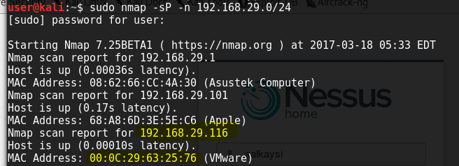
Target machine IP discovery
Used NMAP to find the IP
Initial scan – ‘192.168.29.0/24’
Only a couple results returned, none being the target machine
Decided to use MAC address to find IP
MAC address known via VMware – ‘00:0C:29:63:25:76’
2nd scan ‘-sP -n 192.168.29.0/24’
discovered ‘192.168.29.116’ associated with above MAC
Targeted specific IP using ‘-Pn 192.168.29.116’
Message returned saying all 1000 ports filtered
Decided to move on to Nessus

Slide 3
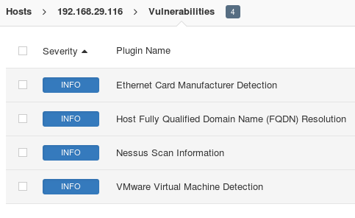
Nessus and Conclusion
Used Basic Network Scan in Nessus
Took ~15 minutes to complete
No vulnerabilities were discovered
Only ‘4’ Info items were found
Interesting one of the items were specifying the MAC address and Vendor
Overall, it seemed like no services were running
Security was tight, couldn’t find any holes to exploit

