Slide 1
Intrusion Detection
MIS.5213.011
ALTER 0A234
Lecture 3

Slide 2
Objectives
Identify the components of an intrusion detection and prevention system
Describe options for implementing intrusion detection and prevention systems

Slide 3
Goals of an IDPS
Network intrusion
  Attempt to gain unauthorized access to network resources
Intrusion Detection and Prevention System (IDPS)
  Consists of more than one application or hardware device
  Incorporates more than just detection
Intrusion detection and prevention
  Involves prevention, detection, and response

Slide 4
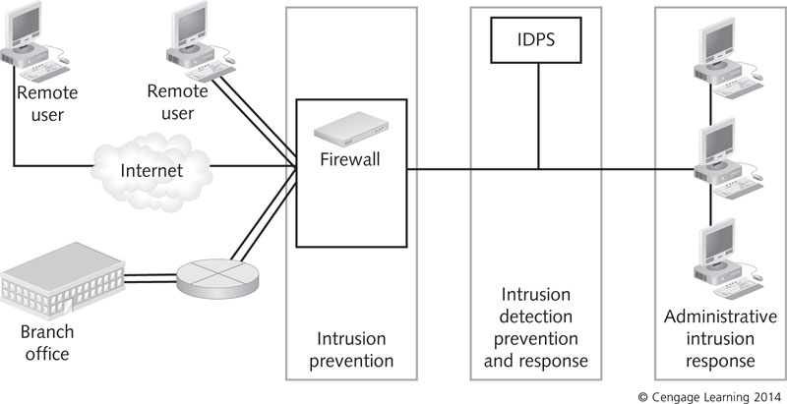
The role of intrusion detection and prevention in network defense

Slide 5
Goals of an IDPS
An IDPS should be able to:
  Assess large volumes of network traffic or system activity to find signs of unauthorized access
  Record its findings in a log so that administrators can examine past activity
  Detect and record unauthorized access without compromise to produce evidence admissible in court
  Respond almost immediately
  Make itself and systems it protects as inaccessible as possible to attackers

Slide 6
Anomaly and Signature Detection Systems
Anomaly detection system: makes use of profiles that describe services and resources each authorized user normally accesses
  Network baselines are associated with profiles
  System can monitor profiles for suspicious activity that does not fit the profiles
IDPS can create baselines by monitoring network traffic to observe what is considered normal behavior

Slide 7
Anomaly and Signature Detection Systems
If profiles are incomplete or inaccurate:
  IDPS sends alarms that false positives (legitimate traffic rather than actual attacks)
  False negatives (genuine attacks that an IDPS does not detect) could occur
True negatives: legitimate communications that do not set off an alarm
True positive: used to describe a genuine attack that an IDPS detects successfully

Slide 8
Anomaly and Signature Detection Systems
Signature detection: triggers alarms based on characteristic signatures of known external attacks
Signature-based IDPS best for companies that want a basic IDPS and mostly concerned with known attacks
  Network engineers research well-known attacks and record rules associated with each signature
  Signatures should be updated regularly

Slide 9
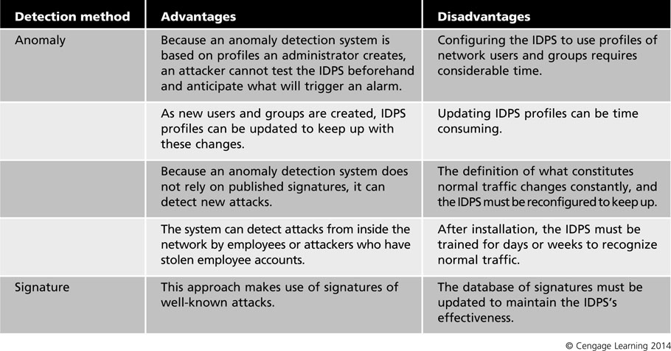
Advantages and disadvantages of detection systems

Slide 10
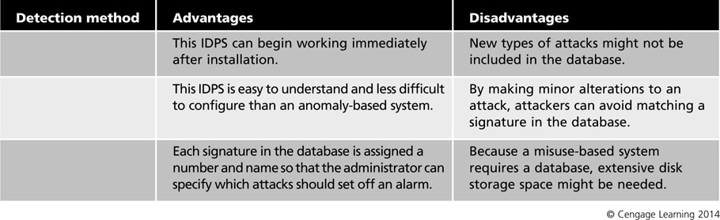
Advantages and disadvantages of detection systems (continued)

Slide 11
Stateful Protocol Analysis
Stateful protocol analysis: information gathering about a connection
  When an IDPS receives a packet, connection information between the host and remote computer is compared to entries in a state table
  State table: maintains a record of connections between computers
    Includes: source and destination IP address and port, and protocol
Event horizon: entire length of the attack
  IDPS needs to maintain state information during this

Slide 12
Stateful Protocol Analysis
Stateful protocol analysis approaches:
  Traffic rate monitoring – If IDPS detects sudden increase in traffic it can stop and reset all TCP traffic
  Protocol state tracking – IDPS maintains a record of connection’s state and allows packets to pass through if it is an established connection
  Dynamic Application layer protocol analysis – Can identify applications not using standard ports
  IP packet reassembly – Can reassemble fragmented packets to prevent fragments from passing through to the internal network

Slide 13
Examining IDPS Components
Components
  Network sensors or host-based agents
  Detection and prevention capabilities
  Command console
  Database server that stores attack signatures or behaviors

Slide 14
Sensors and Agents
Sensor or agent
  Functions as electronic “eyes” of an IDPS
  Host-based IDPS – IDPS installed on a single host computer has its agent built into the IDPS software
  Network-based IDPS – sensor is hardware or software that monitors network traffic in real time
  Attacks detected by an IDPS sensor
    Single-session attacks – isolated attempt
    Multiple-session attacks – take place over a period of time

Slide 15
Sensors and Agents
Sensors should be placed at common-entry points
  Internet gateways
  Connections between one network and another
  Remote access server that receives dial-up connections from remote users
  Virtual private network (VPN) devices
Sensors could be positioned at either side of the firewall
  Behind the firewall is a more secure location
IDPS management server: central repository for sensor and agent data

Slide 16
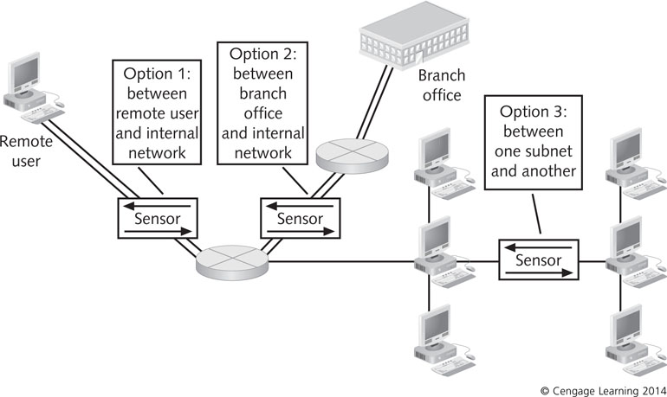
Positioning sensors at entry points to the network

Slide 17
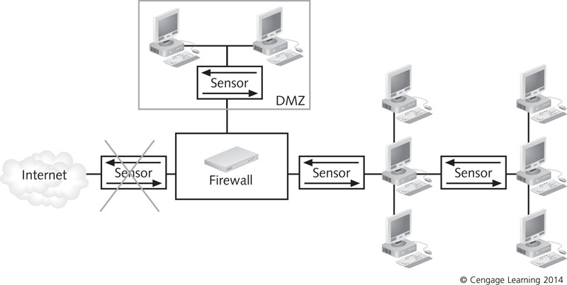
Positioning sensors behind the firewall in the DMZ

Slide 18
Detection and Prevention Capabilities
When selecting an IDPS, consider the following:
  Threshold – Values that set the limit between normal and abnormal behavior
  Blacklists – lists of entities that have been associated with malicious activity
  Whitelists – lists of entities known to be harmless
  Alert settings – specifying default priorities or severity levels, determining which prevention capabilities should be used for certain events, and specifying what information should be logged

Slide 19
Detection and Prevention Capabilities
Prevention Capabilities
  IDPS can be configured to take preventative countermeasures
    Example: resetting all network connections when an intrusion is detected
  Some IDPSs allow administrators to specify which measure should be taken for each alert type
  Some have a simulation mode in which all prevention capabilities are disabled but generate reports used to fine-tune prevention capabilities

Slide 20
Command Console
Provides a graphical front-end interface to an IDPS
  Enables administrators to receive and analyze alert messages and manage log files
IDPS can collect information from security devices throughout a network
Command console should run on a computer dedicated solely to the IDPS
  To maximize the speed of response

Slide 21
Database of Attack Signatures or Behaviors
IDPSs do not have the capability to use judgment
  Can make use of a source of information for comparing the traffic they monitor
Signature-detection IDPS
  Reference a database of known attack signatures
  If traffic matches a signature, it sends an alert
Keep database updated
Anomaly-based IDPS
  Store information about users in a database

Slide 22
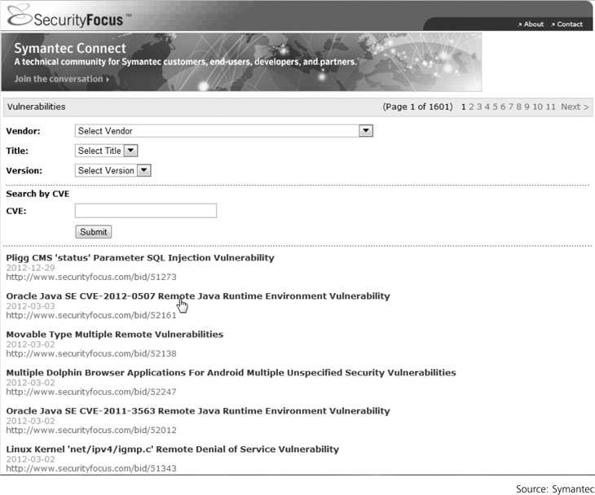
The SecurityFocus online database of known vulnerabilities

Slide 23
Options for IDPSs
Network-based IDPS
Host-based IDPS
Hybrid IDPS

Slide 24
Network-Based IDPSs
Network-based IDPS (NIDPS)
    Monitors network traffic by using well-positioned sensors, management servers, a command console, and a signature database
    Can be hardware devices equipped with NICs for capturing and analyzing packets
    Can also be software-based sensors installed on a dedicated computer
  Positioning an NIDPS on the Network
    Behind the firewall and before the LAN
    Between the firewall and the DMZ
    Any network segment

Slide 25
Network-Based IDPSs
An NIDPS can use:
  Inline sensors – positioned so that network traffic must pass through it
    Used to stop attacks from blocking network traffic
    Usually placed where firewalls are positioned
  Passive sensors – monitor copies of traffic; no actual traffic passes through them
    Can monitor traffic by:
      Spanning port
      Network tap
      IDPS load balancer

Slide 26
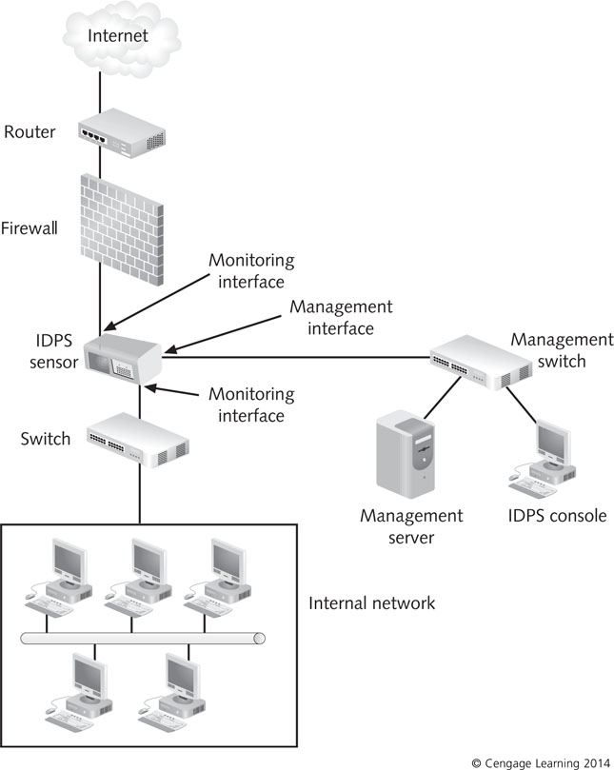
Positioning an inline sensor

Slide 27
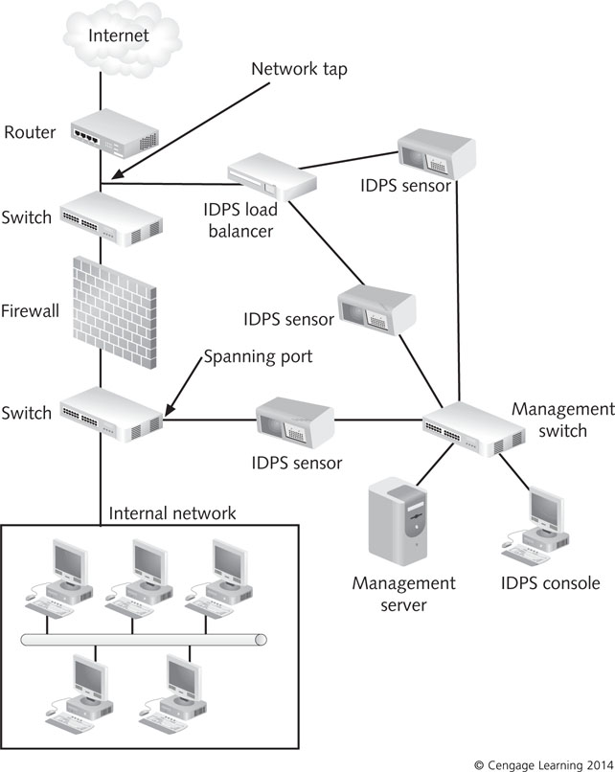
Positioning a passive sensor

Slide 28
Network-Based IDPSs
NIDPS Capabilities
  Vary depending on product
  Some can:
    Collect information about hosts, OSs, applications, and network activities and characteristics
      Used to help identify vulnerable hosts
    Analyze packet headers to identify unusual behavior
  Most have traffic logs to help identify and analyze potential attacks, locate vulnerabilities, and assess network use and performance

Slide 29
Network-Based IDPSs
NIDPS prevention capabilities vary based on sensor types:
  Passive only – Ends the current TCP session
  Inline only – Uses inline firewalling and bandwidth throttling, and alters malicious content
  Passive and inline – Reconfigures other network security devices
Administrators can configure specific actions for each type of alert

Slide 30
Network-Based IDPSs
NIDPS Management
  Designing architecture includes:
    Determining where sensors are located
    How many are needed and how they should be connected
  Testing NIDPS components includes:
    Accounting for network downtime while deploying sensors
  Securing components involves:
    Making sure sensors do not have IP addresses
    Hardening management networks and configuring hosts for log files and backups

Slide 31
Host-Based IDPSs
Host-based IDPS (HIDPS)
  Deployed on hosts in the network perimeter
  Commonly use management servers, signature databases, and console
  Evaluates traffic generated by the host
    Often used to protect a Web server or database server
  Gathers system variables such as
    System processes, CPU use, file accesses, system logs, and system and application configuration changes
  Does not sniff packets as they enter the LAN
    Monitors log file entries and user activity

Slide 32
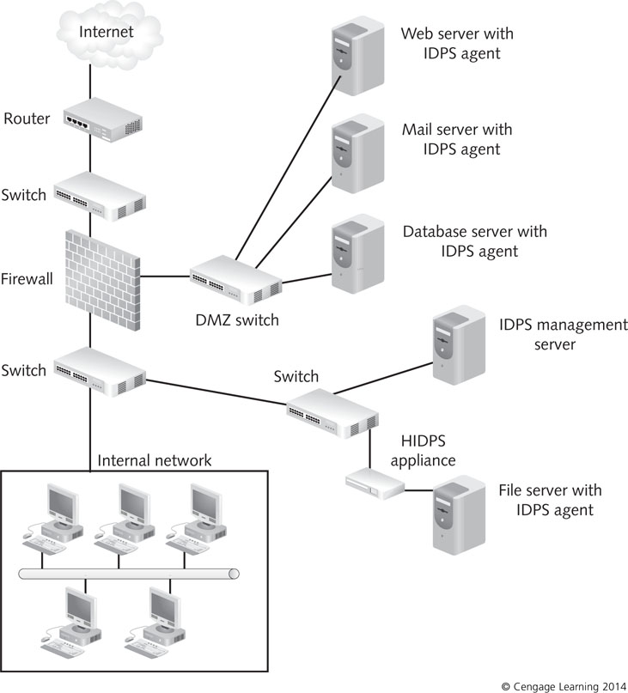
A typical HIDPS deployment

Slide 33
Host-Based IDPSs
Configuring an HIDPS
  Centralized configuration
    HIDPS sends all data to a central location
    Host’s level of performance is unaffected by the IDPS
    Alert messages that are generated do not occur in real time
  Distributed configuration
    Processing of events is distributed between host and console
    Host generates and analyzes it in real time
    Performance reduction in host

Slide 34
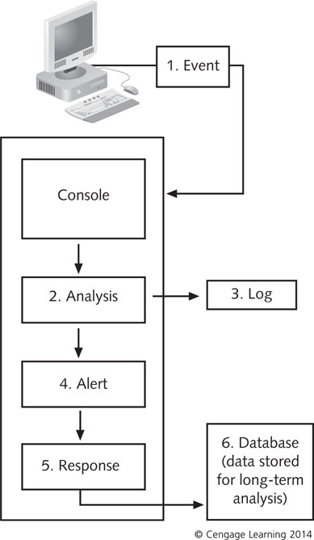
A centralized HIDPS

Slide 35
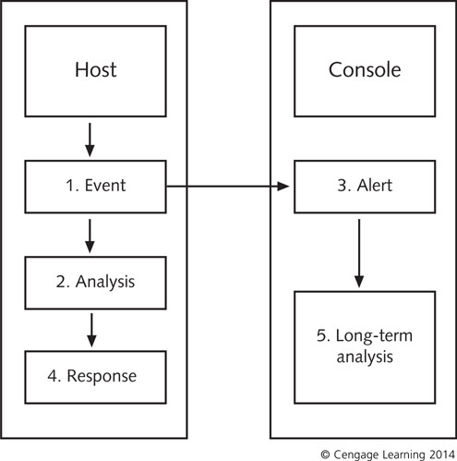
Processing event data from an HIDPS

Slide 36
Host-Based IDPSs
Choosing the Host
  Centralized configuration
    RAM, hard disk memory, and processor speed requirements are minimal
  Distributed configuration
    Host should be equipped with maximum memory and processor speed

Slide 37
Comparing an NIDPS and HIDPS
HIDPS
  Can tell whether an attack attempt was successful
  Can detect attacks that would get past NIDPS
  Provides only data pertaining to the host, not network as a whole
  Compares records stored in audit logs
NIDPS
  Provides alerts on suspicious network activity
    Does not tell whether attack occurred
  Detects attacks on network
    Such as port scanning on a range of computers

Slide 38
Hybrid IDPSs
Hybrid IDPS
  Combines the features of HIDPSs and NIDPSs
    Gains flexibility and increases security
Combining IDPS Sensor Locations
  Put sensors on network segments and network hosts
  Can report attacks aimed at particular segments or the entire network

Slide 39
Hybrid IDPSs
Combining IDPS Detection Methods
  IDPS combines anomaly and signature detection
  Database of known attack signatures enables IDPS to run immediately
  Anomaly-based systems keep the alert system flexible
  A hybrid IDPS that combines anomaly and signature detection can respond to both external and internal attacks
  Administrators have more configuration and coordination work to do

Slide 40
Hybrid IDPSs
Advantages
  Combine aspects of NIDPS and HIDPS configurations
  Can monitor network as a whole
  Can monitor attacks that reach individual hosts
Disadvantages
  Getting disparate systems to work in coordinate fashion
  Data gathered by multiple systems can be difficult to analyze

Slide 41
Securing IDPS Components
IDPS must be able to handle the volume of traffic or activity it encounters
IDPSs should be tested regularly
Sensors should not be addressable
Communication between IDPS components should be encrypted
Authentication should be required for use and administration of the IDPS
IDPSs should be able to work during DoS attacks
Remote logging should be used in an HIDPS
OSs of HIDPSs should be patched and hardened

Slide 42
Developing IDPS Filter Rules
To create IDPS filter rules you must know basics of Snort rule syntax
  Snort rule has two sections: header and options
Example:
  Alert tcp any any -> 192.16.21.0/24 111 (content: “00 01 86 a5” ; msg: “mounted access”;)
  Header is the opening portion
  Options are in parentheses

Slide 43
Examining Intrusion Detection Step by Step
Steps
  Installing the IDPS database
  Gathering data
  Sending alert messages
  The IDPS responds
  The administrator assesses damage
  Following escalation procedures
  Logging and reviewing events

Slide 44
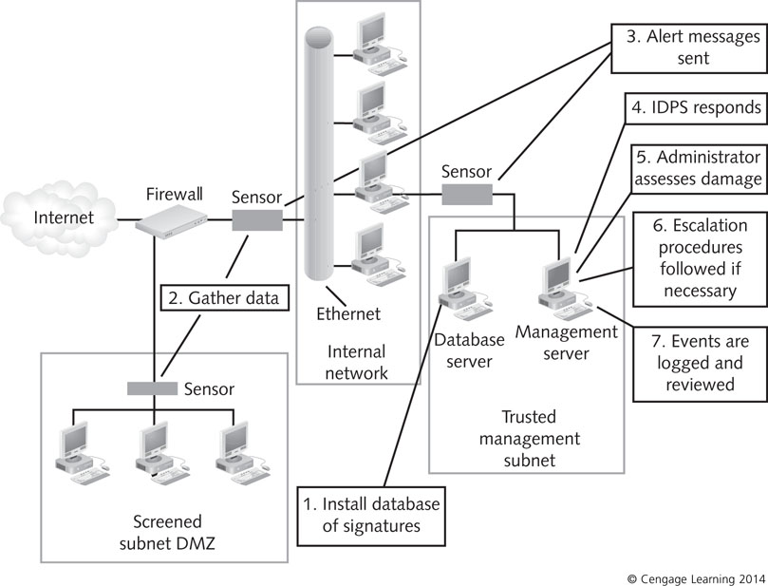
Figure 8-11 Steps in intrusion detection

Slide 45
Step 1: Installing the IDPS Database
IDPS uses the database to compare traffic detected by sensors
Anomaly-based systems
  Requires compiling a network baseline by observing network traffic (over a week)
Signature-based IDPS
  Can use database immediately
  You can add your own custom rule base

Slide 46
Step 2: Gathering Data
Network sensors gather data by reading packets
Sensors need to be positioned where they can capture all packets
  Sensors on individual hosts capture information that enters and leaves the host
  Sensors on network segments read packets as they pass throughout the segment
Sensors on network segments cannot capture all packets
  If traffic levels become too heavy

Slide 47
Step 3: Sending Alert Messages
IDPS detection software compares captured packets with information in its database
IDPS sends alert messages
  If captured packets match an attack signature or
  Deviates from normal network behavior

Slide 48
Step 4: The IDPS Responds
Command console receives alert messages
  Notifies the administrator
IDPS response actions:
  Alarm - Send an alarm message
  Drop – Packet is dropped
  Reset – IDPS stops and restarts network traffic
  Code analysis – Prevents malicious code from running
  File system monitoring – Prevent files from being modified
  Network traffic filtering – act as firewall
  Network traffic analysis – stop incoming traffic

Slide 49
Step 5: The Administrator Assesses Damage
Administrator monitors alerts
  Determines whether countermeasures are needed
Administrator need to fine-tune the database
  The goal is avoiding false negatives
Line between acceptable and unacceptable network use is not always clear

Slide 50
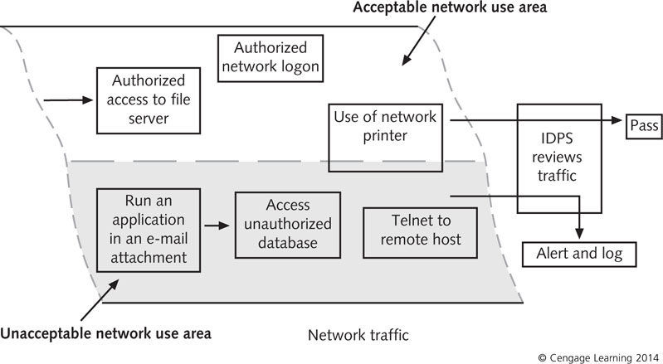
Differentiating acceptable and unacceptable network use

Slide 51
Step 6: Following Escalation Procedures
Escalation procedures
  Set of actions to be followed if the IDPS detects a true positive
Should be spelled out in company’s security policy
Incident levels
  Level One
    Might be managed quickly
  Level Two
    Represents a more serious threat
  Level Three
    Represents the highest degree of threat

Slide 52
Step 7: Logging and Reviewing the Event
IDPS events are stored in log files
  May also be sent to a database file
Administrator should review logs
  To determine patterns of misuse
  Administrator can spot a gradual attack
IDPS should also provide accountability
  Ability to track an attempted attack or intrusion back to the responsible party
  Some systems have built-in tracing features

Slide 53
Evaluating IDPS Products
Evaluate the various options and match them to your needs
Consider the following basic factors:
  Determine whether an IDPS is necessary
  Conduct a risk assessment
  Define general requirements and goals an IDPS should meet
  Determine whether to use proprietary or open-source products
  Consider the frequency and accuracy of signature updates
  Assess availability of support

Slide 54
Evaluating IDPS Products
Consider the following basic factors (cont’d):
  Evaluate technical specifications
  Determine external security requirements
  Evaluate need for security capabilities and logging
  Review detection and prevention capabilities
  Identify performance and management requirements
  Define the interoperability and scalability
  Determine a reasonable cost estimate that includes acquisition, testing, installation, and maintenance
  Identify resource limitations
  Identify any training, documentation, and support needed

Slide 55
Summary
Intrusion detection and prevention systems (IDPSs) add another line of defense behind firewalls and antivirus software
IDPS components include sensors, management servers, command consoles, and databases of signatures
A network-based IDPS (NIDPS) uses sensors positioned at key points on the network
A host-based IDPS (HIDPS) deploys agents on selected hosts in the network

Slide 56
Summary
A hybrid IDPS combines aspects of NIDPS and HIDPS configurations
Selecting an IDPS requires evaluating the organization’s needs and security goals and the product’s features
Steps of intrusion detection include: installing the IDPS and signature database, gathering data, sending an alert, responding to the alert, assessing damage, following escalation procedures, and logging and reviewing events

Slide 57
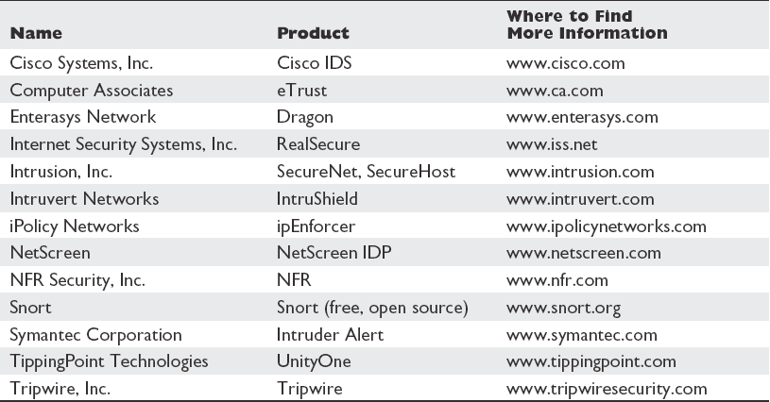
IDS Products and Vendors

