Slide 1
Intrusion Detection
MIS.5213.011
ALTER 0A234
Lecture 7

Slide 2
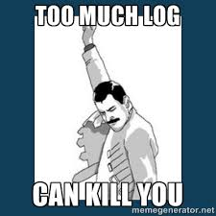
LOGS - LOGS - LOGS
TOO Many logs, too much data, not enough time..

Slide 3
How Do We Get There?
Generate Useful Data
Collect and Archive
Extract Wisdom

Slide 4
How do we get there?
Picking the most efficient place to start
Getting the data you need into your logs
Understanding the syslog paradigm, and how it generalizes to other systems
Integrating Windows Event Log data into your log management system
Integrating Other device log data into your log collector
Notes:
This space intentionally left blank.

Slide 5
How do we get there? cont.
Managing audit data in a heterogeneous computing environment
Reducing log content to human-readable quantities
Interpreting the content of log files
→ Keeping track of what’s going on in your network!
Notes:
This space intentionally left blank.

Slide 6
The Log Problem
On most OSes and apps, security events form less than 1% of total volume of log data
“Intelligent” security devices – IDS – help, but don’t eliminate the need for archiving host-based logs
Ignoring the problem – or the data – doesn’t make it go away

Slide 7
The Log Problem cont.
Conservative minimum amount of operating system log data, for UNIX/NT servers, on a mid-sized corporate network:
Not including Web server access logs, mail logs, IDS data, authentication records, etc.
3.8 GB per day
Notes:
This estimate is based on operating system logs, router and remote access logs, and non-Exchange Windows NT Event Log data – no applications or IDS data. Obviously, your mileage may vary.

Slide 8
The Log Problem cont.
Successful attacks are often not logged
Log messages vary in quality, and not designed for machine parsing
What’s “interesting” is very dependent on your environment
Notes:
If an intrusion detection system sets off an alarm, the first thing an administrator is likely to do is to go look at the logs of the affected system. Having the IDS doesn’t mean that you can discard your host-level audit records. It just lets you know particularly good times to go look at the audit trail.

Slide 9
What does it take?
Automated processing
Nominal status data – usage patterns, capacity planning, etc – off-line, batch processing okay
Critical event data – security issues, hardware failures – must be handled real-time or close to real-time
Notes:
This space intentionally left blank.

Slide 10
Overview – Log Management
Strategy
Centrally Log all relevant events
Define and document the scope of coverage
Review logs in a timely fashion
Create an audit trail for reviewed events

Slide 11
Overview – Log Management
Strategy
Centrally Log all relevant events
  Identify and define events to be relevant
  Identify what information is required to be considered relevant
    Source IP Address, Source Host Name, Destination IP, Destination Host, Time, etc.
  Events may be filtered, aggregaged, and / or normalized
  Only events that have been defined should be collected and monitored.

Slide 12
Overview – Log Management
Strategy
2) Define and Document the scope of coverage
  Identify which assets are part of scope
  Identify which networks are relevant and need to be monitored
  Create a Record of Authority (ROA)
  Identify Records retention policies
    Where they will be stored,
    for how long
    who has access and who does not.
    Who authorizes access

Slide 13
Overview – Log Management
Strategy
3) Review Logs in a timely fashion
  Define and document Service Level Agreements (SLAs) and Standard Operating Procedures (SOPs)
    Per event of Interest define the time frame for follow up
    Define and document the minimum process for follow up
    Define standard response for each event investigated
  Define regular reports for review of key events and oversight.

Slide 14
Overview – Log Management
Strategy
4) Create and audit trail for reviewed events
  Maintain an auditable trail to prove events of interest
  Document that each Event of Interest (EOI) was investigated using SOPs

Slide 15
syslog (1)
The purpose of syslog is to write system messages to a log
Syslog messages can include everything from critical alarm conditions to ordinary debugging statement
It provides a general trail of activities
It provides the capability for the device to emit event messages without solicitation

Slide 16
syslog (2)
Syslog message has 2 parts
  A message header and the message body
The message body contains the content of the message itself (english text, unstructured)
The message header contains minimal but essential information in structured manner

Slide 17
General syslog message
179.19.209.130 – IP Address
000024 – sequence number
Apr 12 18:01:55:643 – local time
ENV_MON – facility emitting the alarm
1 – severity
SHUTDOWN – Event

Slide 18
syslog Protocol
IETF is in process of passing a particular version of syslog as a standard
  RFC 3164 BSD syslog protocol
  RFC 3195 reliable delivery for syslog
Refer to RFC3164 (RFC 5424)
  UDP is used as transport service
  Port 514

Slide 19
definition
A machine that can generate a message will be called a "device".
A machine that can receive the message and forward it to another machine will be called a "relay".
A machine that receives the message and does not relay it to any other machines will be called a "collector". This has been commonly known as a "syslog server".

Slide 20
syslog message
Consists of 3 parts :PRI /HEADER/MSG
Length Maximum 2048 bytes or less

Slide 21
PRI (Priority) part
Priority – combination of a facility and severity
  Facility – category of a message (kernel message) , it is a numeric code
  Severity – numeric code 0 -7 , 0 is the most severe
  Priority is formed by multiplying the numeric code of the facility by 8 and adding the severity
  Facility 7 and severity 3 , so priority = 59

Slide 22
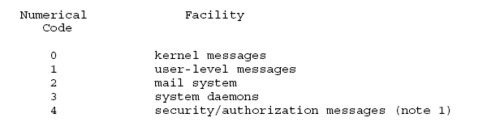
Example of Facility code

Slide 23
Example of Severity

Slide 24
HEADER part (1)
The HEADER part contains a timestamp and an indication of the hostname or IP address of the device
The HEADER part of the syslog packet MUST contain visible (printing) characters (7-bit Ascii)
HOSTNAME field will contain the hostname or IP address
Timestamp field will contain the local time and is in the format of “Mmm dd hh:mm:ss"

Slide 25
HEADER part (2)
Mmm –month of the year with the first character in uppercase and the other two characters in lowercase
“Jan, Feb, Mar, Apr, May, Jun, Jul, Aug, Sep, Oct, Nov, Dec”
dd -dd is the day of the month.
  If the day of the month is less than 10, then it MUST be represented as a space and then the number.
For example,
  the 7th day of August would be represented as "Aug 7", with two spaces between the "g" and the "7

Slide 26
HEADER part (3)
hh:mm:ss is the local time.
The hour (hh) is represented in a 24-hour format.
  Valid entries are between 00 and 23
The minute (mm) and second (ss) entries are between 00 - 59

Slide 27
MSG part (1)
It contains some additional information of the process that generated the message, and then the text of the message
It has 2 fields : TAG and CONTENT
TAG field will be the name of the program or
process that generated the message.(not exceed 32 chars)
CONTENT field contains the details of the message.
  This has traditionally been a freeform message that gives some detailed information of the event

Slide 28
Example of syslog message
<34> Oct 11 22:14:15 mymachine su: ’su root’ failed for lonvick on /dev/pts/8
<34> - priority
Oct 11 22:14:15 – timestamp
mymachine – hostname
su – TAG
: ’su root’ failed for lonvick on /dev/pts/8- Content

Slide 29
Security consideration (1)
Authentication
  The syslog delivery mechanism does not strongly associate the message with the message sender
  a misconfigured machine may send syslog messages to a collector representing itself as another machine
  An attacker may transmit syslog messages to a collector.

Slide 30
Security consideration (2)
Sequenced delivery
  the syslog process and protocol do not ensure ordered delivery.
Reliable delivery
  no mechanism within either the syslog process or the protocol to ensure delivery
  May be maliciously intercepted or discarded
Message Integrity
  syslog messages may be damaged in transit or an attacker may maliciously modify them.

Slide 31
Security consideration (3)
Message observation
  No mechanisms to provide confidentiality of the messages in transit. (clear-text messages)
Message Prioritization & Differentiation
  No mechanism relating to priority message
  Critical message and non critical message can be treated as equal in term of reception

Slide 32
Security consideration (4)
Misconfiguration
  The syslog message may go to untended receiver
Load Considerations
  An attacker may perform a Denial of Service attack by filling the disk of the collector with false messages.

Slide 33
syslog deployment (1)
Two roles are distinguished
  syslog sender (management agent)
  syslog receiver (management manager)
Syslog receiver (1)
  Device itself writing the messages to a local log file
    use circular log file for a limit size
    Log files are created with a certain capacity

Slide 34
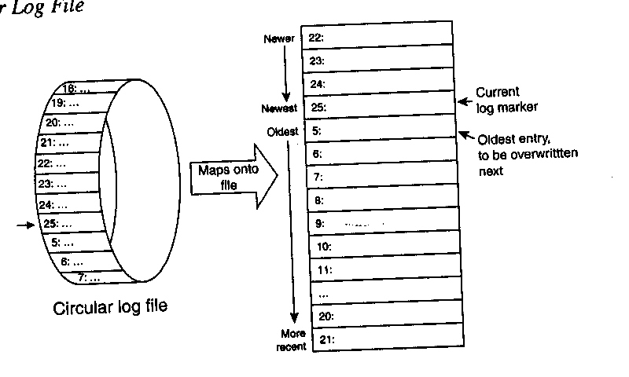
syslog deployment (2)
Circular log file

Slide 35
syslog deployment (3)
syslog receiver (con’t)
  Centralized logging host
    Receiving messages from several devices and logging those messages
    Applications access this logging host instead of individual devices
    It often function as a syslog relay , forwarding syslog messages to various apps.

Slide 36
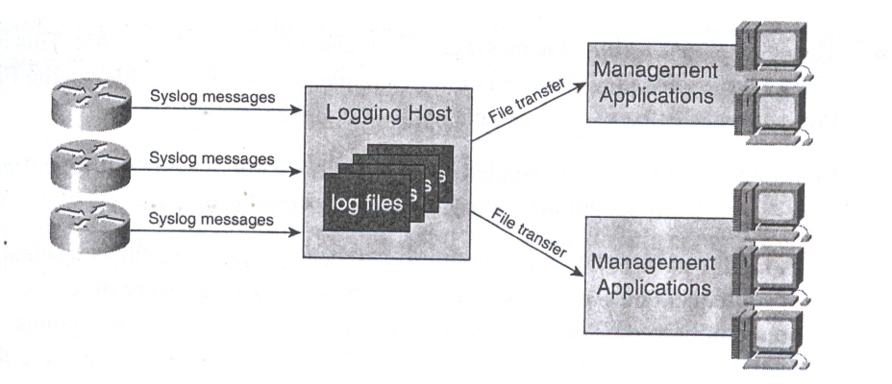
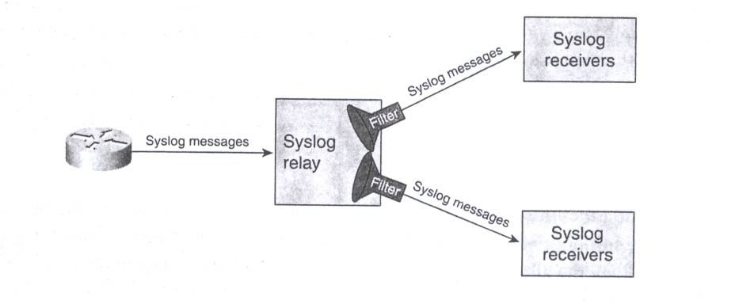
syslog deployment (4)
Logging host
syslog relay

Slide 37
Logging
Syslog – configuration in /etc/syslog.conf
/var/log
Remote logging, as always, is a very good idea.
  Syslog server can be restricted to only accept alerts from certain IP(s) or subnet(s).
  Generally a good idea to have a separate partition for /var or even /var/log on a syslog server

Slide 38
What to Log?
Devices to Log:
Firewalls, routers, Switches, Servers, DHCP, DNS, Database, Authentication Servers, etc.
What else

Slide 39
DHCP
How does it work?
You go on your computer to connect to the Internet.
The network requests an IP address (this is actually referred to as a DHCP discover message).
On behalf of your computer's request, the DHCP server allocates (leases) to your computer an IP address. This is referred to as the DHCP offer message.
Your computer (remember—you're the DHCP client) takes the first IP address offer that comes along. It then responds with a DHCP request message that verifies the IP address that's been offered and accepted.
DHCP then updates the appropriate network servers with the IP address and other configuration information for your computer.
Your computer (or whatever network device you're using) accepts the IP address for the lease term.

Slide 40
DHCP – Microsoft DHCP server
Enabling DHCP Server Logs
  To enable DHCP server logging
  Open the DHCP Microsoft Management Console (MMC) snap-in.
  In the console tree, click the DHCP server you want to configure.
  On the menu, click Properties.
  On the General tab, select Enable DHCP audit logging, and then click OK.
  (Note: Applies to Windows Server 2008 R2)
  https://technet.microsoft.com/en-us/library/dd759178.aspx
  Information Logged: (ID, Date, Time, Description, IP Address, HostName, Mac Address)

Slide 41
DNS
The client computer will send a DNS query to one of their internet service provider's DNS servers. The DNS server looks in it's DNS database to tell whether it can answer the query authoritatively. If the DNS server can answer authoritatively, the DNS server answers the query and the DNS query process is complete.
If the server cannot answer the query authoritatively it will look in its DNS cache of previous queries. If the DNS server finds a matching entry in its cache, it will answer the query with a non-authoritative answer based on the information in its cache and the DNS query process is complete.

Slide 42
DNS
If the ISP DNS server did not have the DNS information in its DNS database or its DNS cache the DNS query process will use recursion to complete the DNS query.
The ISP DNS server will use its root hints file to find information to contact other DNS servers. The root hints file specified DNS servers that are authoritative for the DNS domain root and top level domains in the DNS system. This includes the .com, .org, .net, .gov and other domain types.
If the query is for www.w3.org the ISP DNS server would contact an authorittative server for the top level "org" domain and send an iterative query to the org DNS server asking for information about the authoritative server for w3.org. The org domain DNS server responds with the the nameserver information including IP address of the nameserver for w3.org.
Then the ISP DNS server sends a query to the w3.org DNS server asking for the IP address of www.w3c.org. The w3.org DNS server sends an authoritative answer back to the ISP DNS server which is cached in the ISP DNS server cache and also sent to the client computer.

Slide 43
DNS – Microsoft DNS server
Enabling DNS Server Logs
  To enable DNS server logging
    Open DNS
    In the console tree, right-click the applicable DNS server, then click Properties.
    Click the Debug Logging tab.
    Select Log packets for debugging, and then select the events that you want the DNS server to record for debug logging.
      Ie:
        Log Packets for debugging
        Packet Direction
          Outgoing & Incoming
          Transport Protocol (UDP)
        Packet Contents
          Queries / Transfers
          Packet Type
            Request / Response
          Other Options
            Details

Slide 44
Cisco Devices
Cisco devices define logging in terms of levels
Level | System | Description
Emergency | 0 | System unusable messages
Alert | 1 | Immediate action required messages
Critical | 2 | Critical condition messages
Error | 3 | Error condition messages
Warning | 4 | Warning condition messages
Notification | 5 | Normal but significant messages
Information | 6 | Informational messages
Debugging | 7 | Debugging messages

Slide 45
Cisco Devices
Firewall# show logging | grep ASA-4
Aug 24 2007 08:54:31: %ASA-4-500004: Invalid transport field for protocol=TCP, from 192.168.208.63/46855 to 192.168.150.77/0
Aug 24 2007 08:54:31: %ASA-4-500004: Invalid transport field for protocol=TCP, from 192.168.208.63/46856 to 192.168.150.77/0
Aug 24 2007 08:54:48: %ASA-4-106023: Deny tcp src outside:192.168.208.63/46857 dst inside:192.168.150.77/443 by access-group "OUTSIDE" [0x5063b82f, 0x0]
Aug 24 2007 08:54:48: %ASA-4-106023: Deny tcp src outside:192.168.208.63/46863 dst inside:192.168.150.77/256 by access-group "OUTSIDE" [0x5063b82f, 0x0]
Aug 24 2007 08:54:48: %ASA-4-106023: Deny tcp src outside:192.168.208.63/46867 dst inside:192.168.150.77/389 by access-group "OUTSIDE" [0x5063

Slide 46
Cisco Router
Router#show access-lists 185
Extended IP access list 185
10 deny tcp 172.16.1.0 0.0.0.255 host 192.168.2.1 range domain 123 (284 matches)
20 deny tcp 172.16.1.0 0.0.0.255 host 192.168.2.1 range 137 445 log (1236 matches)
30 deny tcp 172.16.1.0 0.0.0.255 host 192.168.2.1 range 500 1024 log-input (1574 matches)
40 permit ip any any (1550 matches)

Slide 47
Cisco Router
Router#
Router#show logging | include 185
002092: Mar 30 2010 11:41:48.681 EDT: %SEC-6-IPACCESSLOGP: list 185 denied tcp 172.16.1.92(59078) -> 192.168.2.1(417), 1 packet
002093: Mar 30 2010 11:41:49.681 EDT: %SEC-6-IPACCESSLOGP: list 185 denied tcp 172.16.1.95(14897) -> 192.168.2.1(427), 1 packet
002094: Mar 30 2010 11:41:50.681 EDT: %SEC-6-IPACCESSLOGP: list 185 denied tcp 172.16.1.182(16737) -> 192.168.2.1(437), 1 packet
002095: Mar 30 2010 11:41:56.985 EDT: %SEC-6-IPACCESSLOGP: list 185 denied tcp 172.16.1.219(14872) (FastEthernet0/1 0007.8580.9edd) -> 192.168.2.1(500), 1 packet
002096: Mar 30 2010 11:41:57.984 EDT: %SEC-6-IPACCESSLOGP: list 185 denied tcp 172.16.1.208(7751) (FastEthernet0/1 0007.8580.9edd) -> 192.168.2.1(510), 1 packet
002097: Mar 30 2010 11:41:58.984 EDT: %SEC-6-IPACCESSLOGP: list 185 denied tcp 172.16.1.26(41202) (FastEthernet0/1 0007.8580.9edd) -> 192.168.2.1(520), 1 packet
Router#

