Slide 1
Intrusion Detection
MIS.5213.011
ALTER 0A234
Lecture 2

Slide 2
Incident Response Plan (IRP)
Preparation
Plan PRIOR to Incident
Identification
Determine what is/has happened
Containment
& Escalation
Limit incident
[If data breach]
Analysis &
Eradication
Determine and remove
root cause
Notification
Notify any data
breach victims
Recovery
Return operations
to normal
Ex-Post
Response
Establish call center,
reparation activities
Lessons
Learned
Process improvement:
Plan for the future
Notes:
The next slides will go through these steps in detail.
Source: CISM® Review Manual 2009, © 2008, ISACA. All rights reserved. Used by permission.

Slide 3
Lecture Objectives
Topics for lecture 2
Relevant Documents
Incident Response Plans – Continued
  Sample Incident Response Plans
Building IRTs (Roles and Responsibilities)
    Activity – Identification of roles and responsibilities

Slide 4
Documents
What are the relevant documents
  Sample Policies
  Asset Inventory
  System Recovery Documents
  Roles and Responsibilities
  Notification Call Tree
  Sample Reports

Slide 5
Policies
What kind of policies will be relevant for a successful Incident Response
  Acceptable Use Policy – How can corporate assets and infrastructures are to be used.
  Remote Access Policy – How can corporate assets are access remotely and protected when accessed remotely
  Information Security Policy – How critical assets are to protected
  Awareness Policy – How the users of critical assets will be trained on the use, handling, and what are the risks.
  Any others???

Slide 6
Components of Effective Policies
What are the components of the effective policies
  Clear / Concise Policy Statement
  Identifies the scope (Who the policy applies to and what systems are covered under the policy)
  Enforcement Clause
  Purpose of the policy
  Guidance – How to comply
  Signed off by Most Senior management
  Updated periodically

Slide 7
Asset Inventories
What kinds of information should be recorded or tracked for tracking inventory
  Name / System – IP Address
  Geogrpahic locations
  What businesses are supported
  Criticality
  Data Classification
  Where are the system recovery documents?
  Any thing else???

Slide 8
Develop IRT
How is an IRT developed
  What is the mission
  Identify the Stake holders
  Identify skills needed to deal with an intrusion
  Identify the communication Procedures

Slide 9
What is the mission
The mission may include all or some of the following
  Respond to all security incidents or suspected incidents using an organized investigative process.
  Conduct a complete impartial investigation
  Quickly confirm or dispel whether an intrusion or security incident has occurred
  Assess the damage
  Control and contain the incident
  Collect and document all evidence related to the incident
  Protect privacy rights protected by law or corporate privacy
  Maintain the confidentiality to protect the organization

Slide 10
Communication Procedures
Types of communications
  Emails
  Adhoc
  Conference Calls
  Press Releases
  Notifications to victims
  Sharing of information with External Parties
    What information will be shared
    Who will provide that communications

Slide 11
Team Roles
Intrusion Manager - Team Manager
  Administrative and Personnel Management
  Reports to CISO / CIO
  Communicates to other stake holders
Intrusion Specialist – Team Leader
  Coordinates a Specific Incident
  Senior Incident Handler
  Reports to Intrusion Manager
Analyst
  Incident Responder
  SME – Called upon based on the incident
  Strong technical skills
Equipment Manager
  Responsible for maintaining all Intrusion equipment
  Reports to Intrusion Manager
  Dotted line to Intrusion Specialist

Slide 12
Team Roles
HR Representative
  Provides Guidance and counsel on Employee matters
Legal Representative
  Provides legal guidance
  Interacts with law enforcement entities
  Ensures Chain of Custody is maintained with evidence
  Helps draft contracts with outside vendors as needed
Public Relations Representative
  Provides the face to the incident and represents the company to the public, community, news, etc. Many times it is the attorney.

Slide 13
Notification Call tree
Following questions need to be answered
  Who Activates the IRT?
    Help Desk
    IT Managers
    Senior Managers
    Users ??
  Once the IRT has been activated
    Who calls whom?

Slide 14
Communications
Additional things to consider
  When does the incident meet a reporting threshold?
    Immediately,
    within 24 hours,
    after intrusion has been eradicated?
  When communicating to external party, what contract language is in place to protect
    confidentiality
    Against law suits
    Improper disclosures
  Which laws are impacted

Slide 15
Team Resources
Is the team adequately funded
Does the team have adequate resources
  Funding stream, approvals, credit cards, etc.
Is the team adequately skilled
  In-house training
  Outside training
  Annual training budget
  Cross Training
  Has a skills gap analysis been conducted
  Do we have contracts in place with outside vendors with the right skills

Slide 16
Preparing the infrastructure
Detecting an incident is heavily dependent on how the infrastructure has been configured
  Hosts
  Network Architecture
  Logging

Slide 17
Hosts
  Are all of the assets accounted for
    Servers
    Desktops
    Laptops
    Printers
    Mobile Devices
  Have all of the systems been hardened
    While all of the hardening the systems is important, are the systems logging enabled.
  Have all of the systems been baselined **
  Have all of the systems been surveyed
    OS, Hardware, Security Software, Applications, Business Applications, DBs, Local and Networked

Slide 18
Networks
  Are all of the assets accounted for
    Switches
    Wireless Access Points
    DMZ
    Routers
    Firewalls
    AntiVirus
    Authentication Servers
    VPN Concentrators
    Etc..
  Have all of the systems been hardened
    While all of the hardening the systems is important, are the systems logging enabled.
  Have all of the systems been baselined **
  Have all of the systems been surveyed

Slide 19
Networks
  Has the network been segmented
    VLANs
    Firewalls,
    ACLs
    Etc..
  In order to minimize the impact of an intrusion, the network should be segmented
    Based on the information being processed
    Based on role & the criticality of the systems
    Have different zones been created and traffic controlled between zones.

Slide 20
Logging
  Has logging been turned on all hosts and network devices
  Are all of the logs being sent to a log collector
  Is the log collector configured to protect the access from all users including the admins.
  What is the retention policy for logs
  What is the backup policy for log server
  Who has logical and physical access to logs
  Is there ample physical security for the logs
  UTC???

Slide 21
Starting the investigation
Investigation should began with clear, precise and accurate information.
Creating Checklist to help get investigations started.
  Incident Summary
  How the incident was detected
  System Details
  Network Details
  Malware Details

Slide 22
Incident Summary
  Date and Time the incident was reported
  Date and Time the incident was detected
  Contact info: individual completing the checklist
  Contact info: individual who reported the incident
  Contact info: individual who detected the incident
  Nature of the incident (virus, malware, spear phishing, failed logon, etc)
  Type of affected resource
  How the incident was detected (brief summary)
  Computer ID – Host Name, HW Address, IP Address, etc, Location, Data port / switch port, etc.
  Who has access to system before and after the incident
  Is the incident ongoing
  Sensitivity of the incident

Slide 23
Incident Detection Checklist
  Was the detection manual or automated
  What information was part of the initial detection (alert, person, etc)
  What sources provided the data that contributed to the detection ? (Network utilization, file size, person noticing an odd glitch, etc)
  Has the incident been validated as accurate: Raw data compared with an alert, detection methodologies scrutinized
  Has the source data been preserved?
  How long has the detection system been online?
  What are the detection rates of the detection system?

Slide 24
Individual System Details
  Physical Location
  Asset Tag
  System’s make and model
  Operating System installed
  Primary function of the system
  System Administrator for the system
  Assigned IP address (if static) – Lease assignment for DHCP (Lease details)
  System host name and Domain
  Type of Information Stored on the system
  If there are backups, where are they
  Is the system still connected to the network
  List of any malware detected
  List of any remediation steps that have been taken
  Has any data been saved or backed up since incident and where are the backups kept.

Slide 25
Network Details
  List of all external malicious IP addresses and domain anmes
  Whether network monitoring is being conducted
  List of remediation steps that has been taken
  Network diagrams and updates.

Slide 26
Malware Details
  Date and time of detection
  How the malware was detected
  List of systems where malware was found
  Name of the malicious file and the directory it was present in
  If malware is active, are there any active network connections
  Copy of the malware if it has been preserved.
  Status of any analysis
  Was the malware submitted to third parties

Slide 27
Development of Leads
Leads: Actionable items about stolen data, network indicators, identities of potential subjects, or issues that led to the compromise or an incident.
A good lead has three characteristics
  Lead must be relevant
  Lead must be actionable
  Lead must have sufficient detail
Following operations should be done on leads before investing resouces on them
  Clarify the data
  Verify the veracity of the lead
  Determine the context of the lead

Slide 28
Leads into IOCs
Most leads should consist of detectable characteristics of malicious actions.
  Two types of indicators
    Property Based : describes a set of known observable characteristics of malicious software or actions
      A registry key
      MD5 hash
    Methodology based – Anomaly based: leads are less specific, where a combination of characteristics can define a malicious or suspicious act
  IOC : Indicators of Compromise
    http://www.openioc.org/
    IOC stands for Indicators of Compromise. The term may be used to refer to specific artifacts left by an intrusion, or greater sets of information that allow for the detection of intrusions or other activities conducted by attackers. The term is also used as the name for a file in the OpenIOC format that contains a set of data. The file extension for such files is .ioc. (Source: www.openioc.org)

Slide 29
Usings IOCs
In computer forensics, an IOC is an activity and/or malicious artifact identified on a network or an Endpoint. We can identify these IOCs and can thus improve our abilities to detect a future attack.
IOCs utilize XML to create a signature of an intrusion.
IOCs are created using IOC editors
The IOCs are then used to sweep the enterprise and to look for similar patterns. Computers with similar characteristics are identified, and taken down for cleanup.

Slide 30
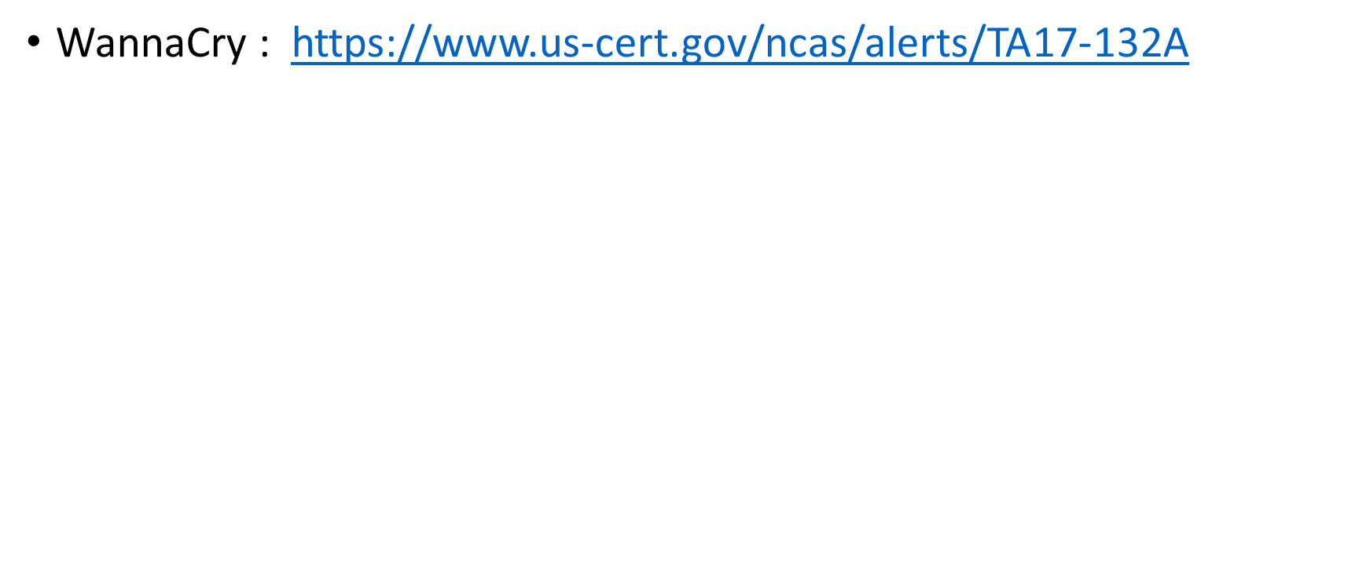
Sample IOCs the following IOCs looks for vmtoolsd.exe
<?xml version="1.0" encoding="us-ascii"?>
<ioc xmlns:xsi="http://www.w3.org/2001/XMLSchema-instance"
xmlns:xsd="http://www.w3.org/2001/XMLSchema"
id="72b85cfa-ea89-4633-983b-c2aa01a2b312"
last-modified="2014-03-12T12:03:59"
xmlns="http://schemas.mandiant.com/2010/ioc">
<short_description>QA</short_description>
<authored_by>Smart Sensor Team</authored_by>
<authored_date>2014-03-12T11:48:50</authored_date>
<links />
<definition>
<Indicator operator="OR"
id="5be0c2e0-53e0-49e9-842d-75d92d3261b3">
<Indicator operator="AND"
id="5be0c2e0-53e0-49e9-842d-75d92d3261b3">
<IndicatorItem
id="10ee8b41-3586-41ad-b8ce-90e088706ef4"
condition="contains">
<Context document="FileItem"
search="FileItem/FilePath" type="mir" />
<Content type="string">
C:\Program Files\VMware\VMware Tools</Content>
</IndicatorItem>
<IndicatorItem
id="10ee8b41-3586-41ad-b8ce-90e088706ef4"
condition="contains">
<Context document="FileItem"
search="FileItem/FileName" type="mir" />
<Content type="string">vmtoolsd.exe</Content>
</IndicatorItem>
</Indicator>
</Indicator>
</definition>
</ioc>

Slide 31
Resolving Internal Leads
Non – System leads (humans)
  Thoroughly document all interviews and statements
  Listen more than talk
  Avoid leading questions / avoid questions with yes / no answers
  Collect the facts before opinions

Slide 32
Resolving External Leads
When dealing with external leads – legal may need to get involved.
Hardest part will be to get someone to talk.

