Slide 1
Intrusion Detection
MIS.5213.011
ALTER 0A234
Lecture 4

Slide 2
Overview
What’s snort?
Snort architecture
Snort components
Detection engine and rules in snort
Possible research works in snort.

Slide 3
What’s snort?
NIDS: A network intrusion detection system (NIDS) is an intrusion detection system that tries to detect malicious activity such as denial of service attacks, port scans or even attempts to crack into computers by monitoring network traffic.
Snort: an open source network intrusion prevention and detection system. It uses a rule-based language combining signature, protocol and anomaly inspection methods
Snort: the most widely deployed intrusion detection and prevention technology and it has become the de facto standard technology worldwide in the industry.

Slide 4
Snort
A packet sniffer: capture and display packets from the network with different levels of detail on the console
Packet logger: log data in text file
Honeypot monitor: deceiving hostile parties
NIDS: network intrusion detection system

Slide 5
Snort architecture
From: Nalneesh Gaur, Snort: Planning IDS for your enterprise, http://www.linuxjournal.com/article/4668, 2001.

Slide 6
Snort components
From: Rafeeq Ur Rehman, Intrusion Detection Systems with Snort: Advanced IDS Techniques with Snort, Apache, MySQL, PHP, and ACID.

Slide 7
Logical components of snort
Packet Decoder: takes packets from different types of network interfaces (Ethernet, SLIP,PPP…), prepare packets for processing
Preprocessor: (1) prepare data for detection engine; (2) detect anomalies in packet headers; (3) packet defragmentation;(4) decode HTTP URI; (5) reassemble TCP streams.
Detection Engine: the most important part, applies rules to packets
Logging and Alerting System
Output Modules: process alerts and logs and generate final output.

Slide 8
Detection engine
Number of rules
Traffic load on the network
Speed of network and machine
Efficiency of detection algorithm

Slide 9
Rules
In a single line
Rules are created by known intrusion signatures.
rule header
rule options

Slide 10
Snort Rule
destination ip address
Apply to all ip packets
Source ip address
Destination port
Source port #
Rule options
Alert will be generated if criteria met
Rule header

Slide 11
Snort Rules
Snort rules are extremely flexible and are easy to modify, unlike many commercial NIDS
Sample rule to detect SubSeven trojan:
alert tcp $EXTERNAL_NET 27374 -> $HOME_NET any (msg:"BACKDOOR subseven 22"; flags: A+; content: "|0d0a5b52504c5d3030320d0a|"; reference:arachnids,485; reference:url,www.hackfix.org/subseven/; sid:103; classtype:misc-activity; rev:4;)
Elements before parentheses comprise ‘rule header’
Elements in parentheses are ‘rule options’

Slide 12
Snort Rules
alert tcp $EXTERNAL_NET 27374 -> $HOME_NET any (msg:"BACKDOOR subseven 22"; flags: A+; content: "|0d0a5b52504c5d3030320d0a|"; reference:arachnids,485; reference:url,www.hackfix.org/subseven/; sid:103; classtype:misc-activity; rev:4;)
alert action to take; also log, pass, activate, dynamic
tcp protocol; also udp, icmp, ip
$EXTERNAL_NET source address; this is a variable – specific IP is ok
27374 source port; also any, negation (!21), range (1:1024)
-> direction; best not to change this, although <> is allowed
$HOME_NET destination address; this is also a variable here
any destination port
Notes:
Why need “pass”, like firewall, you may have some specific traffic you want to allow.
Activate/dynamic rule pairs give Snort a powerful capability. You can now have one rule activate another when it's action is performed for a set number of packets. This is very useful if you want to set Snort up to perform follow on recording when a specific rule goes off. Activate rules act just like alert rules, except they have a *required* option field: activates. Dynamic rules act just like log rules, but they have a different option field: activated_by. Dynamic rules have a second required field as well, count.
Activate rules are just like alerts but also tell Snort to add a rule when a specific network event occurs. Dynamic rules are just like log rules except are dynamically enabled when the activate rule id goes off.
http://www.snort.org/docs/snort_htmanuals/htmanual_261/node155.html

Slide 13
Snort Rules
alert tcp $EXTERNAL_NET 27374 -> $HOME_NET any (msg:"BACKDOOR subseven 22"; flags: A+; content: "|0d0a5b52504c5d3030320d0a|"; reference:arachnids,485; reference:url,www.hackfix.org/subseven/; sid:103; classtype:misc-activity; rev:4;)
msg:”BACKDOOR subseven 22”; message to appear in logs
flags: A+; tcp flags; many options, like SA, SA+, !R, SF*
content: “|0d0…0a|”; binary data to check in packet; content without | (pipe) characters do simple content matches
reference…; where to go to look for background on this rule
sid:103; rule identifier
classtype: misc-activity; rule type; many others
rev:4; rule revision number
other rule options possible, like offset, depth, nocase

Slide 14
Snort Rules
bad-traffic.rules exploit.rules scan.rules
finger.rules ftp.rules telnet.rules
smtp.rules rpc.rules rservices.rules
dos.rules ddos.rules dns.rules
tftp.rules web-cgi.rules web-coldfusion.rules
web-frontpage.rules web-iis.rules web-misc.rules
web-attacks.rules sql.rules x11.rules
icmp.rules netbios.rules misc.rules
backdoor.rules shellcode.rules policy.rules
porn.rules info.rules icmp-info.rules
virus.rules local.rules attack-responses.rules

Slide 15
Snort Rules
Rules which actually caught intrusions
alert tcp $EXTERNAL_NET any -> $SQL_SERVERS 1433 (msg:"MS-SQL xp_cmdshell - program execution"; content: "x|00|p|00|_|00|c|00|m|00|d|00|s|00|h|00|e|00|l|00|l|00|"; nocase; flags:A+; classtype:attempted-user; sid:687; rev:3;) caught compromise of Microsoft SQL Server
alert tcp $EXTERNAL_NET any -> $HTTP_SERVERS 80 (msg:"WEB-IIS cmd.exe access"; flags: A+; content:"cmd.exe"; nocase; classtype:web-application-attack; sid:1002; rev:2;) caught Code Red infection
alert tcp $EXTERNAL_NET any -> $HOME_NET 21 (msg:"INFO FTP \"MKD / \" possible warez site"; flags: A+; content:"MKD / "; nocase; depth: 6; classtype:misc-activity; sid:554; rev:3;) caught anonymous ftp server

Slide 16
Detection engine order to scan the rules
Snort does not evaluate the rules in the order that they appear in the Snort rules file. In default, the order is:
Alert rules
Pass rules
Log rules

Slide 17
Challenges with snort
Misuse detection – avoid known intrusions
Rules database is larger and larger
It continues to grow
snort version 2.3.2, there are 2,600 rules
80% of them are signatures
Snort spends 80% work time to do string match
Anomaly detection – identify new attacks
Probability of detection is low

Slide 18
Snort
1. Download Snort from the Snort.org website. (http://www.snort.org/snort-downloads)
2. Download Rules from here.
3. Double click on the .exe to install snort. This will install snort in the “C:\Snort” folder. It is important to have WinPcap installed

Slide 19
Snort
4. Extract the Rules file. You will need WinRAR for the .gz file.
5. Copy all files from the “rules” folder of the extracted folder. Now paste the rules into “C:\Snort\rules” folder.
6. Copy “snort.conf” file from the “etc” folder of the extracted folder. You must paste it into “C:\Snort\etc” folder. Overwrite any existing file. Remember if you modify your snort.conf file and download a new file, you must modify it for Snort to work.

Slide 20
Snort
7. Open a command prompt (cmd.exe) and navigate to folder “C:\Snort\bin” folder. ( at the Prompt, type cd\snort\bin)
8. To start (execute) snort in sniffer mode use following command: snort -dev -i 3 -i indicates the interface number. You must pick the correct interface number. In my case, it is 3. -dev is used to run snort to capture packets on your network.

Slide 21
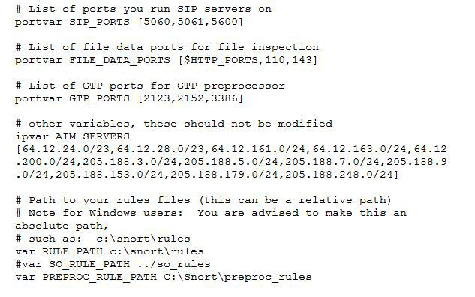
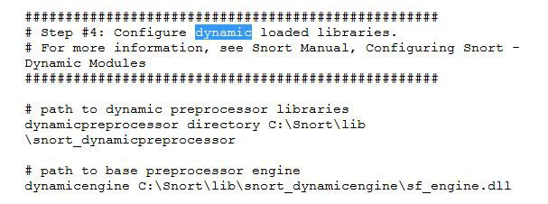
Snort
9. To run snort in IDS mode, you will need to configure the file “snort.conf” according to your network environment.
10. To specify the network address that you want to protect in snort.conf file, look for the following line. var HOME_NET 192.168.1.0/24 (You will normally see any here)
11. You may also want to set the addresses of DNS_SERVERS, if you have some on your network.

Slide 22
Snort
12. Change the RULE_PATH variable to the path of rules folder. var RULE_PATH c:\snort\rules
13. Change the path of all library files with the name and path on your system. and you must change the path of snort_dynamicpreprocessorvariable. C:\Snort\lib\snort_dynamiccpreprocessor You need to do this to all library files in the “C:\Snort\lib” folder. The old path might be: “/usr/local/lib/…”. you will need to replace that path with your system path. Using C:\Snort\lib
14. Change the path of the “dynamicengine” variable value in the “snort.conf” file.. Example: dynamicengine C:\Snort\lib\snort_dynamicengine\sf_engine.dll

Slide 23
Snort
15 Add the paths for “include classification.config” and “include reference.config” files. include c:\snort\etc\classification.config include c:\snort\etc\reference.config
16. Remove the comment (#) on the line to allow ICMP rules, if it is commented with a #. include $RULE_PATH/icmp.rules
17. You can also remove the comment of ICMP-info rules comment, if it is commented. include $RULE_PATH/icmp-info.rules

Slide 24
Snort
18. To add log files to store alerts generated by snort, search for the “output log” test in snort.conf and add the following line: output alert_fast: snort-alerts.ids
19. Comment (add a #) the whitelist $WHITE_LIST_PATH/white_list.rules and the blacklist
Change the nested_ip inner , \ to nested_ip inner #, \
20. Comment out (#) following lines: #preprocessor normalize_ip4 #preprocessor normalize_tcp: ips ecn stream #preprocessor normalize_icmp4 #preprocessor normalize_ip6 #preprocessor normalize_icmp6
21. Save the “snort.conf” file.

Slide 25
Snort
22. To start snort in IDS mode, run the following command:
snort -c c:\snort\etc\snort.conf -l c:\snort\log -i 3 (Note: 3 is used for my interface card)
If a log is created, select the appropriate program to open it. You can use WordPard or NotePad++ to read the file.
To generate Log files in ASCII mode, you can use following command while running snort in IDS mode: snort -A console -i3 -c c:\Snort\etc\snort.conf -l c:\Snort\log -K ascii
23. Scan the computer that is running snort from another computer by using PING or NMap (ZenMap).
After scanning or during the scan you can check the snort-alerts.ids file in the log folder to insure it is logging properly. You will see IP address folders appear.

Slide 26
Switch SPAN
What is SPAN
Switched Port Analyzer (SPAN)
SPAN Terminology
Ingress traffic-Traffic that enters the switch.
Egress traffic-Traffic that leaves the switch.
Source (SPAN) port -A port that is monitored with use of the SPAN feature.
Source (SPAN) VLAN -A VLAN whose traffic is monitored with use of the SPAN feature.
Destination (SPAN) port -A port that monitors source ports, usually where a network analyzer is connected.
Reflector Port -A port that copies packets onto an RSPAN VLAN.
Monitor port-A monitor port is also a destination SPAN port in Catalyst 2900XL/3500XL/2950 terminology.

Slide 28
Switch Configuration Example
Configuration Example
This example creates two concurrent SPAN sessions.
Port Fast Ethernet 0/1 (Fa0/1) monitors traffic that ports Fa0/2 and Fa0/5 send and receive.
Port Fa0/1 also monitors traffic to and from the management interface VLAN 1.
Port Fa0/4 monitors ports Fa0/3 and Fa0/6.
Ports Fa0/3, Fa0/4, and Fa0/6 are all configured in VLAN 2. Other ports and the management interface are configured in the default VLAN 1.

Slide 29
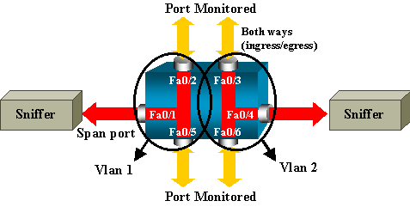
Switch Configuration Example
Configuration Example

Slide 30
Switch Configuration Example
!--- Output suppressed.!interface FastEthernet0/1 port monitor FastEthernet0/2 port monitor FastEthernet0/5 port monitor VLAN1 ! interface FastEthernet0/2 ! interface FastEthernet0/3 switchport access vlan 2 ! interface FastEthernet0/4 port monitor FastEthernet0/3 port monitor FastEthernet0/6 switchport access vlan 2 ! interface FastEthernet0/5 ! interface FastEthernet0/6 switchport access vlan 2 ! !--- Output suppressed. ! interface VLAN1 ip address 10.200.8.136 255.255.252.0 no ip directed-broadcast no ip route-cache ! !--- Output suppressed.

Slide 31
Configuration Steps Explanation
In order to configure port Fa0/1 as a destination port,
the source ports Fa0/2 and Fa0/5, and
the management interface (VLAN 1),
select the interface Fa0/1 in the configuration mode:
Switch(config)#interface fastethernet 0/1
Enter the list of ports to be monitored:
Switch(config-if)#port monitor fastethernet 0/2 Switch(config-if)#port monitor fastethernet 0/5
Switch(config-if)#port monitor vlan 1

Slide 32
Switch Configuration Example
In order to finish the configuration, configure another session.
This time, use Fa0/4 as a destination SPAN port:
Switch(config-if)#interface fastethernet 0/4
Switch(config-if)#port monitor fastethernet 0/3
Switch(config-if)#port monitor fastethernet 0/6
Switch(config-if)#^Z

Slide 33
IOC tools
IOC editor : Used to create your IOCs and compare
Redline: Used to create a scanning package.
Memoryze: used to scan memory and it is utilized by the Redline tool

