Slide 1
Security Architecture - Week 2 - Introduction to Security Architecture

Slide 2
Welcome
Introductions
Course Objectives
Readings
Grading
Participation & Weekly Assignments
Class Blog
Exams and Quizzes
Semester Project
Typical Class Session
Semester Schedule
Review of Week 1
Week 2: Introduction to Security Architecture

Slide 3
Course Objectives
In this course you will gain an understanding and a practical of the techniques and architectural components used to provide a secure computing environment.
The Key subject areas that are covered in the course are:
Enterprise Security Architecture Concepts
The Technologies and Techniques used in Cyber Security Architecture
While the first half of the course has a concentration on cyber architectural concepts, the technologies of cyber security architecture are introduced almost immediately leading up to the mid-term exam. The second half of the course covers additional cyber security architectural components and concepts. The final exam will be comprehensive.

Slide 4
Reading Assignments

Slide 5
Grading
Item | Percent of Total Points
Class Participation | 10%
Weekly assignments | 10%
Mid-term Exam | 20%
Final Exam | 20%
Semester Project | 40%
Total | 100%

Slide 6
Participation
Preparation for class – To facilitate active participation in the class, I request that you do the following before noon on the Wednesday before each Thursday class session.
Briefly address and summarize:
One key point you took from each web based reading assigned for the next class session. (One or two sentences per reading)
One question that you would ask your fellow classmates that facilitates discussion.
This submission is to be posted as a comment in response to a weekly class blog post by the instructor with details of the class and assignments. The comment should be posted by noon on the day before the class meets that week.

Slide 7
Participation
Preparation for class (continued) Each week you will be given an assignment to create of modify and architectural diagram related to the topics we are covering in class.
The diagram should be submitted to me via email (tue90933@temple.edu) by noon on the Wednesday before we meet for that week’s class

Slide 8
Participation
Participation during class – I will chose 2 -3 students per class to have them introduce the result of their weekly design assignment. I will display their design assignment work and they will lead the discussion with the class.

Slide 9
Participation
Participation during class – I will chose 2 -3 students per class to have them introduce the result of their weekly design assignment. I will display their design assignment work and they will lead the discussion with the class.

Slide 10
http://community.mis.temple.edu/mis5214s2015/
Insert blog page image

Slide 11
Assignments
We will do two formal cases that require a written analysis
To complete this requirement you must:
Address the questions I will provide
Do a one page report exploring the issues
Single spaced, 11 pt Times Roman, 1” margins
Post on the class blog by midnight the Tuesday before the class meets

Slide 12
Quizzes and Exams
Exams
One Mid-term Exam
Final Examination
Weekly Quiz
Practice exam questions
Grades for quiz do not count
Taking the quiz counts toward participation score

Slide 13
Semester Project
Your work over the semester will lead-up to your ability to represent an enterprise security architecture solution as a diagram or diagrams with annotations. The project involves depicting a Security Architecture for one of the following businesses:
Financial (Bank, brokerage, Insurer, etc.)
Hospital/Medical Services
Pharmaceutical/Chemical
Social Media Company
Energy Company (Electrical Utility, Oil Company, Solar, Wind, etc.)
Manufacturer (Automobile, Computer, Consumer Electronics, etc.)

Slide 14
Semester Project
There are 2 milestone deliverables for the project:
Milestone 1: Project Abstract, Goals and Approach
Submissions due no later than Wednesday at noon the week before the mid-term exam as an email attachment or attachments to my tue90933@temple.edu address.
Milestone 2: Architectural diagrams and annotations
Submissions due no later than Wednesday at noon the week before the final exam as an email attachment or attachments to my tue90933@temple.edu address.

Slide 15
Typical Class Session
Student-led discussion
Explain that week’s diagram
Answer Questions, Facilitate Discussion
Class discussion – reading assignments
Lecture
Weekly Quiz

Slide 16
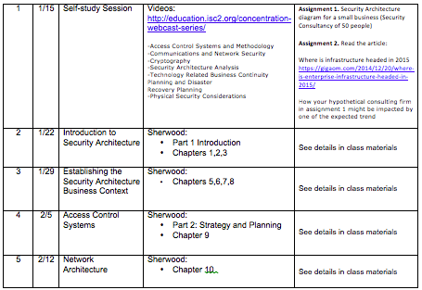
Semester Schedule

Slide 17
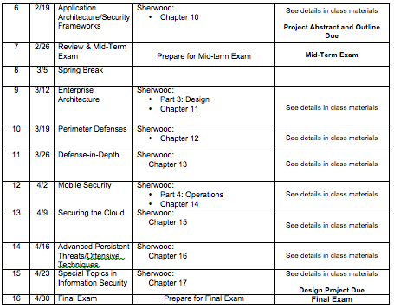
Semester Schedule

Slide 18
Security Architecture
Devising the means of managing the secure implementation between business processes in the enterprise system context is a principle mission of security architecture. The security architecture context encompasses the complete business context more than any other business discipline. Security architecture therefore focuses on the development of security solutions based on the mapping among the control architectures, protection processes and systems life cycles in a business context.

Slide 19
What do we mean by security architecture?
Can be approached from a number of perspectives
Security architecture exists in a business context
Security architecture is typically an afterthought in an existing systems context
A top-down approach is optimal

Slide 20
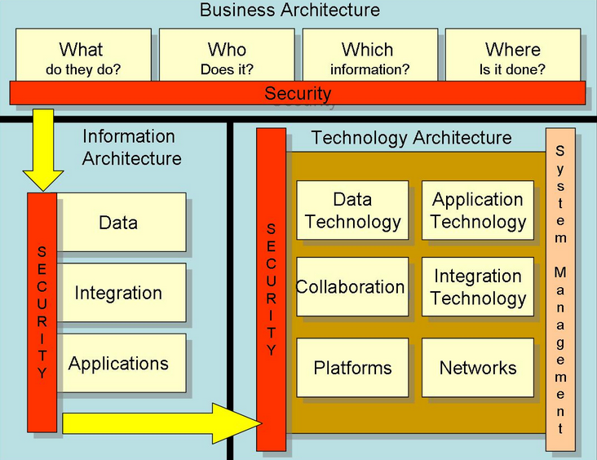
Enterprise Architecture Context
Source: Wikipedia 2014

Slide 21
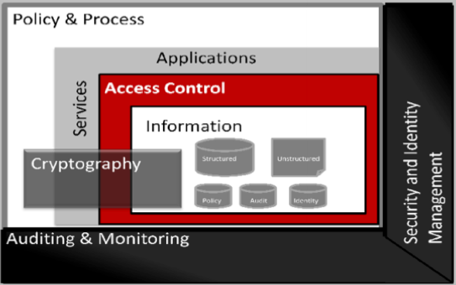
Security Process Context
Source: Oracle Corp.

Slide 22
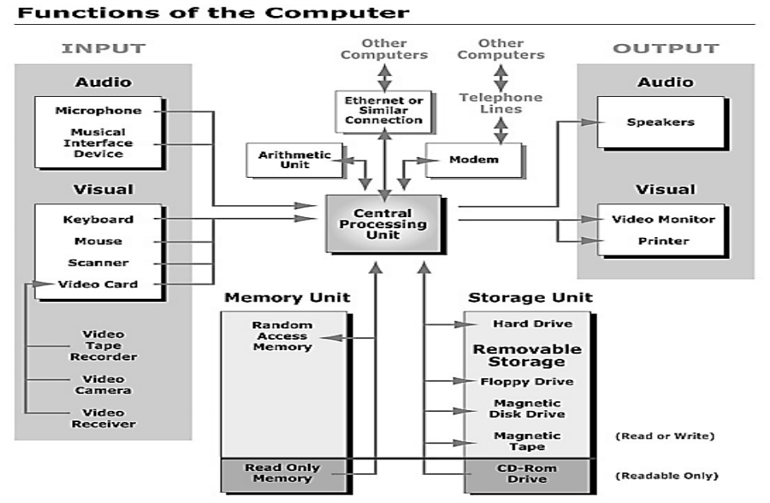
Device Level Security

Slide 23
How do we get there from here?
Business Objectives
Systems Context
Formal Frameworks
Standard Topographies
Reference Architectures

Slide 24
Security Architecture Context*
* From a recent job post
Knowledge of IT security principles and practices
Subject Matter Expert in remote access (Citrix) technologies
Experience with Network Design
Experience with Unix, Linux, and Microsoft Windows server operating systems
Experience with administering, or integrating with, relational database management systems
Experience creating data center capacity management plans
In-depth knowledge of enterprise scale storage platforms (e.g. SAN, NAS)
Management and/or design of virtualization platforms (e.g. VMWare ESX, KVM, Xen)
In-depth knowledge of web services (e.g. SOA, SAML, REST, SOAP, HTTP, HTTPS, UDDI, SSL, TLS, XML, WSDL, ESB) j.

Slide 25
Security Architecture Context*
* From a recent job post
Familiarity with SQL, ORACLE, SYBASE
Extensive troubleshooting and logical skills
Experience with Cloud architectures and technologies
Knowledge of systems integration principles and practices as well as interoperability concepts
Experience with enterprise architecture processes
Knowledge of LDAP and LDAP design and integration
Knowledge of Citrix and/or VMWare View software and technology
Knowledge of architecture and infrastructure lifecycle management plans

Slide 26
SAMSA Security Service Management Architecture
Contextual Layer | Business driver development, business risk assessment, service management, relationship management, point-of-supply management and performance management.
Conceptual Layer | Developing the Business Attributes Profile, developing operational risk management objectives through risk assessment, service delivery planning, defining service management roles, responsibilities, liabilities and cultural values, service portfolio management, planning and maintaining the service catalogue and managing service performance criteria and targets (service level definition).
Logical Layer | Physical access control and monitoring system, intrusion detection and alarm system, fire detection and suppression system, uninterrupted power supply, heating / ventilation / air conditioning system (HVAC), disk mirroring, data backup
Physical Layer | Asset management, policy management, service delivery management, service customer support, service catalogue management, and service evaluation management.
Component Layer | Tool protection, operational risk management tools, tool deployment, personnel deployment, security management tools and service monitoring tools.

Slide 27
Security Control Types
Administrative Controls | Facility selection, facility construction and management, personnel control, evacuation procedure, system shutdown procedure, fire suppression procedure, handling procedures for other exceptions such as hardware failure, bomb threats
Physical Controls | Facility construction material, key and lock, access card and reader, fences, lighting
Technical Controls | Physical access control and monitoring system, intrusion detection and alarm system, fire detection and suppression system, uninterrupted power supply, heating / ventilation / air conditioning system (HVAC), disk mirroring, data backup

Slide 28
Where are we?
Lifecycle
Continuous improvement
- different from building a building
Building an ecosystem
Refer the design principle's book ??? - (a pattern language)

Slide 29
How do we get there from here?
Context
Objectives
Components
Functions
Evolutionary considerations
Context changes
Designed for change

Slide 30
Component Architectures
Application architecture
Network architecture
Enterprise architecture
Technical Architecture
Web architecture
Cloud architecture
Service oriented archtecture

Slide 31
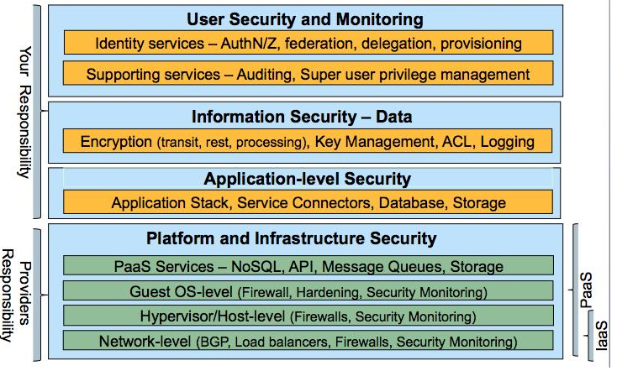
Do the same rules apply to the cloud?
Source:Titoenater

Slide 32
Design Considerations
Meta-Architecture | Architectural vision, principles, styles, key concepts and mechanisms. Typically part of EA | Focus: high-level decisions that will strongly influence the structure of the system; rules certain structural choices out, and guides selection decisions and trade-offs among others
Application Architecture | Structures and relationships, static and dynamic views, assumptions and rationale | Focus: decomposition and allocation of responsibility, interface design, assignment to processes and threads
Architecture Guidelines and Policies | Use model and guidelines; policies, mechanisms and design patterns; frameworks, infrastructure and standards | Focus: guide engineers in creating designs that maintain the integrity of architecture
Source:Malan, R., Bredemeyer, B., 2002

Slide 33
Quiz

